Slide 1
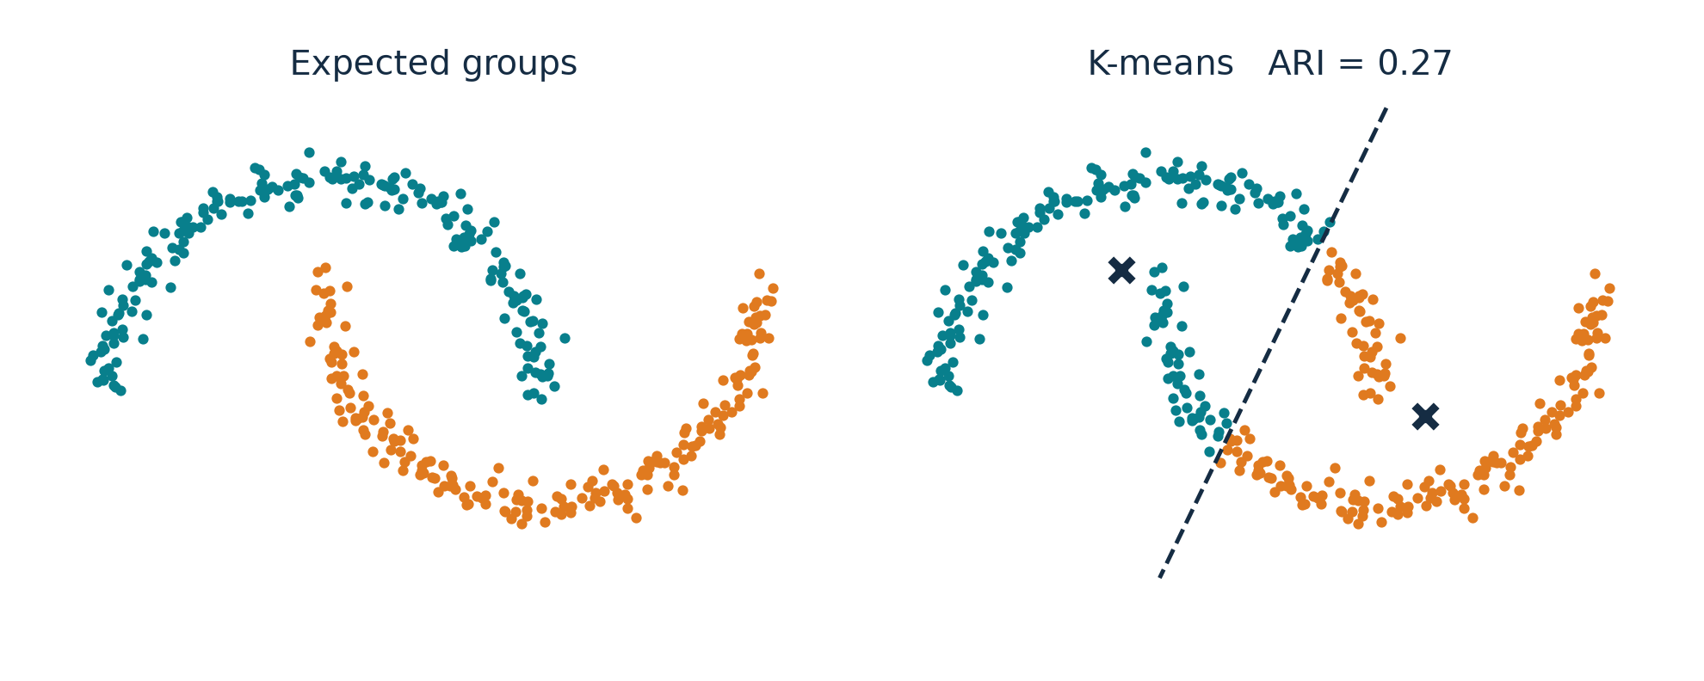
On Spectral Clustering
Analysis and an Algorithm
Andrew Y. Ng, Michael I. Jordan, Yair Weiss
NIPS 2001
Our data: two moons. Left: the groups we want. Right: K-means.
COMP3314 Group Project
Group members: ________________
Notes:
[~10 s] Title. Ng, Jordan and Weiss, NIPS 2001. We start straight from the example on the right.

Slide 2
Why does K-means get this wrong?
1 MOTIVATION
Two moons, 400 points, k = 2. Same data in both panels.
What K-means does
Each point joins the nearest centroid (✕).
Two centroids give one straight boundary (dashed).
Why that fails
The moons interlock. Any straight line cuts through both of them.
K-means ARI = 0.27 (1 = perfect, 0 = chance). These groups follow connectivity, not distance to a centre.
02
Notes:
[45 s] Here are two moons, 400 points we generated. On the left are the groups we would expect. On the right is
K-means with k = 2. K-means puts every point with its nearest centroid - the two crosses - so the boundary between the
two clusters is a straight line, the dashed one. The moons interlock, so any straight line cuts through both.
ARI is 0.27; ARI 1 would mean identical to the expected groups. The problem: these groups are defined by which points
are connected to which, not by distance to a centre.

Slide 3
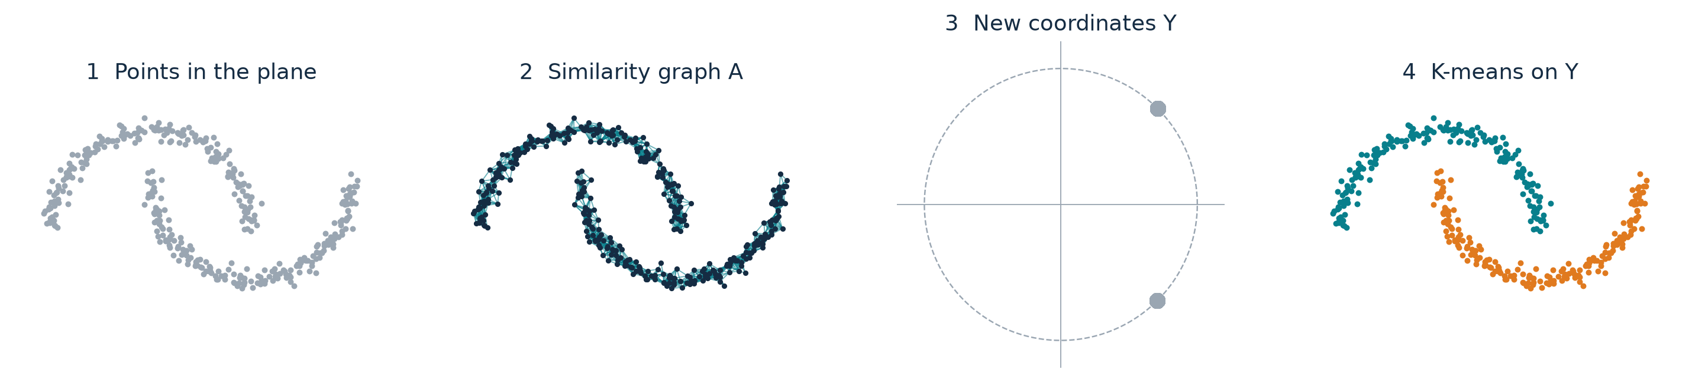
What does the new method change?
2 THE ALGORITHM
It changes the coordinates, not the clustering step.
Points
S: n × 2
›
Affinity
A: n × n
›
Normalize
L: n × n
›
Eigenvectors
X: n × k
›
Unit rows
Y: n × k
›
K-means
labels
Raw points
S: n × 2
Who is close to whom
A: n × n
One row per point
Y: n × k
Same K-means as before
labels
03
Notes:
[25 s] The method keeps K-means as its last step. What it changes is the representation. From the points we build a
similarity graph: who is close to whom. From the graph we compute new coordinates, one row per point. In those
coordinates each moon collapses to almost a single point, and K-means is trivial. The next three slides open up these
steps on a tiny example with six points, so that every number is visible.

Slide 4
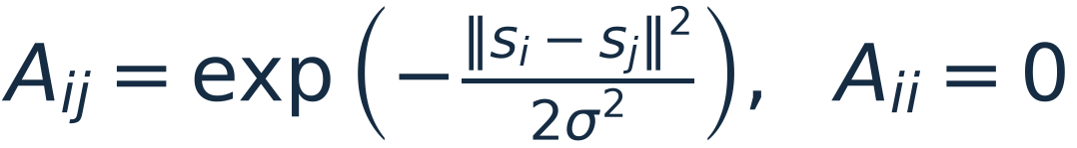
How do points become a matrix?
2 THE ALGORITHM
Every pair of points gets a similarity weight between 0 and 1.
Points
S: n × 2
›
Affinity
A: n × n
›
Normalize
L: n × n
›
Eigenvectors
X: n × k
›
Unit rows
Y: n × k
›
K-means
labels
1
2
3
4
5
6
0.00
Six points, σ = 0.7.
Entry Aᵢⱼ compares point i with point j.
The diagonal is 0: a point is not its own neighbour.
3
6
1
2
0.00
4
2
5
3
0.00
1
0.00
4
5
0.00
6
0.00
A (6 × 6)
04
Notes:
[65 s, two clicks] To see every number, take six points, sigma 0.7. A is a 6 by 6 table: entry i, j says how similar
point i and point j are. The diagonal is zero.

Slide 5
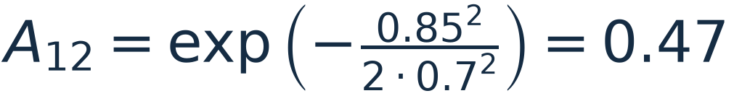
How do points become a matrix?
2 THE ALGORITHM
Every pair of points gets a similarity weight between 0 and 1.
Points
S: n × 2
›
Affinity
A: n × n
›
Normalize
L: n × n
›
Eigenvectors
X: n × k
›
Unit rows
Y: n × k
›
K-means
labels
1
2
3
4
5
6
0.00
0.47
Points 1 and 2 are 0.85 apart, so A₁₂ = 0.47.
A is symmetric: A₂₁ = A₁₂.
3
6
1
2
0.47
0.00
4
2
5
3
0.00
1
0.00
4
5
0.00
6
0.00
A (6 × 6)
04
Notes:
(click) Points 1 and 2 are 0.85 apart. Plug into the Gaussian: exp of minus 0.85 squared over 2 sigma squared gives
0.47. A is symmetric, so the same number goes in row 2, column 1.

Slide 6
How do points become a matrix?
2 THE ALGORITHM
Every pair of points gets a similarity weight between 0 and 1.
Points
S: n × 2
›
Affinity
A: n × n
›
Normalize
L: n × n
›
Eigenvectors
X: n × k
›
Unit rows
Y: n × k
›
K-means
labels
1
2
3
4
5
6
0.00
0.47
0.40
0.00
0.00
0.00
Two blocks: {1, 2, 3} and {4, 5, 6}.
One weak link across: A₂₄ = 0.07.
Line width in the graph = weight.
3
6
1
2
0.47
0.00
0.54
0.07
0.00
0.01
4
2
5
3
0.40
0.54
0.00
0.01
0.00
0.00
1
0.00
0.07
0.01
0.00
0.47
0.60
4
5
0.00
0.00
0.00
0.47
0.00
0.47
6
0.00
0.01
0.00
0.60
0.47
0.00
A (6 × 6)
Rows are numbered by group only so the blocks are easy to see. NJW never uses that order.
04
Notes:
(click) Fill in every pair. Within each group the weights are around 0.4 to 0.6; between the groups they are almost zero,
except one weak link, 0.07 between points 2 and 4. So A has two blocks. That block structure is what the rest of the
algorithm turns into coordinates.

Slide 7
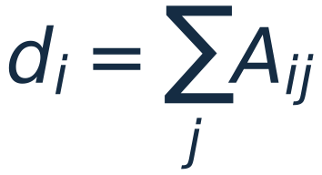
How do we get new coordinates?
2 THE ALGORITHM
A → D → L → X, on the same six points.
Points
S: n × 2
›
Affinity
A: n × n
›
Normalize
L: n × n
›
Eigenvectors
X: n × k
›
Unit rows
Y: n × k
›
K-means
labels
1
2
3
4
5
6
d
1
0.00
0.47
0.40
0.00
0.00
0.00
0.88
2
0.47
0.00
0.54
0.07
0.00
0.01
1.09
dᵢ is the row sum of A: how strongly point i is connected overall.
Point 2 has the largest degree, d₂ = 1.09: it also touches the other group.
D is the diagonal matrix with d on the diagonal.
3
0.40
0.54
0.00
0.01
0.00
0.00
0.95
4
0.00
0.07
0.01
0.00
0.47
0.60
1.16
5
0.00
0.00
0.00
0.47
0.00
0.47
0.95
6
0.00
0.01
0.00
0.60
0.47
0.00
1.08
A (6 × 6)
degrees
05
Notes:
[70 s, two clicks] Step two. The degree d_i is the row sum of A: how connected point i is overall. Point 2 has the
largest degree because it also touches the other group.

Slide 8
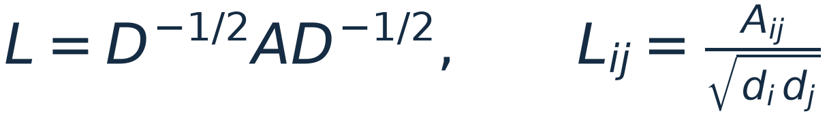
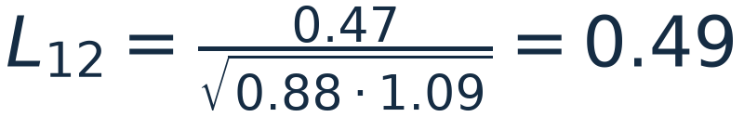
How do we get new coordinates?
2 THE ALGORITHM
A → D → L → X, on the same six points.
Points
S: n × 2
›
Affinity
A: n × n
›
Normalize
L: n × n
›
Eigenvectors
X: n × k
›
Unit rows
Y: n × k
›
K-means
labels
1
2
3
4
5
6
d
1
0.00
0.49
0.44
0.00
0.00
0.00
0.88
2
0.49
0.00
0.53
0.06
0.00
0.01
1.09
3
0.44
0.53
0.00
0.01
0.00
0.00
0.95
4
0.00
0.06
0.01
0.00
0.45
0.54
1.16
Each weight is divided by how connected its two endpoints are.
L is still 6 × 6, symmetric, with the same two blocks.
5
0.00
0.00
0.00
0.45
0.00
0.47
0.95
6
0.00
0.01
0.00
0.54
0.47
0.00
1.08
L (6 × 6)
degrees
05
Notes:
(click) L divides each weight by the square root of the two degrees. For example L12 = 0.47 over the square root of
0.88 times 1.09, which is 0.49. L is still 6 by 6 and keeps the two blocks.

Slide 9
How do we get new coordinates?
2 THE ALGORITHM
A → D → L → X, on the same six points.
Points
S: n × 2
›
Affinity
A: n × n
›
Normalize
L: n × n
›
Eigenvectors
X: n × k
›
Unit rows
Y: n × k
›
K-means
labels
1
2
3
4
5
6
Eigenvalues of L
v₁
v₂
1
0.00
0.49
0.44
0.00
0.00
0.00
1.00
0.94
-0.42
-0.44
-0.51
-0.57
1
0.38
0.41
2
0.49
0.00
0.53
0.06
0.00
0.01
keep the k = 2 largest → their eigenvectors v₁, v₂
2
0.42
0.42
3
0.44
0.53
0.00
0.01
0.00
0.00
Row i of X = new coordinates of point i.
Point 2 → (0.42, 0.42).
v₂ is positive on {1, 2, 3} and negative on {4, 5, 6}: it already separates the groups.
3
0.39
0.42
4
0.00
0.06
0.01
0.00
0.45
0.54
4
0.44
-0.39
5
0.00
0.00
0.00
0.45
0.00
0.47
5
0.39
-0.39
6
0.00
0.01
0.00
0.54
0.47
0.00
6
0.42
-0.41
L (6 × 6)
X (6 × 2)
05
Notes:
(click) Now the eigenvalues of L: 1.00 and 0.94, then a big drop to negative values. We keep the k = 2 largest and put
their eigenvectors side by side: that is X, 6 by 2. Read it by rows: row i is the new coordinate of point i. Point 2 is
now (0.42, 0.42). Look at the second column: positive on the first group, negative on the second. The groups are already
separated, but the rows still have different lengths.

Slide 10
Why normalize the rows?
2 THE ALGORITHM
X → Y. The numbers on the left and the points on the right change together.
Points
S: n × 2
›
Affinity
A: n × n
›
Normalize
L: n × n
›
Eigenvectors
X: n × k
›
Unit rows
Y: n × k
›
K-means
labels
x₁
x₂
‖xᵢ‖
y₁
y₂
0.38
0.41
True coordinates, no rescaling.
Unit circle for reference.
1
2
0.42
0.42
3
2
1
3
0.39
0.42
4
0.44
-0.39
5
0.39
-0.39
4
5
6
6
0.42
-0.41
X
÷
= Y
Rows of X as points: group {1, 2, 3} and group {4, 5, 6} point in two directions, at different lengths.
06
Notes:
[85 s, three clicks] Why the extra normalization? On the left is X; on the right each row of X is drawn as a point,
with the true coordinates. The two groups already point in two different directions, but at different lengths.

Slide 11
Why normalize the rows?
2 THE ALGORITHM
X → Y. The numbers on the left and the points on the right change together.
Points
S: n × 2
›
Affinity
A: n × n
›
Normalize
L: n × n
›
Eigenvectors
X: n × k
›
Unit rows
Y: n × k
›
K-means
labels
x₁
x₂
‖xᵢ‖
y₁
y₂
0.38
0.41
0.56
Dashed: the two directions.
1
2
0.42
0.42
0.60
3
2
1
3
0.39
0.42
0.58
4
0.44
-0.39
0.58
5
0.39
-0.39
0.56
4
5
6
6
0.42
-0.41
0.59
X
÷
= Y
‖xᵢ‖ is the length of row i. It differs inside a group, so it carries no group information.
06
Notes:
(click) Compute the length of each row. The lengths differ inside a group - 0.56 to 0.60 here, and much more on real
data - so the length says nothing about the group. It only adds noise for K-means.

Slide 12
Why normalize the rows?
2 THE ALGORITHM
X → Y. The numbers on the left and the points on the right change together.
Points
S: n × 2
›
Affinity
A: n × n
›
Normalize
L: n × n
›
Eigenvectors
X: n × k
›
Unit rows
Y: n × k
›
K-means
labels
x₁
x₂
‖xᵢ‖
y₁
y₂
0.38
0.41
0.56
0.68
0.74
Points slide along their direction onto the circle.
1
1
3
2
2
0.42
0.42
0.60
0.71
0.70
3
0.39
0.42
0.58
0.68
0.73
0.44
-0.39
0.58
0.74
-0.67
90°
4
5
0.39
-0.39
0.56
0.71
-0.70
6
0.42
-0.41
0.59
0.71
-0.70
4
6
5
X
÷
= Y
yᵢ = xᵢ / ‖xᵢ‖: keep the direction, set the length to 1. Each group collapses to one point, 90° apart.
06
Notes:
(click) Divide each row by its length. The numbers become Y, and every point slides along its direction onto the unit
circle. Each group collapses to one point, and the two points are 90 degrees apart. The next slide explains why 90.

Slide 13
Why normalize the rows?
2 THE ALGORITHM
X → Y. The numbers on the left and the points on the right change together.
Points
S: n × 2
›
Affinity
A: n × n
›
Normalize
L: n × n
›
Eigenvectors
X: n × k
›
Unit rows
Y: n × k
›
K-means
labels
x₁
x₂
‖xᵢ‖
y₁
y₂
0.38
0.41
0.56
0.68
0.74
K-means labels:
teal = {1, 2, 3}
orange = {4, 5, 6}
1
1
3
2
2
0.42
0.42
0.60
0.71
0.70
3
0.39
0.42
0.58
0.68
0.73
0.44
-0.39
0.58
0.74
-0.67
90°
4
5
0.39
-0.39
0.56
0.71
-0.70
6
0.42
-0.41
0.59
0.71
-0.70
4
6
5
X
÷
= Y
K-means on the rows of Y now has an easy job: {1, 2, 3} and {4, 5, 6}.
06
Notes:
(click) K-means on these rows is trivial: two far-apart dots. The labels go back to the six original points.

Slide 14
Why does this recover the clusters?
2 THE ALGORITHM
Start from a disconnected graph, then add links across the groups.
1
2
3
4
5
6
0.00
0.47
0.40
0.00
0.00
0.00
λ₁ = 1.00
λ₂ = 1.00
λ₃ = -0.44
gap λ₂ − λ₃ = 1.44
Dashed: the ideal directions.
Colour = group.
1
1
2
3
2
0.47
0.00
0.54
0.00
0.00
0.00
3
0.40
0.54
0.00
0.00
0.00
0.00
4
0.00
0.00
0.00
0.00
0.47
0.60
5
0.00
0.00
0.00
0.47
0.00
0.47
6
0.00
0.00
0.00
0.60
0.47
0.00
4
5
6
A
Ideal: no links across groups. L is block diagonal, λ₁ = λ₂ = 1, and Y is exactly two orthogonal points.
Theorem 2 (paper): if the gap is large compared with the links across groups, Y stays close to k orthogonal points.
07
Notes:
[50 s, two clicks] Why does this work? Start from the ideal case: delete every link between the groups. Then L is block
diagonal, the top two eigenvalues are both exactly 1, and each group lands on exactly one point - two orthogonal points.

Slide 15
Why does this recover the clusters?
2 THE ALGORITHM
Start from a disconnected graph, then add links across the groups.
1
2
3
4
5
6
0.00
0.47
0.40
0.00
0.00
0.00
λ₁ = 1.00
λ₂ = 0.94
λ₃ = -0.42
gap λ₂ − λ₃ = 1.37
Dashed: the ideal directions.
Colour = group.
1
1
3
2
2
0.47
0.00
0.54
0.07
0.00
0.01
3
0.40
0.54
0.00
0.01
0.00
0.00
4
0.00
0.07
0.01
0.00
0.47
0.60
5
0.00
0.00
0.00
0.47
0.00
0.47
6
0.00
0.01
0.00
0.60
0.47
0.00
4
6
5
A
Our actual weak link (A₂₄ = 0.07): λ₂ drops to 0.94. Y barely moves.
Theorem 2 (paper): if the gap is large compared with the links across groups, Y stays close to k orthogonal points.
07
Notes:
(click) Now our actual data, with the weak link of 0.07. Lambda 2 drops slightly to 0.94, and Y barely moves.

Slide 16
Why does this recover the clusters?
2 THE ALGORITHM
Start from a disconnected graph, then add links across the groups.
1
2
3
4
5
6
0.00
0.47
0.40
0.02
0.00
0.00
λ₁ = 1.00
λ₂ = 0.65
λ₃ = -0.18
gap λ₂ − λ₃ = 0.83
Dashed: the ideal directions.
Colour = group.
1
1
3
2
0.47
0.00
0.54
0.70
0.03
0.07
2
3
0.40
0.54
0.00
0.09
0.00
0.01
4
0.02
0.70
0.09
0.00
0.47
0.60
5
0.00
0.03
0.00
0.47
0.00
0.47
0.00
0.07
0.01
0.60
0.47
0.00
4
6
6
A
5
Links ×10 (A₂₄ = 0.70, as strong as inside a group): λ₂ = 0.65. Points 2 and 4 are pulled toward each other.
Theorem 2 (paper): if the gap is large compared with the links across groups, Y stays close to k orthogonal points.
07
Notes:
(click) Make the cross links ten times stronger - as strong as the links inside a group. Lambda 2 falls, the gap
shrinks, and points 2 and 4, which carry the link, are pulled toward each other. This is the paper's Theorem 2 in a
picture: small links and a large gap keep Y near the ideal; large links push it away. This is also why sigma matters.

Slide 17
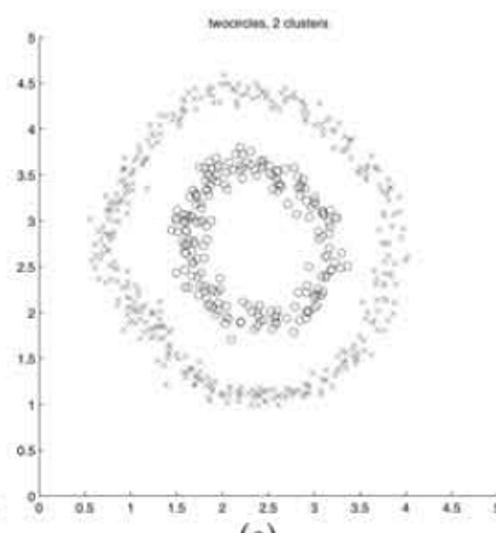
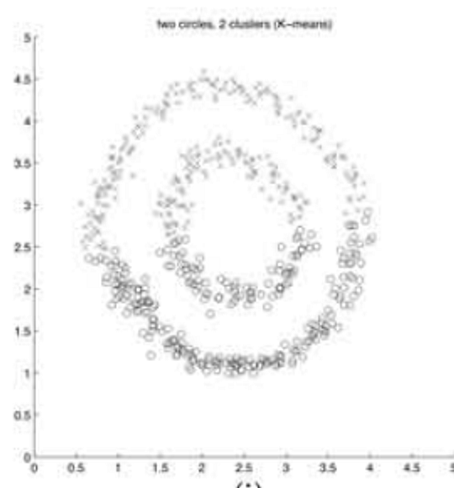
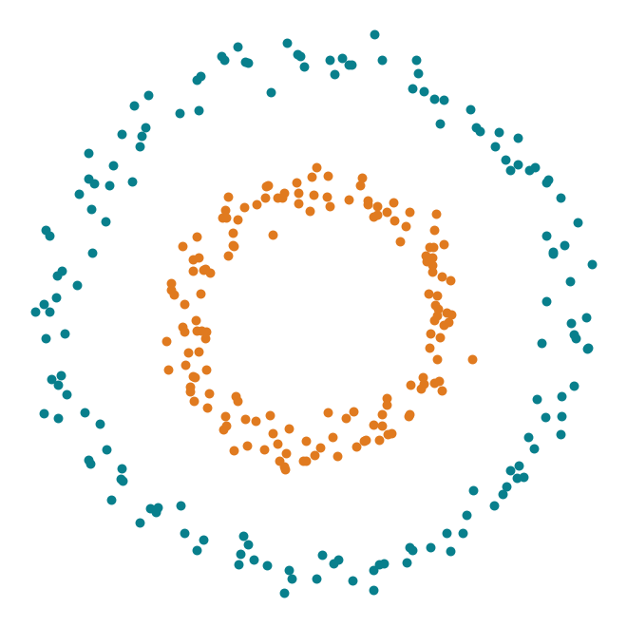
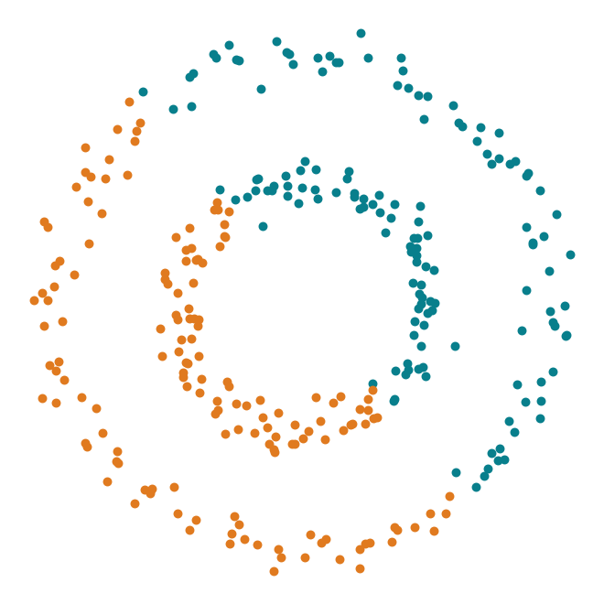
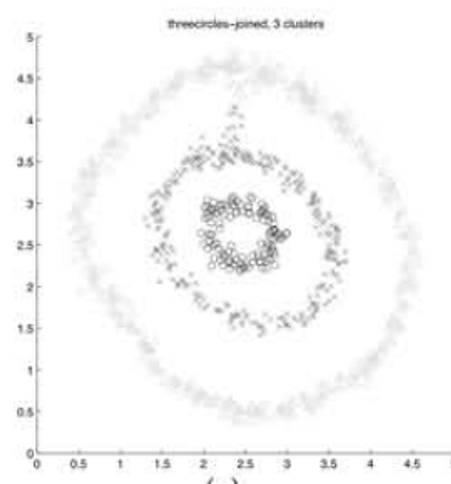
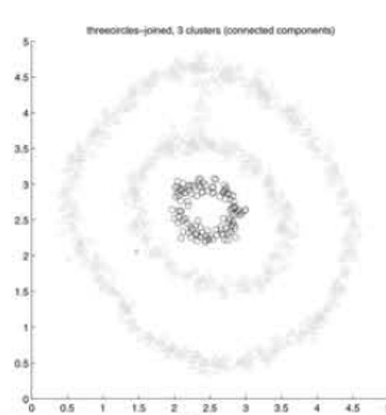
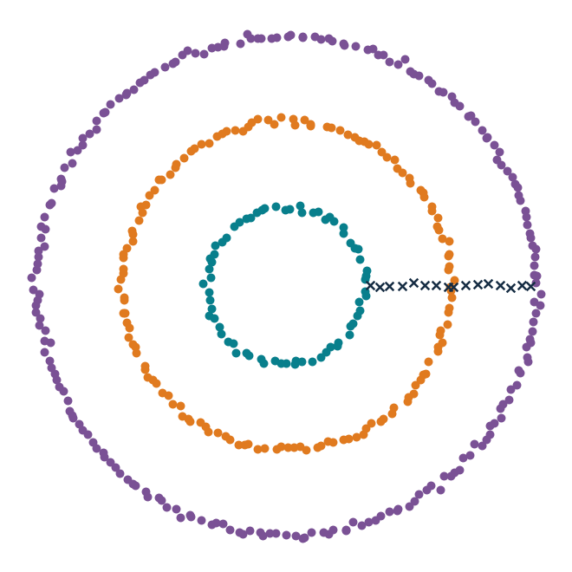
Did we see the same effect?
3 OUR REPRODUCTION
Original paper (pictures only) next to our implementation on data we rebuilt.
Original paper, Figure 1
Our reproduction (ARI)
All our numbers
K-means → NJW
Circles 0.00 → 1.00
Moons 0.27 → 1.00
Blobs 1.00 → 1.00
Figure 1 settings: NJW 1.00 on 6 of 6.
The paper reports no metric and released no data.
Two circles
k = 2
NJW
K-means
NJW 1.00
K-means 0.00
Joined rings
k = 3
Three rings recovered. K-means still fails on this shape.
NJW
Components
NJW 1.00
08
Notes:
[65 s] Did we see the same thing? Left, the paper's Figure 1; right, our own implementation on data we rebuilt - the
paper released neither the points nor sigma, so this is a qualitative comparison, and the ARI numbers are ours.
Top row, two circles: the paper shows NJW succeeding and K-means failing; we get exactly that, 1.00 against 0.00.
Bottom row, three rings joined by short bridges: NJW recovers the three rings here too. One sentence, then move on.
Across everything we ran: NJW beats K-means on circles and moons, ties on blobs, and gets 1.00 on the rebuilt
Figure 1 settings.

Slide 18
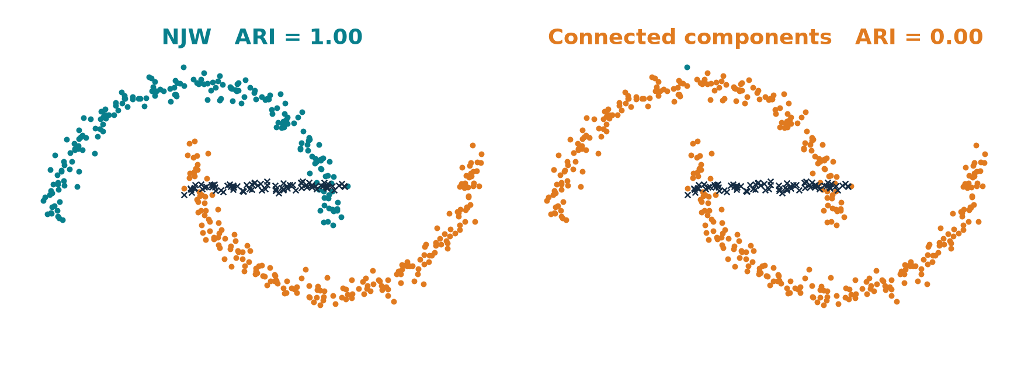
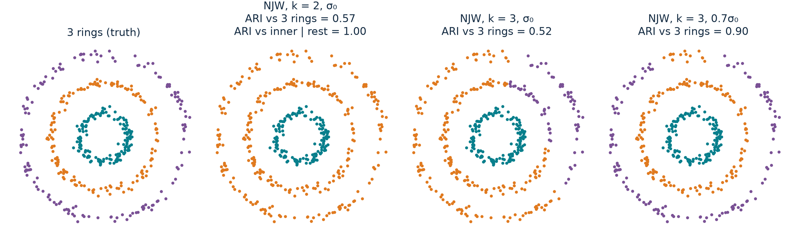
When does it fail, and why?
4 CRITICAL ANALYSIS
Scale σ, noise, and a wrong-looking answer with the right k.
Moons, σ = 1 σ₀ ARI = 1.00
Noise: a bridge of 80 points between the moons
NJW 1.00
Components 0.00
Weights, not a hard threshold.
A failure: three rings, true k = 3 → ARI 0.52 at σ₀
moons (solid), circles (dashed)
ARI 1
0.25
1
σ / σ₀
4
Our default σ₀.
09
Notes:
[95 s, two clicks] When does it fail? First, the scale sigma. Here are the moons at our default sigma: perfect.

Slide 19
When does it fail, and why?
4 CRITICAL ANALYSIS
Scale σ, noise, and a wrong-looking answer with the right k.
Moons, σ = 2.8 σ₀ ARI = 0.81
Noise: a bridge of 80 points between the moons
NJW 1.00
Components 0.00
Weights, not a hard threshold.
A failure: three rings, true k = 3 → ARI 0.52 at σ₀
moons (solid), circles (dashed)
ARI 1
0.25
1
σ / σ₀
4
Bigger σ = stronger links across the moons (previous slide).
09
Notes:
(click) Make sigma 2.8 times larger. That is exactly the stronger cross links from the previous slide: the moons start to
mix and ARI drops to 0.81. On circles - the dashed curve - it collapses to zero already at 2 sigma-zero.

Slide 20
When does it fail, and why?
4 CRITICAL ANALYSIS
Scale σ, noise, and a wrong-looking answer with the right k.
Moons, σ = 8 σ₀ ARI = 0.30
Noise: a bridge of 80 points between the moons
NJW 1.00
Components 0.00
Weights, not a hard threshold.
A failure: three rings, true k = 3 → ARI 0.52 at σ₀
moons (solid), circles (dashed)
ARI 1
0.25
1
σ / σ₀
4
Links everywhere: the graph no longer shows two groups.
09
Notes:
(click) At 8 times, links are everywhere, the graph no longer has two groups, and ARI is 0.30. One global sigma, and
nothing in the method tells you the safe window.
Top right, noise: an 80-point bridge between the moons. NJW still scores 1.00, while connected components, a hard
threshold, falls to 0 - one chain of points is enough to merge them. So it is robust to sparse noise.
Bottom right, a failure even with the right k: three rings, k = 3, ARI 0.52 at our default sigma - the outer rings mix.
At 0.7 sigma-zero it reaches 0.90. k must be given by hand, and even the right k does not fix a wrong sigma.

Slide 21
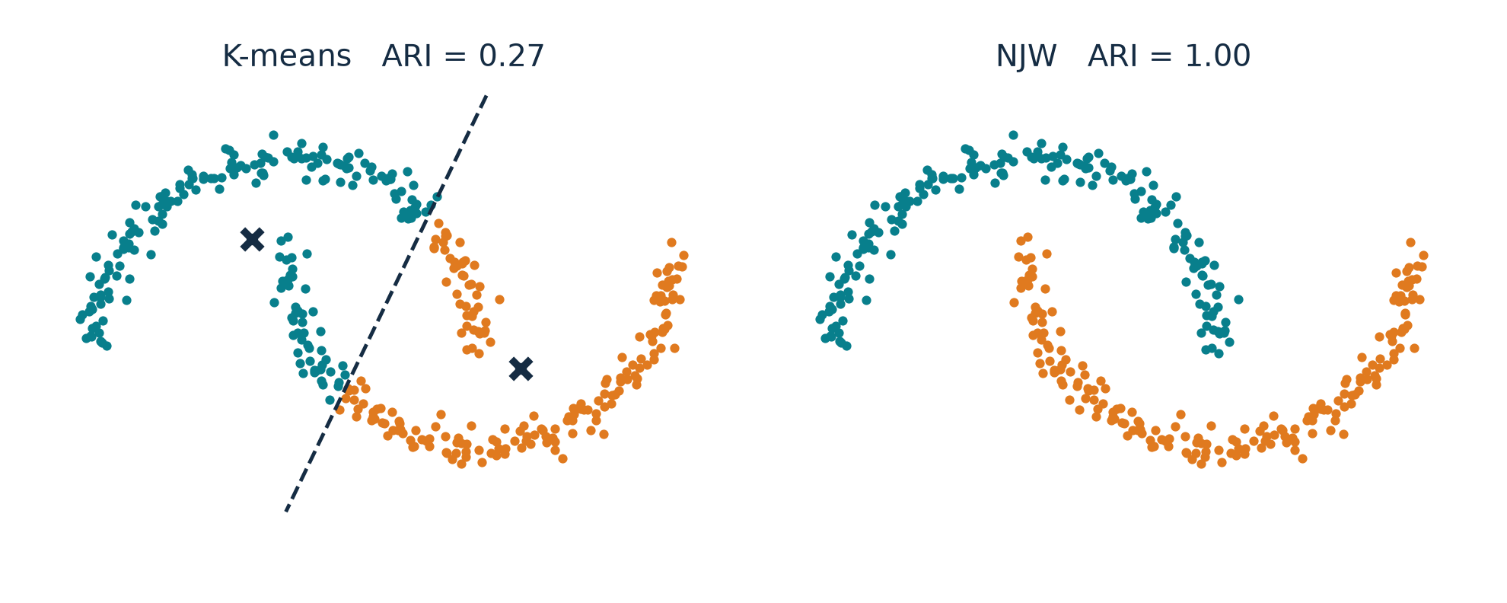
What to remember
5 SUMMARY
Back to the opening example: same points, same k.
Contribution
A simple algorithm: graph → top-k eigenvectors → unit rows → K-means.
An explanation: groups become orthogonal directions; weak links only perturb them.
Limits
One global σ, and k given by hand.
Theorem 2's condition fails on these moons (gap 0.0036 < 0.0144), yet NJW is perfect: the theory is sufficient, not necessary.
K-means 0.27 → NJW 1.00. Not a new clustering step: a better representation for the old one.
10
Notes:
[40 s] Back to where we started: the same moons, the same k. K-means 0.27, NJW 1.00. What to remember: NJW is not a new
clustering step, it is a better representation for the old one. Its contribution is a simple algorithm and an
explanation: each group becomes one direction, and weak links only perturb it. Its limits: one global sigma, k chosen by
hand, and a theory whose condition does not even hold on these moons - it is sufficient, not necessary. Thank you.

Slide 22
Backup · Theorem 2 on our runs
BACKUP
True clusters used only as the blocks in the proof.
Dataset | gap δ | needs > (2+√2)ε | Condition | NJW ARI | Bound vs observed
circles | 0.0053 | 0.1818 | fails | 1.00 | -
moons | 0.0036 | 0.0144 | fails | 1.00 | -
blobs | 0.0879 | 2.5e-05 | holds | 1.00 | 1.5e-04 vs 3.6e-14
Thin shapes (rings, moons) mix slowly inside a cluster, so their own λ₂ is close to 1 and the gap is tiny.
Where the condition holds (blobs), the bound is about ten orders of magnitude loose.
B

Slide 23
Backup · Connections to the course
BACKUP
Concept | Connection | Distinction
K-means | Same final step, run on rows of Y | The embedding changes the geometry
PCA | Both keep top eigenvectors | PCA: covariance of features. NJW: graph over samples
Kernels / similarity | Gaussian pairwise weight | Aᵢᵢ = 0, so A need not be a PSD Gram matrix
Normalization | Degree normalization of A | Row normalization of X is a different step
B

Slide 24
Backup · Questions we prepared
BACKUP
Question | Short answer
Why run K-means again? | On Y the clusters are tight and orthogonal, so its job is easy.
Why keep the first eigenvector? | NJW uses the whole top-k subspace; dropping one loses a direction.
What if the eigenvectors rotate? | Rotations keep lengths and angles; Y is rotated, clusters stay.
Does a large eigengap prove correctness? | It supports subspace stability under A1–A4, not any particular labelling.
How do you choose σ and k? | σ: label-free rule or the paper's distortion search. k: given; see our three-ring test.
What exactly did you reproduce? | Our code, our data, Figure-1-like settings. Not the paper's points.
B

Slide 25
Backup · Baselines on the Figure 1 settings
BACKUP
ARI. Kernel methods share the distortion-chosen σ. Components search their own threshold.
Setting | NJW | Meila–Shi | Kannan-style* | Components | K-means
twocircles, k=2 | 1.00 | 1.00 | 1.00 | 1.00 | 0.00
lineandballs, k=3 | 1.00 | 1.00 | 1.00 | 1.00 | 0.68
fourclouds, k=2 | 1.00 | 1.00 | 1.00 | 1.00 | 1.00
squiggles, k=4 | 1.00 | 1.00 | 0.71 | 1.00 | 0.33
nips, k=8 | 1.00 | 1.00 | 0.76 | 1.00 | 0.64
threecircles_joined, k=3 | 1.00 | 1.00 | 0.33 | 0.00 | 0.00
threecircles_joined, k=2 | 0.79 | 0.79 | 0.04 | 0.00 | 0.00
* Our reading of one sentence in the paper (largest absolute eigenvector coordinate), not Kannan et al.'s code. Joined rings: NJW ARI here scores the ring points only.
B

Slide 26
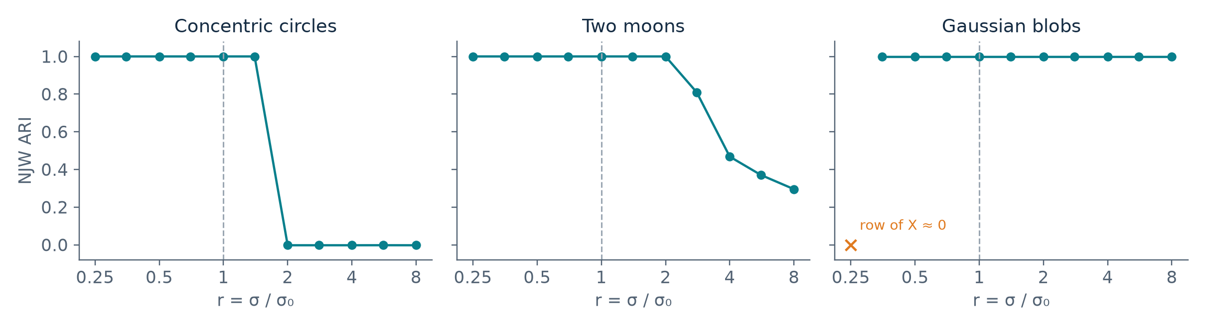
Backup · σ sensitivity on all three datasets
BACKUP
Same data and k as Part 3. Dashed line: our default σ₀. Labels did not choose σ₀.
Blobs: at r = 0.25 a point's row of X is numerically zero, so row normalization is undefined.
Moons: 1.00 up to r = 2, then 0.81, 0.47, 0.37, 0.30.
Row normalization off (350 vs 50-point blobs, same σ and k): ARI 1.00 → 0.96.
B

Slide 27
Backup · References and attribution
BACKUP
Primary paper
A. Y. Ng, M. I. Jordan, Y. Weiss. On Spectral Clustering: Analysis and an Algorithm. NIPS 14, 2001, pp. 849–856.
Figures
Slide 1 crops Figure 1 of the paper. Every other figure is our points, our code and our measurements.
Code
NJW implemented by us (src/njw_spectral). Libraries: SciPy eigh, scikit-learn KMeans and ARI, Matplotlib. sklearn SpectralClustering is not used.
B

