Slide 1


Titanic Spaceship:
an analysis for transported passengers
João António & Tiago Freitas
Curricular Unit: Fundamentos de Aprendizagem Automática
Professor: Dr. Pétia Georgieva
12 to 16 September 2022
17 November 2022

Slide 2
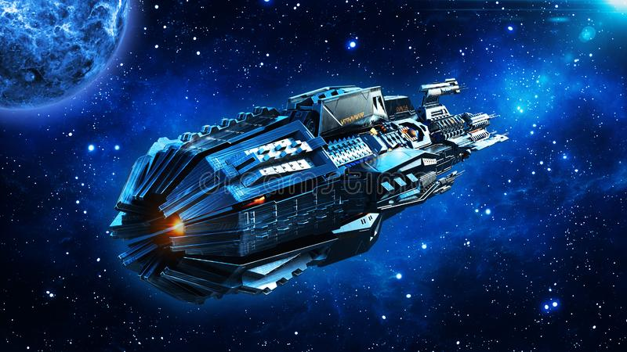
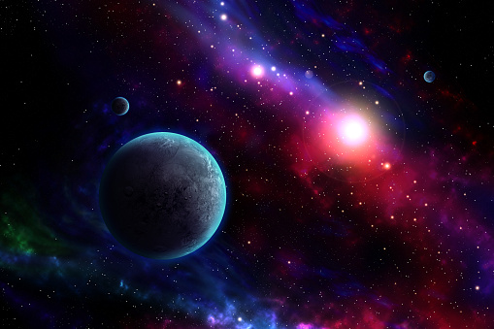

The Facts
The Titanic Spaceship suffered a space anomaly disaster
We were able to recover the damage computer from the ship
Almost half of the passengers were transported to an alternative dimension
Goal: Predict who was transported from dataset without the transported target

Slide 3
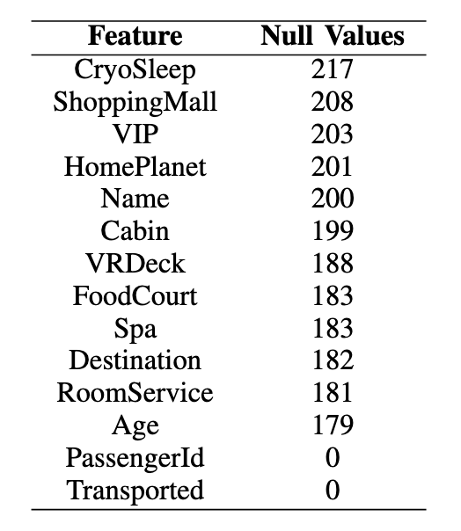
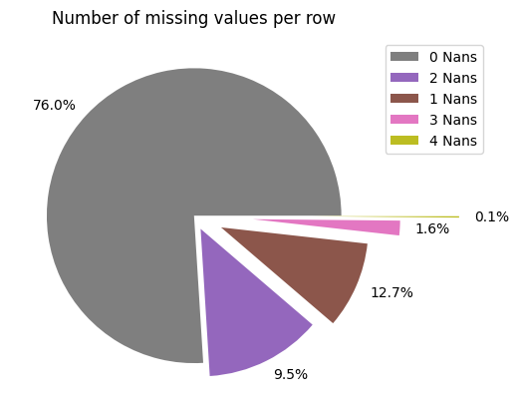
The Damaged Computer
Some of the information of the passengers got lost

Slide 4
Features
PassengerId - A unique Id for each passenger. Each Id takes the form gggg_pp where gggg indicates a group the passenger is travelling with and pp is their number within the group. People in a group are often family members, but not always.
HomePlanet - The planet the passenger departed from, typically their planet of permanent residence.
CryoSleep - Indicates whether the passenger elected to be put into suspended animation for the duration of the voyage. Passengers in cryosleep are confined to their cabins.
Cabin - The cabin number where the passenger is staying. Takes the form deck/num/side, where side can be either P for Port or S for Starboard.
Destination - The planet the passenger will be debarking to.
Age - The age of the passenger.
VIP - Whether the passenger has paid for special VIP service during the voyage.
RoomService, FoodCourt, ShoppingMall, Spa, VRDeck - Amount the passenger has billed at each of the Spaceship Titanic's many luxury amenities.
Name - The first and last names of the passenger.
Transported

Slide 5
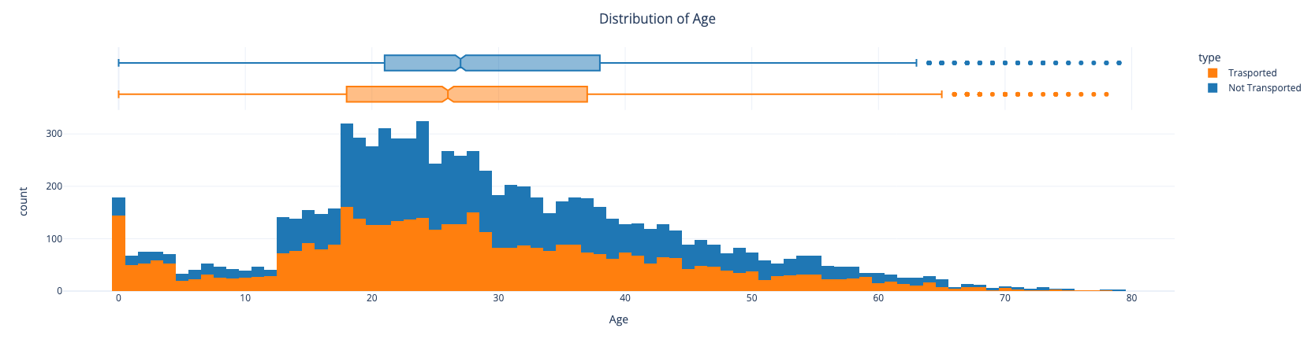
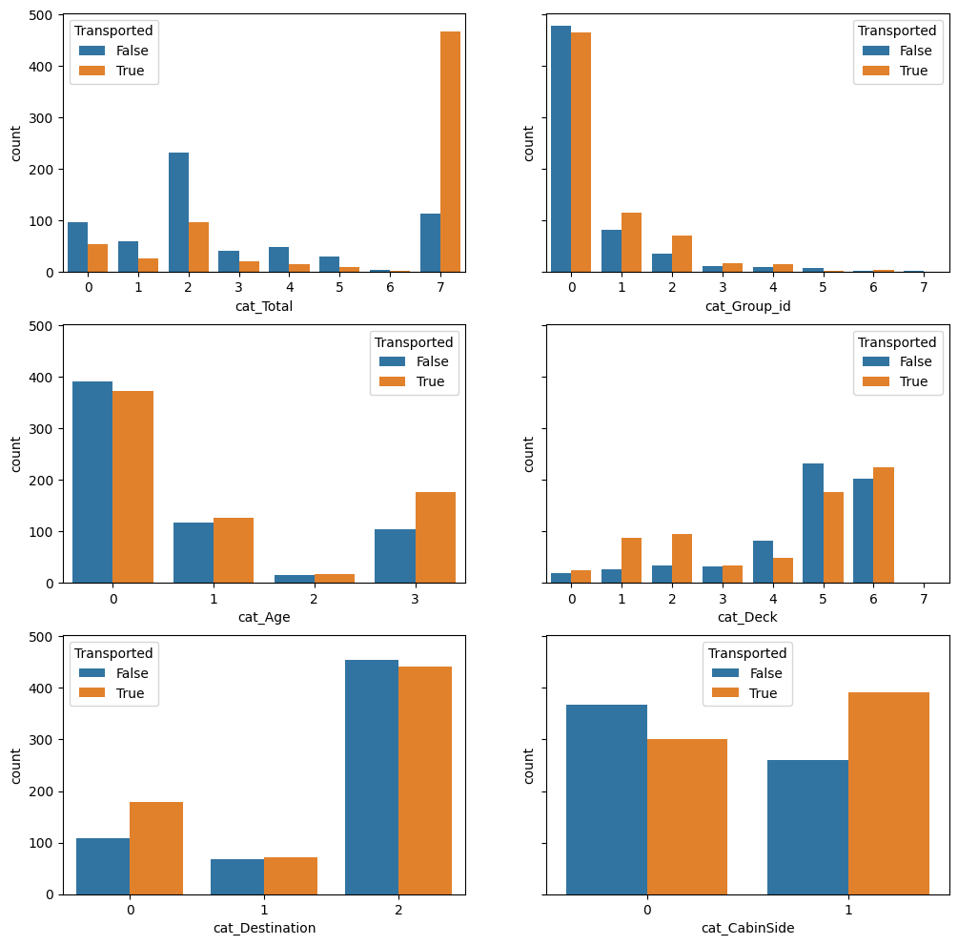
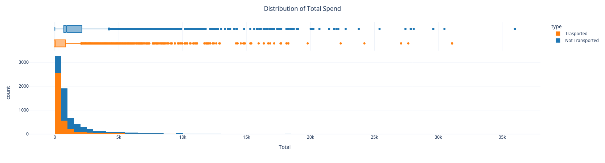
Features Graphs

Slide 6
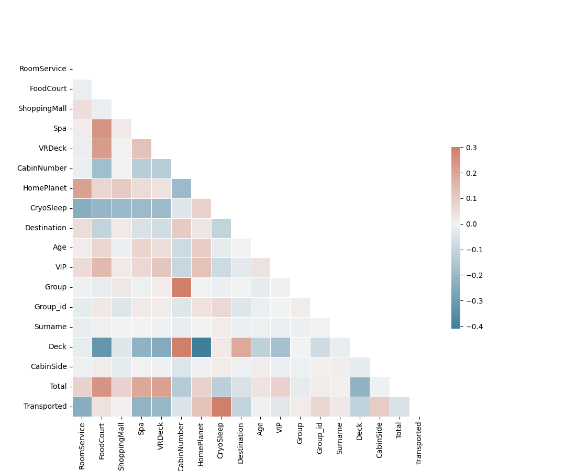
New features

Slide 7
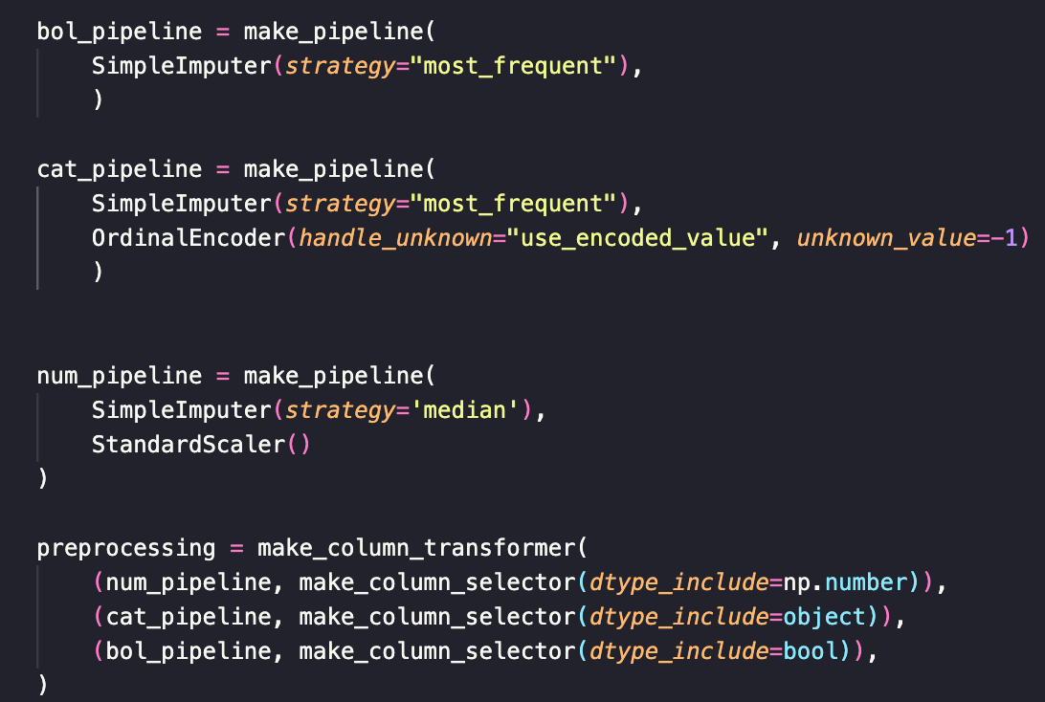
Pipeline

Slide 8
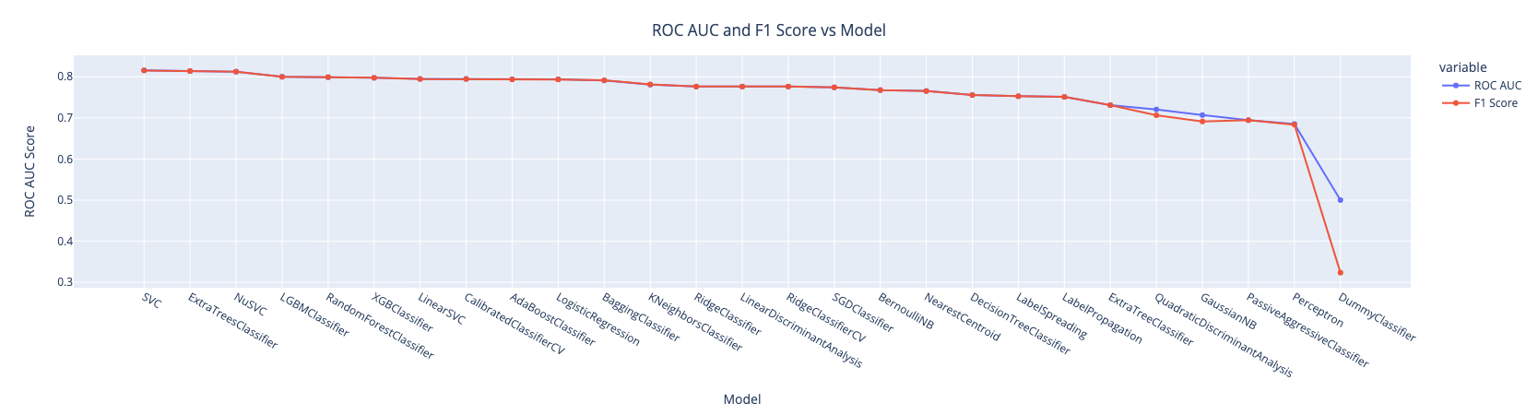
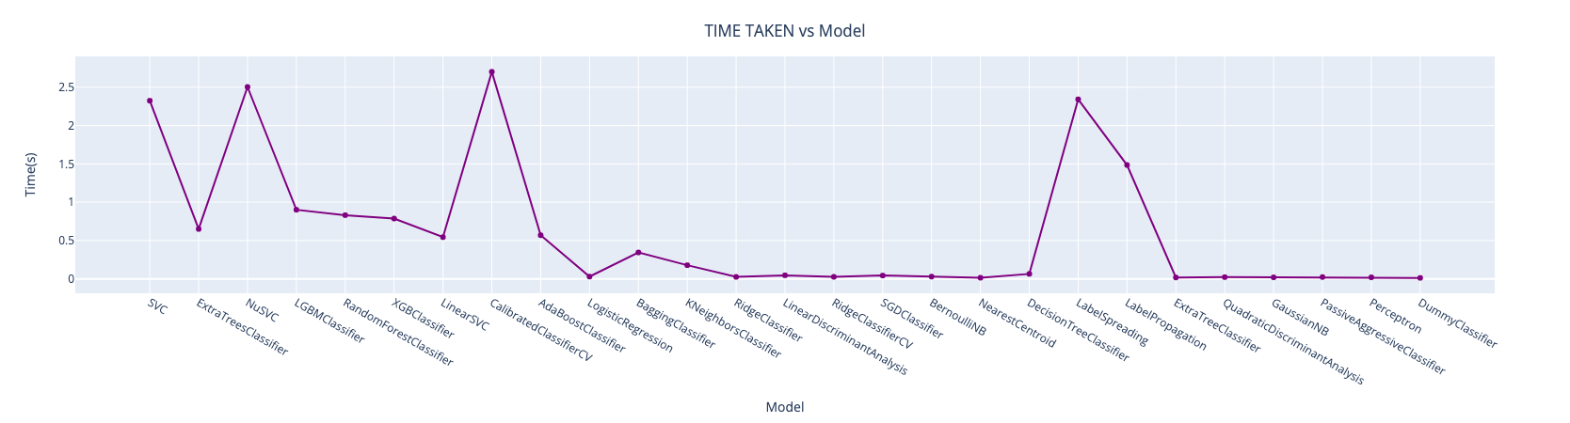
Lazy predict

Slide 9
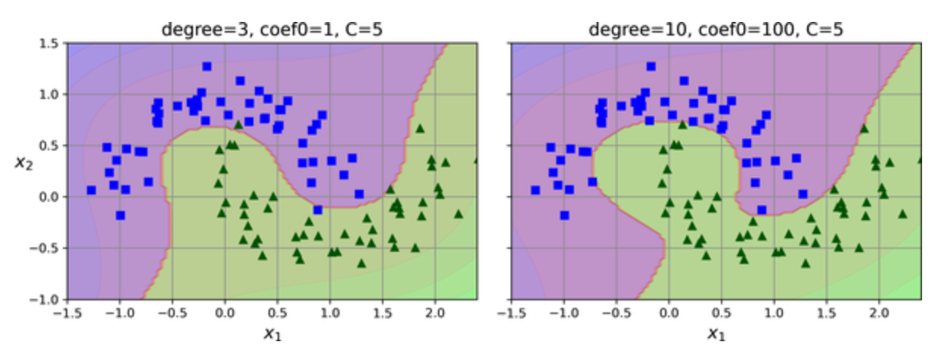
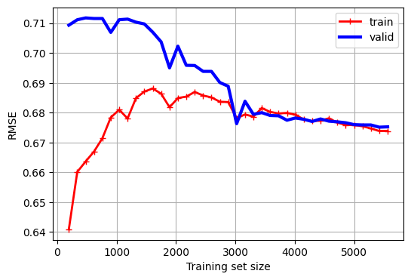
SVC

Slide 10
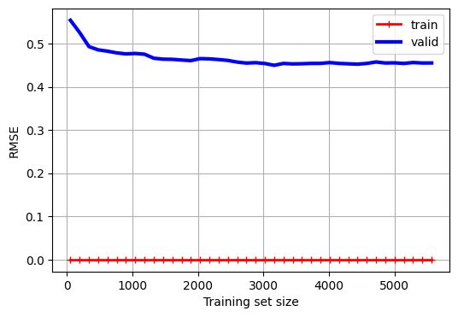
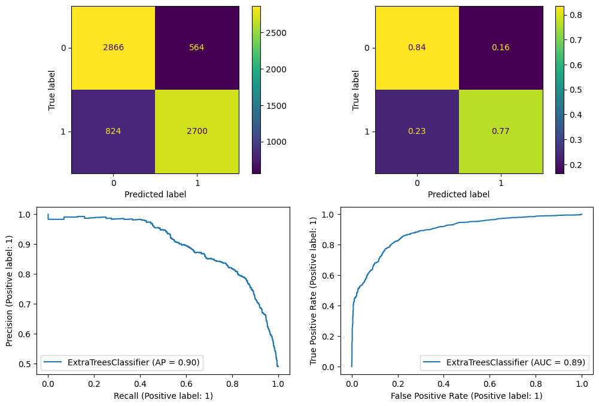
XTREE

Slide 11
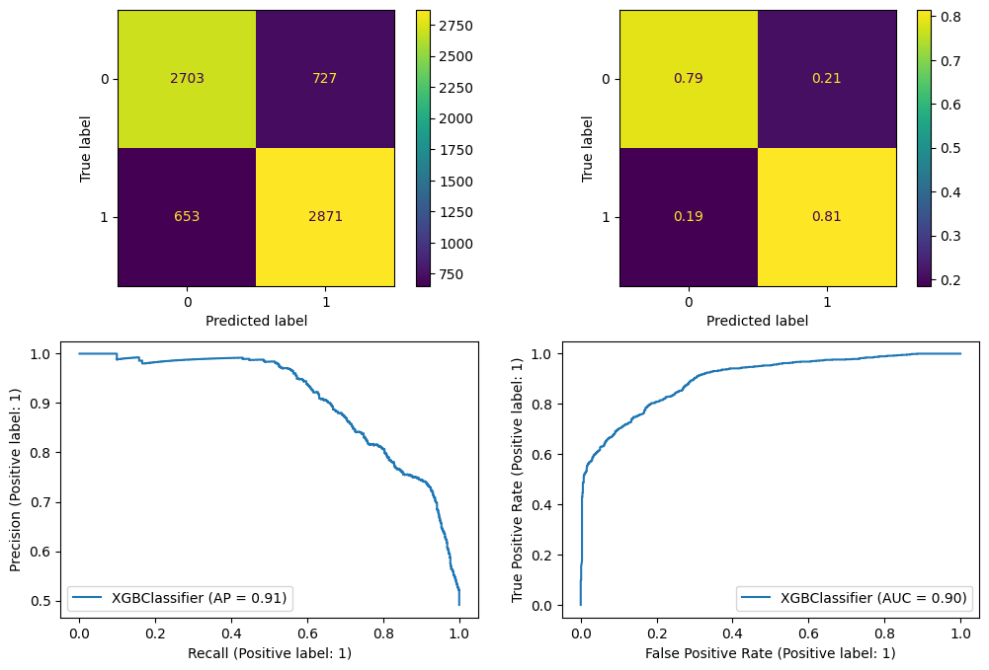
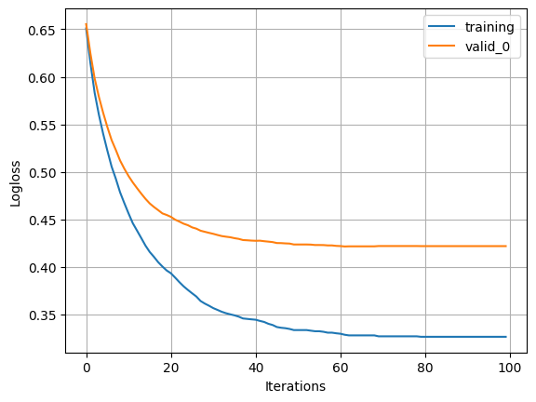
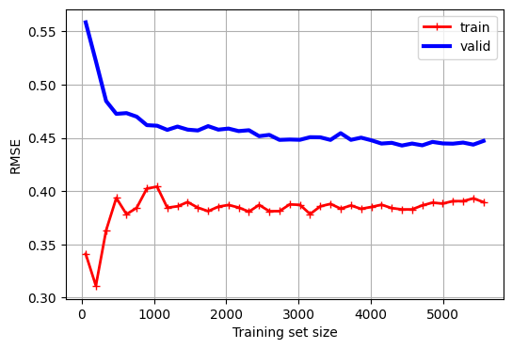
XGBoost

Slide 12
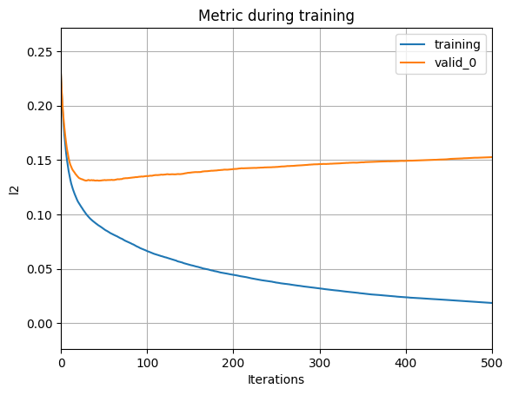

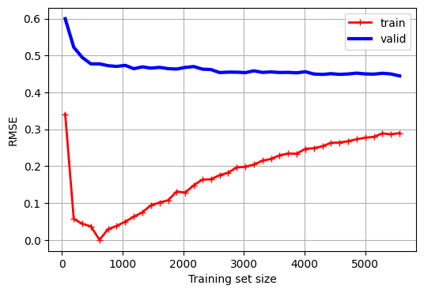
LGBM

Slide 13

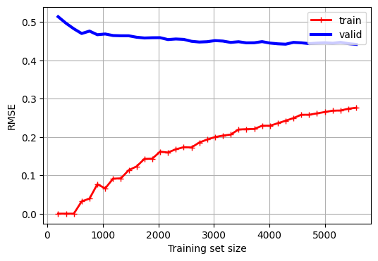
Cat Boost

Slide 14
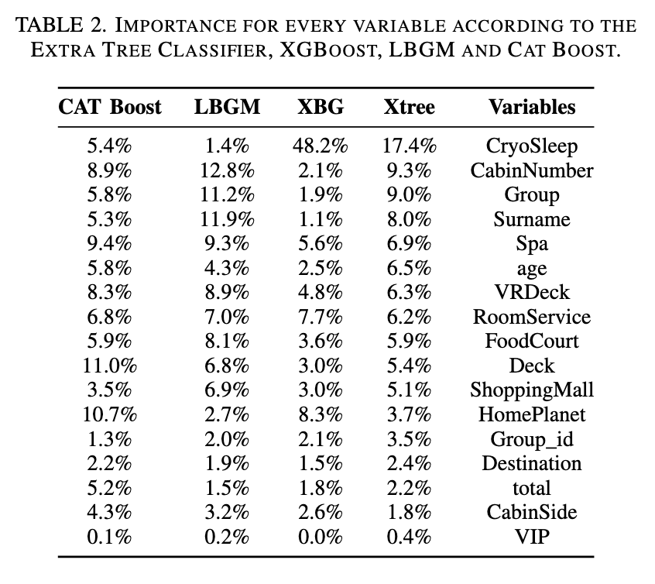
Feature Importance

Slide 15
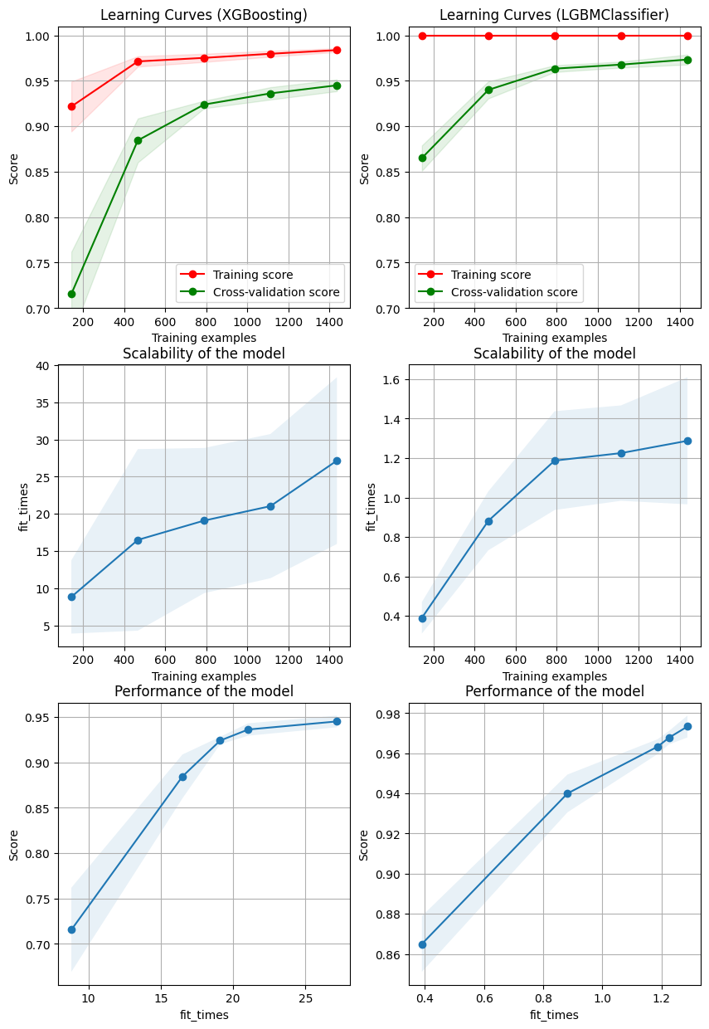
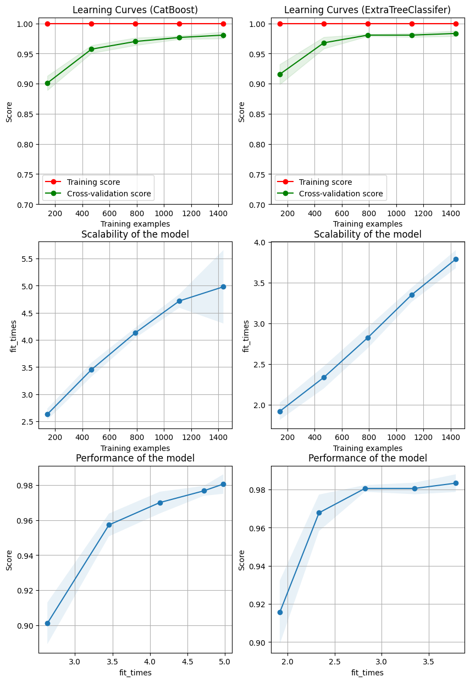
Models Comparison

Slide 16
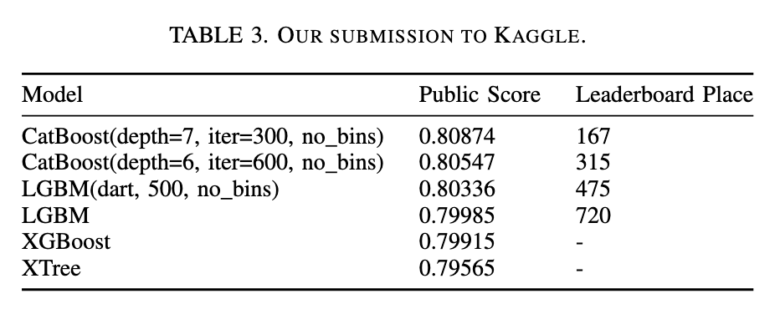
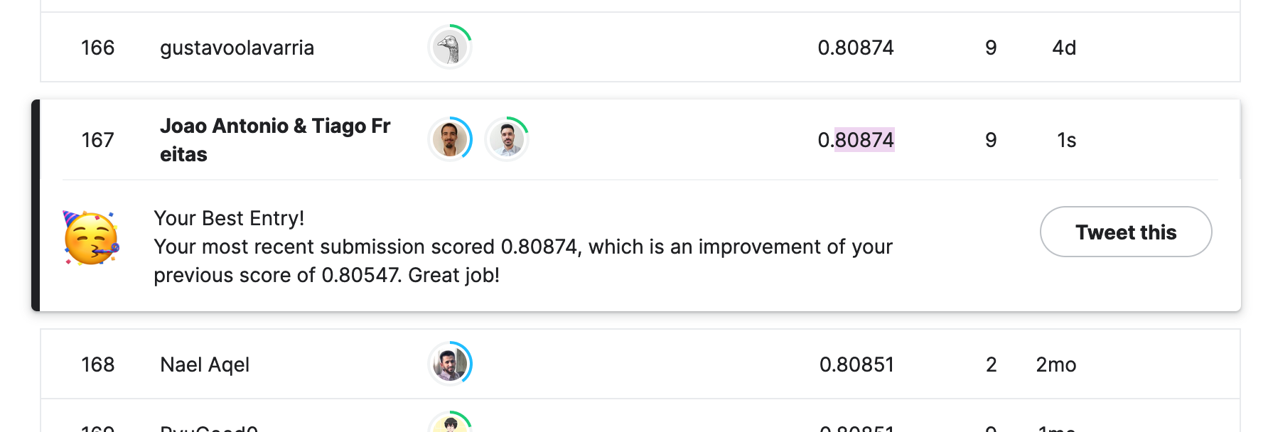
Kaggle Submission

