Slide 1


Titanic Spaceship:
an analysis for transported passengers
João António & Tiago Freitas
Curricular Unit: Fundamentos de Aprendizagem Automática
Professor: Dr. Pétia Georgieva
12 to 16 September 2022
17 November 2022

Slide 2
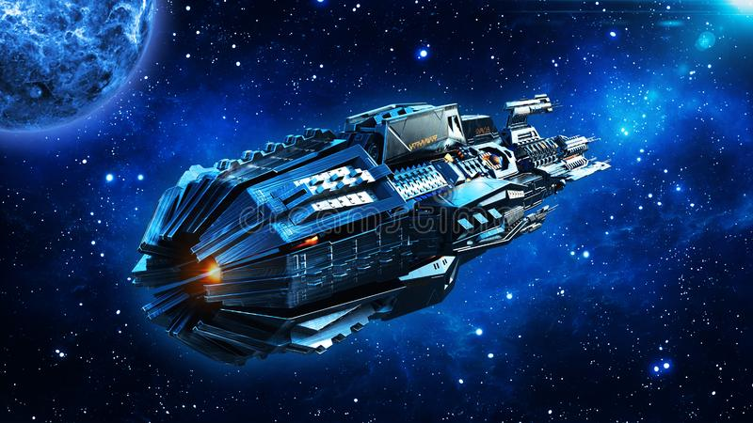


The Facts
The Titanic Spaceship suffered a space anomaly disaster.
We were able to recover the damage computer from the ship.
Almost half of the passengers were transported to an alternative dimension.
Goal: Predict who was transported from dataset without the transported target

Slide 3
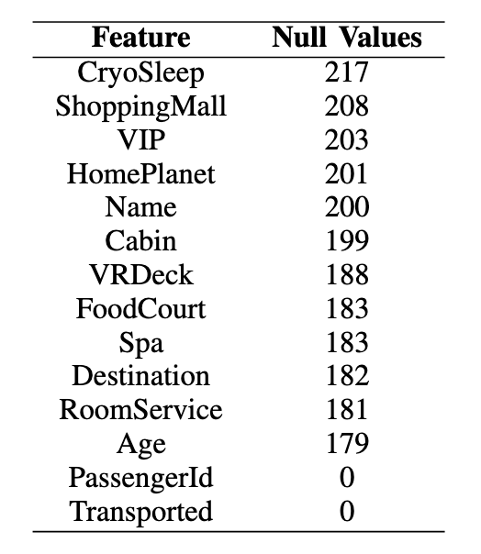
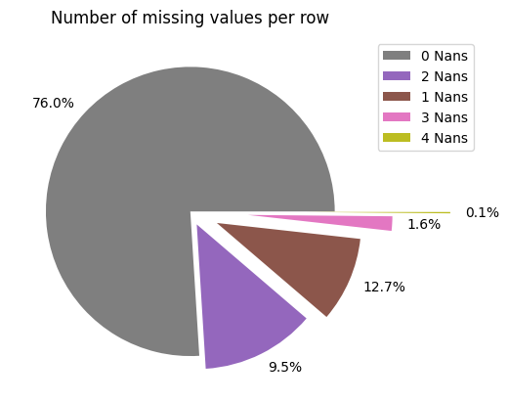
The Damaged Computer
Some of the information of the passengers got lost

Slide 4
Features
PassengerId - A unique Id for each passenger. Each Id takes the form gggg_pp where gggg indicates a group the passenger is travelling with and pp is their number within the group. People in a group are often family members, but not always.
HomePlanet - The planet the passenger departed from, typically their planet of permanent residence.
CryoSleep - Indicates whether the passenger elected to be put into suspended animation for the duration of the voyage. Passengers in cryosleep are confined to their cabins.
Cabin - The cabin number where the passenger is staying. Takes the form deck/num/side, where side can be either P for Port or S for Starboard.
Destination - The planet the passenger will be debarking to.
Age - The age of the passenger.
VIP - Whether the passenger has paid for special VIP service during the voyage.
RoomService, FoodCourt, ShoppingMall, Spa, VRDeck - Amount the passenger has billed at each of the Spaceship Titanic's many luxury amenities.
Name - The first and last names of the passenger.
Transported

Slide 5
Feature engineering
PassengerId
↓
Group, Group_Id
Cabin
↓
Deck, CabinNumber, CabinSide
Age
↓
Age (bins of 10 years)
Name
↓
FirstName, Surname
RoomService, FoodCourt, ShoppingMall, Spa, VRDeck
↓
Total (10 equal width bins)

Slide 6
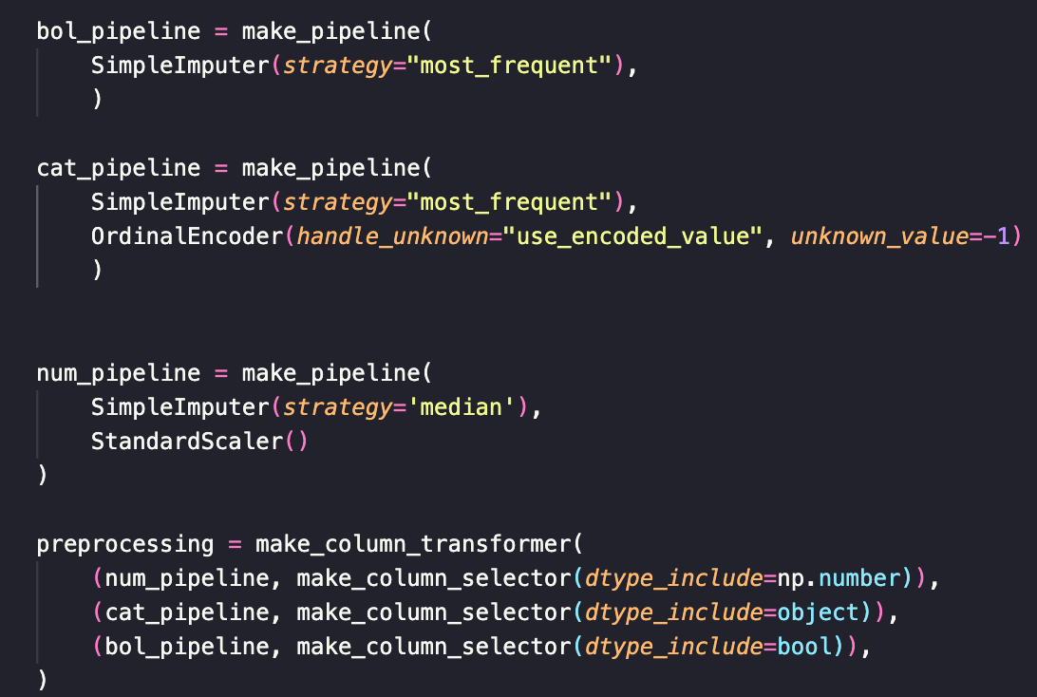
Pipeline

Slide 7
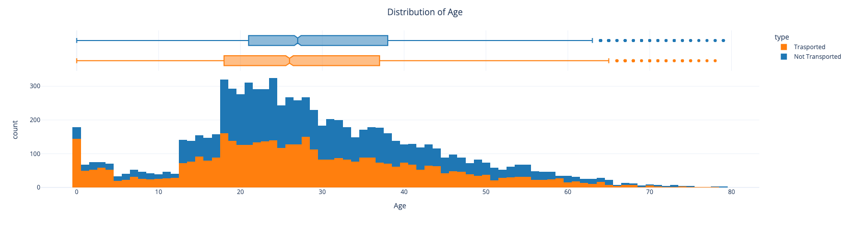
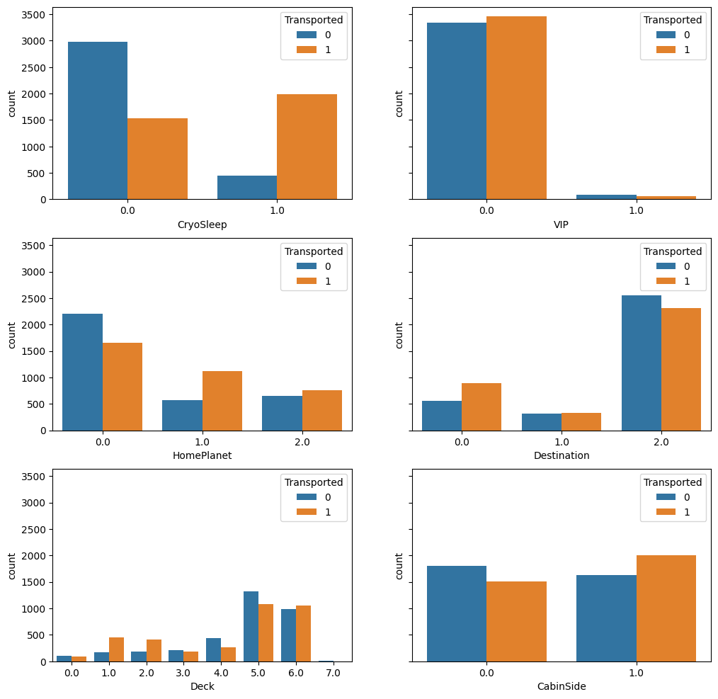
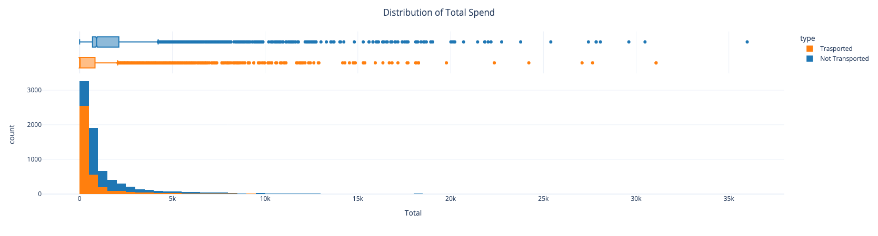
Features Graphs

Slide 8
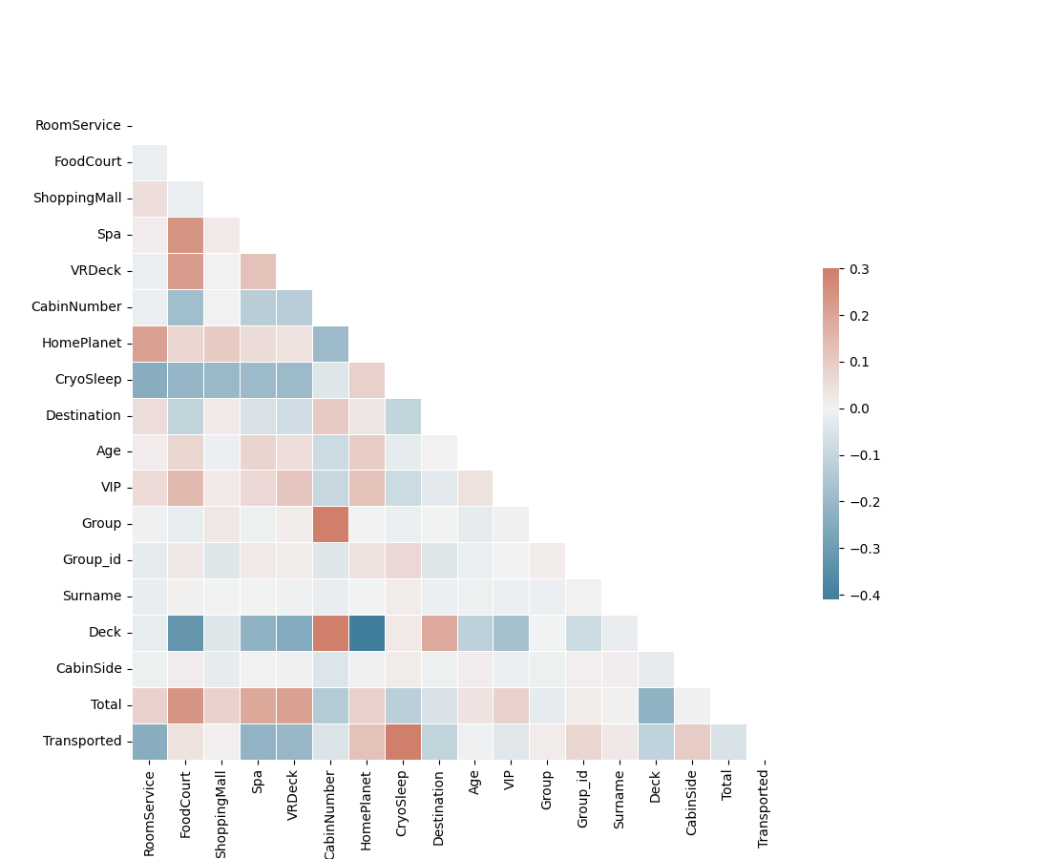
New features

Slide 9
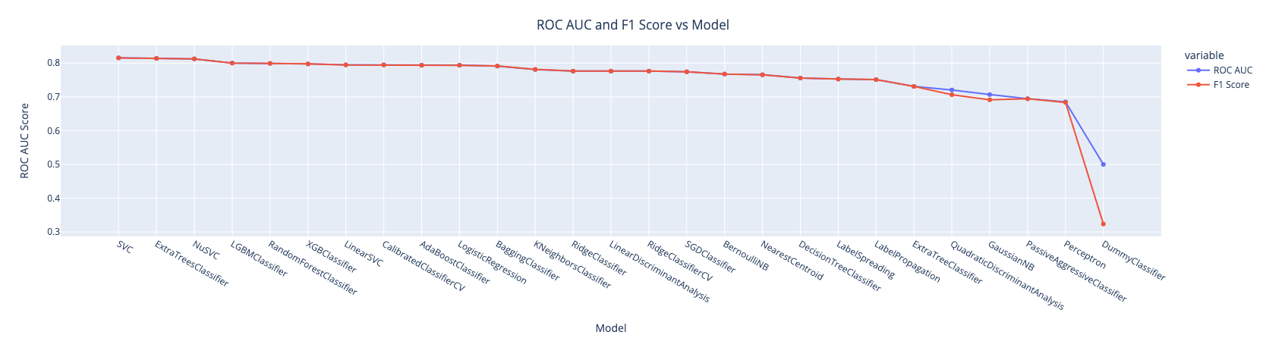
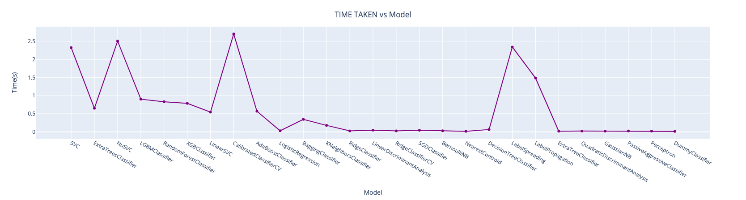
Lazy predict

Slide 10
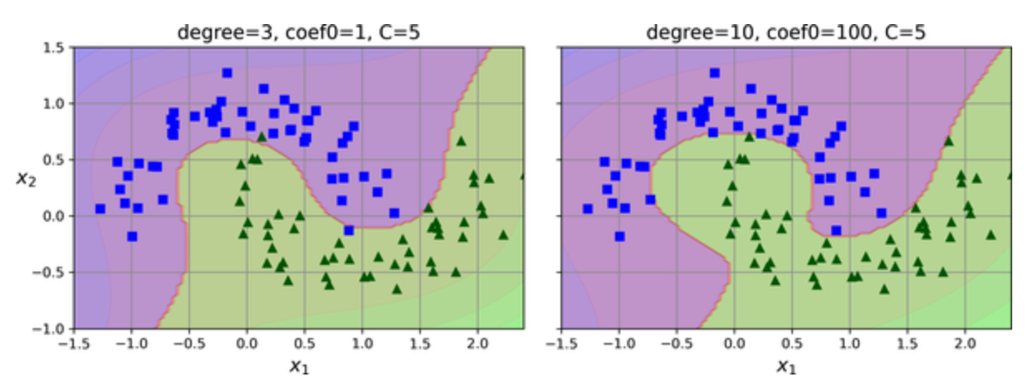
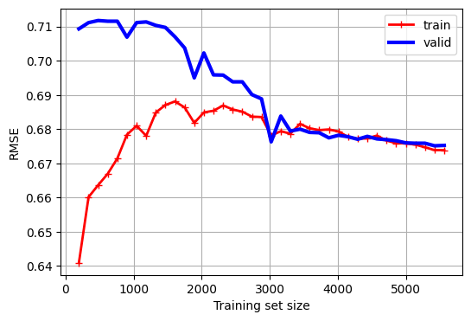
SVC

Slide 11
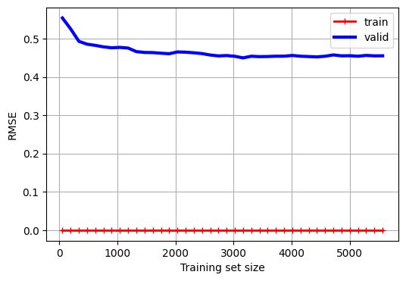
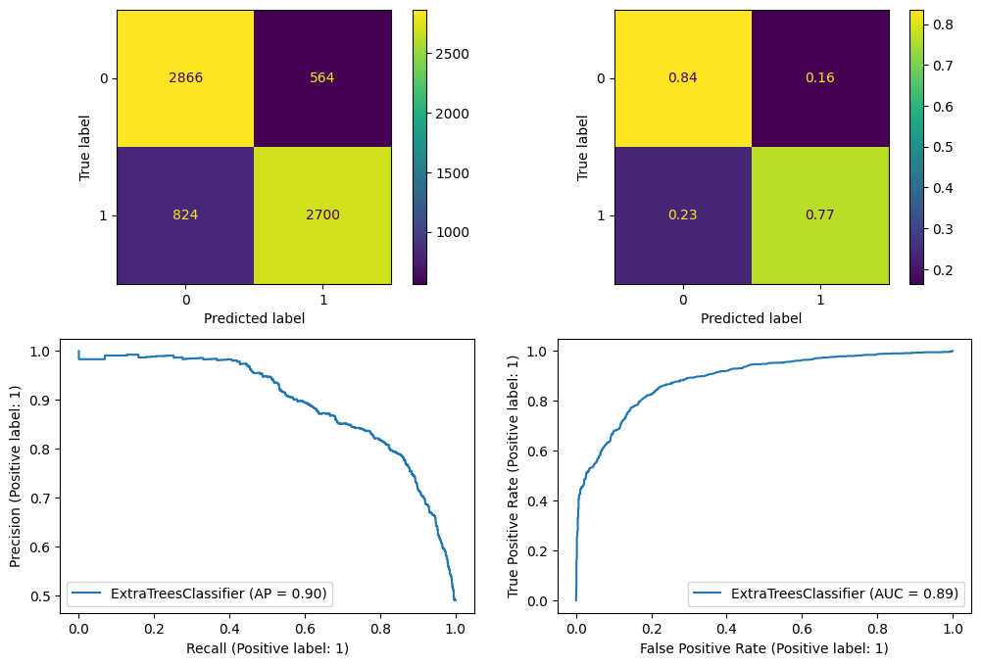
XTREE

Slide 12
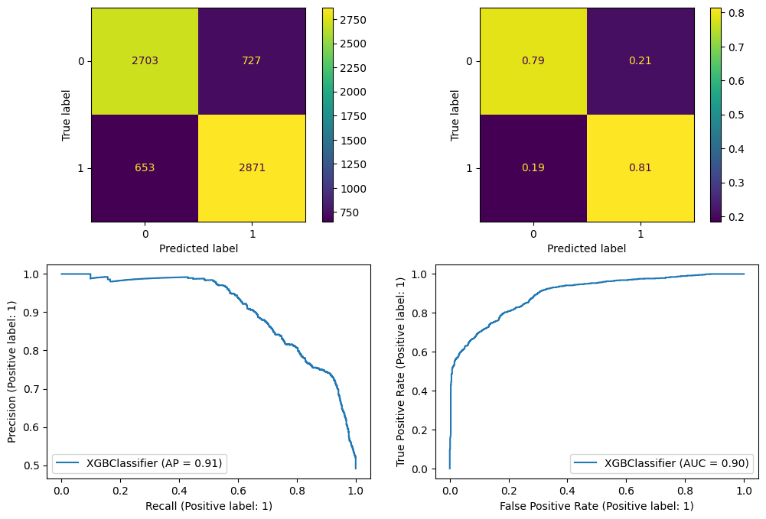
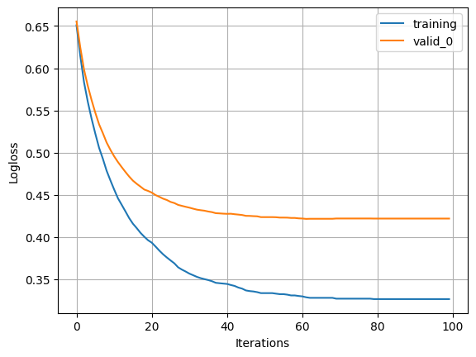
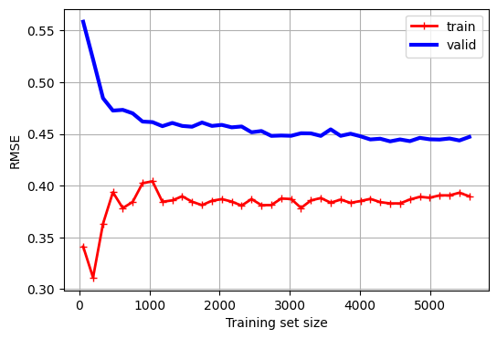
XGboost

Slide 13
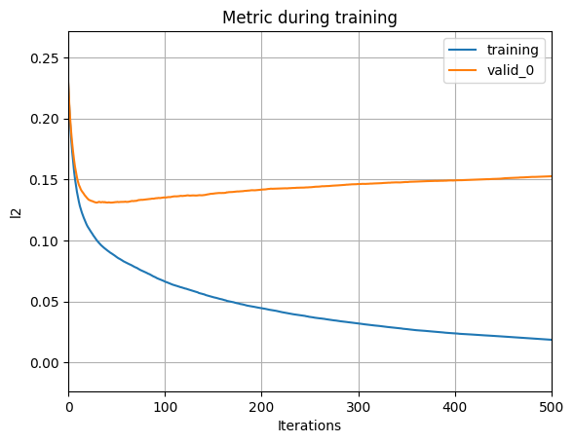

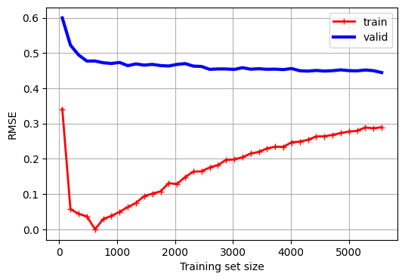
LGBM

Slide 14

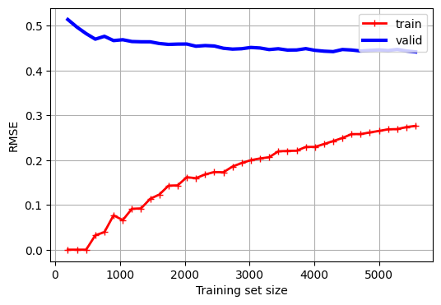
Cat Boost

Slide 15
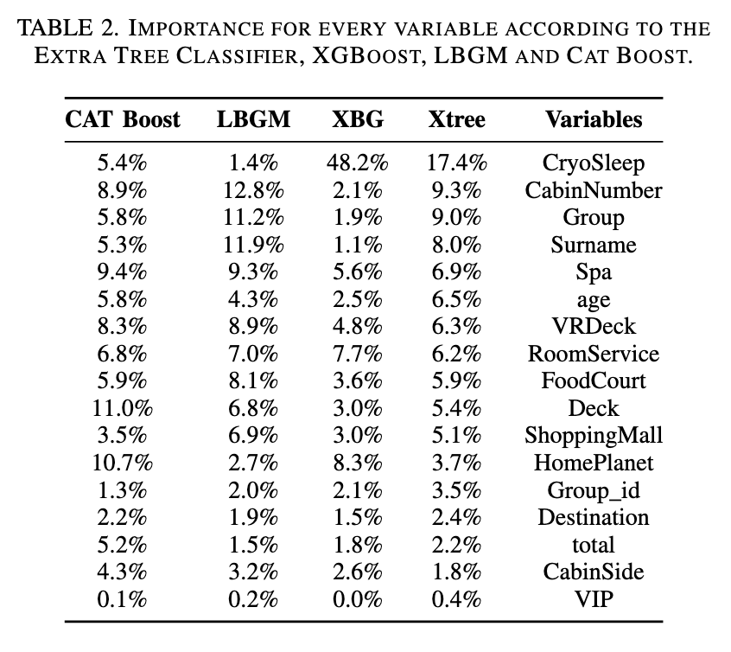
Feature Importance

Slide 16
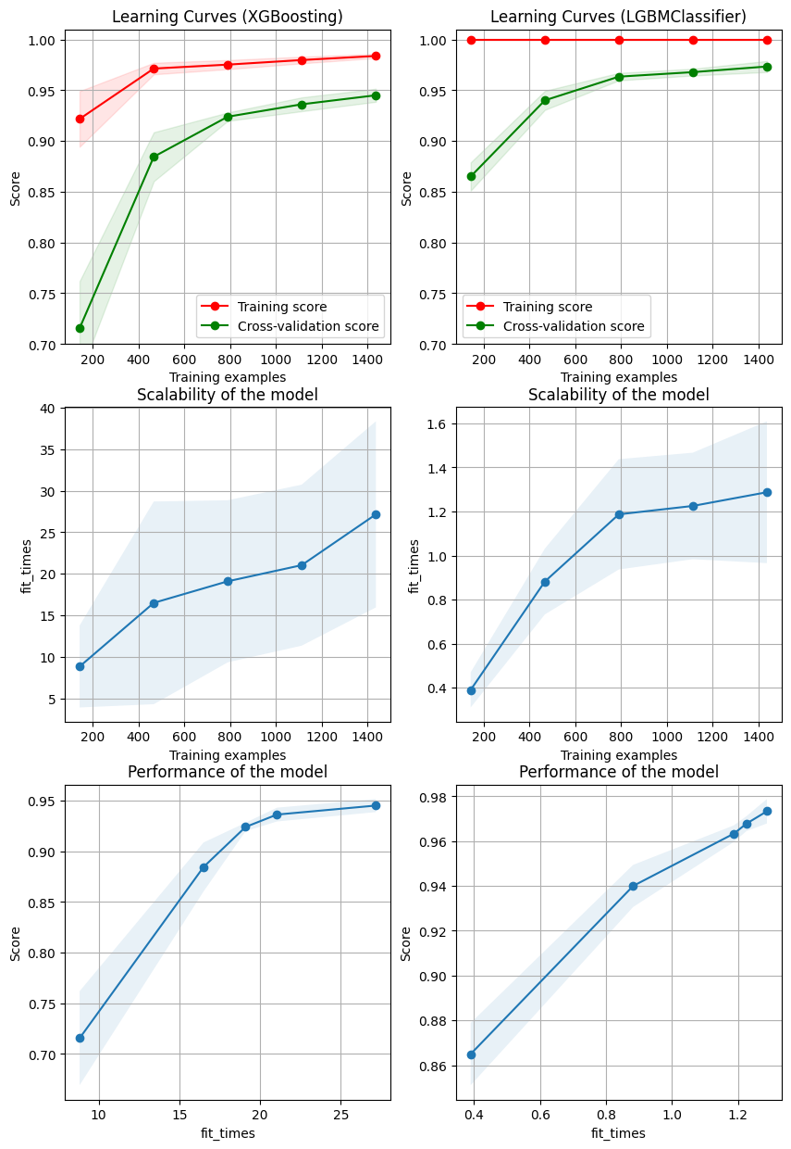
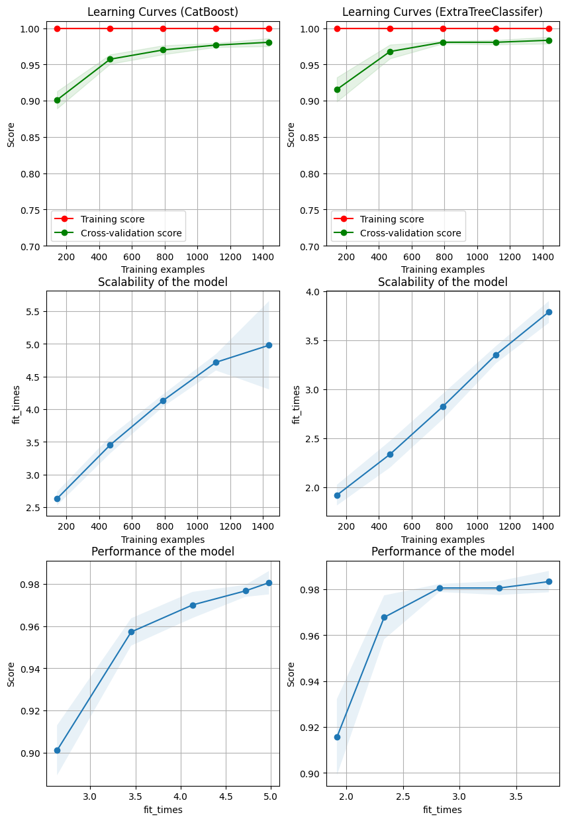
Models Comparison

Slide 17
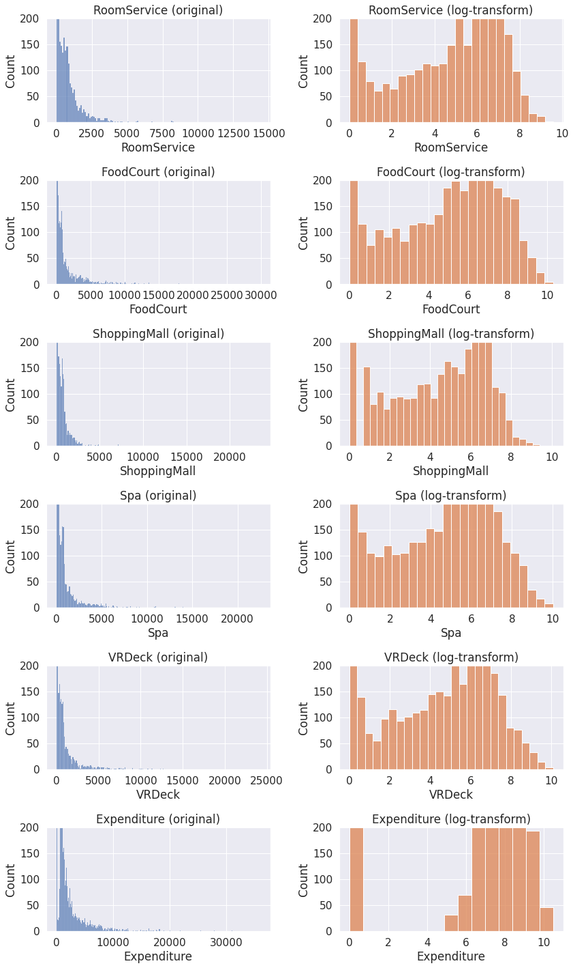
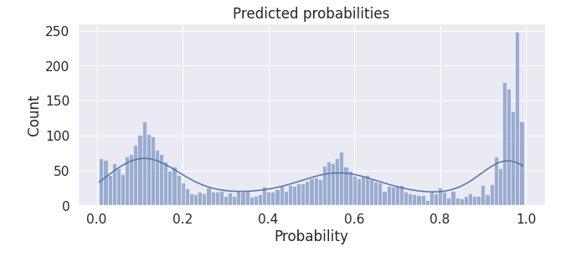
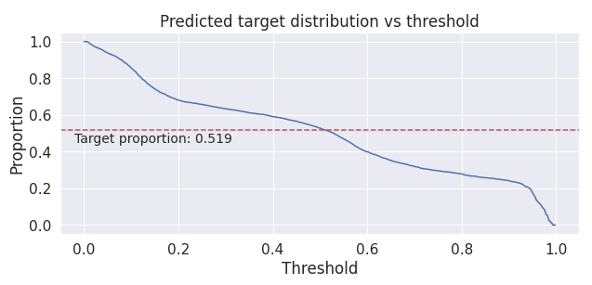
Other Kaggle Notebooks/ideas

Slide 18

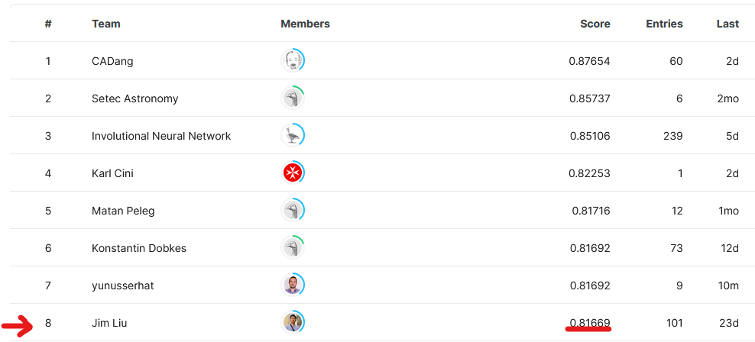
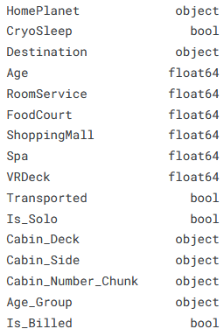
Other Kaggle Notebooks/ideas

Slide 19
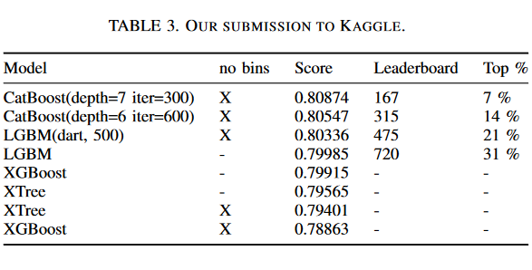
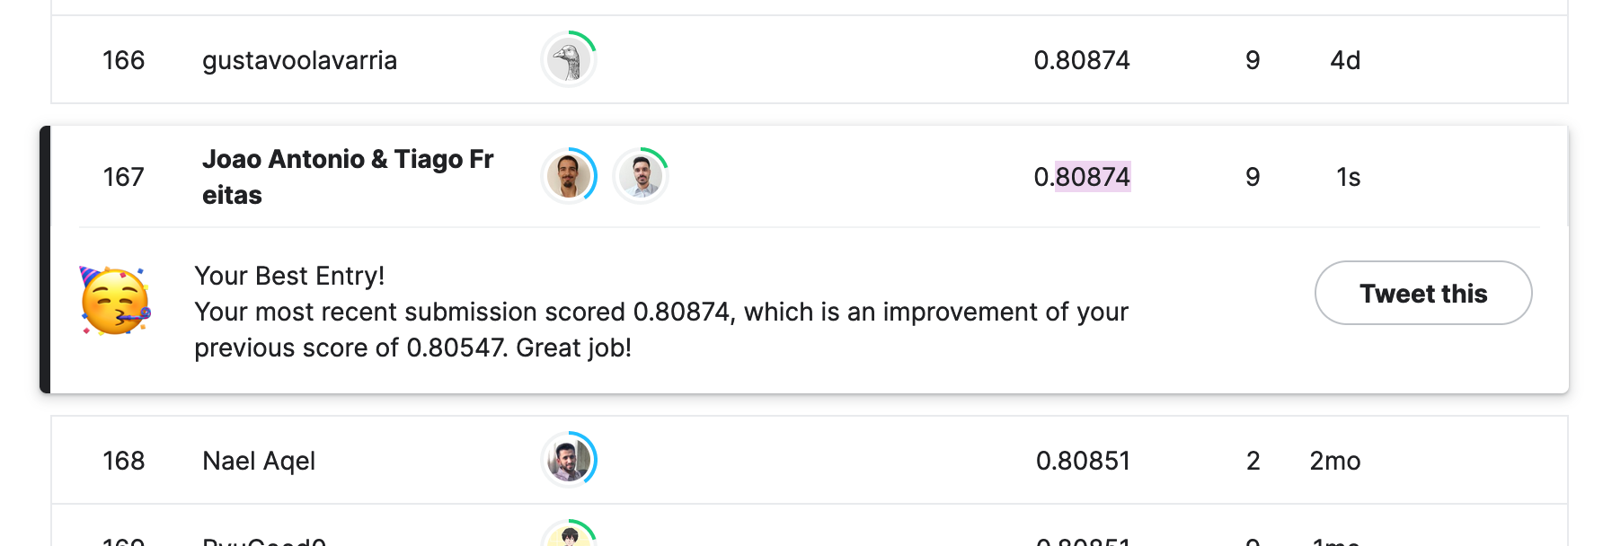
Kaggle Submission

Slide 20
Conclusions
+ Feature engineering
- Lazy Predict
+Hyper parameter search
The top 7% was a boost of motivation
Pipelines and not so clean data, with extra information encoded in the initial features was interesting.

