Slide 1


Bruno Oliveira - 113663 João Bastos - 113470
Train APP
HCI - Assignment 1
2024/2025

Slide 2
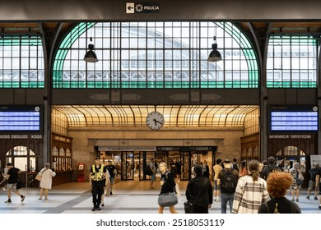
The problem
Contextualization:
Problem: repetitive payments, lack of event alerts, lack of clear information
Who: Relevant to majority of people
Currently: CP app with an average
review score of 2.5 stars.
Why this project:
- Personal use and experience

Slide 3

Objectives
Redesign the CP app to make it intuitive, proactive and adaptable to critical situations (e.g. delays, cancellations).
Users will have an easier way to deal with train events, unexpected delays, and/or manage their tickets

Slide 4
Competitor analysis
National train company: Comboios de Portugal
Offer a similar app, but lacks information

Slide 5






Competitor - Heuristic Evaluation
 | Heuristic | Issue | Bruno | João
Issue 1 | Visibility of System Status | App does not open in an option menu |  | 2
Issue 2 | Match Between System & Real World | No labels of the meaning of train types (AP,IC,R,U) |  | 2
Issue 3 | Recognition Rather Than Recall | When buying a ticket with green pass, they always have to insert with no option of saving it |  | 3
Issue 4 | Flexibility and Efficiency Use | Shortcut to immediately see the next trains on your most used station |  | 2
Issue 5 | Help Users Recognize, Diagnose, and Recover from Errors | No warnings about train strikes which impact when trying to buy a ticket |  | 3
Issue 6 | Help and Documentation | Help button shows in bottom corner and only shows when we select a ticket and it's little information |  | 3

Slide 6
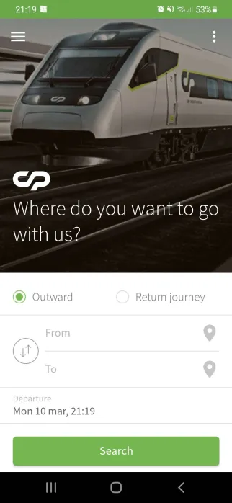
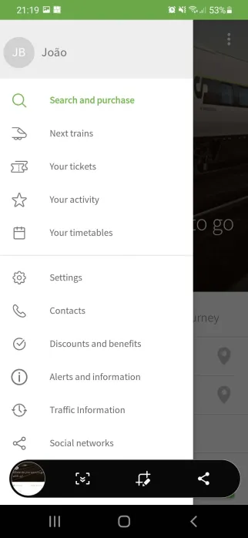
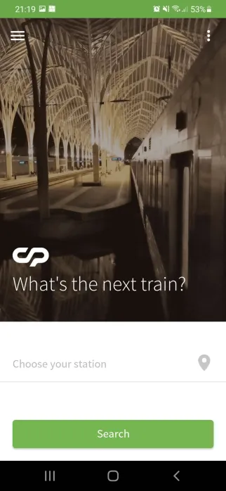
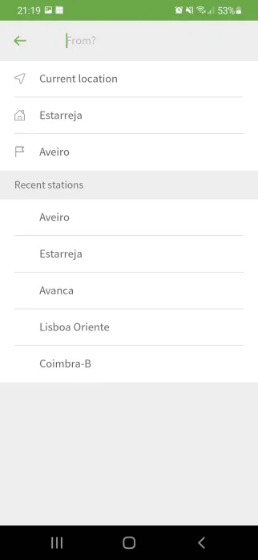
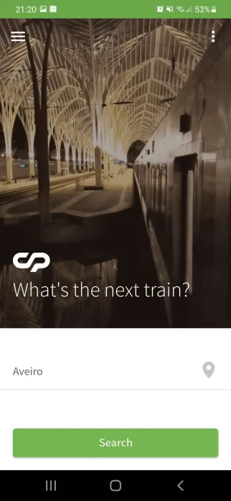
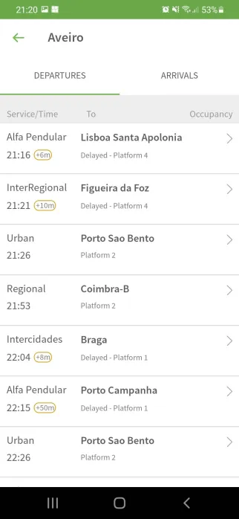
Issue 4 - Shortcut to immediately see the next trains on your most used station

Slide 7
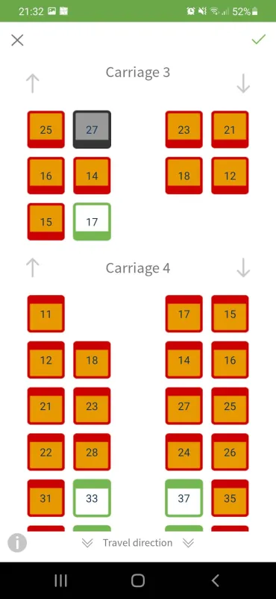
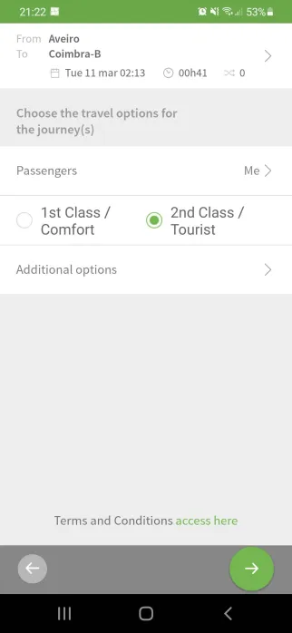
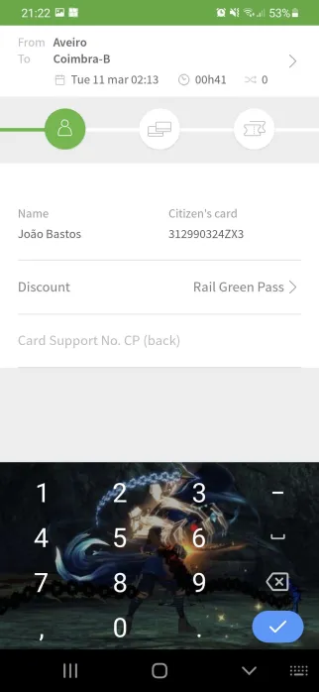
Issue 6 - Help button shows in bottom corner and only shows when we select a ticket and it's little information

Slide 8
Competitor - Cognitive Walkthrough
Subtasks | Will the user know what to do at this step? |  | If the user does the right thing, will they know that they did the right thing, and are making progress towards their goal?
 | Yes | No | Yes | No
Choose destination | X |  | X
Choose a Train | X |  | X
Choose a seat |  | X |  | X

Slide 9
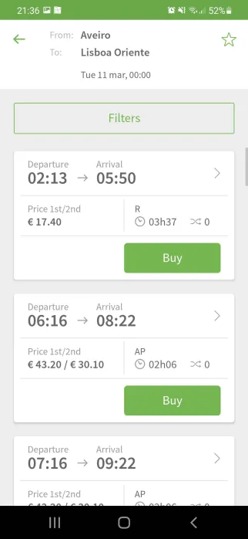
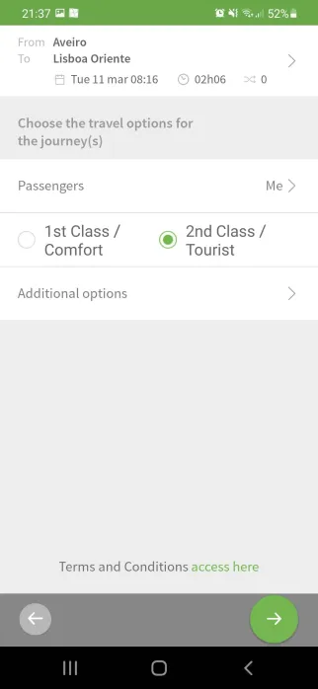
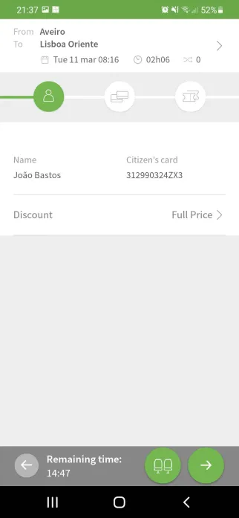
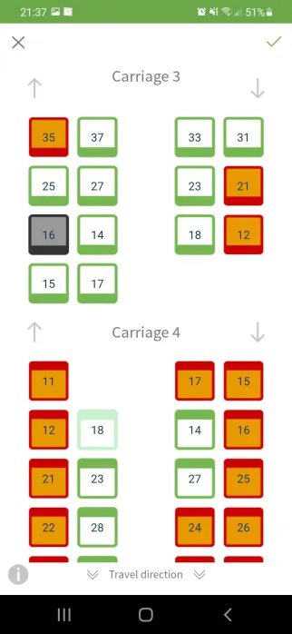
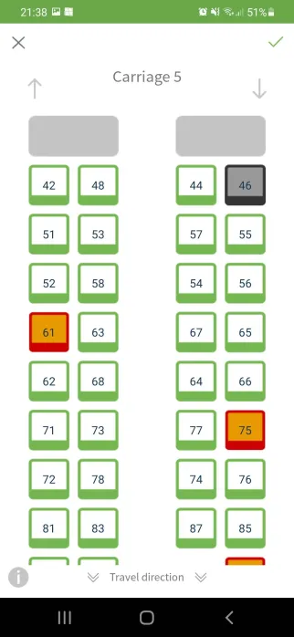
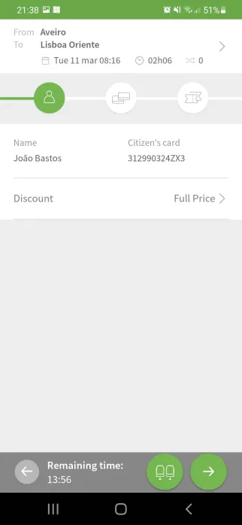
Competitor - Cognitive Walkthrough
?

Slide 10

Understanding Users - Interviews
6 Interviews.
Usage: Daily commutes, occasional trips.
Tasks: Checking schedules, purchasing/cancelling tickets.
Frustrations: Lack of useful info, inefficient payment process.
Needs: Real-time alerts, intuitive interface, information persistance.

Slide 11

Personas
Name: Marcos Silva
Occupation: Engineering Student
Background: Regular commuter who relies on the app for daily planning.
Motivations: "I want to open the app, get quick updates and complete my tasks with minimal hassle."
Goals/Needs: Simplified, on-the-go features with real-time delay alerts and payment saving options.

Slide 12

Personas
Name: Ana Rodrigues
Occupation: Administrative Assistant
Background: Occasional commuter, less tech-savvy and appreciates detailed guidance.
Motivations: "I need an app that's easy to learn, with clear instructions and all the necessary info for smooth travel."
Goals/Needs: Intuitive interface with well-explained information and easy navigation to prevent forgetting steps.

Slide 13
Context of use
Marcos lives in Lisbon and depends on the train to get to university and his internship on time.
On a typical morning, while you're still at home, he opens the CP app to check the times and confirm the departure platform. The solution sends a real-time notification that informs you of a platform change due to a delay. This information allows Marcos to adjust his departure time without rushing and avoid unnecessary rush.
During the journey, Marcos can see precise updates on the app, stops he has already passed, those he will still pass and the respective estimated arrival times, reinforcing Marcos' confidence in the journey.
Additionally, a streamlined payment flow allows you to save your preferred methods, eliminating the need to re-enter data for each trip.

Slide 14
Requirements
Functional requirements
Visualizar horários e a sua plataforma de partida Notificar o utilizador de atrasos ou alteração de plataforma Poder ver o trajeto do comboio em tempo real Guardar dados de pagamento para futuras compras
Non-functional requirements
Interface intuitiva com informações claras

Slide 15
Possible tools

Slide 16
Group assesment
Work worth
Member’s effort
Bruno: 50%
João: 50%

