Slide 1

Java Nextbot
João Bastos – 113470 TP-1

Slide 2
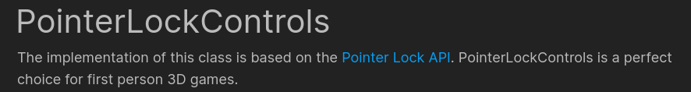
First Person system
URL: https://joaobastos023.github.io/javanextbot/scene.html

Slide 3
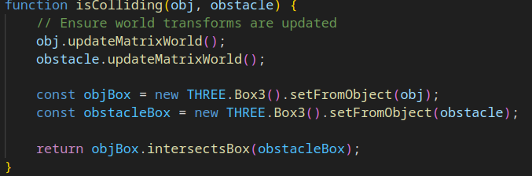
Collision
URL: https://joaobastos023.github.io/javanextbot/scene.html

Slide 4
DEMO
URL: https://joaobastos023.github.io/javanextbot/scene.html

