Slide 1


Interaction using speech
Multimodal Interaction - Assignment 2
University of Aveiro
Department of Electronics, Telecommunications and Informatics
João Borges (98155), Ana Rosa (98678)

Slide 2
Applications
Shell Shockers Game:
The world's best multiplayer egg shooter. Through voice interaction there is no need to waste time with the keyboard and mouse to play.
Elearning Project:
The electronic platform that supports distance learning at the University of Aveiro (UA) is Moodle. This platform is intended to support all the Curricular Units of the courses taught at the UA.

Slide 3


Framework and software Used
Console C# Application:
The information sent by the mmi service is then taken care by a c sharp application, that uses also input simulator packages so that we can interact with some of the website features
Selenium:
Selenium was used so that we could interact with our website. It became unusable in the shell shockers website because of cheating (automation) protection.

Slide 4
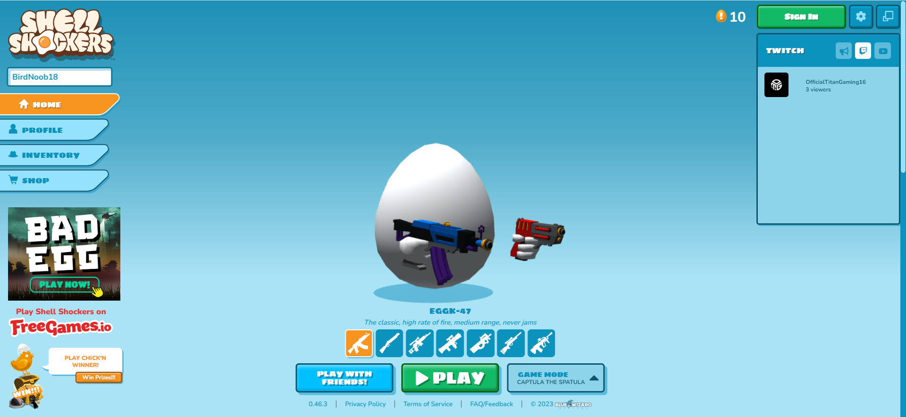
Home Page

Slide 5
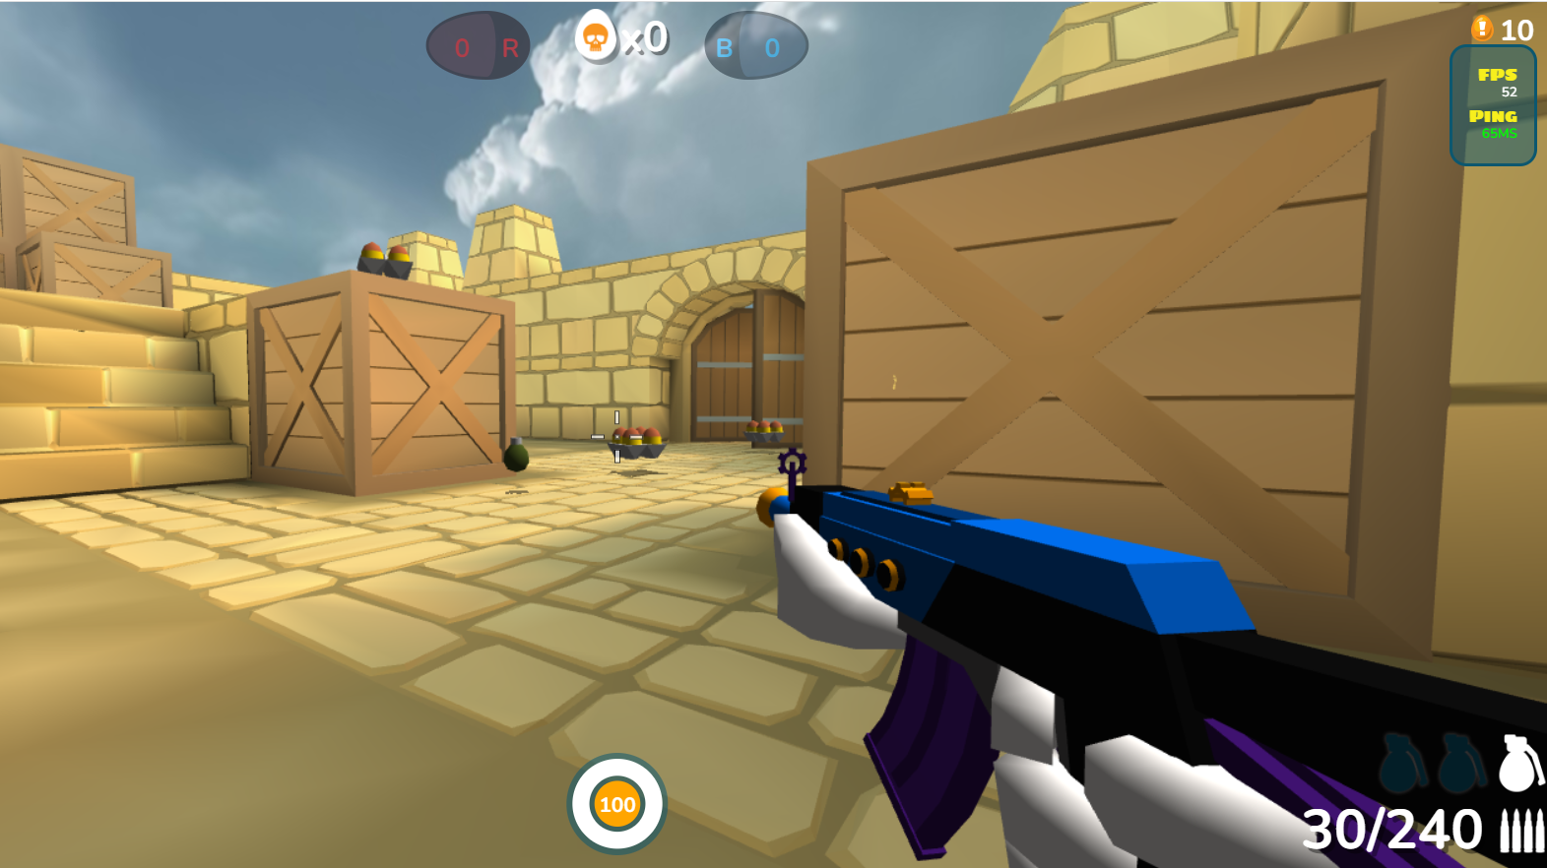
Gameplay Screen

Slide 6

Features Game Project
Open Game Website
Close Game Website
Move
Shoot
Grenade
Jump
Look
Aim
Change gun
Melee

Slide 7
Features Elearning Project
Open Elearning Website
Close Elearning Website
Authentication
Data authentication (studentnmec)
See notifications
Close notifications
See my events
Schecule event
Date new event (name; day; month; year)
Time new event (hour; minutes)
Confirm event
Unconfirm event
Log out

Slide 8
Speech Interaction (Some examples)
Elearning Project:
To help you know what to do with your voice (e.g when asking the authentication data)
Ask if we want to confirm the functionality (e.g when creating a new event)
Gives confirmation feedback (e.g when we logged in and got into the account)

Slide 9
Participation
João Borges – 50%
Ana Rosa – 50%

