Slide 1
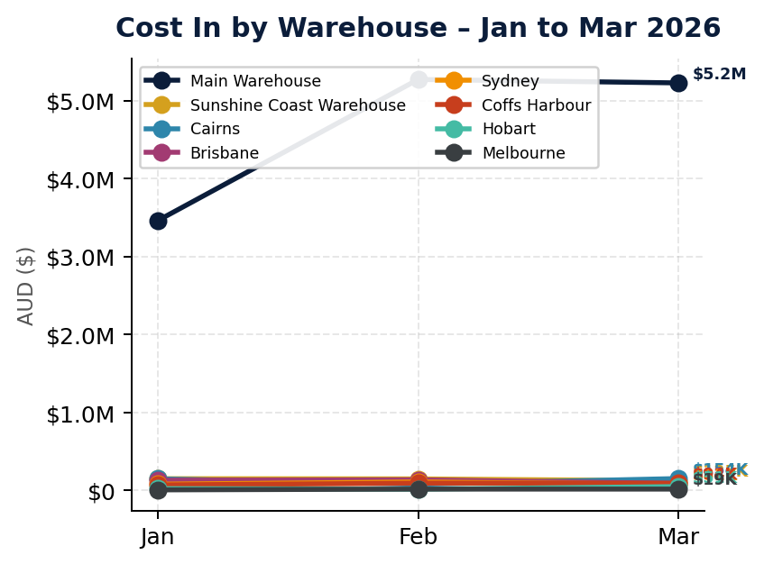
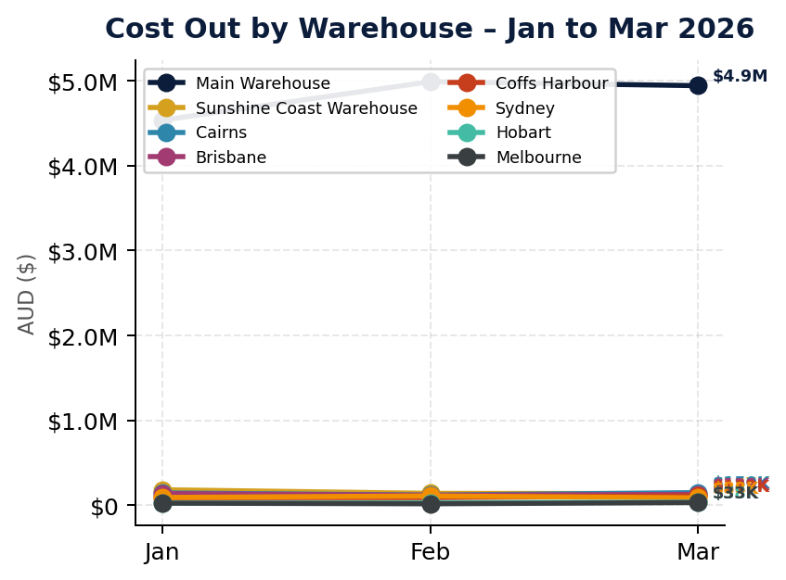

Warehouse Cost In vs Cost Out – Per Location | Q1 2026
Source: Cin7 Inventory Movement Details Report | Includes Purchase, Sale, StockTransfer, StockTake movements

Slide 2
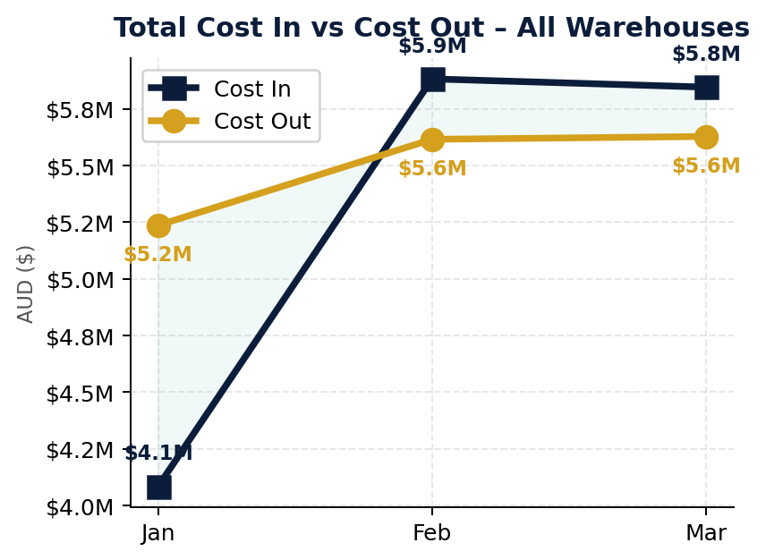
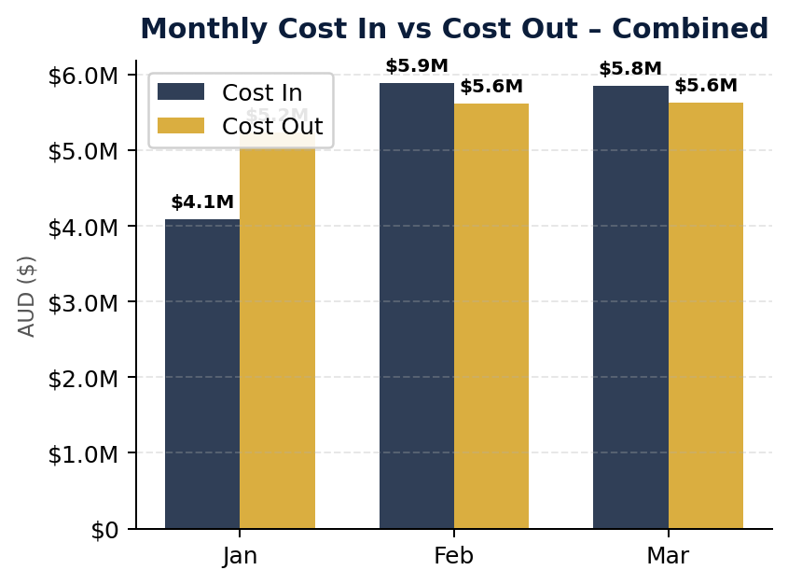
All Warehouses Combined – Cost In vs Cost Out | Q1 2026
Cost In = Purchases + Returns + Transfers In | Cost Out = Sales + Transfers Out | All 8 warehouses aggregated

