Slide 1
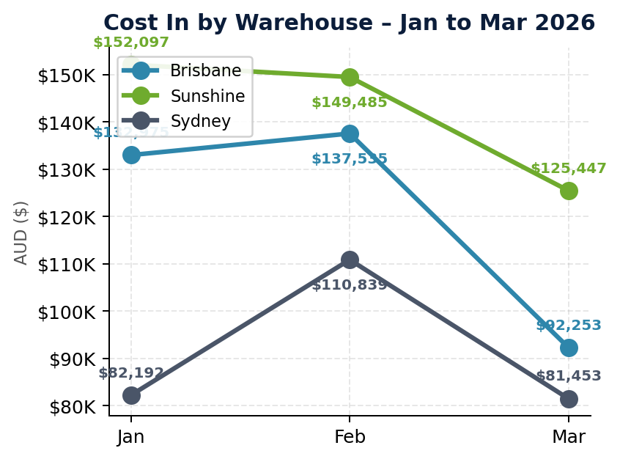
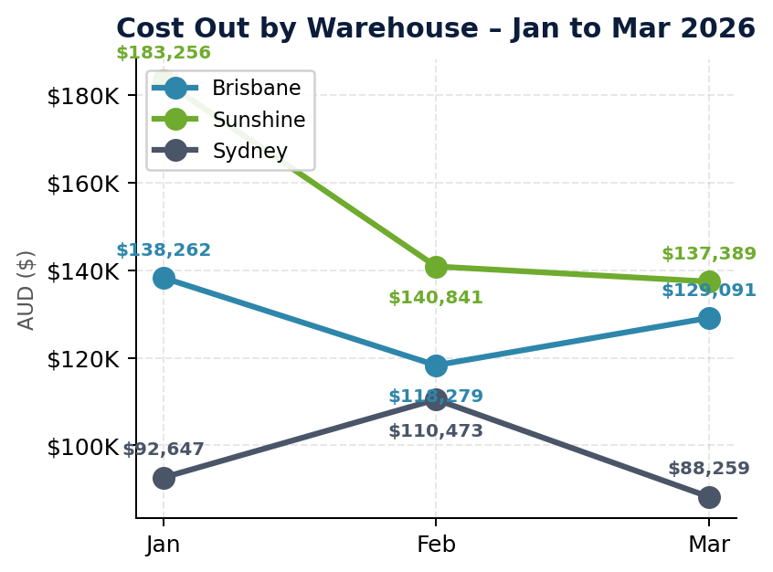

Branch Cost In vs Cost Out | Brisbane · Sunshine Coast · Sydney | Q1 2026
Source: Cin7 Inventory Movement Details Report | Includes Purchase, Sale, StockTransfer, StockTake movements

Slide 2
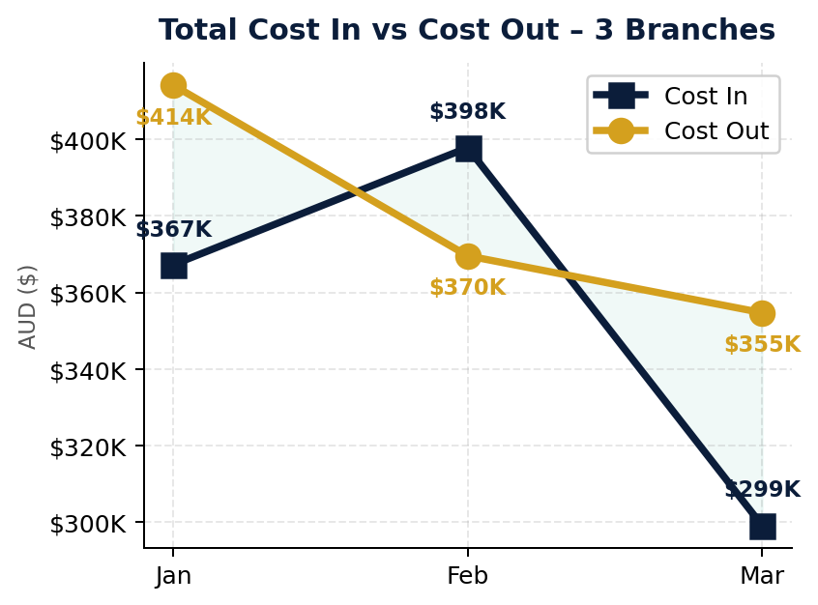
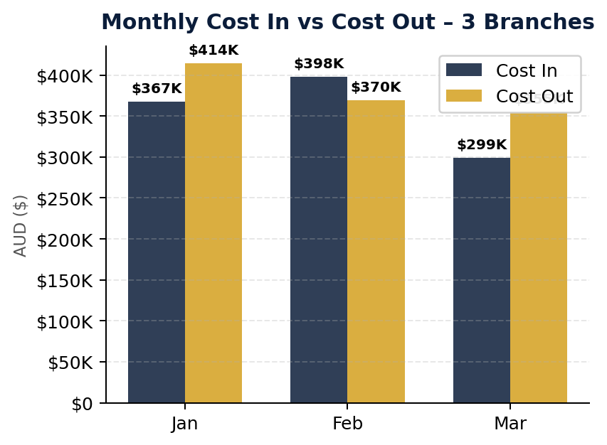
3 Branches Combined – Cost In vs Cost Out | Q1 2026
Cost In = Purchases + Returns + Transfers In | Cost Out = Sales + Transfers Out | Brisbane + Sunshine Coast + Sydney

