Slide 1

Warehouse Cost Report
Cost In & Cost Out Evolution | Q1 2026 (Jan – Mar)
Generated: 13 April 2026

Slide 2
Q1 2026 – Key Metrics Overview
$15.8M
Total Cost In (Q1)
Jan→Mar: +43.1%
$16.5M
Total Cost Out (Q1)
Jan→Mar: +7.5%
-667,388
Net Inventory Change ($)
1,420,573
Total Units In
1,438,931
Total Units Out
8
Active Warehouses

Slide 3
Overview
Total Cost In vs Cost Out | All Warehouses Combined

Slide 4
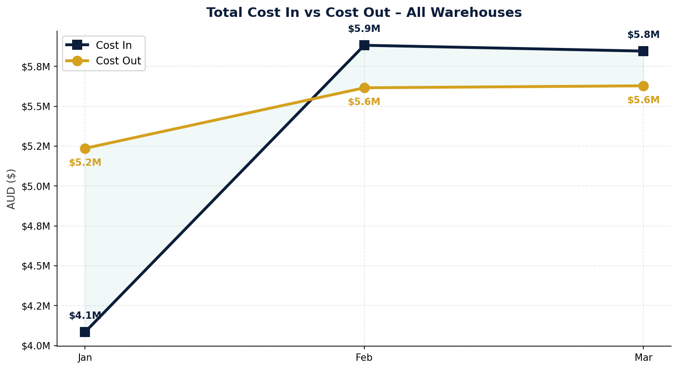
Total Cost In vs Cost Out – Q1 2026
Cost In = Purchases + Returns + Transfers In | Cost Out = Sales + Transfers Out

Slide 5
Cost In
Stock received into warehouses | Purchases, Transfers In, Returns

Slide 6
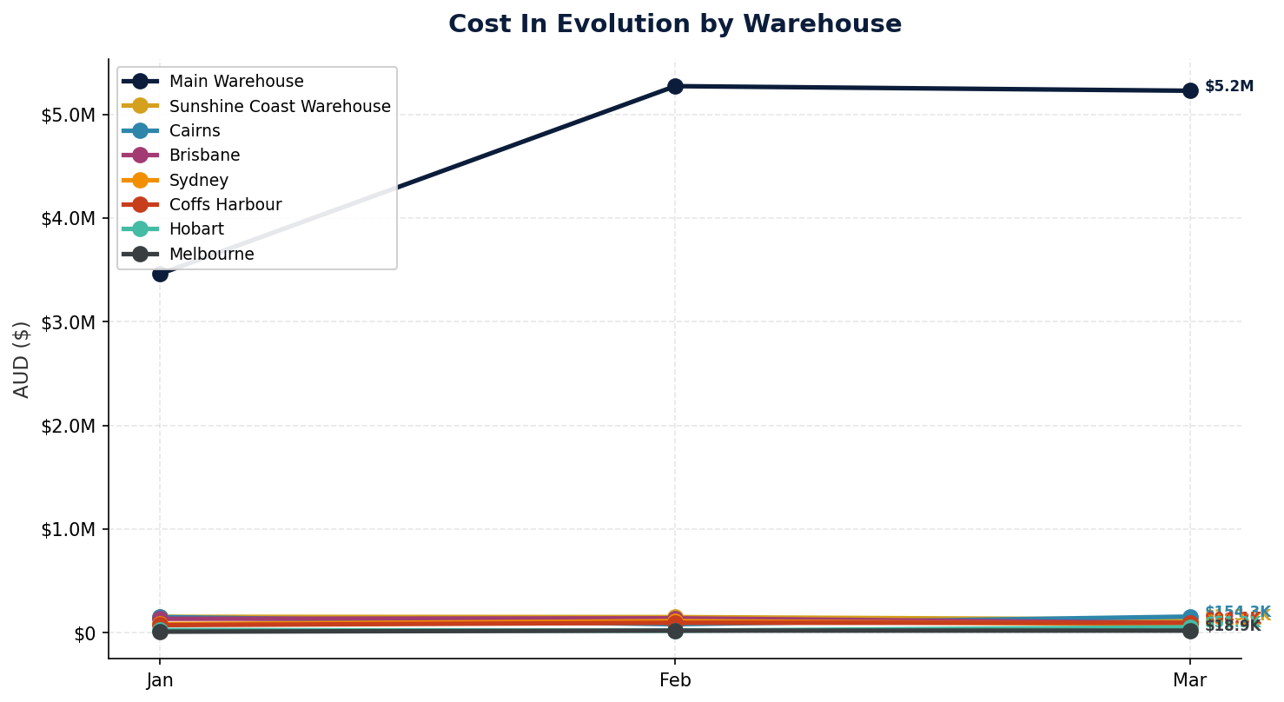
Cost In – Evolution by Warehouse
Source: Cin7 Inventory Movement Details Report | Top 8 warehouses by total cost in

Slide 7
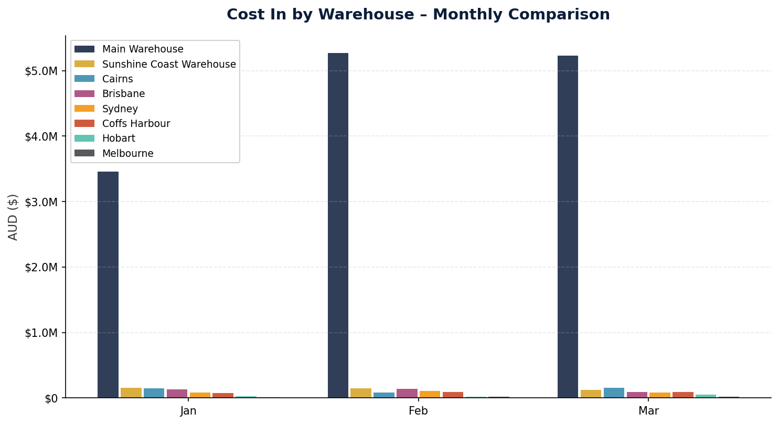
Cost In – Monthly Comparison

Slide 8
Cost Out
Stock dispatched from warehouses | Sales, Transfers Out

Slide 9
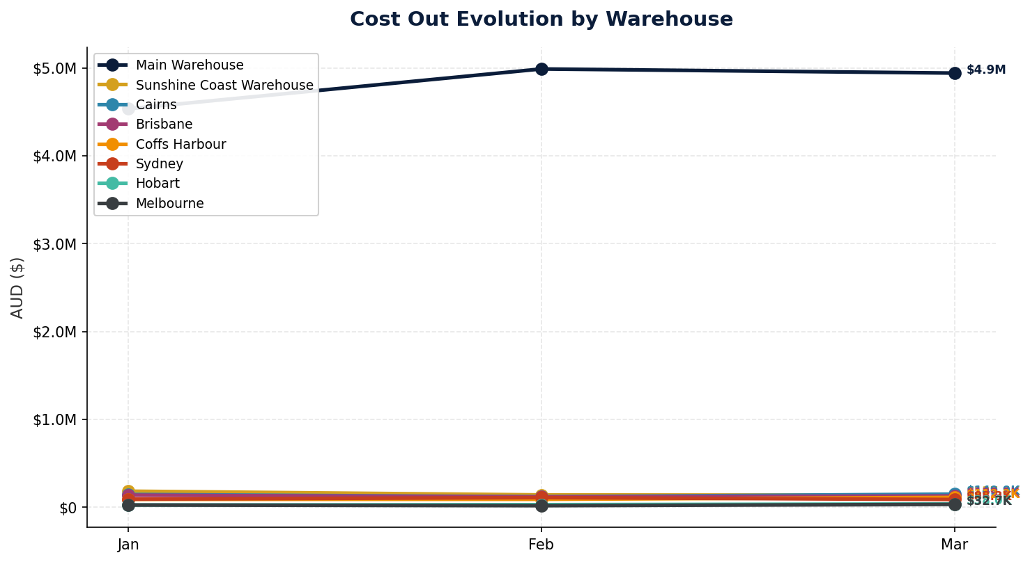
Cost Out – Evolution by Warehouse
Source: Cin7 Inventory Movement Details Report | Top 8 warehouses by total cost out

Slide 10
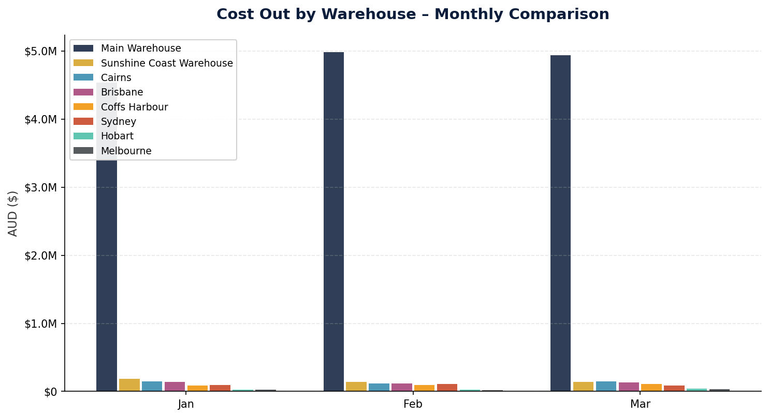
Cost Out – Monthly Comparison

Slide 11
Net Flow
Cost In minus Cost Out | Positive = net stock accumulation

Slide 12
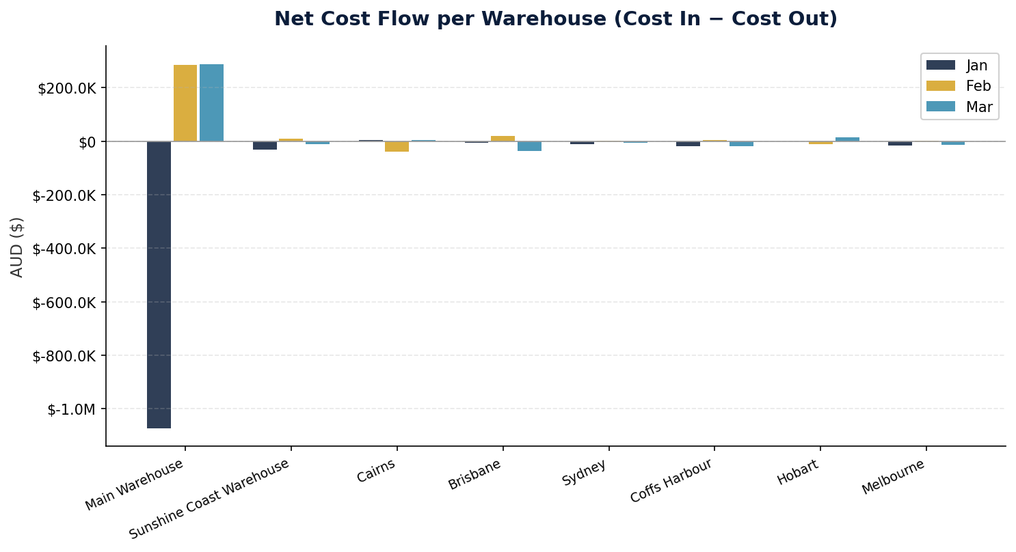
Net Cost Flow per Warehouse
Positive values indicate net stock increase in value. Main Warehouse negative net = primary distribution hub.

Slide 13
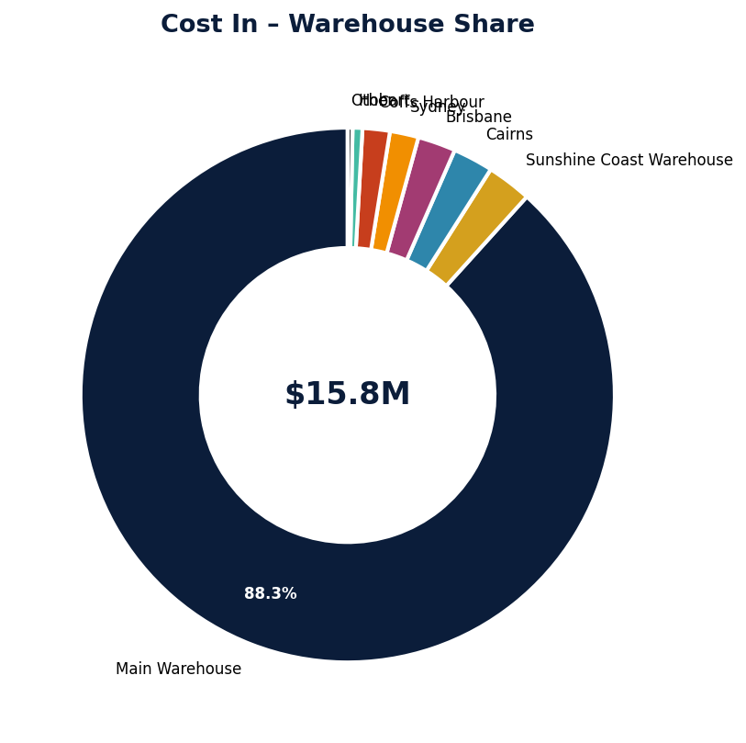
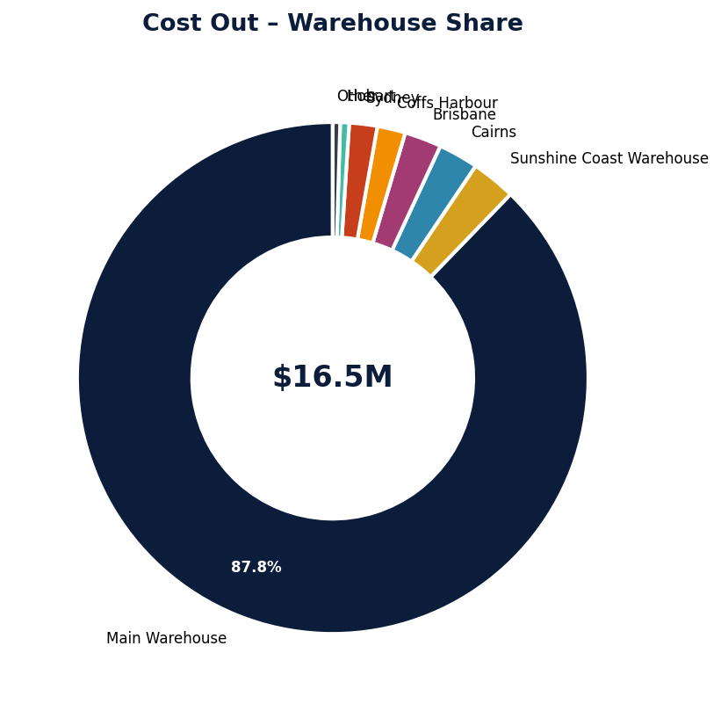
Warehouse Share – Cost In vs Cost Out
Proportional share of each warehouse in total Q1 cost flows.

Slide 14
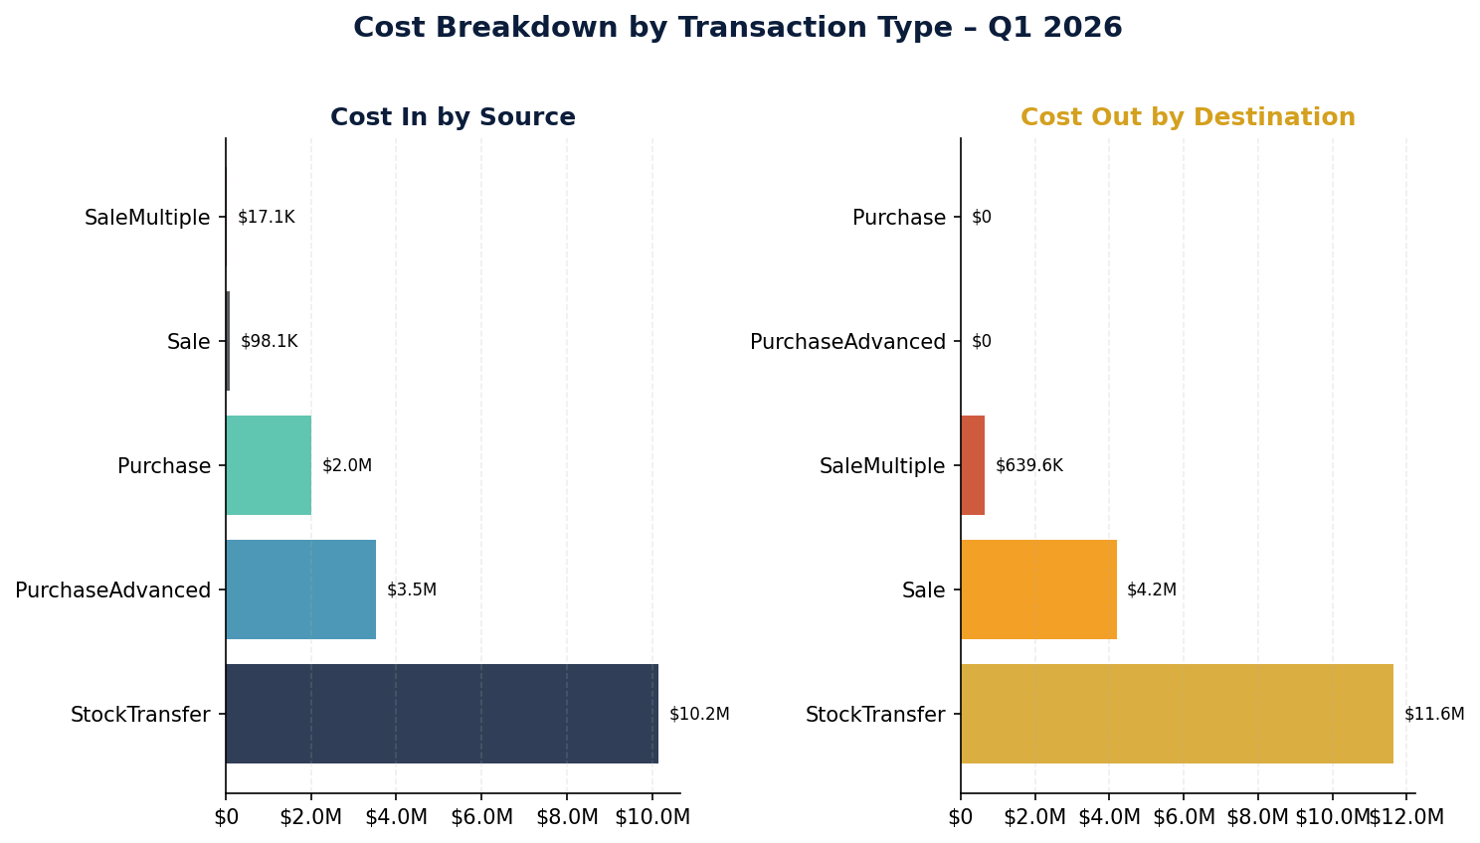
Cost Breakdown by Transaction Type
Reference types: Purchase, PurchaseAdvanced (multi-line POs), Sale, SaleMultiple, StockTransfer, StockTake

Slide 15
Cost In – Detailed by Warehouse
Warehouse | Jan 2026 | Feb 2026 | Mar 2026 | Q1 Total | Jan→Mar
Main Warehouse | $3,461,749.38 | $5,272,292.07 | $5,227,790.63 | $13,961,832.08 | +51.0%
Sunshine Coast Warehouse | $152,097.25 | $149,484.87 | $125,446.56 | $427,028.67 | -17.5%
Cairns | $150,251.56 | $80,431.82 | $154,276.86 | $384,960.24 | +2.7%
Brisbane | $132,974.87 | $137,535.14 | $92,252.76 | $362,762.76 | -30.6%
Sydney | $82,191.61 | $110,839.06 | $81,452.76 | $274,483.44 | -0.9%
Coffs Harbour | $72,030.28 | $94,643.91 | $94,113.66 | $260,787.84 | +30.7%
Hobart | $24,419.43 | $17,838.10 | $51,331.67 | $93,589.20 | +110.2%
Melbourne | $8,892.77 | $18,901.22 | $18,899.40 | $46,693.39 | +112.5%

Slide 16
Cost Out – Detailed by Warehouse
Warehouse | Jan 2026 | Feb 2026 | Mar 2026 | Q1 Total | Jan→Mar
Main Warehouse | $4,534,133.90 | $4,987,136.20 | $4,940,314.22 | $14,461,584.31 | +9.0%
Sunshine Coast Warehouse | $183,256.21 | $140,841.42 | $137,388.59 | $461,486.23 | -25.0%
Cairns | $146,112.45 | $120,088.33 | $149,882.44 | $416,083.22 | +2.6%
Brisbane | $138,262.29 | $118,278.83 | $129,091.46 | $385,632.58 | -6.6%
Sydney | $92,646.61 | $110,473.17 | $88,258.77 | $291,378.55 | -4.7%
Coffs Harbour | $90,305.20 | $90,768.34 | $112,272.63 | $293,346.17 | +24.3%
Hobart | $25,661.45 | $29,576.69 | $38,030.76 | $93,268.90 | +48.2%
Melbourne | $25,804.68 | $18,252.58 | $32,688.79 | $76,746.05 | +26.7%

Slide 17
Cost by Warehouse & Transaction Type
Warehouse | Type | Cost In | Cost Out | Net
Main Warehouse | Purchase | $1,771,195.23 | $0.00 | $1,771,195.23
Main Warehouse | PurchaseAdvanced | $3,173,055.16 | $0.00 | $3,173,055.16
Main Warehouse | Sale | $22,834.65 | $2,541,273.46 | $-2,518,438.81
Main Warehouse | SaleMultiple | $4,050.73 | $433,275.25 | $-429,224.52
Main Warehouse | StockTransfer | $8,990,696.30 | $11,487,035.60 | $-2,496,339.30
Sunshine Coast Warehouse | Purchase | $46,560.23 | $0.00 | $46,560.23
Sunshine Coast Warehouse | PurchaseAdvanced | $79,872.36 | $0.00 | $79,872.36
Sunshine Coast Warehouse | Sale | $19,458.94 | $363,892.21 | $-344,433.27
Sunshine Coast Warehouse | SaleMultiple | $3,272.83 | $56,333.96 | $-53,061.12
Sunshine Coast Warehouse | StockTransfer | $277,864.31 | $41,260.06 | $236,604.25
Cairns | Purchase | $53,307.12 | $0.00 | $53,307.12
Cairns | PurchaseAdvanced | $193,458.37 | $0.00 | $193,458.37
Cairns | Sale | $9,160.47 | $361,563.84 | $-352,403.37
Cairns | SaleMultiple | $619.47 | $47,293.50 | $-46,674.02
Cairns | StockTransfer | $128,414.80 | $7,225.89 | $121,188.91

