Slide 1
ensemble learning
Carlos Soares
(based on materials kindly provided by João Mendes Moreira)

Slide 2
plan & goals
introduction
categories of methods
popular methods
issues
understand the basic principles of ensemble learning
understand the intuition and high-level algorithm of some of the most common ensemble methods

Slide 3
definition
multiple models
base models
… each of them obtained by applying a learning process to a given problem
e.g. same algorithm applied to different samples of the data
… combined to make a single prediction
e.g. in classification, each model makes a prediction
… then combined to obtain the final prediction of the ensemble

Slide 4
intuition
aggregation of multiple learned models with the goal of improving model quality
e.g. expert panel in a human decision-making process
… or the popular concept of “the wisdom of the crowds”

Slide 5
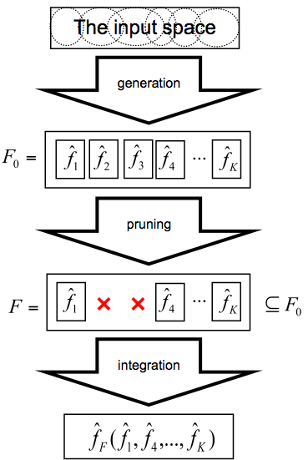
ensemble learning process
[optional]

Slide 6
discussion
why should ensemble methods work?
[even better, when...?]
what’s the catch?

Slide 7
pros & cons
+
-
accuracy
majority compensates for individual errors
diversity is key
individual models specialize in different areas of the data space
how?
... but must be reasonably accurate
... and by “reasonable” we mean...?
complexity
understanding the global model
explaining decisions
computational
remember Occam’s Razor
simplicity leads to greater accuracy
identifying the best model requires identifying the proper "model complexity"

Slide 8
gps
introduction
categories of methods
homogeneous
popular methods
issues

Slide 9
ensembles methods for...
classification
regression
clustering
aka consensual clustering
label ranking
…
anything, really
our focus

Slide 10
types of ensembles: how to generate models
homogeneous
single induction algorithm
heterogeneous
multiple induction algorithms
where does diversity come from?
our focus

Slide 11
types of ensembles: how to combine models
regression
classification
average
weighted average
sum
weighted sum
product
maximum
minimum
median
majority voting
weighted majority voting
borda count
base models rank candidates in order of preference
e.g. remember scoring?
points assigned to each position
prediction is class with more points

Slide 12
homogeneous ensembles: how to generate different models?
fixed
Induction algorithm
Training
Parameter set
Training Examples
Model
Data manipulation
training set
Modeling process manipulation
induction algorithm
parameter set
model
uncommon

Slide 13
data manipulation
Manipulating the input features
Sub-sampling from the training set
Ratings, Actors
Classifier A
Actors, Genres
Classifier B
Predictions
Genres, Ratings
Classifier C
Training set
Classifier A
Classifier B
Predictions
Classifier C
Training set

Slide 14
modeling process manipulation
Manipulating the parameter sets
Manipulating the induction algorithm
algorithm(x1,y1)
Classifier A
algorithm(x2,y2)
Classifier B
Predictions
algorithm(x3,y3)
Classifier C
Training set
algorithm
Classifier A
algorithm’
Classifier B
Predictions
algorithm’’
Classifier C
Training set
still homogeneous: algorithm’ and algorithm’’ are variations of algorithm

Slide 15
gps
introduction
categories of methods
popular methods
bagging
boosting
random forest
negative correlation
issues

Slide 16
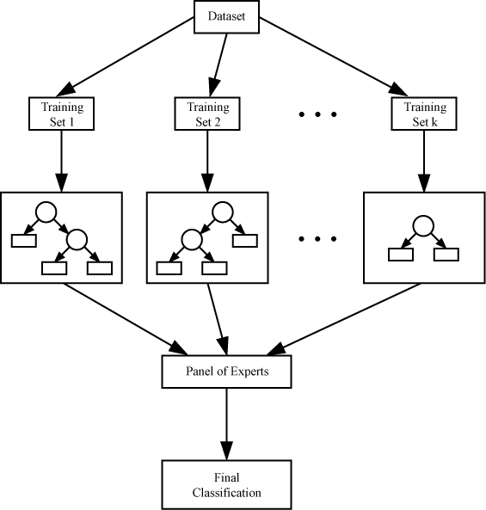
bagging: Bootstrap AGGregatING
diagnosis analogy
diagnosis based on the majority vote of multiple doctors
trained in slightly different contexts
training
given a set D of d tuples
at each iteration i
training set D_{i} of d tuples is sampled with replacement from D
i.e. bootstrap
model M_{i} is learned for training set D_{i}
prediction
given an observation X
for each classifier M_{i}
make a prediction
an aggregation of the predictions is the prediction of the bagged model M* for X
http://en.wikibooks.org/wiki/File:DTE_Bagging.png
Breiman, L. (1996). Bagging predictors. Machine Learning, 24(2), 123–140. https://doi.org/10.1007/BF00058655

Slide 17
bagging
accuracy
often significantly better than a single classifier derived from D
robust to noise
… if classifier is unstable!
unstable means a small change to the training data may lead to major decision changes
decision trees
neural networks
Notes:
Originally rejected (journal of statistics). Can also create multiple NN using different random initial weights for diversity. Another bagging technique?

Slide 18
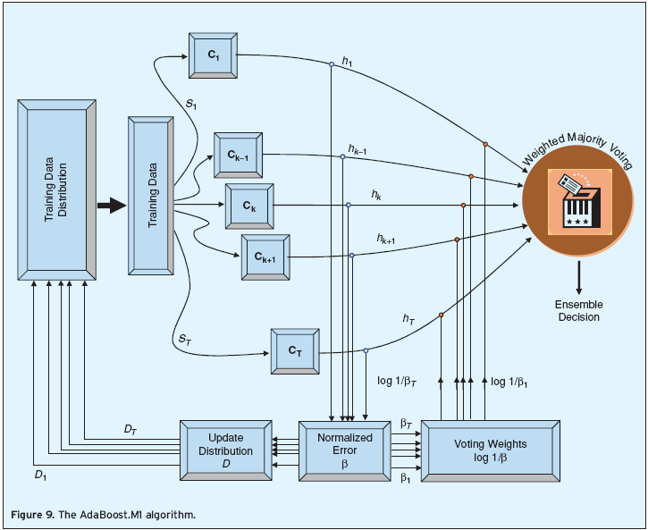
boosting
training
equal weights are assigned to each training example
learn model M₁
learn additional k-1 models
give more weight to the examples that were incorrectly predicted by M_{i}
learn model M_{i+1}
prediction
given an observation X
for each classifier M_{i}
make a prediction
an aggregation of the predictions is the prediction of the bagged model M* for X
the weight of each classifier's vote is a function of its accuracy
Freund, Y., & Schapire, R. E. (1997). A Decision-Theoretic Generalization of On-Line Learning and an Application to Boosting. Journal of Computer and System Sciences, 55(1), 119–139. https://doi.org/10.1006/jcss.1997.1504
Notes:
source of figure?

Slide 19
boosting: discussion
boosting vs. bagging
differences
independent sampling vs. error-dependent sampling
uniform aggregation vs. weighted aggregation
… so
boosting tends to achieve greater accuracy
… but it also risks overfitting the model to misclassified data

Slide 20
random forest
training
learn k models
… with changed algorithm
at each split
randomly select a subset of the original features during the process of tree generation
prediction
given an observation X
for each classifier M_{i}
make a prediction
an aggregation of the predictions is the prediction of the bagged model M* for X
Breiman, L. (2001). Random Forests. Machine Learning, 45(1), 5–32. https://doi.org/10.1023/A:1010933404324

Slide 21
random forest: discussion
RF vs adaboost
comparable in accuracy
more robust to errors and
… outliers
… vs bagging and adaboost
RF is insensitive to the number of attributes selected for consideration at each split and
faster

Slide 22
negative correlation learning
training
learn k models
… with changed algorithm
trained to minimize the error function of the ensemble
i.e., it adds to the error function a penalty term with the average error of the models already trained
prediction
given an observation X
for each classifier M_{i}
make a prediction
an aggregation of the predictions is the prediction of the bagged model M* for X
Notes:
source of figure?

Slide 23
negative correlation learning: discussion
only regression
algorithms that try to minimize/maximize a given objective function
e.g., neural networks, support vector regression
models negatively correlated with the averaged error of the previously generated models

Slide 24
popular ensemble methods: summary
bagging
base models: train algorithm on different bootstrap samples
prediction: average/majority
task: classification and regression
boosting
base models: sequence of training processes, with more weight given to instances incorrectly classified by previous model
prediction: weighted vote
task: classification
random forest
base models: train algorithm on different samples of attributes
prediction: average/majority
task: classification and regression
negative correlation learning
base models: sequence of training processes, with new models forced to be more negatively correlated with the existing ones
prediction: average
task: regression

Slide 25
gps
introduction
categories of methods
popular methods
issues

Slide 26
characteristics of the base models: classification
base classifiers should be as accurate as possible and
although there is “the strength of weak classifiers”
R.E. Schapire. 1990. The Strength of Weak Learnability. Mach. Learn. 5, 2 (July 1990), 197-227
having diverse errors
Brown, G. & Kuncheva, L., “Good” and “Bad” Diversity in Majority Vote Ensembles, Multiple Classifier Systems, Springer, 2010, 5997, 124-133

Slide 27
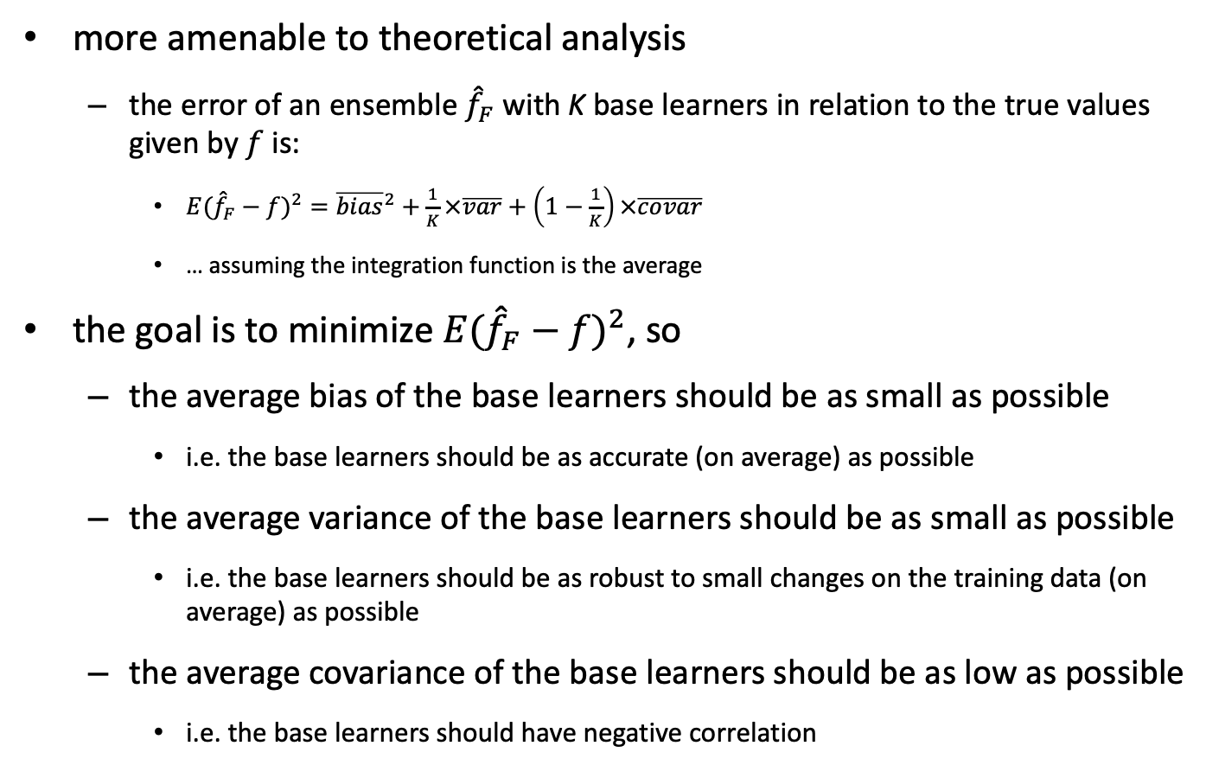
characteristics of the base models: regression
more amenable to theoretical analysis
the error of an ensemble ${\hat{f}}_{F}$ with K base learners in relation to the true values given by $f$is:
${E({\hat{f}}_{F}−f)}^{2}={\overline{bias}}^{2}+\frac{1}{K}×\overline{var}+\left(1−\frac{1}{K}\right)×\overline{covar}$
… assuming the integration function is the average
the goal is to minimize ${E({\hat{f}}_{F}−f)}^{2}$, so
the average bias of the base learners should be as small as possible
i.e. the base learners should be as accurate (on average) as possible
the average variance of the base learners should be as small as possible
i.e. the base learners should be as robust to small changes on the training data (on average) as possible
the average covariance of the base learners should be as low as possible
i.e. the base learners should have negative correlation

Slide 28
summary
combination of multiple models
majority compensates for individual errors
individual models specialize in different areas of the data space
diversity is key
today
focused on homogeneous
but essentially applicable to heterogeneous ensembles
Notes:
TODO:

Slide 29
Introductory References
‘Data Mining: Practical Machine Learning Tools and Techniques with Java Implementations’, Ian H. Witten and Eibe Frank, 1999
‘Data Mining: Practical Machine Learning Tools and Techniques second edition’, Ian H. Witten and Eibe Frank, 2005
Todd Holloway, 2008, “Ensemble Learning Better Predictions Through Diversity”, power point presentation
Leandro M. Almeida, “Sistemas Baseados em Comitês de Classificadores”
Cong Li, 2009, “Machine Learning Basics 3. Ensemble Learning”
R. Polikar, “Ensemble based systems in decision making,” IEEE Circuits and Systems Magazine, vol. 6, no. 3, pp. 21–45, Quarter 2006.
João Mendes-Moreira, Carlos Soares, Alípio Jorge, Jorge Freire de Sousa, “Ensemble approaches for regression: a survey”, ACM Computing surveys, 45(1), article 10, 2012.

Slide 30
Core References
Wolpert, D. H., Stacked generalization, Neural Networks, 1992, 5, 241-259
Breiman, L., Bagging predictors, Machine Learning, 1996, 26, 123-140
Freund, Y. & Schapire, R., Experiments with a new boosting algorithm, International Conference on Machine Learning, 1996, 148-156
Breiman, L., Random forests, Machine Learning, 2001, 45, 5-32
Liu, Y. & Yao, X., Ensemble learning via negative correlation, Neural Networks, 1999, 12, 1399-1404
Rodríguez, J. J.; Kuncheva, L. I. & Alonso, C. J., Rotation forest: a new classifier ensemble, IEEE Transactions on Pattern Analysis and Machine Intelligence, 2006, 28, 1619-1630

