Slide 1
The Walt Disney Company’s Stock: Case 1 Analysis
Ana Barros
up201806593
Diogo Rosário
up201806582
João Cardoso
up201806531
João Costa
up201806560
Rúben Almeida
up201704618

Slide 2
Case study introduction
Crowley, a portfolio manager at Century 23, was monitoring the stock of one of her company’s major holdings: Disney’s stock.
During the last three years, Disney’s stock delivered a strong performance, outperforming its American media conglomerates competitors.
Now, Crowley has to decide whether to hold, buy more, or sell her companies Disney’s stock holdings. To do this, she needs to consider the expected future performance of Disney and its competitors, as there might be better options to consider investing in.

Slide 3
Investment Criteria
1
What key criteria should Crowley apply when making her investment decisions?

Slide 4
Criteria to follow
PEG Ratio Analysis
Perform a Short Term Financial Analysis
Cash Ratio
Perform a Long Term Financial Analysis:
Debt/Assets Ratio.

Slide 5
PEG Ratio Analysis
GARP Stocks—Investor Requirement:
Crowley wants its portfolio to follow a GARP phenomena;
“Promising GARP candidates tended to be those with PEG ratios below 1.0”;
Disney PEG Ratio:
2018: 0.29
2019: -1.07
Disney Average: -0.39
Main competitors’ Average: 2018 ⇒ 0.0; 2019 ⇒ 2.37; Avg. ⇒ 1.19;
Negative PEG ratio due to negative growth rate. Shouldn’t be considered a red flag since the growth’s hasn’t been consistently negative.
Conclusion: Disney stocks follows Crowley requirement.
Notes:
Main competitors: Netflix, Comcast, Viacom

Slide 6
Analyzing factors
2
What are the growth prospects, competitive position, and key success factors?

Slide 7
Growth prospects
“Millennials love theme parks”:
Younger generations (including without children) are driving an economic need for theme parks, an area where Disney dominates;
Theme parks are the single largest revenue source for Disney, and this trend indicates an increase in growth.
Entering the market of streaming services:
Disney sealed an agreement with Comcast to take full control over Hulu. Hulu has 27 million subscribers, and Disney will only pay for the deal after 2024;
Disney is launching Disney+. In contrast with Hulu, which is only available in the USA, this service is available globally;
Disney’s movies and IPs are a significant part of the content consumed in streaming services (e.g. Netflix). Disney can make use of exclusivity of new entries in their repertoire to bring new customers into their service.
Notes:
Disney’s theme parks account for 38% of the company’s revenue and 45% of the company’s operating income

Slide 8
Risks and opportunities
Risks:
Final movie in the “Avengers” series released (Avengers End-game): one of their most profitable IPs ended;
Downward market tendency for Television and Cinema: some of the biggest Disney’s revenue sources.
Opportunities:
Spin-offs from the “Avengers” series;
Acquisition of full control over Hulu;
Launching of Disney+ (November 2019);
The service is in direct competition with Netflix, but is significantly cheaper;
Purchase of Twenty-First Century Fox, Inc (TFCF) (March 2019).

Slide 9
Key success factors
Expansion of amusement parks:
The Highest Source of revenue. Positive future prospects.
Investment in streaming (acquisition of Hulu and creation of Disney+)
Capitalization of vast array of current Intellectual Properties:
E.g.: exclusivity of select content in Disney+.
Acquisition of new Intellectual Properties:
With the acquisition of 21st Century Fox.
All these support Disney’s previous established strengths and help counteract the weaknesses:
Strength:
Growing portfolio of popular products.
Weaknesses:
Limited ability to distribute their media
Limited expansion of amusement parks
Notes:
More and more parks are dedicated to providing highly immersive environments that integrate intellectual properties, sophisticated storylines and cutting edge technology, such as internet of things (IOT) and virtual reality (VR).
2017 SWOT analysis:
http://panmore.com/walt-disney-company-swot-analysis-recommendations
Strengths:
Popular and strong brand
Growing portfolio of popular products
Strong cooperative growth among business segments
Weaknesses:
Limited innovation
Limited diversification
Limited expansion of amusement parks
“Also, Hong Kong Disneyland Resort was expanding to add new themed
areas, including Disney’s highly popular Frozen Ever After as well as Marvel Super Hero Island. The resort
recently debuted a new stage show based on Disney’s popular animated musical adventure film Moana,
called Moana: A Homecoming Celebration.”

Slide 10
Financial Performance
3
How would you evaluate Disney’s financial performance, both on an absolute basis and relative to its peers?

Slide 11
Short Term Financial Analysis
A company is a short term sustainable if it has enough cash resources to cover short term liabilities.
Although short term analyses aren’t a good perspective to conclude if a company will generate revenue for its stock investor in the future. Nevertheless, any sustainable enterprise should face short term liquidity issues.
Disney Cash Ratio : 1.07
Average Industry Cash Ratio: 1.03
Conclusion: Disney has good cash ratios. The best scorer in the industry.

Slide 12
Long Term Assets/Liabilities Analysis(I/II)
A company is as sustainable in the long term as its long term liabilities are lower than the expected revenues of its investments.
Enterprises tend to in-debt themselves while performing investments. Debt is a powerful tool to support companies' expansion and diversification.
One good metric for supporting the sustainability of company debt is its Debt/Assets Ratio. The lower D/A is, the more sustainable is the debt operation:
Disney D/A Ratio : 0.2
Industry D/A Ratio: 0.4
Conclusion: Disney's debt is sustainable.

Slide 13
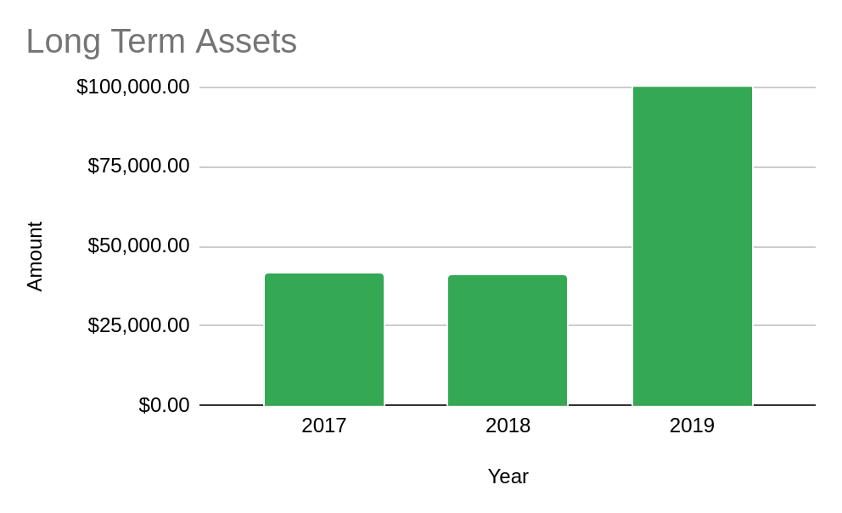
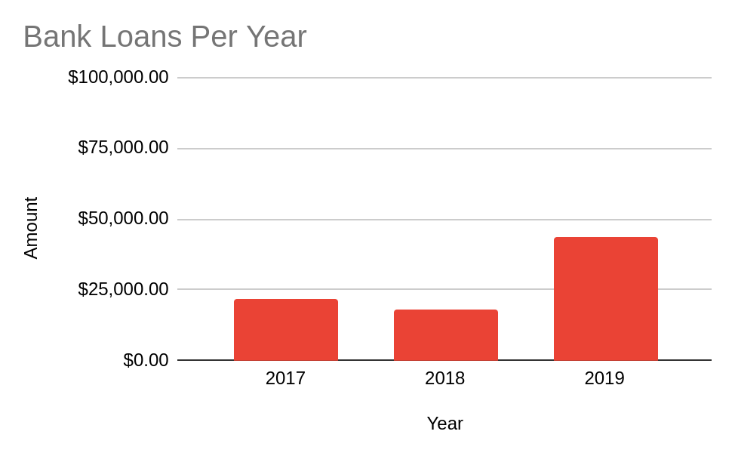
Long Term Assets/Liabilities Analysis(II/II)
Is the 2019 Increase in Bank Loans a Bad Sign?:
Support Investment: “In March 2019, Disney acquired Twenty-First Century Fox, Inc. (renamed TFCF Corporation) through a $71 billion acquisition.”
The Plot shows TFCF market value is higher than the amount Disney got into Debt with the Banks.

Slide 14
Assessing Disney
4
Assess Disney’s prospects compared with the consensus analysts’ forecasted revenue and profits, and the future performance of its peers?

Slide 15
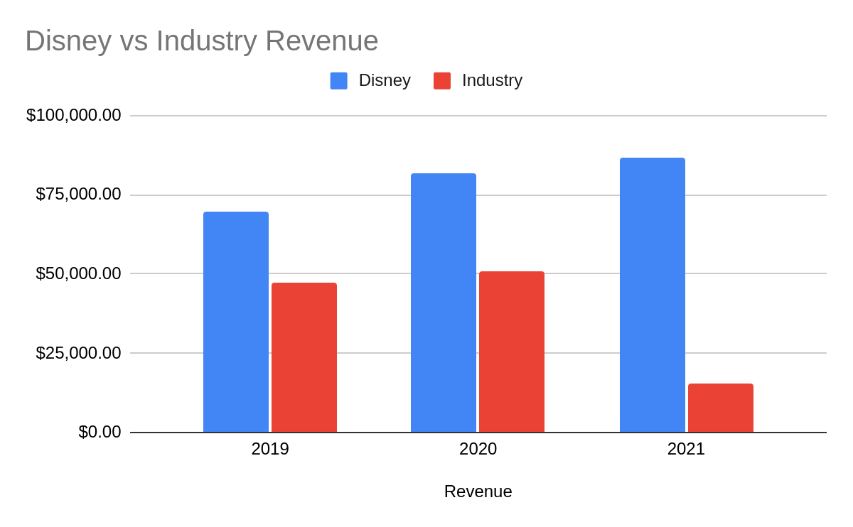
Forecasted Revenue
Disney is the Revenue Winner:
Disney will lead the industry in revenue in the current and following years.
It is expected to continue growing the Disney revenue.
Competitors are expected to face a strong retraction in 2021, while Disney will continue strong and steady.

Slide 16
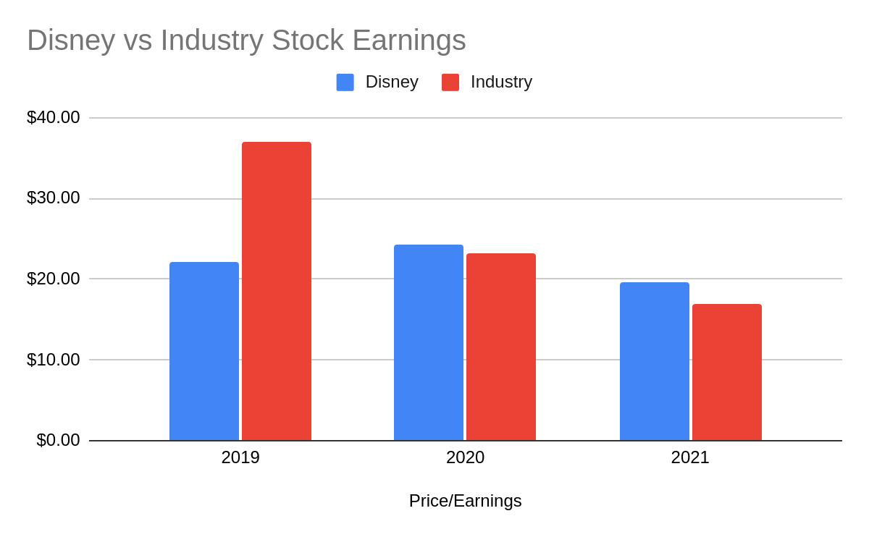
Stock Earnings
Disney Stock Earning is Stable:
Disney's stock earnings for its shareholders maintain stable across the years.
In 2020 and 2021 Disney is expected to outperform the competition.
Disney stocks will find their best performance in 2020.

Slide 17
Final Decision
5
Buy, hold or sell?

Slide 18
Final answer: Hold
Disney is in a good position in the market with their theme parks and new streaming service, Disney+;
New significant acquisitions with 21st Century Fox and Hulu:
Long term investments that lead to a substantial increase in debt.
Disney’s stock price is expected to increase:
It's better to sell the stock at a later date.
Entering the streaming service market can prove difficult given the presence that Netflix has:
Can be leveraged by making use of exclusivity opportunities on new repertoire items;
Most of Disney’s revenue comes from other sources, so success in this market isn’t vital.

Slide 19
Full Report with notes
https://docs.google.com/presentation/d/1Wmpay2wrQR0Ht9vCrmLZN3Lu1Dt_qHUCs5FosxCRxgo/edit?usp=sharing

