Slide 1
Drinkworks — Home bar by Keurig
2nd case study
Ana Barros
up201806593
Diogo Rosário
up201806582
João Cardoso
up201806531
João Costa
up201806560
Rúben Almeida
up201704618

Slide 2
Case study introduction
In the summer of 2018, Nathaniel Davis, CEO of Drinkworks, is looking for the next billion-dollar product.
Drinkworks is specialized in a single product. A home bar machine.
Drinkworks is a joint venture between KDP and AB InBev.
Nathaniel has questions about market targeting, product distribution and pricing.
Notes:
Shareholding composition:
KDP, Keurig Green Mountain, has the expertise on mixer pods.
AB InBev has the distribution expertise and know how in handling the strict american regulation on alcohol.
AB InBev is the majority shareholder.

Slide 3
Is it a good product?
1
Flaws | Qualities
Expensive (high price per feature) | Produces quality drinks
High wear on replaceable parts | Appealing design
Proprietary pods | Many features
Takes a long time to chill the water
Bad product
The product has desirable qualities, but it is quite expensive (premium product);
The consumers will perceive the scarcity of sources for pods as a risk;
The frequent replacement of parts (CO2 canister, and filters) makes the product maintenance heavy;
The quality of the drinks and the design make this an appealing “affordable luxury”.
Notes:
While being marketed as a premium product, it brings a “lot of baggage”: high maintenance effort and wasted time (if not always plugged in). It will also have trouble convincing potential customers that the drinks are good quality: people don’t believe a good drink can come from such a small pod.
Full of irrelevant features:
Why should a cocktail machine need access to the internet? It is said that the internet access is needed for updates and to add new drinks. However, there could be another way of adding new drinks without the need of the wifi connection. It feels like they added the internet access as an excuse to make the product more expensive. There is also an intrusion of privacy. The internet access is also used to send usage statistics. Users that worry about their privacy might lose interest in buying this product for that reason.
Too Expensive
Both the machine and pods are overpriced. Although it gives the impression that this is a premium product, it also makes it hard for people to buy it. If the machine was more accessible, there would be more potential customers. That’s the strategy of coffee machines, revenue comes from the pods instead of the machines. Coffee machines are sold at a lower price, so everybody is able to afford one and they eventually have to buy capsules.
“Making people shell out a lot of money up-front for a machine whose utility they still have to be convinced of is a big ask. And it’s the wrong way to build a platform — as any expert will tell you, you want to lure customers to your platform first, and make the money from their presence there later on.” - taken from https://marker.medium.com/why-keurigs-300-cocktail-machine-failed-c0eda1a6f19c
Proprietary pods
“every business today has an ecosystem dimension to it. What Drinkworks was trying to do was become a go-to at-home bartender in much the same way Keurig’s popular coffee machines are used by 27% of all Americans. One could conceive of such a machine that would be a platform through which multiple producers could sell their products. For this to work, the company would have to lower the barriers to ownership, potentially subsidizing the machines significantly while a critical mass of regular users would be created.” - taken from https://marker.medium.com/why-keurigs-300-cocktail-machine-failed-c0eda1a6f19c
Environmental concerns
“The water filter and CO2 canister needed to be replaced on a regular basis. Chilling the water took about 10 minutes, so Drinkworks users needed to leave their devices plugged in and prepped in order to minimize wait times and have the best user experience.” - taken from the case study.
This means that this machine is practically like a fridge since it has to been plugged in all the time.
The need for the constant parts replacement for the machine to work makes it seem like both a chore and a long term expense.
Keeping it plugged in and frequently exchanging parts will make environmental conscious people worried.

Slide 4
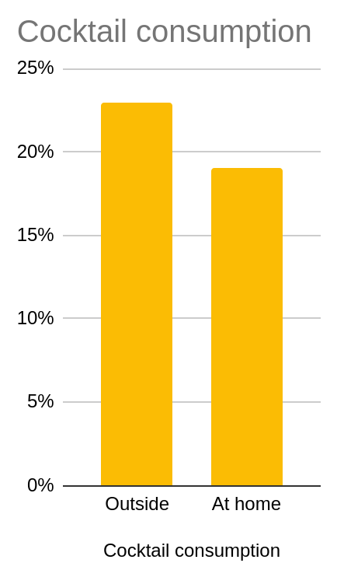
What problem is it trying to solve?
1
People mostly drink alcohol at home (at least 67%);
Cocktail consumption doesn’t follow this trend;
People throw parties (77%) where they serve multiple drinks to fit different preferences (51%);
The difficulty is that cocktails are hard to prepare: require extra actions and ingredients.
The company wants to make cocktail preparation as fast and easy as any other drink
Notes:
51% of the hosts (77% of people), serve multiple drinks to fit different preferences

Slide 5
What is its reference market?
1
Drinkworks wants to target the US at home cocktail consumption, alcoholic and non-alcoholic, but also beer and ciders.
At home, consumption is connected with social gathering. Events like parties and meals often have alcohol available for their attendees.
Drinking at home is more relaxing and cheaper.
There are already a handful of companies that develop home appliances for cocktails.
There are also a few companies that sell cocktail-themed monthly subscription services.
U.S. population | 329 million
Population allowed to purchase alcohol. | 197 million
U.S. Median Average Salary | $2854
2017 U.S. sales of alcoholic beverages | $234 billion
Alcohol beverages in-home consumption | $130 billion
Notes:
Drinkworks is entering the in-home alcohol beverages consumption market in the US.
There are 197 million people allowed to purchase alcohol in the U.S.
In 2017, the U.S. sales of alcoholic beverages reached 234 billion dollars.
For in-home consumption the value is 13 billion dollars.
Drinking at home is associated with positive feelings. People say that is more relaxing and cheaper than drinking outside.
At home, consumption is connected with social gathering. Events like parties and meals often have alcohol available for its attendees.
Wine leads at home consumption, with 58% of consumers. Followed by beer and spirits with 54% and 53%.
Cocktail consumption is half this range of values, by only accounting for 23% of the consumers.
Ready to drink market is expected to see a slow down in the short term, but is expected to watch a middle term increase. Continuous increase until 2022.
There are already a handful of companies that develop home appliances for cocktails like Bartesian.

Slide 6
Market Regulation
1
U.S. alcohol cluster is highly regulated
Liquor selling is, within this industry, the top regulated line of products;
Regulation is heterogeneous among states. Severe measures like prohibitions on Sunday are adopted in some states;
AB InBev is well established in the US market and is aware of the regulations.
Notes:
It is expected that Drinkwords face some troubles in the regulation field.
Some states prohibited having a vertical monopoly of produce, distribute and retail alcohol. Drinkwords is willing to give up on retail.
The major idea to overturn regulation is to sell only non alcoholic beverages and allow users to introduce the liquor separately, whose regulation can be done apart using the drinkwords mobile app.

Slide 7
Macro Environment Analysis - PESTEL
1
Political
Legal
Heterogeneous laws across the US states.
Alcohol is highly regulated in the US.
Social
Technological
Macro
Environment
Consumer market is niche.
Not many home cocktail drinkers
Mobile app
Modern features - Wifi
Environmental
Economic
Machine should be plugged in all the time. - Energy consumption
Constant machine parts replacement - Waste
US is a developed country with an high PIB per capita
Economics prospects for 2018 are favorable
Notes:
US states’ heterogeneous laws affect alcohol capsules in 2 ways:
Make it easier for a segment of the maket (a state) to not allow alcohol.
Make it somewhat harder for the entire market (whole country) to restrict alcohol in some way.

Slide 8
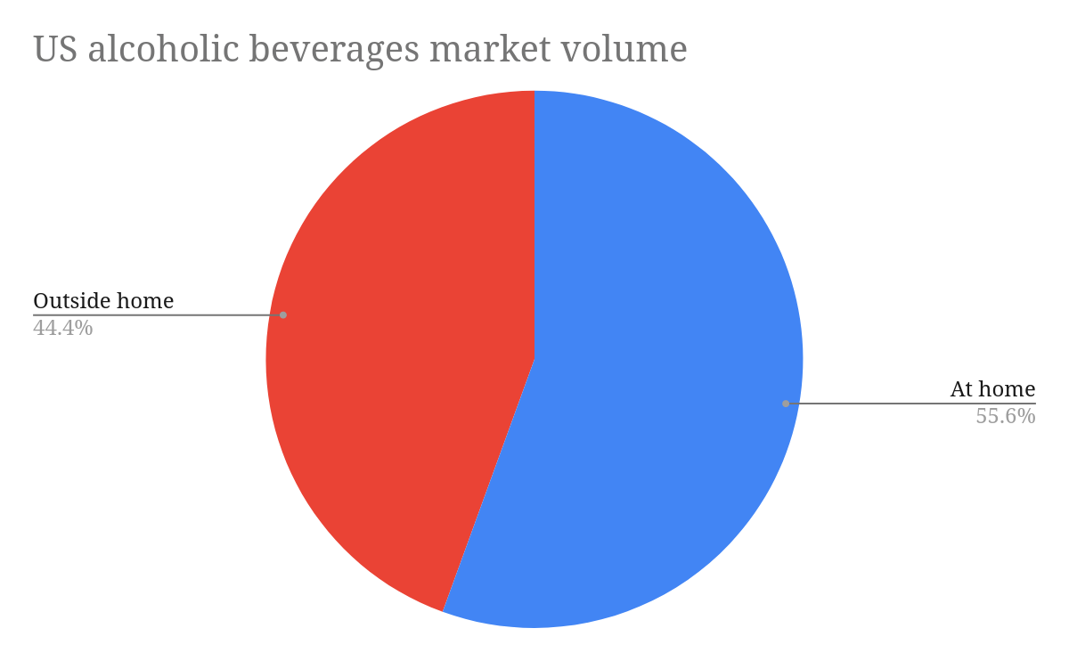
Target market segments(I/II)
2
“The target customer tends to be a ‘hoster’. They love exploring. They’re multicategory drinkers—beer, wine, and spirits—who want to step up the experience when they’re hosting”;
The target market consists of people who host a party at home;
Most of the alcoholic beverages market volume is dedicated to at-home drinking;
We have to segment these 55% to find out our target client profiles;
Notes:
“The target customer tends to be a ‘hoster’.” - Source: a 2017 survey

Slide 9
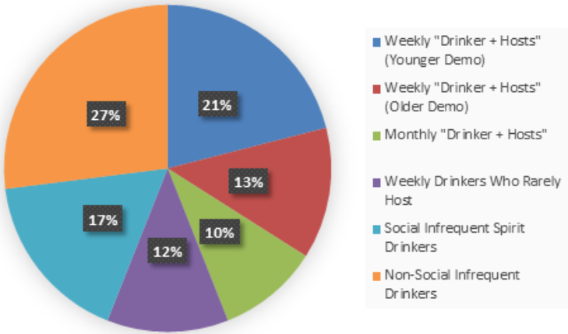
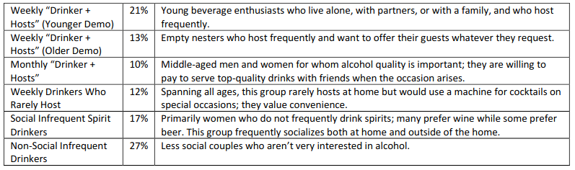
Target market segments(II/II)
2
Drinkworks established a list of six target customer profiles, based primarily on alcohol-consumption frequency, hosting frequency, age, and Keurig device ownership.
Customer segmentation

Slide 10
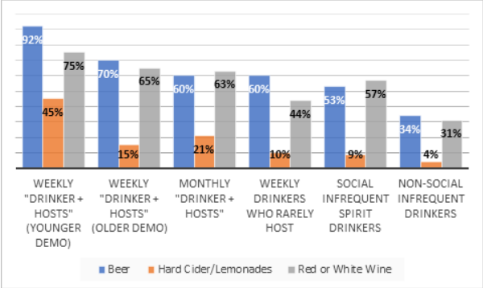
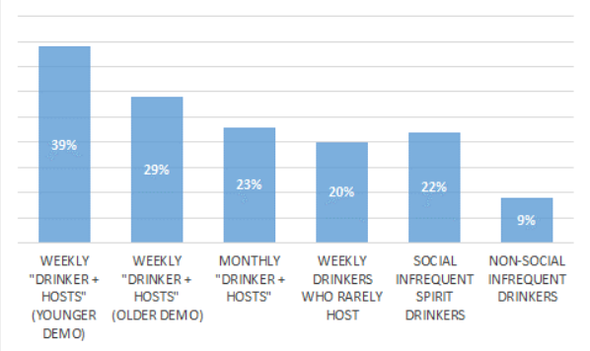
Target market segments
2
Generally, for all these segments, the main alcoholic drink of choice is beer and wine.
Problem: The target market of Drinkworks won’t be selling wine pods.
However, there’s the advantage that Drinkworks mother company is a beer seller.
Generally, for all these segments, the purchase intent is low (with a maximum intent of 40%).

Slide 11
Potential market size
2
The target market is rather a niche:
The target country is the US.
Not a lot of people drink cocktails.
Even fewer people drink cocktails at home. The hope is that Drinkworks increases this value.
The purchase intent of these people is very low.
The potential market size is very reduced
Notes:
The market exists and has space for Drinkworks, yet, isn’t enough to satisfact the intentions of the brand to become a new billion dollar company.
In order to be that level of successful drinkworks required to be universal. Which means target a broader segment of customers.

Slide 12
What is the value proposition?
3
The convenient, barrier-free solution for at home premium beverage preparation
Point of difference:
Cheaper than competition;
Customers don’t need to add their own alcohol;
Lower barrier of entry on cocktail preparation: they are prepared automatically.
Point of Parity:
Brings the simplicity of coffee machines to the world of alcohol;
Possibility of being sold alongside the products of traditional market;
Notes:
Point of difference:
Distribution is easier: pods are easier to transport than bottles/cans;
The pods are cheaper than traditional drinks;
Pods can be seen as a more environmentally friendly alternative to bottled/canned drinks;
In contrast with the most direct competition (Bartesian), there are alcoholic drinks/pods available, without the consumer adding their own alcohol separately.
Point of parity:
Customers can explore the multitude of existing drinks;

Slide 13
What is the positioning in the market?
3
The Drinkworks segmentation research is clear. Drinkworks position itself as a company for “Weekly drinkers + Hosters”;
The cost of acquisition of the physical product restricts the product to medium-high income customers;
The positioning within this cluster constitute a case of more (benefits) for the same (price);
Targeting this segment is an example of niche-marketing case.
Notes:
Graph shows the 3 largest segments of the expected target audience.
Out of the 6 segments:
The 3 largest were (weekly or monthly) drinkers who host
The 2 largest were weekly drinkers who host

Slide 14
What pods should be introduced?
3
Alcohol Free MIXER Pods | Beer/Cider Pods | Cocktail Pods
Fewer regulations | There’s a purchase interest in beer capsules by consumers | Higher price per capsule at a similar cost ⇒ much higher profit
Easier to comprehend: people bias against alcohol in pods | Capsules sold for more than the beer price | Main interest of the target market
More readily conceivable | Mother company sells beer | Advantageous for the customer over Bartesian’s offering
Focus on the drinks’ flavors | Difficult to distribute/sell alcohol | Difficult to distribute/sell alcohol
Consumer adds the alcohol
Notes:
The group agrees that all capsules should be introduced. Main reasons to introduce each capsule:
Alcohol free mixer pods – Although the profits are the smallest (see question 4), it is the easiest to sell/distribute (doesn’t have to deal with alcohol selling regulations);
Beer/Cider pods – The mother company sells beer. Customers are available to buy beer capsules for prices higher than the beer price (≃$0.70). Very cost effective;
Cocktail pods – If the company finds a way to deal with the alcohol distribution/sale regulations, it can sell this pods. Focus on the target market and deals a direct blow to their main competitor, Bartesian.
People believe that pods can’t have a full cocktail with alcohol and are turned off by the idea.
Pods without alcohol give the user the option to add their own choice of alcohol.
Most people care about their brand of alcohol.
“Mixer pods could be cheaper and might avoid regulatory problems for distribution. They were also easier for consumers to comprehend. Davis explained, “The non-alcoholic pod is more readily conceivable. People understand: ‘I put in a pod, then I pour in the spirit.’ With the alcoholic pod using concentrate technology, there’s an aspect where people don’t understand how we could possibly fit a whole drink in the pod.” Mixer pods also gave consumers the option to add their own preferred brand and amount of alcohol. Davis noted, “If you ask people if they care about what brand of alcohol they drink, the answer is a very clear ‘yes.’ They will pay more for premium vodka because they perceive it to be better.”

Slide 15
How should the devices be priced?
4
According to surveys made by Drinkworks, devices should be sold as a luxury/premium product;
This would allow for the maximum profit for the product;
The manufacturing and distribution cost of the machines includes accounting for returns, warranty replacements, promotions, fulfillment, and freight.
Drinkworks appliances
Price ($) | Willing to buy (%) | Production cost ($) | Client acquisition cost ($) | Profit
499 | 1.6 | 250 | 100 | 238.4
399 | 2.1 | 250 | 100 | 102.9
299 | 3.8 | 250 | 100 | -193.8
249 | 4.7 | 250 | 100 | -474.7
199 | 6.9 | 250 | 100 | -1041.9
149 | 10.5 | 250 | 100 | -2110.5
Notes:
Bartesian sells their cocktail maker for $369.99
By selling the product cheaper, we can potentially gather more customers and a bigger share of the market
However, if we sell as a luxury/premium product, the price should be higher
*Mention that the table’s profit column is for 100 * (percentage of willing to buy) appliances/capsules

Slide 16
How should the devices be priced?
4
Beer/Cider pods should be sold at $4 each;
This is the most expensive price point, but would prove to be the most profitable;
People are willing to pay a premium for beer, which counter-intuitive: beer from the same “mother company” can be bought for as low as $0.70 in stores.
Beer/Cider Pods
Price ($) | Willing to buy (%) | Production cost ($) | Profit
4 | 35.3 | 1.1 | 102.37
3 | 42 | 1.1 | 79.8
2.5 | 44.5 | 1.1 | 62.3
2 | 51.7 | 1.1 | 46.53
1 | 55.1 | 1.1 | -5.51

Slide 17
How should the devices be priced?
4
Non-Alcohol mixer pods should be sold at $2.5 each;
This maximizes the profits of the pods sold;
There’s a big difference between the percentage of people willing to pay $1 vs. $2 for each pod;
Cocktail pods should be sold at $6 each;
Once again, the pods should be sold at the highest price to maximize profits;
As expected, most people are willing to pay a premium for cocktails.
Non-Alcohol Mixer Pods
Price ($) | Willing to buy (%) | Production cost ($) | Profit
4 | 7.2 | 0.95 | 21.96
3 | 15.2 | 0.95 | 31.16
2.5 | 21.6 | 0.95 | 33.48
2 | 31.8 | 0.95 | 33.39
1 | 72.7 | 0.95 | 3.635
Cocktail Pods
Price | Willing to buy (%) | Production cost | Profit
6 | 39.1 | 1.2 | 187.68
5 | 45.5 | 1.2 | 172.9
4.5 | 46 | 1.2 | 151.8
4 | 51.5 | 1.2 | 144.2
3 | 57.4 | 1.2 | 103.32
2 | 72.8 | 1.2 | 58.24
Notes:
As a comparison, Bartesian sells their cocktail pods ranging from 2.25$ to 2.5$.

Slide 18
Will Drinkworks be the next billion-dollar opportunity of Keurig and AB InBev?
5
We don’t believe Drinkworks will be successful
Bartesian, its direct competitor, is basically the same product, and it already well established.
The target market doesn’t seem interested enough;
The price of the machines is too high for what the most interested customers are willing to pay;
The audience is too niche;
Low profit margins, high distribution costs (at least 15-25%), heavy taxes on alcohol sale/production/distribution;
Notes:
Distribution costs are even higher if going for physical sales (retail or liquor stores)

Slide 19
What are the risk and opportunities and how to address them?
5
Opportunities | How to address
Variety of drinks | Sell pods from other brands (partnerships)
Cheaper distribution | Pods are smaller and lighter; easier to transport in mass
Beer market leader connection | Market the association with the KDP and AB InBev brands
Risks | How to address
Expensive | Product versions and pod subscription plans
Niche market | Invest in alternative pods (non-cocktail pods)
Machine inconveniences | Focus in making the product good instead of feature-rich
Notes:
Opportunities:
Many types of alcoholic and non-alcoholic drinks;
Cheaper distribution than traditional options (Capsules are much smaller and lighter than cans);
Connection with beer market leader.
Risks:
Needs to be relatively expensive to make a profit (Premium product);
Entering a small (niche) market that already has an established product;
The machine is inconvenient: it is big, takes 1 minute to make a drink, and needs to always be plugged in;
How to address them:
Focus in making the product good instead of feature-rich;
Once the product is in the market, create new versions of the machine with different features;
Creating pod subscription plans: bulk buying leads to cheaper pods and customer loyalty;
Market the association with the parent-company’s beer brands to reassure consumers of the quality of the pods;
Sell the machine as cheap as possible, and profit from pod sales.
Distribuição:
Retail stores - Bad, high taxes (25-35%). Doesn’t allow for alcoholic pods;
Liquor stores - Allows alcohol and parent company already has experience with it, but doesn’t fit with the style of selling consumables from the liquor stores and very high taxes (25-35% + 0.1$-0.15$ spirit excise tax per pod);
E-commerce - Low taxes (15-25% with amazon), but company has little experience with it and customers might not want to buy something they can’t see. Alternatively, they could host their own distribution system, but they’d have to pay shipping costs.

Slide 20


5 Forces model
5
Alcohol stores don’t like selling pods;
Final consumer can easily use an alternative product.
Bargaining power of buyers
Their product is the substitute in this industry;
Low threat of new ones showing up.
Threat of new entrants
Rivalry among competitors
The market is small;
Bartesian is strong in this market.
Threat of substitutes
Small market segment;
Consumers already have products they enjoy;
Subscriptions lead to consumer loyalty;
Low threat of new entrants.
Bargaining power of suppliers
Similar to their parent companies;
Both are major companies, so their bargaining power over suppliers is high.
Notes:
Suppliers: Product has a high initial cost (from the machine itself); Makes it more difficult to swap brands (sunk cost fallacy and initial investment)

