Slide 1
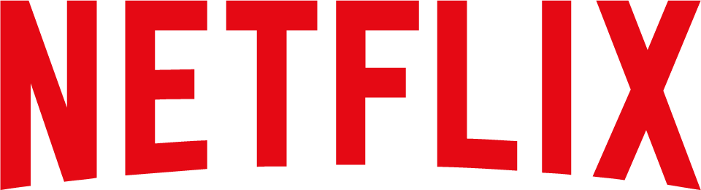
Netflix in 2011
Case Study
Ana Barros — up201806593
Diogo Rosário — up201806582
João Cardoso — up201806531
João Costa — up201806560
Rúben Almeida — up201704618

Slide 2
Introduction
Reed Hastings founded Netflix in 1997 when the DVD technology was still new.
In the 1990s, customers rented movies, primarily on VHS cassette, from a retail location for a specified time period.
Blockbuster Inc. was the market leader.
By 2010, Hastings had built the DVD-by-mail company into an enormously popular customer service.
In 2011, Netflix announced that the company would split the DVD-by-mail and the online streaming business. This led to backlash.
As of March 31, 2022, Netflix had over 220 million subscribers worldwide.

Slide 3
Netflix Model
01
Characterize Netflix’s business model for DVD-by-mail business

Slide 4
Netflix’s DVD-by-mail Business Model
Key Partners
Key Activities
Key Resources
US Postal Service
Major Studios
Red Envelope Entertainment
Small and Independent movie producers
Movie DVD rental by postal service
Order DVDs online
Independent movie “scouting”
Customer Demand responsive Movie Library
National inventory of movies
Warehouses across all the US
IT team with technology know-how
Employees with connection in the movie industry

Slide 5
Netflix’s DVD-by-mail Business Model
Value Propositions
Customer Segments
Customer Relationships
Movie Rental without late fees
Online search engine and personalized recommendation system
Queue of movies to receive
Order movies from home with next-day delivery
Unlimited renting
Movie Enthusiasts: personalized system of suggestions
Best Sellers followers: library both robust and big enough for demand
Early technology adopters who have a DVD player: Provide content movies for their players
Recommendation system is actively improving based on the interaction of all community
Halt the practice of charging late fees
Movie Rental based on "Prepaid Subscription Service"
Notes:
“Compared to traditional video rental outlets, where new releases would make up over 70% of total rentals, new releases represented less than 30% of Netflix’s total rentals in 2006”

Slide 6
Netflix’s DVD-by-mail Business Model
Revenue Streams
Cost Structure
Channels
Subscription Programs
Best sellers renting
Netflix has a median profitability (profits/total revenue) of 33%/year
Major titles: $18-$20 per DVD
Warehouse: $60000 per Warehouse
US Mail Delivery Cost: <$2/DVD
Median Annual percentage investment in R&D over Revenue: 7.55%
Expenses in IT team and equipment maintenance
Website (recommendations, search, and orders)
USPS (delivery of DVDs and their return)

Slide 7
Blockbuster
02
Characterize Blockbuster’s business model. Indicate the differences between the Netflix’s DVD-by-mail business model?

Slide 8
Blockbuster’s Business Model
Key Partners
Key Activities
Key Resources
Wide franchising network across the US
Movie studios
Renting of the bestsellers movies
Focuses on new releases (first 3 weeks within studio release)
Many physical stores across the whole US

Slide 9
Blockbuster’s Business Model
Customer Segments
Value Propositions
Customer Relationships
Impulse buyers: people looking for something for “movie night”
Consumers that prefer physical locations over online retail
Quick movie rental
Everyone is a 10-minute drive away of a Blockbuster
Movies are immediately available
Vast stock of the current bestsellers
Unlimited Renting (2004)
Online Movie Rental – Blockbuster Online (2004)
Continuously increasing the number of physical stores
Ensure that there is always a great stock of high demand movies
Notes:
New releases accounted for 75-80% of demand
They usually stocked ~100 copies of each new release
2006 - Blockbuster Total Access: allowed customers to exchange DVDs by mail or in a store

Slide 10
Blockbuster’s Business Model
Cost Structure
Revenue Streams
Channels
Costs dominated by Occupancy and Payrolls
Movies acquisition:
Classical purchase model
Share of future revenue model
$837M in 2003
Renting of titles to consumers:
$4 per rental
Re-sale of used rental copies:
$8 per copy
Late fees accounted for ≃10% profit (in 2004)
5194 US stores (as of 2006):
4255 company owned
the others franchised
Each store has ≃10 part-time workers, and 1 manager
Online DVD-by-mail (2004):
Blockbuster Online
Notes:
Used to be a 50/50 split of the two models in 2004. By 2006, 81.6% of copies were purchased with a revenue share model.
Each rental store had an estimated $900K in yearly sales, and had an operating profit of $162K

Slide 11
Blockbuster’s vs Netflix DVD-by-mail
Blockbuster
Netflix DVD-by-mail
Focused on new releases (high quantity of copies)
More relations with movie studios
Focused on impulse purchases (“movie night”)
“Instantaneous” renting, usually a 10-minute drive away
High discoverability of older content
Personalized recommendations
Encouraged consistent renting:
Movie renting queue system
“Unlimited” renting subscription system
Renting from home
Usually next day delivery
Physical stores with a lot of employees:
Most costs were occupancy and payrolls
Low discoverability of old content:
Generally unavailable or far away
Wasn’t advertised
Fewer relations with movie studios

Slide 12
Model Evolution
03
Identify key changes in Netflix business model over time. Explain how those changes affected the evolution of the business.

Slide 13
Key changes in the business model
Partnerships with movie studios: lower acquisition cost for new releases;
Acquire content from independent producers: reputation as highest-quality source of independent movies;
Partner with USPS and create more warehouses: next-day delivery across the US;
Three movies out at a time strategy;
Making it easy to cancel a subscription: the profile stays saved for when/if the customer comes back;
Shift from “traditional” rental model to a “no-late-fee subscription model”.
Year | Nº subscribers | Notes
2001 | 400K | Second distribution
2002 | 800K | Easy unsubscribe
2003 | 1.4M | 1st time reaching profitability
2004 | 2.5M | Unlimited rentals 3 movies strategy
2005 | 4.2M | Blockbuster struggling
Notes:
Netflix was having trouble competing with Blockbuster in terms of having the latest releases available:
Not having partnerships with studios made this content acquisition expensive;
Studios reduced the upfront cost of the DVDs in exchange for a fee based on the total number of rentals of the DVD over a certain time period;
This lead to spending more money with the studios, but greater customer satisfaction: “It was like paying 20% more and getting two times the number of copies”.
Most independent movies don’t make it to DVD:
By being distributed by Netflix, the content that didn’t make it could “make it” based on its intrinsic quality;
Netflix built a reputation as the highest-quality source of independent movies;
This movies were cheaper to acquire, and sometimes extremely successful.
Netflix was having trouble acquiring customers in areas where next-day delivery wasn’t available:
Netflix solved this problem in 2 ways;
By partnering with USPS (become a first-class mail customer), they could intercept their customers mail, so it was delivered faster;
This was straightforward, because of the distinctive red color of their envelopes;
Creating more warehouses across the country (USA) to cover more regions with next-day delivery;
This was facilitated by the fact that converting an existing warehouse to Netflix’s needs is cheap ($60 000).
The three movies out at a time strategy:
Netflix started offering “unlimited-rentals”;
This was a great marketing strategy;
Customers could keep 3 movies with them at a time, and could exchange them at any time;
This was simple for the customers to understand, and mitigated some of the problems related to shipping times;
This attracted customers that were turned-off by the high prices of frequent movie renting, but didn’t have any alternatives.
Making it easy to cancel a subscription:
In the past, customers looking to cancel their subscription had to phone Netflix’s customer support line;
This was an attempt to reduce customer-churn as much as possible;
They would be faced with a Netflix employee trying to convince them to keep their subscription;
Now customers were able to unsubscribe online, by filing a form explaining why they were leaving;
This was an encouragement to leaving customers to come back;
This lead to a burst of churn, but also to return customers (their profile was saved).
Shift from “traditional” rental model to a “no-late-fee subscription model”:
Customers didn’t like having to pay each time they rented a movie;
The shipping times for each rental were also a problem;
This is related to the change three movies out at a time.

Slide 14
Role Changes
04
Compare Netflix’s DVD-by-mail and streaming business models. Does Netflix’s role change in streaming compared to DVD-by-mail?

Slide 15
Comparison with DVD-by-mail model
The new service (streaming), would make use of many of the company’s existing strengths:
Brand, recommendation system, and large base of paying customers.
The service was offered at a minimal extra-cost (on top of the DVD-by-mail service);
The licensing of content was much harder:
Licensing wasn’t subject to the first-sale doctrine: the driver of the economic model;
Royalties were paid for each viewing of the content.
Most streaming services target viewing on a computer, but Netflix’s customers enjoyed TV sets:
This led to partnerships with other hardware and software companies to bring Netflix to their platforms.
In 2010, Netflix customers were watching more content through streaming than by the old model.
Notes:
The streaming service was offered as a view instantly option for a minimal ($2) extra-cost:
Netflix hoped the service could build its market position by growing the existing business;
Hastings believed using the existing service and brand would be the only way to differentiate the service from the existing standalone sites (Vongo and MovieLink);
Without a clear link to the DVD-by-mail service, there would be no evident advantages over the start-up competitors.
When Netflix launched its service for the first time, competitors like Apple and Amazon had few titles in their offering:
The content had to be licensed;
The licensing was much harder than with physical media distribution/rental;
Studios weren’t receptive to the idea;
The first breakthrough deal only happened in 2008 (with Starz Entertainment): 2500 titles from Wal Disney.
The deprecation of the first-sale doctrine:
Up until now, the economic model of Netflix had be driven by the fact that DVDs were paid for upfront (sometimes with an extra fee for each rental over a certain period);
Now, the content was licensed;
This meant that royalties were owed for each use of the content;
The entry cost was raised and the operating expense model was changed.
Netflix needed to bring the streaming service to TV:
Partner with Microsoft: gamers used XBoxes (which was connected to the internet) with their TV set;
Partner with Roku: Roku DVP connected a home router to the S-Video/component video of a TV set;
Partner with Samsung: Netflix was available on the predecessors of the Smart-TVs;
Partner with Apple: widespread internet access on iPad and iPhone lead to the development of the Netflix app for iOS;
Rapid growth of streaming:
The streaming service was outgrowing the DVD-by-mail service;
This lead to the decision of separating the services;
Old customers backlash.

Slide 16
Company’s role
The company’s objective was always to provide the best viewing experience;
Hastings always hoped for it to be possible to download more movies;
Streaming started as an adjunct to the (core) DVD-by-mail service;
After 2010, as streaming became more popular/successful, licensing became more expensive:
The licensing costs lead to the idea of developing original content.
The company had success in their original “House of Cards”:
This led to increased investment and a change in focus to producing original content.
Streaming growth indicated a shift from streaming on TV sets to general device streaming:
This included phones, game consoles, and smart-TVs.
The company now serves an international market.
Notes:
Netflix signed a five-year deal for $1 billion in 2010:
This allowed streaming content from Paramount, Lionsgate, and MGM;
As it became more successful, the licensing costs increased.

Slide 17
Company’s role Changes: From DVD to Streaming
Past | Present
A mere movie distributor | Distributor + content creator
Focus on delivery enhancement | Focus on software scalability and widespread
Focus on surpassing blockbuster | Focus on customer retention
Create a different movie rental business model | Create a fully online personalized user experience
Notes:
Netflix signed a five-year deal for $1 billion in 2010:
This allowed streaming content from Paramount, Lionsgate, and MGM;
As it became more successful, the licensing costs increased.

Slide 18
Right Move
05
Was the right move to separate DVD-by-mail business from the streaming one? How do you think Reed Hastings should proceed now?

Slide 19
Decision Impacts: Short vs Long Term Analysis
Short Term
Long Term
Early customer backlash:
Feeling of abandonment from DVD service customers
Price increase if getting both services
The market is moving towards video streaming
Netflix originals are very successful.
More titles in comparison to competitors
Netflix’s services are multiplatform;
Streaming business will be very profitable for Netflix
Bad Decision
Wise Decision

Slide 20
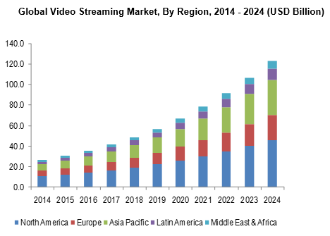
How to proceed?
Continue the increase of investments in the streaming market:
It has better growth prospective.
Invest in original content, as it proves to be very popular;
Gradually reduce the investments in the DVD-by-mail service:
Should be done in a way that doesn’t generate public backlash;
Avoid the public noticing the changes;
Let DVD die by itself.
For Netflix, brand image is very important:
Any attempt to rebrand products (with different names) should be avoided.

