Slide 1
SLAM
Introduction & Data Structures
EDAA - G06
João Costa
Henrique Ribeiro — João Martins
Tiago Duarte

Slide 2
Project description

Slide 3
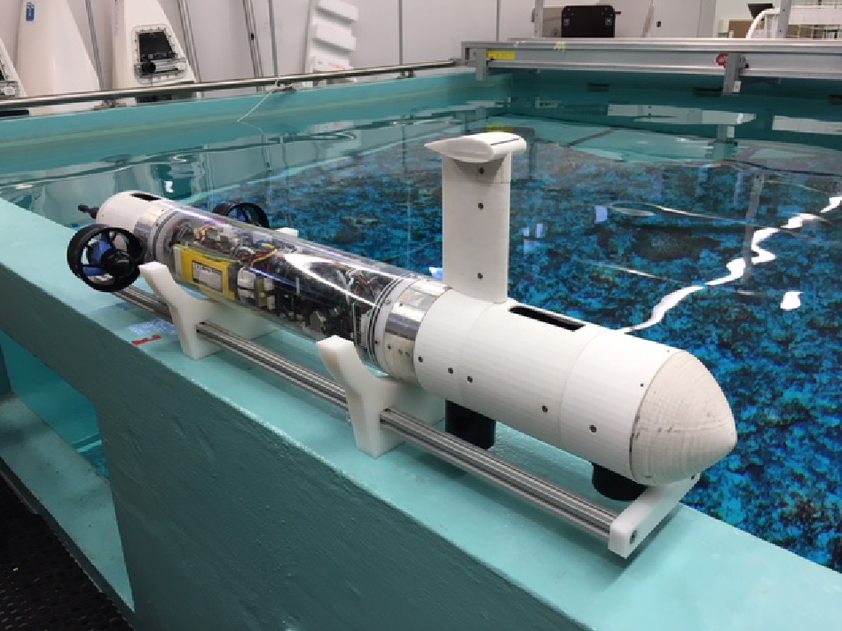
Simultaneous Location And Mapping
Goal – map an environment navigated by and autonomous vehicle, while simultaneously locating it in the map;
Challenges:
  No access to pre-existing maps or external devices;
  Focus on sub-aquatic SLAM ⇒ difficult access and extra data noise;
Datasets – the group will have access to sonar data measured by CRAS.
Fig 1. UAV used to collect the datasets.

Slide 4
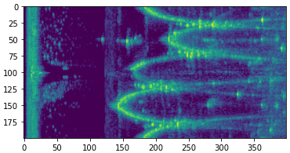
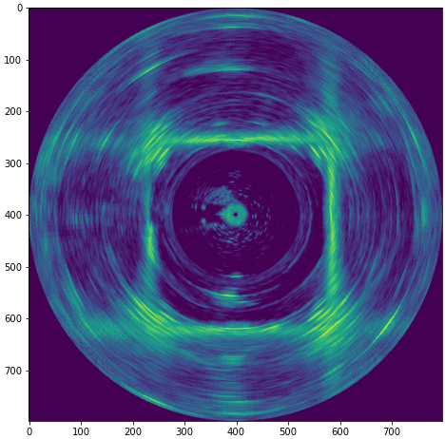
Sonar data
A sonar mounted on a vehicle collects environment data;
Sonar data contains noise and other undesirable effects (e.g. multipath);
Fig 2. Illustrates the raw data of the sonar and the problems present in this data:
  Reflections from the body of the vehicle (self reflections);
  Multipath effects when signals go through the tank walls;
  Noise affecting detection of features (e.g. tank walls and floater).
It is important to clean this data and find the distance to the first feature for each measurement.
Fig 2. Dataset representation in polar and Cartesian coordinates.

Slide 5
Problems to be tackled
Filter noise/undesirable effects in data:
  Multiple reflections;
  Echos;
  Self reflections;
  Multipath errors.
Represent map in a space efficient format;
Implement static/dynamic probabilistic mapping algorithms based on sonar data;
Incorporate new measurements into the map according to some time constraints (≃ 40ms).
Note: the group will focus on 2D mapping with a static vehicle in the first part of the project.

Slide 6
Data structure

Slide 7
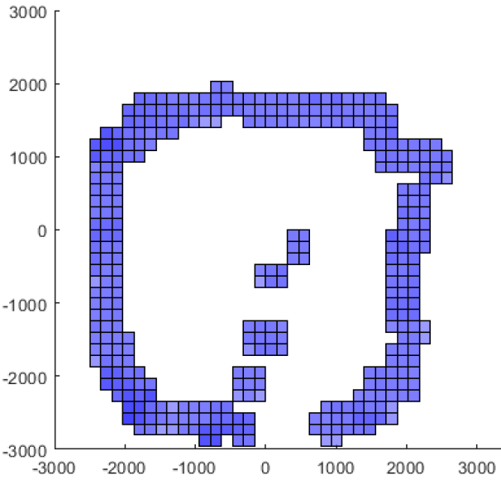
Mapping representation alternatives
Occupancy grid – the most commonly used representation;
Feature based maps – mapping an area through points of interest in the data;
Octomaps – efficient division of the map into cells.
Fig 3. Mapping Representation

Slide 8
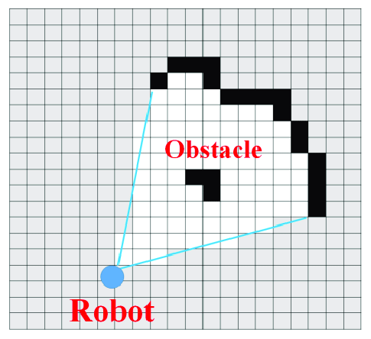
Occupancy Grid
Definition:
  Map the environment into a binary matrix (2 or 3D);
  Usually, zeros represent unknown/occupied locations, and ones represent free cells.
Advantages:
  Easy to implement;
  Represents the state directly.
Disadvantages:
  Fixed map size (doesn’t scale);
  Spatially inefficient;
  Detail representation is limited.
Fig 4. Occupancy Grid

Slide 9
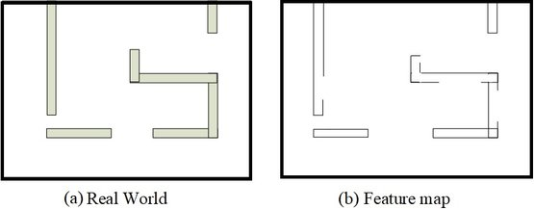
Feature Based Map
Definition:
  Mapping an area through points of interest;
Advantages:
  Unique features help locate the vehicle;
Disadvantages:
  Features can be hard to identify;
  Feature strength can be hard to identify;
  Difficult to store the information efficiently;
Fig 5. Feature Map

Slide 10
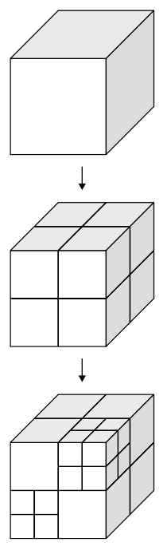
Octomap
Definition:
  The map is divided into cells that can be subdivided into 8 smaller nodes;
  Based on octrees;
  Division only happens when there’s a probability of the voxel containing an object.
Advantages:
  Space efficient;
  Recursive and always adapting.
Disadvantages:
  Implementations are harder.
Note: Although we’re focusing on 2D for now, it was decided that it was better to implement Octomaps instead of Quadmaps, because we’ll use 3D in the future.
Fig 6. Octomap

Slide 11
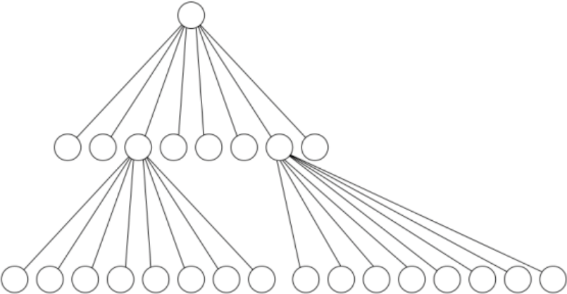
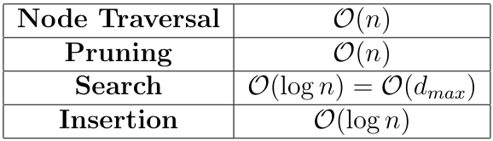
Chosen data structure: Octree
Octrees are a tree data structure where every internal (non-leaf) node has exactly 8 children;
Useful to encode information during tree transversal in some applications: information compression;
Common supported operations:
Fig 7. Octree

Slide 12
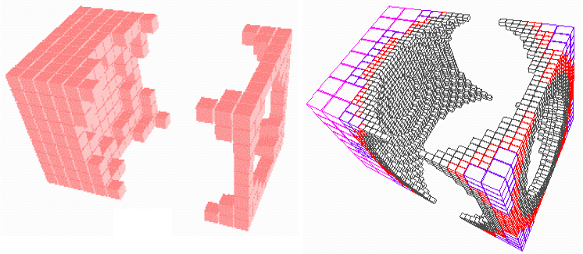
Octree - Example applications: 3D computer graphics
By using octrees, it is possible to represent complex 3D objects in a compressed manner:
  Detail can be controlled by choosing a max depth to the tree (limiting divisions).
Can represent arbitrary objects;
Image generation is efficient;
Enables view frustum culling (Mee Young Sung et al.);
Modern game engines like Unity have multiple implementations of octrees available.
Fig 8. 3D object octree

Slide 13
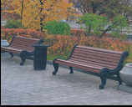
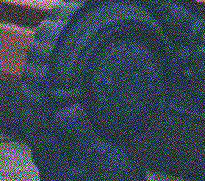
Octree - Example applications: AllRGB
AllRGB is a project where people create images with one pixel for every RGB color (without repetitions);
A complete octree of 9 levels can be used to find approximations to colors that were already used:
  Each node stores how many free children it has. Leafs are either 1 (used) or 0 (not used);
  Nodes are updated during traversal.
The color approximation is calculated during the traversal of the tree in 8 hops:
  Algorithm explained at https://github.com/JoaoCostaIFG/allrgb
Fig 9. AllRBG example.

Slide 14
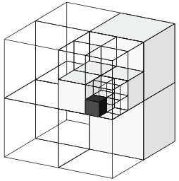
Octomaps/Octrees in our project
Octrees will be used to implement octomaps:
  The max depth of the underlying octree determines the max distance represented by the map. E.g., a max depth of 16 with a resolution of 1 cm allows for 655 m³.
The octomap will be probabilistic:
  3 types of cells: free, occupied, and unknown;
  Each cell has a probability of being empty associated (log-odds): 0.5 means unknown.
Clamping update policy:
  Stable node – when the log-odds value of a cell reaches a lower/upper bound;
  In a static environment, it is likely that all nodes will become stable;
  If all the children of a node are stable and agree on the occupancy state (free/occupied), then the children can be pruned.
Fig 10. Example of octree storing occupied (black) and free (white) cells (Hornung et al.)

Slide 15
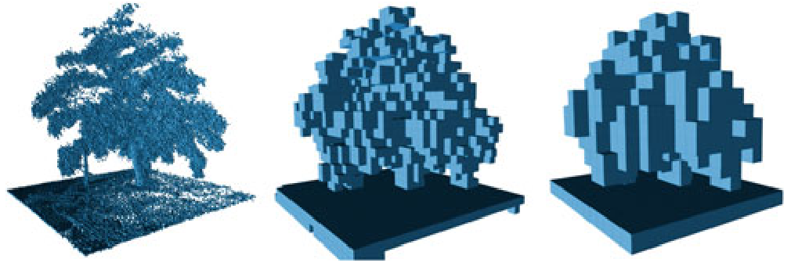
The information in the octomap will be updated by ray-casting: discussed in the next presentation (algorithms);
The map can be evaluated at a lower resolution for faster (but less detailed) drawing:
  Each intermediate node’s occupancy is based on its eight children’s occupancy levels;
  The maximum of those occupancy levels is used (instead of the average);
  This leads to a pessimistic view of the free space, which is useful to avoid collision with the terrain by the vehicle.
Space optimization:
  Use a pointer to an array instead of 8 pointers.
Fig 11. Example of octree depth limiting (Hornung et al.)

Slide 16
Questions?

