Slide 1
SLAM — part 2
Empirical Analysis
EDAA — G06
João Costa — João Martins
Henrique Ribeiro
Tiago Duarte

Slide 2
Why sets
Brief C++ history
Rationale
Set concepts

Slide 3
Rationale
→ Related to C++ inception

Slide 4

Rationale – Brief C++ history
Back when C++ was being standardized:
Open hashing was still a new topic (not mature enough);
C++ sets and maps were based on a paper from 2003 by Matt Austern, which leveraged closed hashing;
This was the safe approach at the time.
At the beginning, the API didn’t require the implementation to use closed hashing:
From C++17 onwards, with the introduction of “extract” capabilities, it became required.
The API requires the following:
Iterator increment must be (amortized) constant time;
The erase method must be constant time on average.
Notes:
Info source: https://bannalia.blogspot.com/2022/06/advancing-state-of-art-for.html
C++ logo source: https://raw.githubusercontent.com/isocpp/logos/master/cpp_logo.png

Slide 5

Rationale – Opportunities for improvements
Our use case needs unordered sets as containers for very small objects:
Objects are 48-bit < 64-bit pointers;
C++ sets are for general usage, so they are optimized for big objects (> 64-bit);
We can leverage the better cache locality of open hashing.
C++ sets use buckets:
Increases memory usage;
Nodes needs an extra pointer to the next object (using more memory).
N is the number of elements. B is the number of buckets:
16 N + 8 B (hash caching);
8 N + 8 B (no hash caching).
Notes:
Image source: https://cdn.pixabay.com/photo/2017/04/16/20/42/brain-2235771_960_720.png

Slide 6
Collision resolution strategies
→ A recap

Slide 7
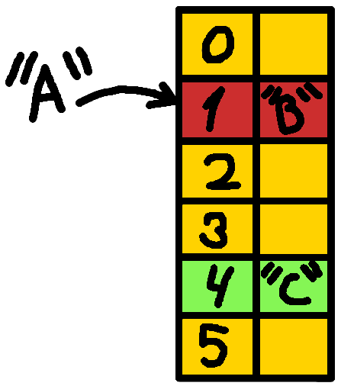
What happens during an insert
Set data structures are supported by hash tables;
During the insertion operations:
We calculate the hash of the object;
From the hash we obtain an index;
The element is stored at the index.
It is possible to obtain the same hash/index from an object:
When this happens, we have a collision.

Slide 8
Collision resolution strategies
One of the simplest ways to deal with collisions is closed hashing:
Each index is a bucket;
A bucket is a linked list of elements with the same hash;
This has performance problems.
The group implemented 3 open hashing techniques:
Linear probing – on collision, we check the next buckets (one-by-one) until we find a free one;
Quadratic probing – similar to linear probing. We check buckets in jumps of power-of-two size, e.g.,: 1 2 4 8…
Double hashing – we have 2 hash functions: 1 for the object hash and another for the offset.
Future work:
Try Cuckoo hashing and Robin Hood hashing;
Apply fast modulo: https://arxiv.org/abs/1902.01961

Slide 9
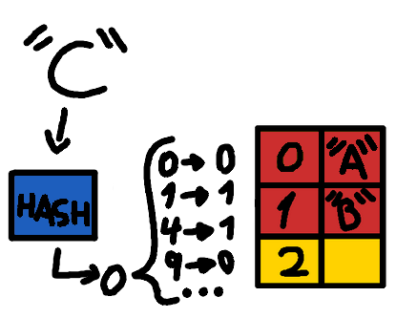
Implementation details – Quadratic probing
Quadratic probing as described can lead to cycles;
The basis of the solution to this problem is: keep the hash table size a power of 2;
The quadratic probing offset becomes: i² ⇒ (i² + i)/2;
These guarantee that a free slot can always be found.
Notes:
Source for the quadratic probing solution: https://research.cs.vt.edu/AVresearch/hashing/quadratic.php

Slide 10
Implementation details – Double Hashing
Double hashing can lead to cycles;
We can’t use the same hash function to hash the element and to calculate the offset;
The cycle size is the LCM of the result of the offset function and the hash table size;
If these 2 numbers aren’t relatively prime, this number can be significantly low:
This is achievable by making one of the numbers prime: i.e., the table size;
This has a significant overhead for set resizing, and the modulo operation;
The other approach is keeping the hash table size a power of 2 and guarantee that the offset always returns an odd number.
Notes:
Source for the double hashing solution: https://ece.uwaterloo.ca/~cmoreno/ece250/2012-02-01--hash_tables.pdf

Slide 11
Implementation details – Set dynamic resizing
When resizing the hash table:
We create a new one with double the size;
Re-insert all elements into this new table.
This process uses an alternative insert function (move function) optimized for this operation:
Reduces the overhead of memory management;
Performs fewer checks: we know there aren’t tombstones;
All hash values are cached (no need to re-calculate them).
Resizing is triggered when an insert causes the load factor to go over 75%: i.e., 75% of the hash table contains an element (not a tombstone);
Future work:
Explore other dynamic resizing methods that explore possibilities that aren’t all-at-once.
Notes:
The current method is bad:
Doesn’t avoid memory fragmentation that triggers heap compaction (Source: https://en.wikipedia.org/wiki/Hash_table#Dynamic_resizing)

Slide 12
Set performance analysis
Set operation’s performance analysis
Collision resolution strategy comparison

Slide 13
Insert operation
→ Performance analysis

Slide 14
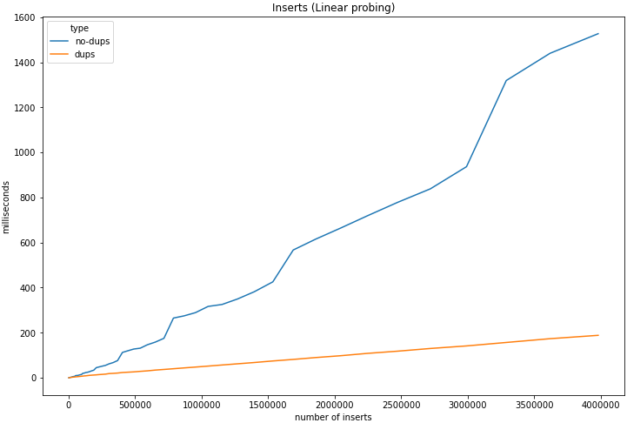
Insert — Linear probing
Insertion of randomly generated objects;
Collision resolution using Linear probing;
Blue line – ≃ 0 duplicated objects;
Orange line – ≃ 58% duplicated insertions;

Slide 15
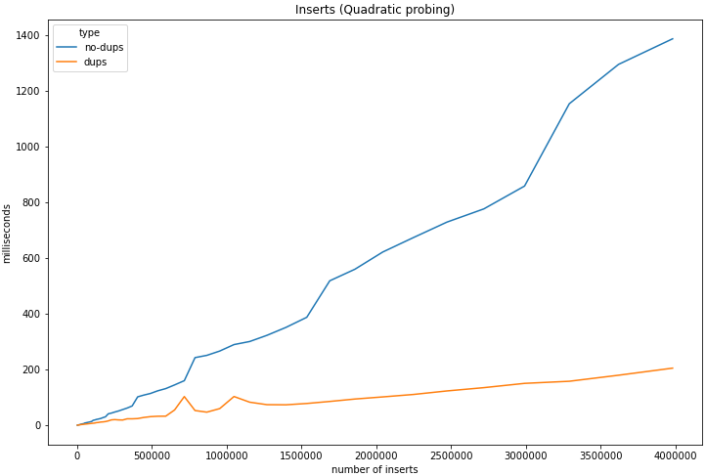
Insert — Quadratic probing
Insertion of randomly generated objects;
Collision resolution using Quadratic probing;
Blue line – ≃ 0 duplicated objects;
Orange line – ≃ 58% duplicated insertions;

Slide 16
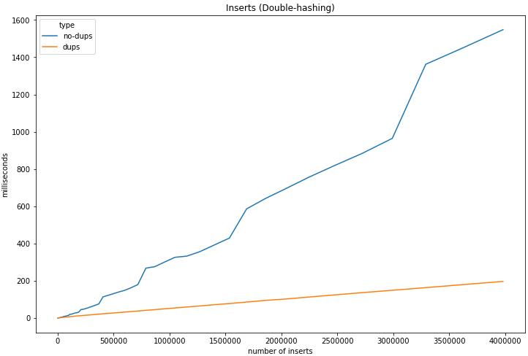
Insert — Double hashing
Insertion of randomly generated objects;
Collision resolution using Double hashing;
Blue line – ≃ 0 duplicated objects;
Orange line – ≃ 58% duplicated insertions;

Slide 17
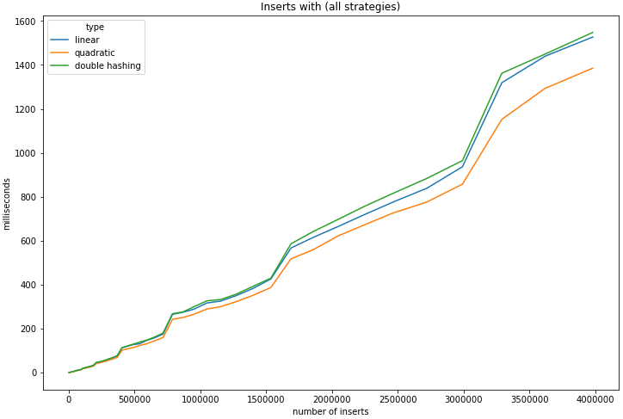
Insert — Comparison of all strategies
Insertion of randomly generated objects;
Performance is similar between all methods;
Quadratic probing is consistently the best.

Slide 18
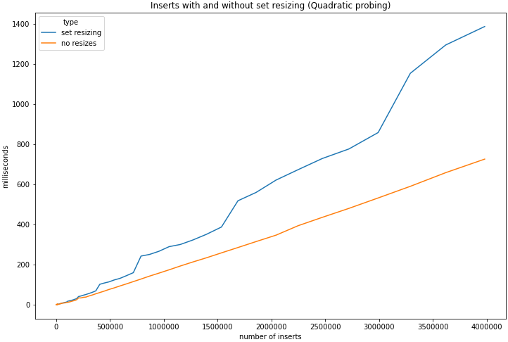
Insert — Impact of set resizing
In the previous examples, the sets were resized multiple times;
This also affects the comparisons:
Smaller sets suffer fewer resizes.
Resize is triggered by a threshold of how full the set is (75%);

Slide 19
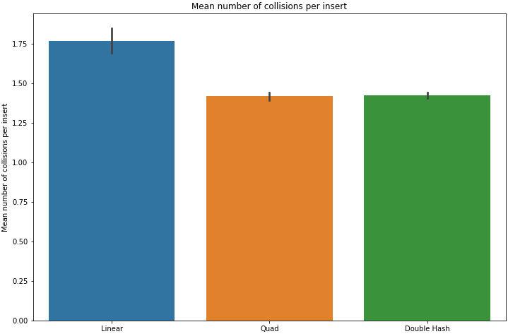
Insert — Number of collisions
Quadratic probing has the best performance:
In par with the fact that it suffers a low amount of collisions.
Double hashing delivers on the promised reduced number of collisions, but performance is hurt:
It as the worst performance.

Slide 20
Lookup/Delete operation
→ Performance analysis

Slide 21
Lookup/Delete — Performance
Lookups and deletes are very similar operations in our set implementation:
A delete operation is a lookup that sets the entry as dead instead of returning it.
Lookups for non-existent items on big sets are fast:
Because of the load factor control, there are numerous empty buckets ⇒ the search is quick to end.
 | Existing | Non-existent
100000 | ≃ 6ms | ≃ 3ms
200000 | ≃ 15ms | ≃ 5ms
300000 | ≃ 23ms | ≃ 5ms
400000 | ≃ 32ms | ≃ 6ms
500000 | ≃ 34ms | ≃ 8ms
600000 | ≃ 42ms | ≃ 9ms
Notes:
Looks of existing nodes searches for all nodes one-by-one:
There’s a slight overhead of getting the “next-item”.

Slide 22
Merge operation
→ Performance analysis

Slide 23
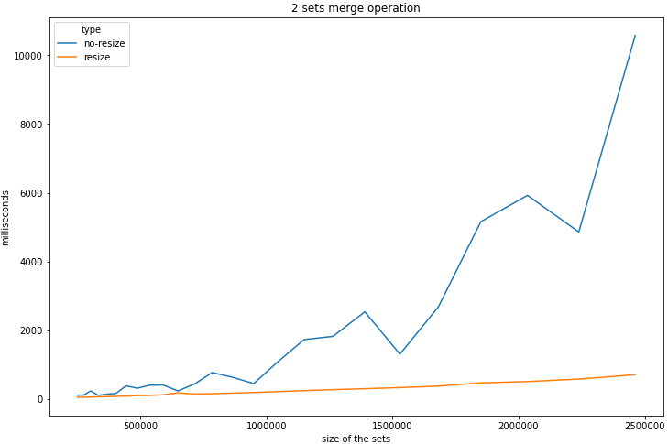
Merge — Performance and impact of resize
In our project, we only need in-place merges;
The merge operation consists of iterating over a set and inserting each object into the second one;
By doing a pessimistic assumption, we can greatly increase the performance of the operation:
Assume that each element in the second set is new (not already part of the set);
Check that the load factor is still ok in that case (no resize needed).
Notes:
Memory over-allocation:
Memory is only really allocated if we need it.

Slide 24
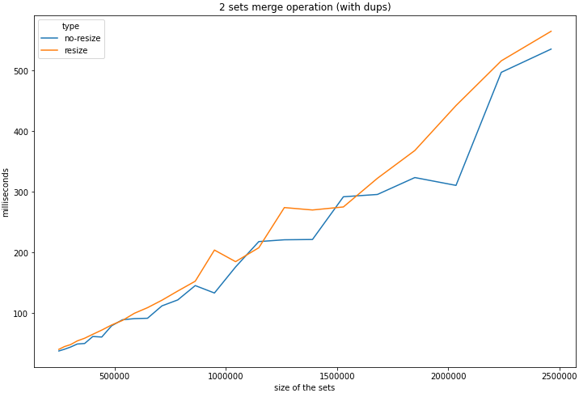
Merge — Optimization with numerous duplicates
Our use case leads to merges with numerous duplicate entries;
In this test, the second set has ≃50% of its elements in common with the first set;
The optimization doesn’t bring anything to the table performance-wise;
But can cause an increase in memory consumption.

Slide 25
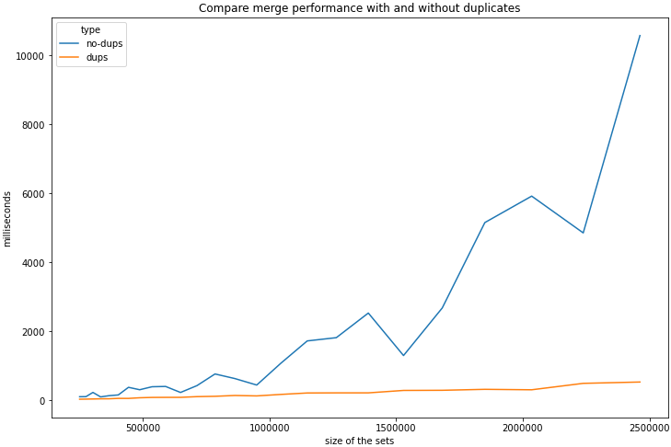
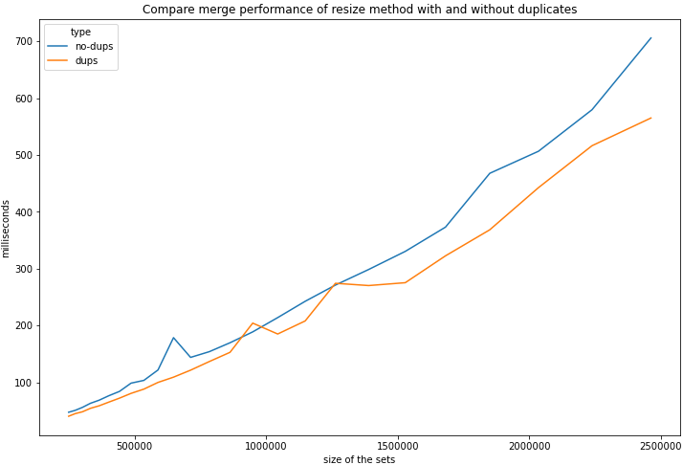
Merge – The impact of duplicates
Notes:
Having duplicates improves the performance of both methods;
It improves the one without duplicates the most:
It is very unstable

Slide 26
Merge operation
→ Comparison with C++

Slide 27
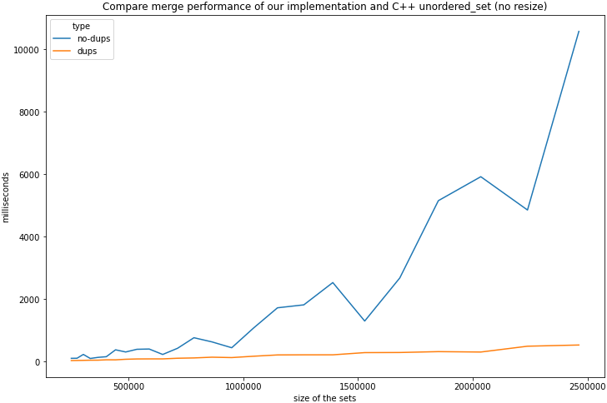
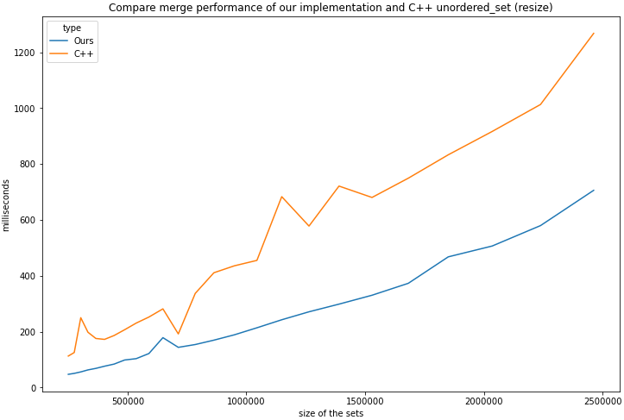
Merge – Comparison with C++ unordered_set
Notes:
The performance of our sets is worst than C++ if we don’t use the resize optimization:
This is probably because C++ resizes the hash table without having to re-insert all elements.
When we use the resize optimization, our implementation is faster.

Slide 28
In-place dynamic resizing
→ Comparison with all-at-once

Slide 29
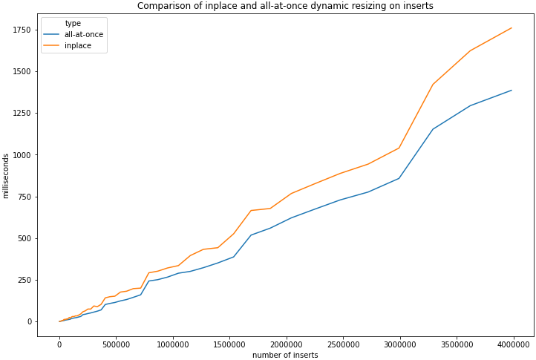
In-place dynamic resizing – comparison
We implemented a way for sets to be dynamically resized in-place:
Less memory overhead;
Less time performance.
Algorithm:
Grow the container (double size);
Re-evaluate all entries in first half;
If they fall on second half, place them there;
Otherwise, save them in a buffer for later;
Clear first half and insert the buffer elements
Notes:
Source of inspiration for inplace resize: https://github.com/TooBiased/DySECT

Slide 30
Real data test
→ Performance on the dataset

Slide 31
Real data test
Tests on real data:
Ray-casts on a plane point cloud dataset;
Only considering the turbines;
About 1000 ray-casts covering 18000 cells each.
Ray-casts are calculated 4 at a time in parallel:
On a computer with 4 CPU cores.
Our set implementation improved performance almost 2-fold.
 | C++ sets | Our sets | In-place resize
Time taken | ≃ 23 s | ≃ 13 s | ≃ 10 s

Slide 32
3D Scan Analysis
Cell coverage analysis
Time analysis

Slide 33
3D Scan Analysis
→ Quick Recap

Slide 34
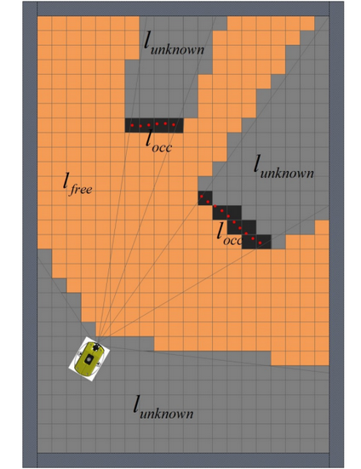
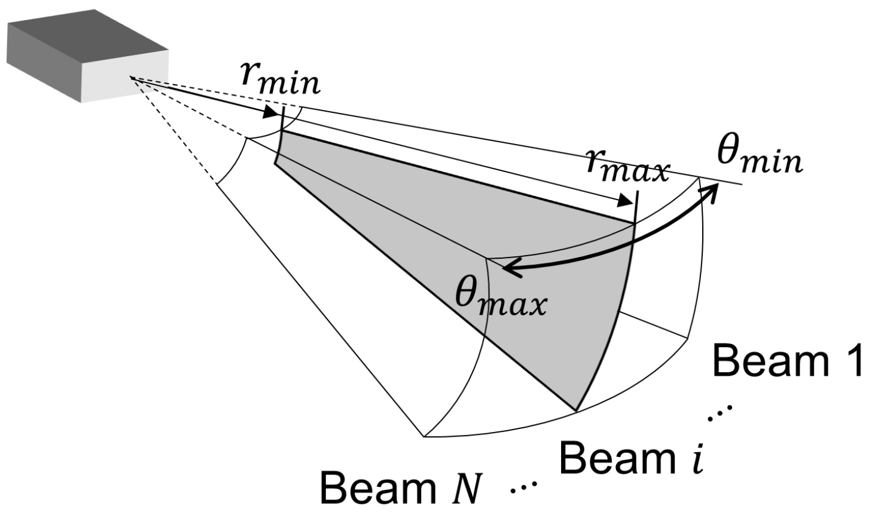
Sonar Data & 2D Mapping
Sonar rotates around itself;
Sends/measures waves in a cone;
Each beam has multiple intensities across several intervals.

Slide 35
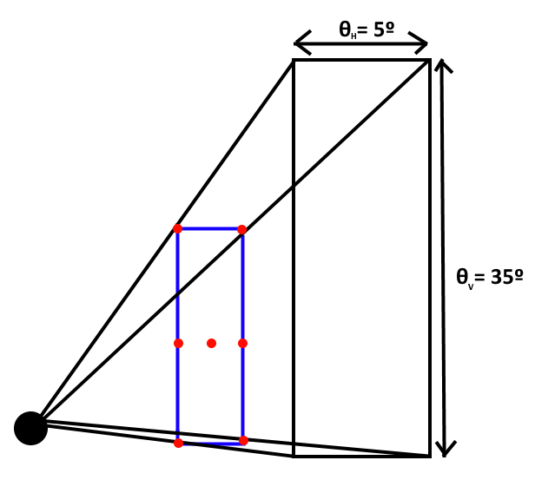
3D – How to Cover a Volume?
Estimate covered cells through 3D ray-casts
Choose destination points to achieve maximum coverage
Divide both horizontal and vertical plane
For the same AUV, Fula[1] uses 7 rays
But what is the optimal number of divisions to maximize coverage?
And what is their impact on performance?
Notes:
Mention search for other algorithms that cover volumes related to viewport algorithms

Slide 36
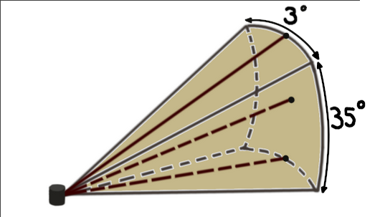
Sonar Beam Spread
Each sonar beam covers an area that spans over 3º horizontally and 35º vertically;
As such, the vertical plane needs to be further divided to capture the same level of detail.

Slide 37
3D Scan Analysis
→ Division Analysis

Slide 38
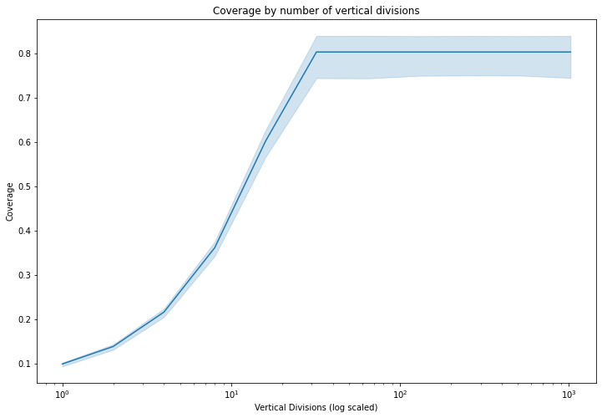
Vertical Divisions – Coverage
Results were as expected;
Coverage increases linearly until 64 divisions;
Subdividing the plane further doesn’t lead to more coverage.

Slide 39
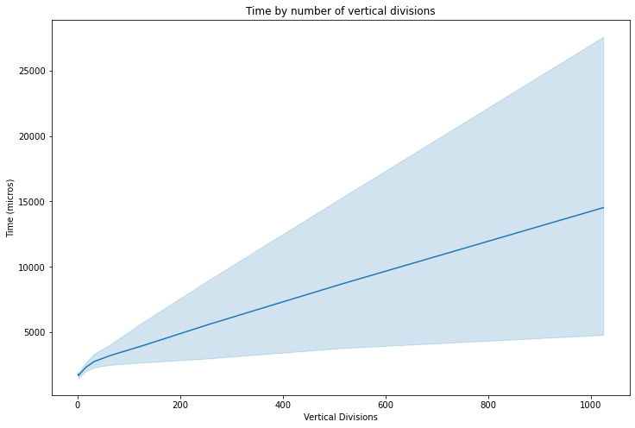
Vertical Divisions – Time
Time increases linearly;
Even though our point-cloud implementation is O(N²);
We believe that this is due to most ray casts having a lot of points in common:
This leads to fast merges;
This is why the merge operation is extremely important.

Slide 40
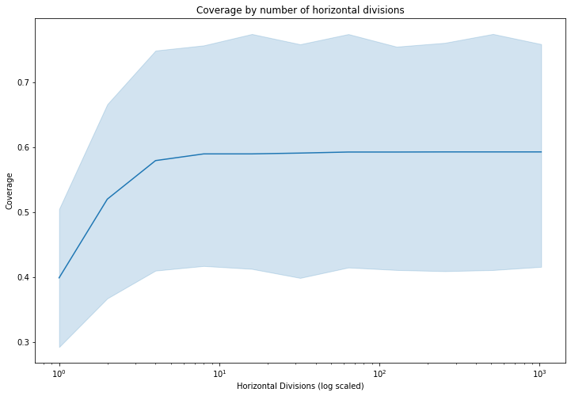
Horizontal Divisions – Coverage
Results were also as expected;
Maximum coverage is reached sooner;
Subdividing the plane further from 32 divisions doesn’t lead to more coverage.

Slide 41
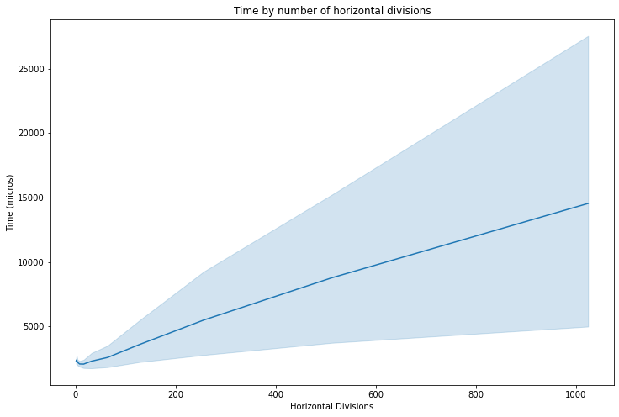
Horizontal Divisions – Time
Time also increases linearly;
Same conclusion as vertical performance.

Slide 42
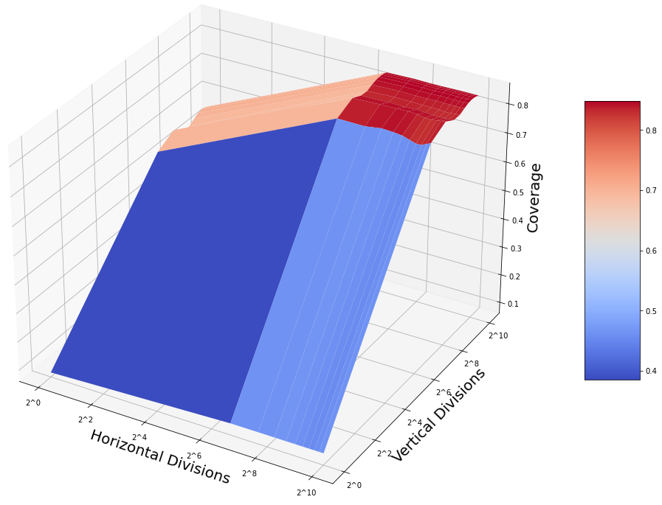
Multivariable Analysis – Coverage
High coverage is only possible with high horizontal and vertical Divisions;
These parameters don’t seem to affect performance by much:
At least in our dataset;
So this won’t be much of a factor in our decision.
BAZINGA
Notes:
Divisions are in logarithmic scale

Slide 43

Number of Divisions – Results
1 horizontal and 2 vertical Division

Slide 44
Number of Divisions – Results
64 horizontal and 128 vertical Divisions

Slide 45
References
[1] – João Pedro Bastos Fula - Underwater mapping using a SONAR
[2] – Virginia Tech Algorithm Visualization Research Group –
https://research.cs.vt.edu/AVresearch/hashing/quadratic.php
[3] – Carlos Moreno –
https://ece.uwaterloo.ca/~cmoreno/ece250/2012-02-01--hash_tables.pdf
[4] – Wikipedia –
https://en.wikipedia.org/wiki/Hash_table#Dynamic_resizing
[5] – Tobias Maier – https://github.com/TooBiased/DySECT
[6] – Joaquín M López Muñoz –
https://bannalia.blogspot.com/2022/06/advancing-state-of-art-for.html
[7] – Daniel Lemire, et al. – https://arxiv.org/abs/1902.01961

