Slide 1
SLAM
Empirical Analysis
EDAA - G06
Henrique Ribeiro — Tiago Duarte
João Costa
João Martins

Slide 2
Octomaps/Octrees Analysis

Slide 3
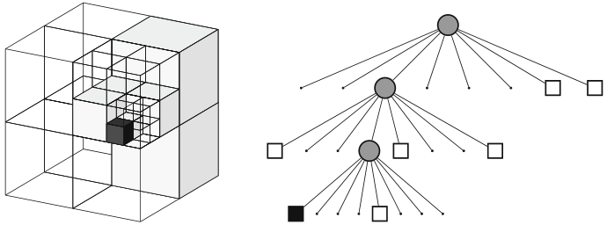
Octomaps/Octrees In Our Project
The octrees used in the max depth 16;
This depth leads to a 8^16-1 = 2.8147498e+14 nodes.
Resolution of 1 cm;
This resolution with the amount of nodes available lets up map a volume of 655 m³.
The octomap will be probabilistic:
3 types of cells: free, occupied, and unknown;
Each cell has a probability of being empty (log-odds)
> 0 more likely to be occupied
< 0 more likely to be empty
Unknown cells are uninitialized
Fig 1. Example of octree storing occupied (black) and free (white) cells (Hornung et al.)

Slide 4
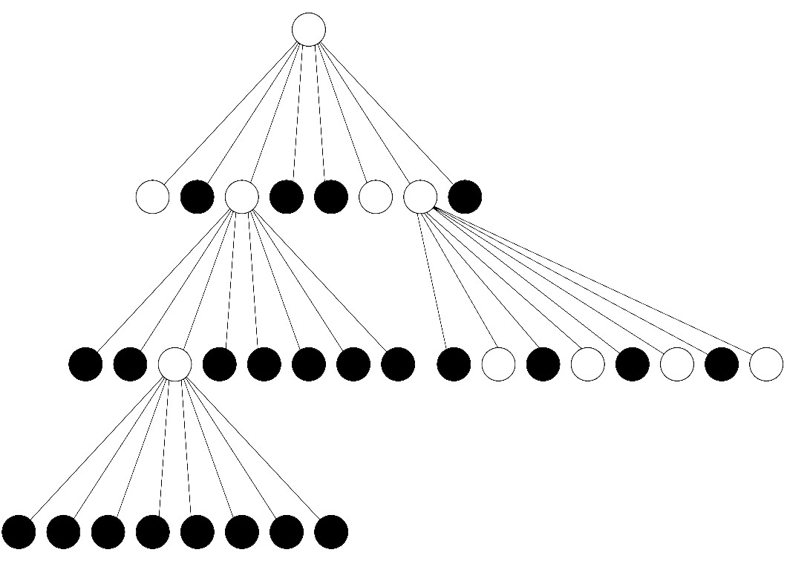
Octree Pruning
If all child nodes are stable and agree on something, these nodes can be pruned, and their value goes to the parent node.
Fig 2. Simple octree representation

Slide 5
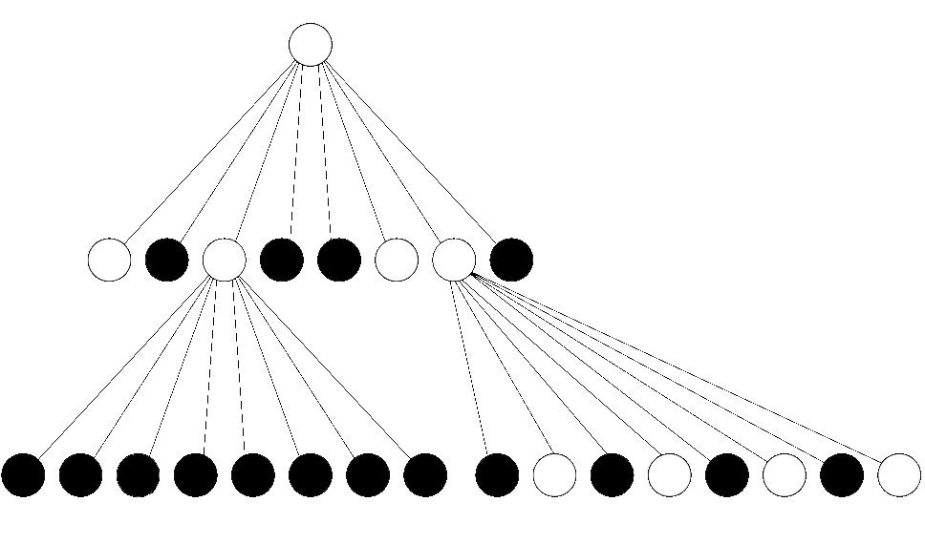
Octree Pruning
This check is recursive starting from the leaves, and additional prunes can happen.
Fig 3. Simple octree after pruning

Slide 6
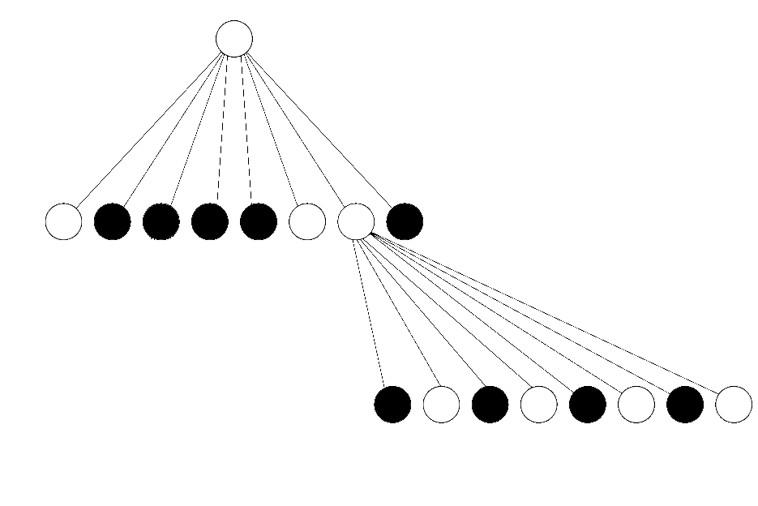
Octree Pruning
Since no more nodes have all children in agreement, this layout would be the final one for this specific octree.
Fig 4. Simple octree after second pruning

Slide 7
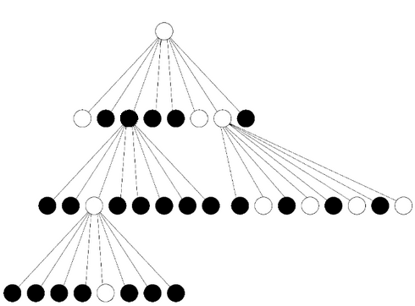
Lazy Eval
Used when a lot of nodes are updated at the same time.
Does not update parent nodes when inserting children.
Saves updating until the end of all insertions.
Fig 5. Unupdated octree
Notes:
An execution without lazy eval should still be done when there aren’t many insertions happening at the same time.

Slide 8
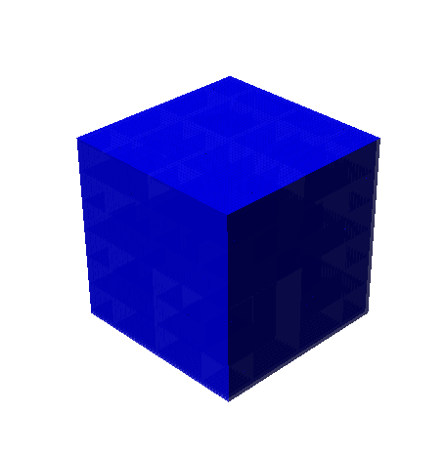
Octree Pruning In Action
The execution time decreases by almost 2 times between lazy eval and no pruning, whereas with pruning it takes more time;
The number of nodes decreases by almost 58-fold;
With Pruning
Without Pruning
Lazy Eval.
Number of Nodes
19 769
1 145 977
19 769
Average Execution
time of 5 runs
13.8s
5.31s
2.9s
Number of Intermediate Nodes
5 201
145 977
5 201
Number of Leaf Nodes
Fig 6. Cube 100cmx100cmx100cm
197 69
1 000 000
19 769

Slide 9
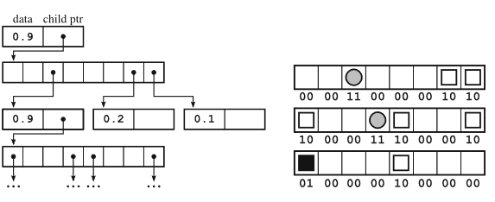
Keeping Children In Octomaps/Octrees
Instead of keeping 8 pointers to each child node, an array of 8 children is kept.
This mean that leaves only have one null pointer instead of 8 null pointers.
Fig 7. Comparing array to eight pointers (Hornung et al.)

Slide 10
Keeping Children In Octomaps/Octrees
Using the previous measurements of 19 769 leaf nodes after pruning, when considering a 64-bit machine:
Using Array
Using 8 Pointers
Number of Null Pointers
19 769
158 152
Structure size (in bytes)
158 152 Bytes
1 265 216‬ Bytes
Fig 8. Cube 100cmx100cmx100cm

Slide 11
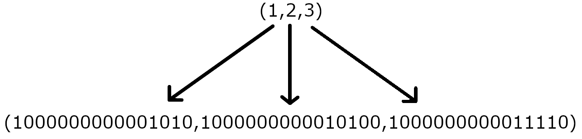
Octree Keys
Instead of keeping the coordinates, each node computes a key value for x, y and z, each containing the same number of bits as the max depth.
Every node has the first N bits of each key set, where N is the depth of the node, the other bits are set to 0.
With these keys, for our usage of octomaps, the look-up is O(1).
There is no direct correlation between coordinates and key values (For example, two sequential coordinates may not have sequential keys).

Slide 12
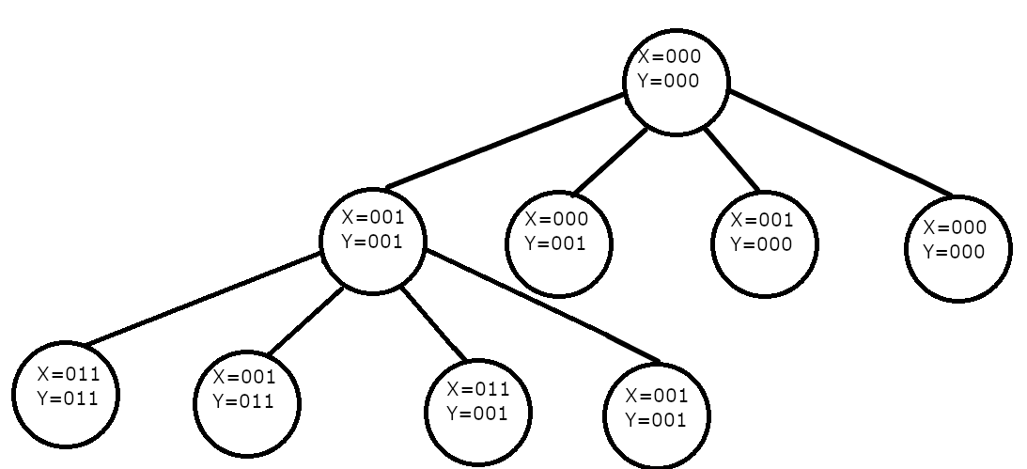
Look up using Octree Keys
Assuming we are looking for coordinate (2,1), and it’s key value is computed to (011,001).

Slide 13

Look up using Octree Keys
Starting at the root node, we see the bits at the position equal to the current depth;
For the keys (011,001), we start by applying the mask 001.
With this we get the step 11 (bitY, bitX).

Slide 14

Look up using Octree Keys
Starting at the root node, we see the bits at the position equal to the current depth;
For the keys (011,001), we start by applying the mask 001.
With this we get the step 11 (bitY, bitX).

Slide 15

Look up using Octree Keys
The next step, we use the mask 010.
For the keys (011,001), after applying the mask we obtain the step 01.

Slide 16
Node Values Update Analysis

Slide 17
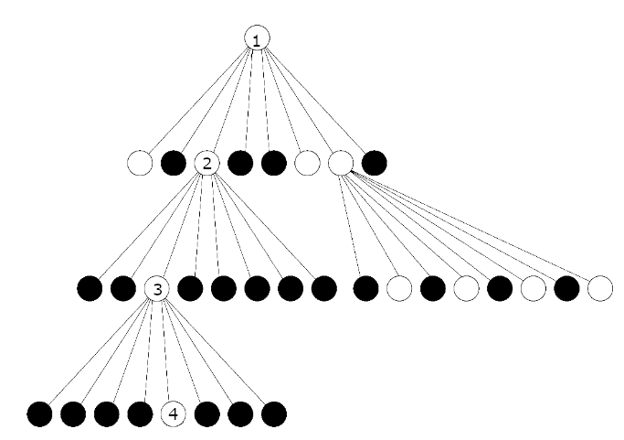
Updating Intermediate Log Odds
Updating a leaf node can change all intermediate nodes before it, except if:
The leaf is already stable
Log odds update of 0 (irrelevant)
Always updating the nodes is not desirable, as some values may not be changed.
Performing a search beforehand to verify if the update is relevant can mitigate this issue.
Fig 9. Octree with numerated nodes

Slide 18
Updating Log Odds Values
With Check
Without Check
Number of Updates
10 000 000
10 000 000
Average Execution time
4.5s
10.5s
43% performance boost when using the check before updating the values.

Slide 19
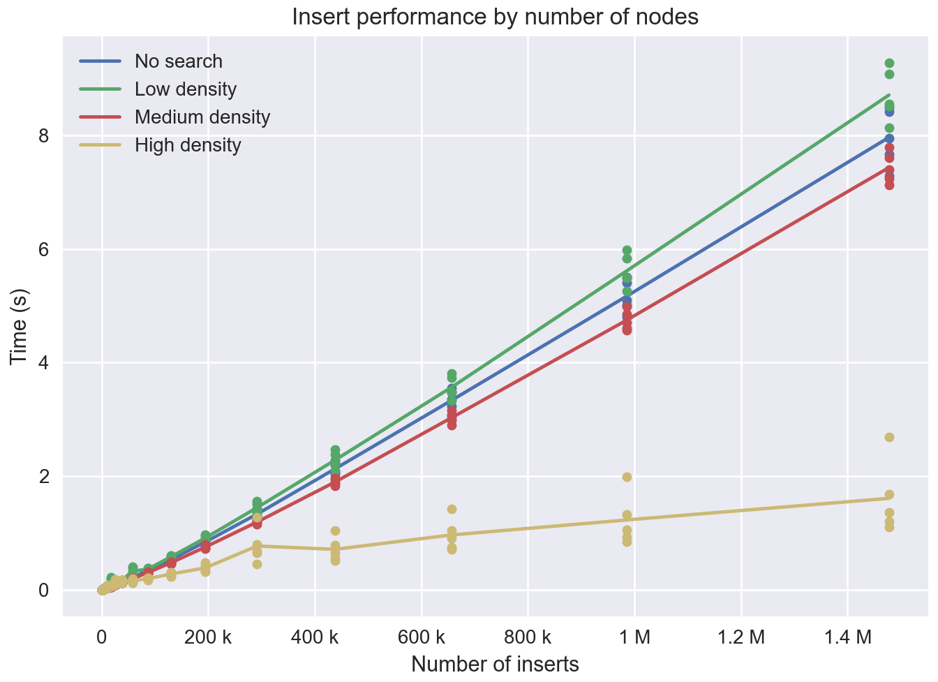
Comparing Results
Points followed a normal distribution with varying std:
μ = 10000
low σ = 5000
medium σ = 50
high σ = 5
Sonar data will more closely resemble the dense model
Fig 10. Inserting values into a tree with check and low locality.
Notes:
Green is worse due to the search’s overhead

Slide 20
Updating Log Odds - Strategy
200
0
Mean of children:
Minimizes error
Optimistic approach
May lower probability of node being empty while it is actually full
Max of children:
Pessimistic approach
Lowers odds of the UAV blindly going into occupied areas
nullptr
-400
- 8.33
-50
nullptr
-100
300
200
0
nullptr
-400
300
-50
nullptr
-100
300

Slide 21
Raycast Analysis

Slide 22
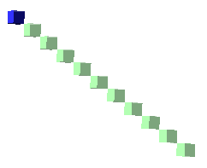
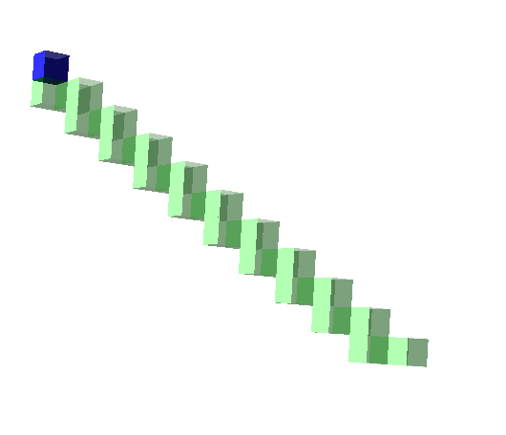
Bresenham vs DDA - Brief Overview
Bresenham’s line algorithm:
Travels in all axis at once
Handles diagonal transitions very well
Very accurate
Digital Differential Analyzer (DDA)
Travels in only one axis at a time
Goes in the direction of the closest axis
May miss the target (see next slide)
Fig 11. Bresenham’s Line Algorithm from the origin to a diagonal
Fig 12. DDA from the origin to a diagonal

Slide 23
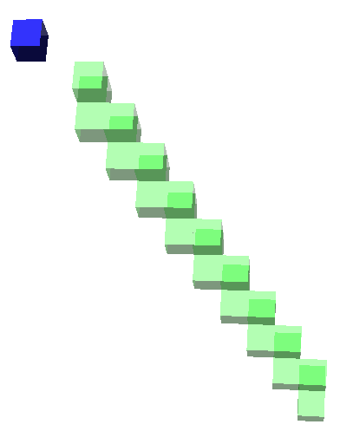
DDA misses
DDA may miss the target
Final portion of the beam may end up missing or off target.
Traditionally has 2 different stopping conditions
Current node is the destination (rare)
The distance travelled is larger than the distance between the start and end points, so we already travelled the required distance and should stop, as we are off-track and would never reach the end
Open source octomap implementation also suffers from these misses
Fig 13. DDA raycast missing
from (0, 0, 0) to (1, 1, 1)

Slide 24
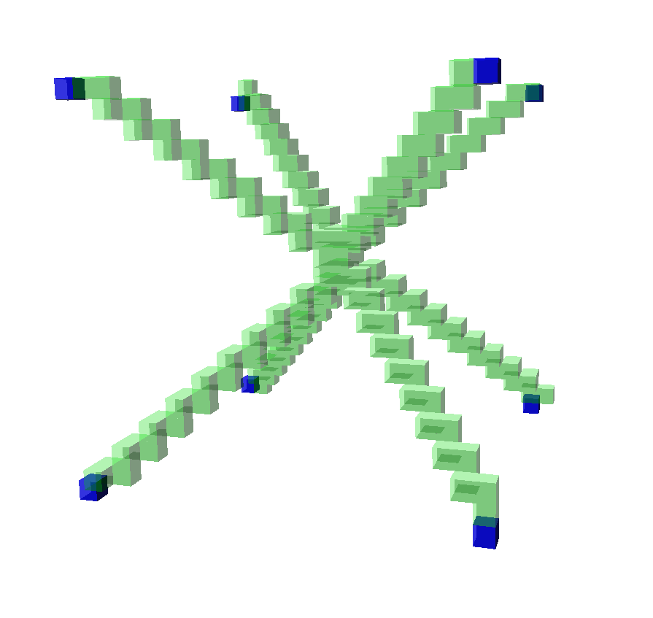
DDA misses - Finishing the raycast
Third custom condition, applied after the others fail:
When we stop early, we are guaranteed to be within the neighborhood of the target, thanks to DDA
We snap a final path towards the destination
Sometimes causes distortions in the end of the rays
But ensures we mark as empty all required the nodes until the destination
Is computationally expensive
Fig 14. Example of distortion at the end of the rays.

Slide 25
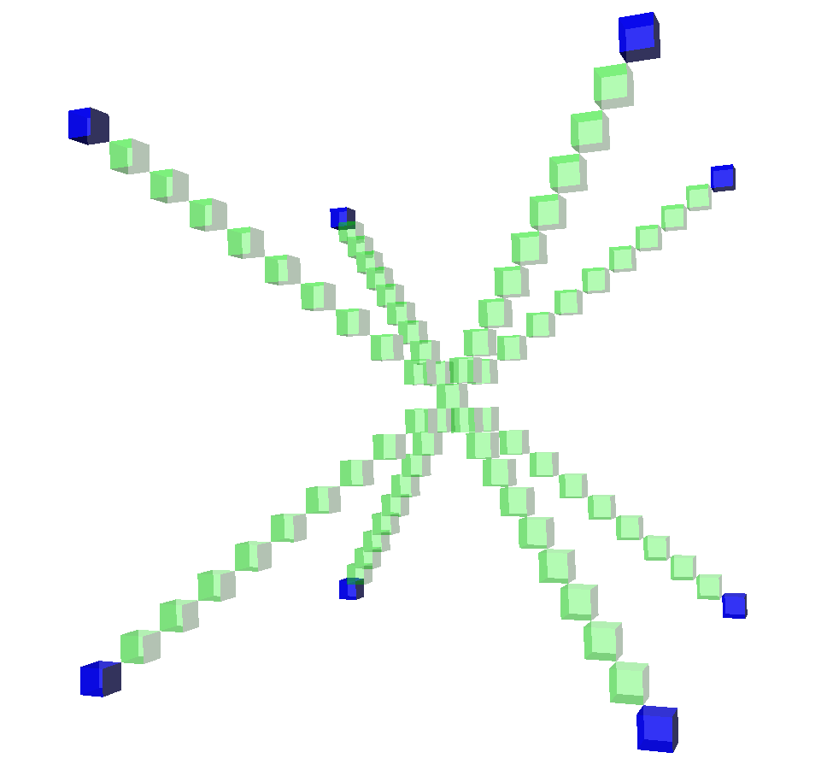
Bresenham vs DDA - Tradeoffs
Bresenham’s accuracy may not always be desirable;
Since it is similar to a laser, it does not represent the broader range of voxels the sonar scans.
Bresenham is more efficient than DDA and has simpler operations;
Additions/subtractions rather than multiplications/divisions.
Fig 15. Bresenham’s Line Algorithm from the origin to all diagonals
Fig 16. DDA from the origin to all diagonals
Notes:
DDA makes steps with resolution/abs(direction). DDA’s lack of accuracy can lead to situations where the ray never reaches the expected destination. This forces an additional verification using the expected ray length and the current ray length.

Slide 26
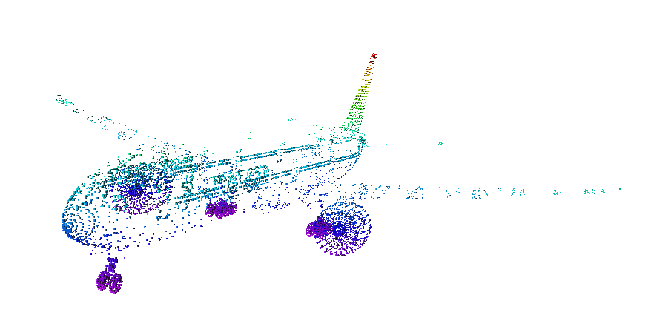
Comparing results
Parallelism obtained using OpenMP library.
A ray was cast from the origin, (0,0,0), to every node of the plane, a total of 20 991 638 nodes
Bresenham’s Line Algorithm
DDA
Average Time With Parallelism
Fig 17. Plane model obtained using the octomap implementation and ModelNet40’s point cloud
23.2s
35.3s
Average Time With No Parallelism
26.2s
63.3s
Notes:
not lazy update -> It’s suspected that parallelism is slower in Bresenham’s algorithm since it is much faster than DDA and as such it has to wait more time in order to access to critical sections of the code, which causes an overhead.

Slide 27
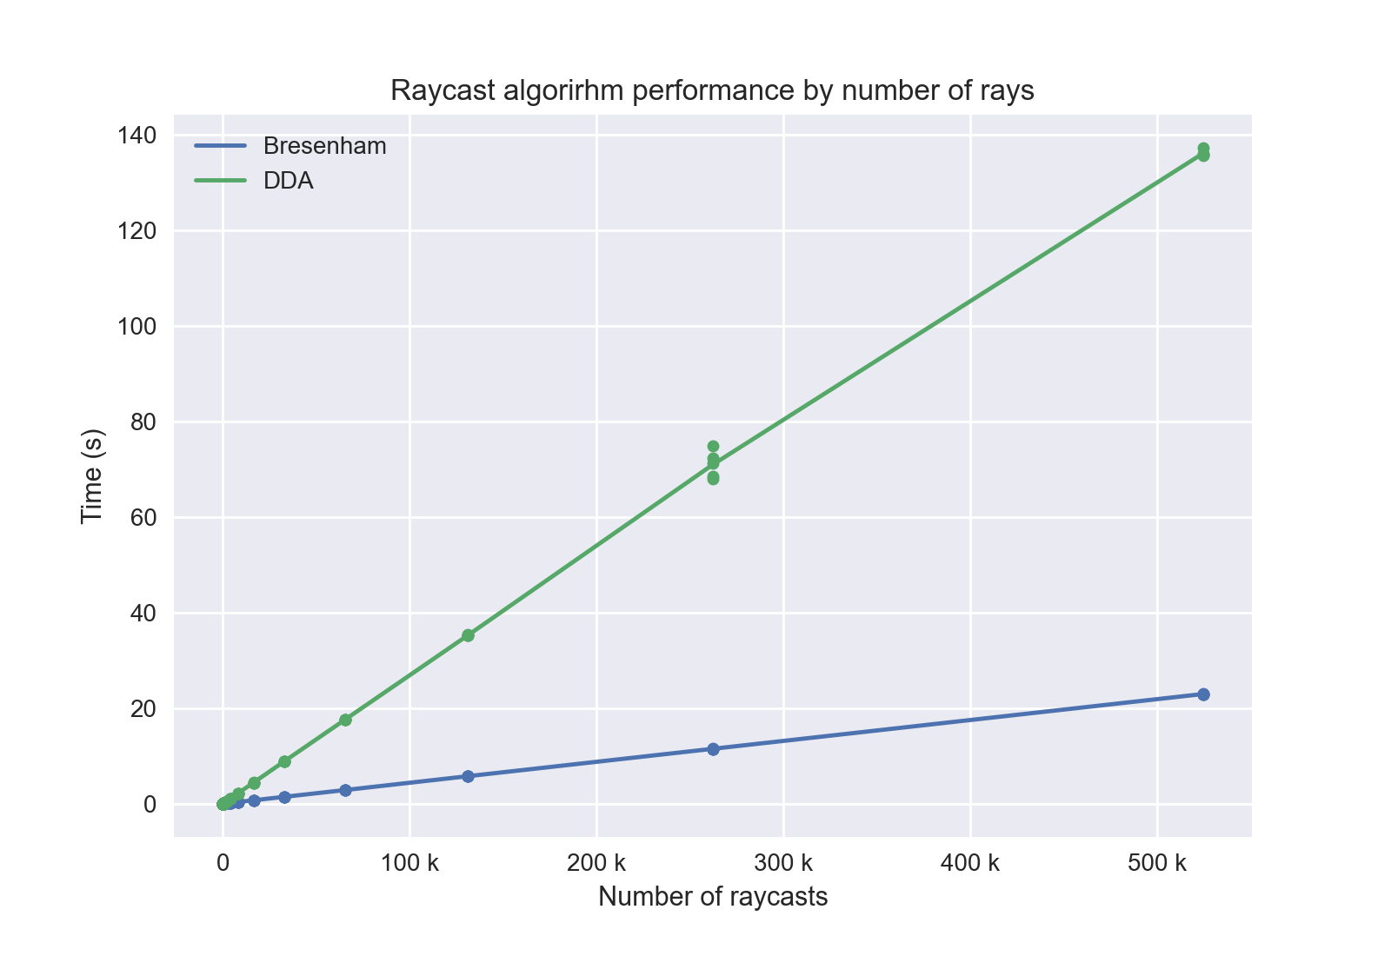
Comparing Results
For traditional applications, DDA would be preferable, as we want to find the first collision
For our use case, we only want the path from the origin to the target, so Bresenham’s performance and lack of misses indicate it will be the most beneficial to our project
Fig 18. Raycast algorithm performance comparison

Slide 28
Gaussian Filter Analysis

Slide 29
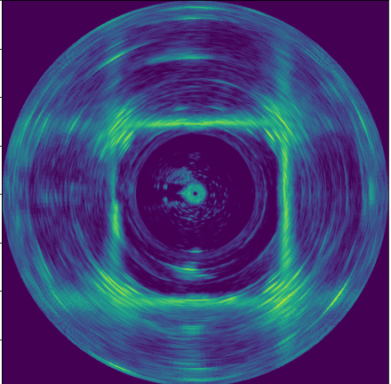
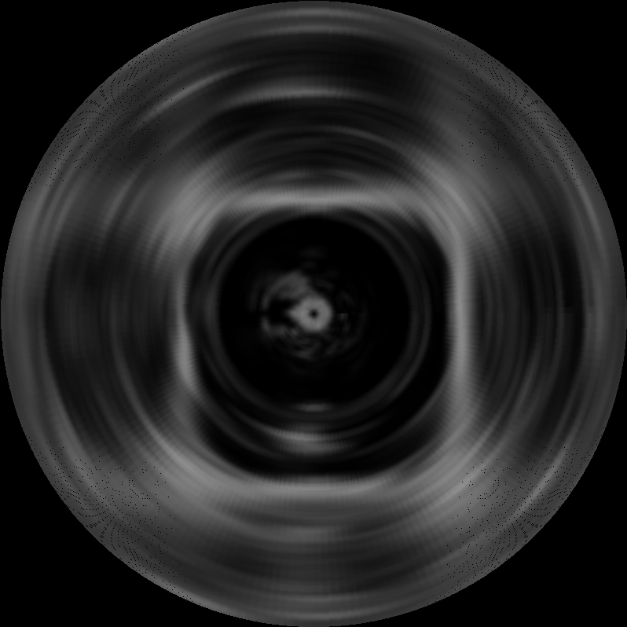
Gaussian Filter
Applies blur to the image in order to try to reduce the image noise.
Improves edge detection.
Applying the blur to a sweep, which contains 399 beams, takes 1 millisecond.
Fig 19. No filter
Fig 20. Gaussian filter

Slide 30
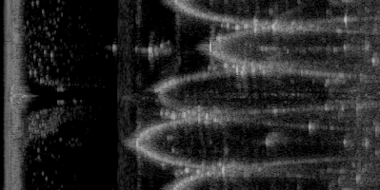
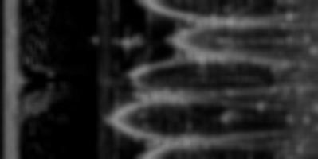
Gaussian Filter Parameter Tuning
Converting beam data into cartesian coordinates is too demanding
Applying the algorithms over the polar images proved to be reliable
Fig 21. No filter polar coordinates
After some experimentation, the following parameters yielded good results:
Sigma 2.3
Kernel size 11
Fig 22. Gaussian filter polar coordinates

Slide 31
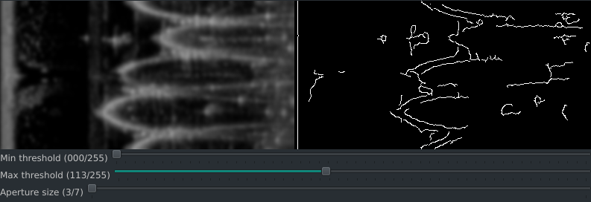
Edge Detection: First Approach
Applied over a Gaussian filter with kernel 11 and sigma 2.3
Fig 23. Canny algorithm for edge detection

Slide 32
Questions?
Notes:
"As nossas estruturas de dados foram implementadas de forma a conseguir uma boa localidade dos dados nas caches do CPU. Atráves do utilitario trace determinamos que temos muito poucos cache misses: que são o maior problema de performance de estruturas em arvore/linked lists"

Slide 33
Slides

