Slide 1
SLAM
Demo
EDAA — G06
João Martins
Henrique Ribeiro — João Costa
Tiago Duarte

Slide 2
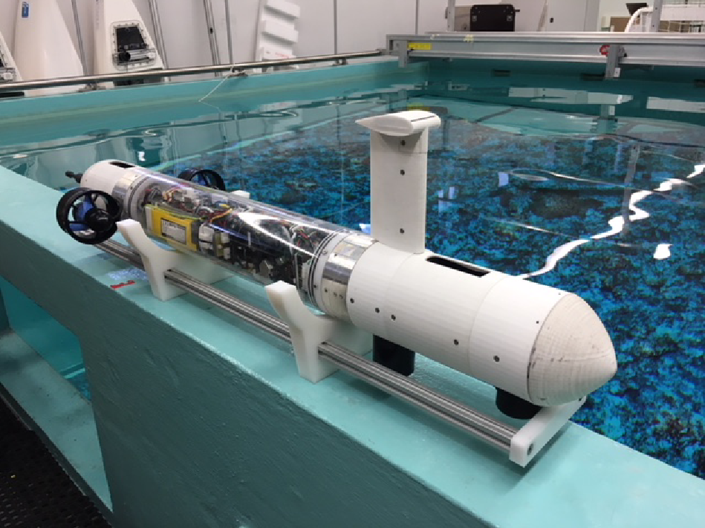
Simultaneous Location And Mapping
Goal – map an environment navigated by and autonomous vehicle, while simultaneously locating it in the map;
Challenges:
No access to pre-existing maps or external devices;
Focus on sub-aquatic SLAM ⇒ difficult access and extra data noise;
Datasets – the group will have access to sonar data measured by CRAS.
Fig 1. UAV used to collect the datasets.

Slide 3
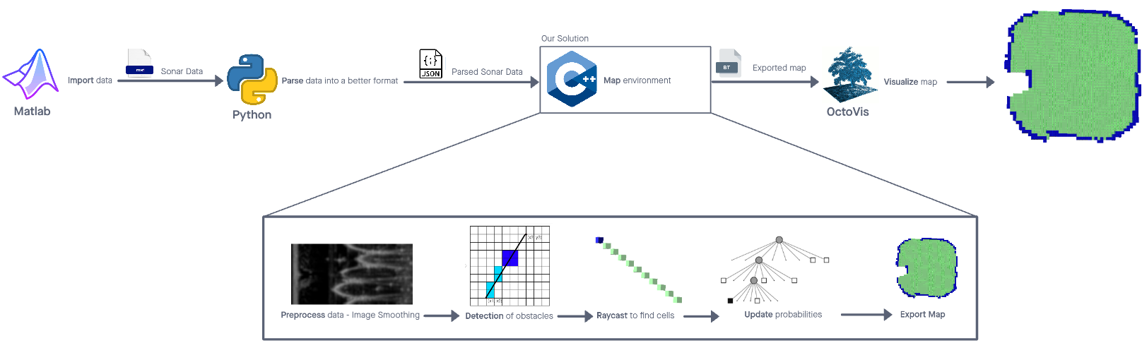
Pipeline

Slide 4
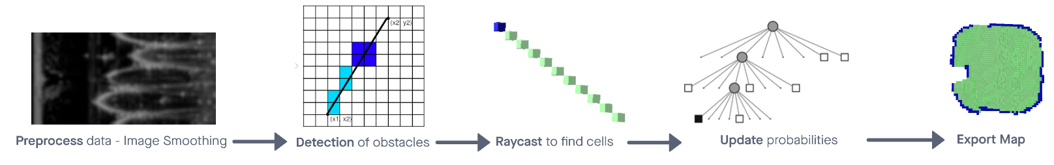
Pipeline

Slide 5
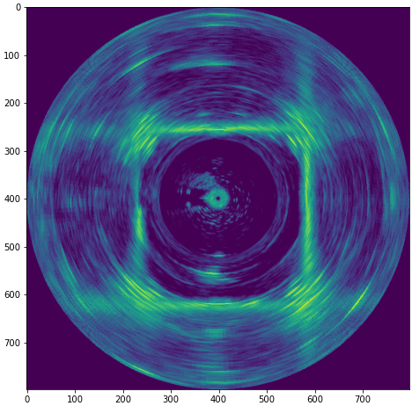
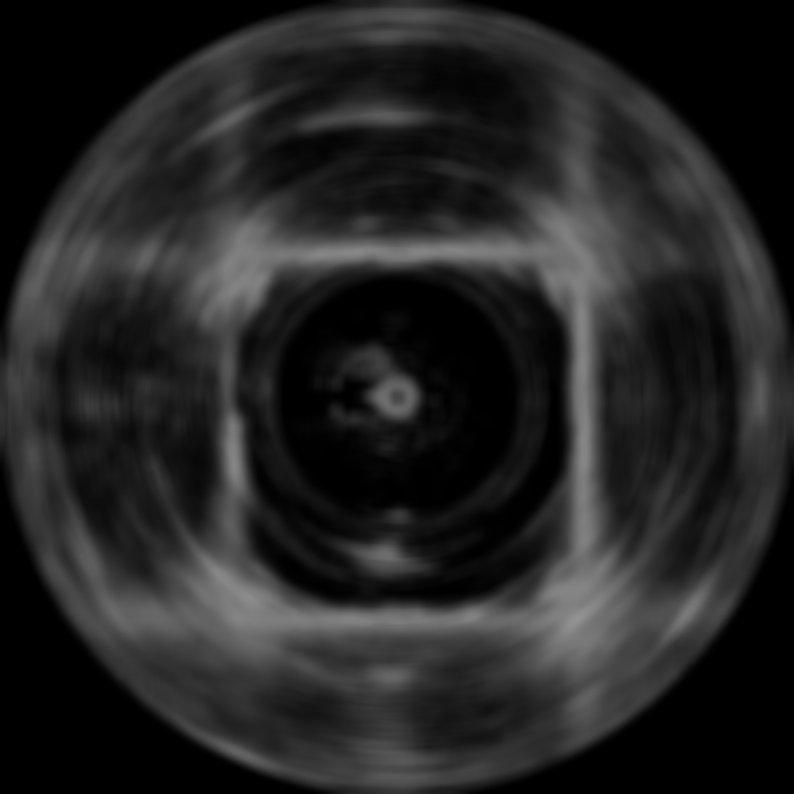


Data Preprocessing - Image Smoothing
Use blurring to reduce noise
Improves drastically edge detection
Applied to polar coordinates
Fig 27. Dataset representation in Cartesian coordinates.
Fig 28. Gaussian filter
Fig 29. Median filter
Fig 30. Mean filter

Slide 6
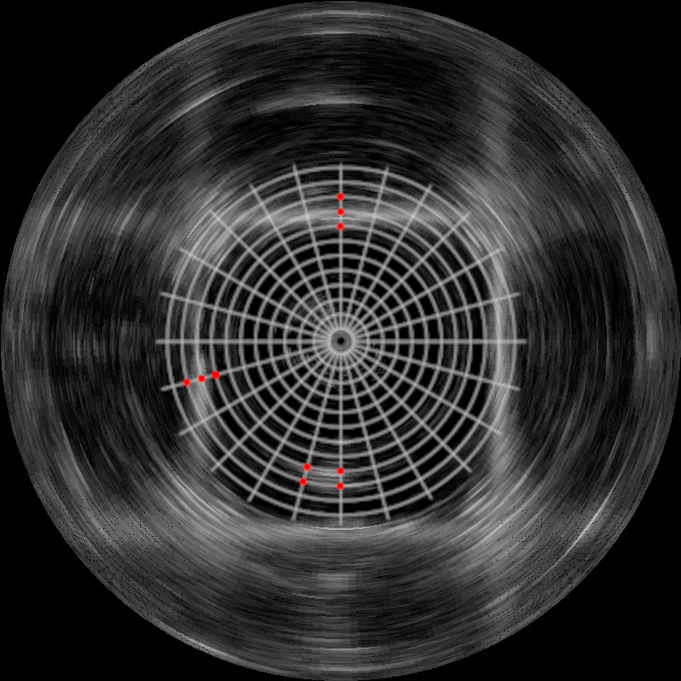
Obstacle Detection - Simple threshold
Calculate variation of intensities
Define a threshold
Variations above that threshold approach
Increased blur provides best results
Fig 23. Original Image
Fig 24. Scan with identified edges using simple threshold approach

Slide 7
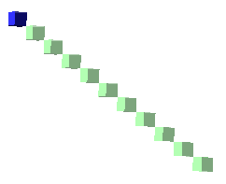
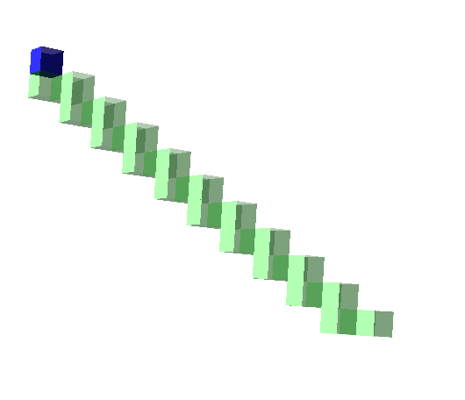
Raycasting - Bresenham vs DDA
Bresenham’s line algorithm:
Travels in all axis at once
Handles diagonal transitions very well
Very accurate
Digital Differential Analyzer (DDA)
Travels in only one axis at a time
Goes in the direction of the closest axis
May miss the target (see next slide)
Fig 11. Bresenham’s Line Algorithm from the origin to a diagonal
Fig 12. DDA from the origin to a diagonal

Slide 8
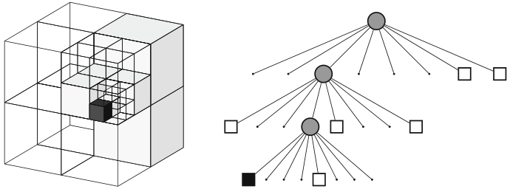
Octomaps/Octrees In Our Project
The octrees used in the max depth 16;
This depth leads to a 8^16-1 = 2.8147498e+14 nodes.
Resolution of 1 cm;
This resolution with the amount of nodes available lets up map a volume of 655 m³.
The octomap will be probabilistic:
3 types of cells: free, occupied, and unknown;
Each cell has a probability of being empty (log-odds)
> 0 more likely to be occupied
< 0 more likely to be empty
Unknown cells are uninitialized
Fig 1. Example of octree storing occupied (black) and free (white) cells (Hornung et al.)

Slide 9



Probabilistic Mapping [1]
Fig 11. Probability update formula.
Which can be converted to log-odds notation:
More efficient – Reduces multiplications/divisions
Fig 12. Probability update formula in log-odds.
Fig 13. Log odds formula.

Slide 10
Octovis Exporting
Exporting to octovis format;
Allows visualization of results using the octovis tool;
Implies some loss of information:
Node can only be full, empty, or unknown;
There’s no distinction between stable and unstable nodes.
Tool works well for the current use case, but has multiple problems that may prove disadvantageous in the future:
Clipping artifacts in dense areas;
Bugs on the controls;
Incorrect object culling when zoomed in (it can be impossible to observe small objects when the zoom level is close to the maximum).

