Slide 1
Semantic Genetic Programming on the GPU
João David & Ye Yang

Slide 2
Motivation
Knapsack genetic algorithm
Increase efficiency in genetic programming
Faster results leading to more improvements over a short period of time

Slide 3
Goal
Implement a genetic crossover algorithm on the GPU
Significant speedup in comparison with a CPU implementation

Slide 4
Approach
Syntax tree representation
Data set parser
Crossover algorithm
Two phase kernel call

Slide 5
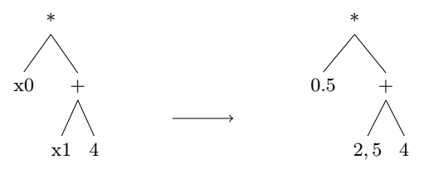
Data set parser & Syntax tree
Assuming the following data set line: [0,5 2,5 5,0 6,3]
and the following equation: x0 * ( x1 + 4)
RPN: 4 2,5 + 0,5 *

Slide 6

Fitness Function
Calculate fitness of trees with Mean Squared Error:
$$\frac{1}{n}\sum_{i=1}^{n}{{\left(O_{i}− T_{i}\right)}^{2}}$$
The lower the value the better the fitness

Slide 7
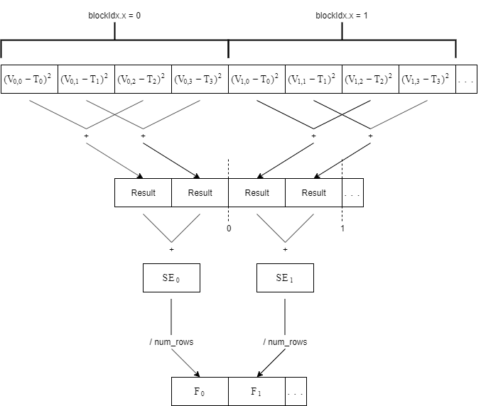
Fitness Calculation on the GPU

Slide 8
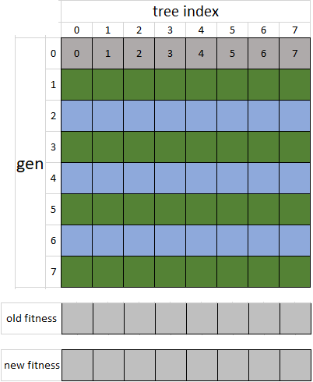
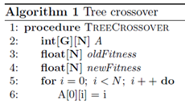
Crossover Algorithm

Slide 9
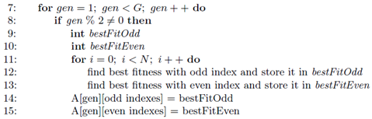
Odd generation

Slide 10
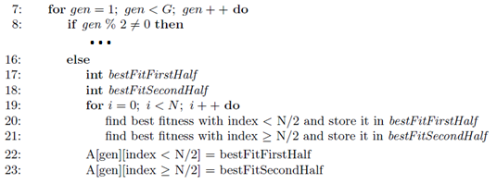
Even generation

Slide 11
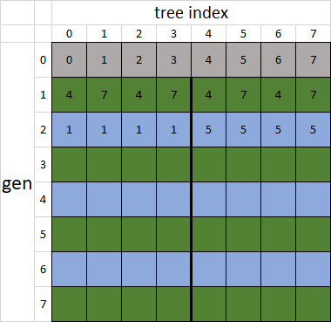
Generation matrix

Slide 12
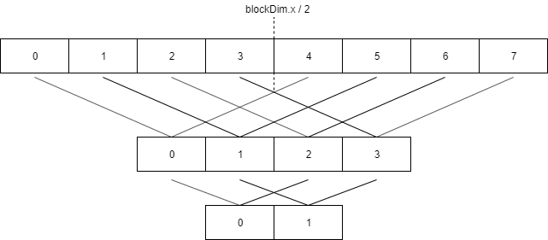
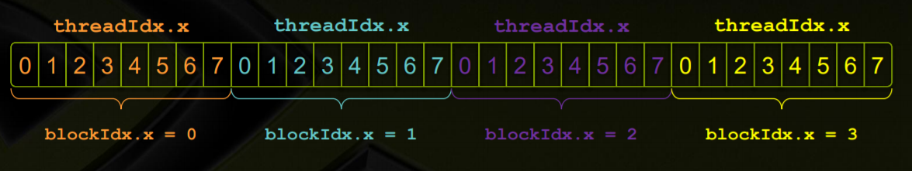
First Phase – odd generation

Slide 13
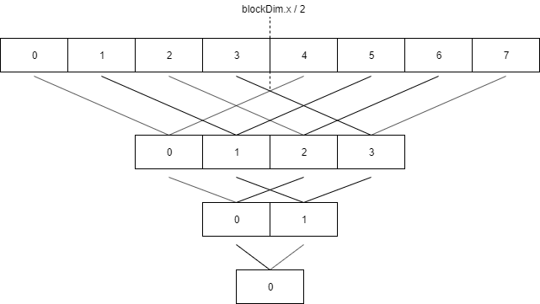
First Phase
Apply crossover algorithm

Slide 14


Second Phase
Find the best fitness computed by each block
Odd
generation
Even
generation

Slide 15
Biggest Challenge
Synchronization between blocks
Sharing state between kernel calls

Slide 16
Results

Slide 17
Future Work
Crossover algorithm optimization
Tree crossover and mutation for fitness tests
Final tree semantic check

