Slide 1

Pytest

Slide 2
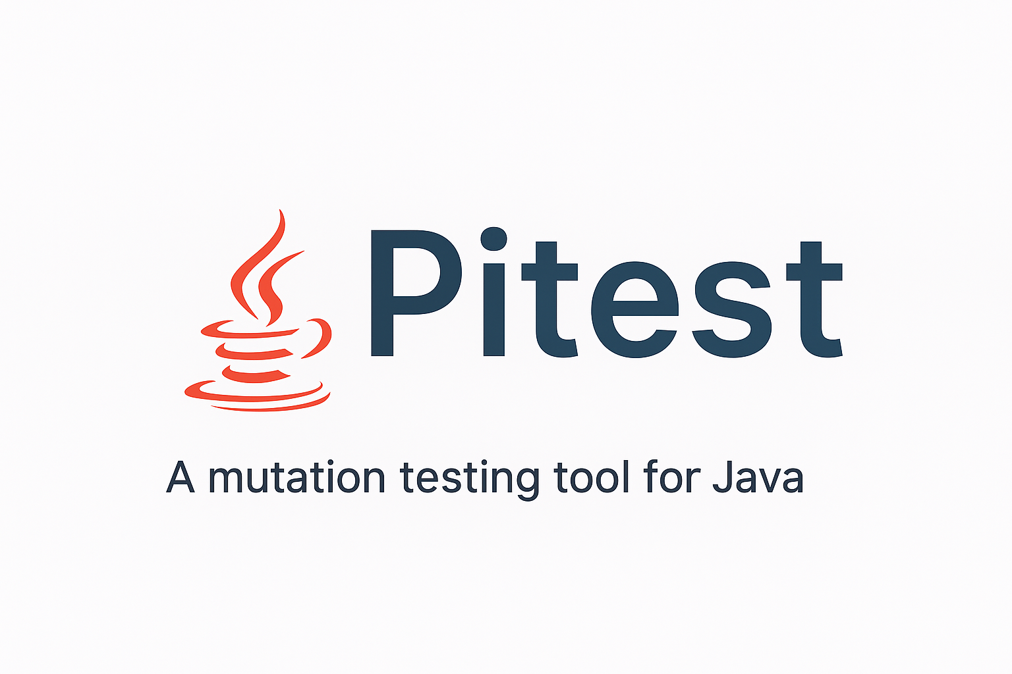

Slide 3
What is Pitest?
Mutation testing system for Java and the JVM
Introduces mutations to your code and checking if your existing test suite can detect these changes.

Slide 4
Key Features
Execution through bytecode manipulation
Integration with popular build tools (Maven, Gradle)
IDE plugins available
Supports JUnit and TestNG

Slide 5
Advanced Features
Incremental Analysis: Pitest can be configured to only run tests for changed code, which can significantly speed up the process.
Mutation Operators: Pitest provides a wide range of mutation operators that can be enabled or disabled to fine-tune the mutation testing process.
History Recording: Pitest can record the history of mutations, which can be used to track the quality of the test suite over time.
CI/CD Integration: Pitest can be integrated into CI/CD pipelines to automatically run mutation testing on every build.

Slide 6
What is Mutation Testing?
Mutation testing evaluates the quality of your test suite by:
  1. Creating Mutants: Small changes are made to your source code
  2. Running Tests: Your test suite runs against each mutant
  3. Measuring Detection: Tests should fail when run against mutants
  4. Calculating Score: Percentage of mutants killed by your tests

Slide 7
Example Mutations
- Change `>` to `>=` or `<`
- Replace `true` with `false`
- Change `+` to `-`
- Remove method calls
- Modify constants

Slide 8
Pitest Metrics Explained
Mutation Score: `(Killed Mutants / Total Mutants) × 100`
Killed: Test failed when run against mutant (good!)
Survived: Test passed despite code change (potential issue)
No Coverage: Mutant in uncovered code
Timed Out: Mutant caused infinite loop

Slide 9
Target Scores probably to be cut
60-70%: Reasonable for most projects
80%+: Excellent mutation coverage
100%: Often impractical due to equivalent mutants

Slide 10
Live Demo
Reserved to live demo

Slide 11
Comparing calculator before and after applying changes
Reserved to showing how the cover changed

Slide 12
Report Analysis
* ps this will probably be replaced for a report demo
Pitest generates detailed HTML reports showing:
- Overall mutation statistics
- Class-by-class breakdown
- Specific mutants created
- Which tests killed which mutants
- Surviving mutants requiring attention

Slide 13
Key Actions
1. Focus on surviving mutants first
2. Add tests to kill surviving mutants
3. Review equivalent mutants
4. Iterate to improve mutation score

Slide 14
Pros
Improves Test Suite Quality: Mutation testing provides a much more accurate measure of test suite quality than traditional code coverage.
Finds Real Faults: It can find real faults in your code that are not caught by your existing tests.
Increases Confidence: A high mutation score gives you more confidence in your test suite and your code.
Drives Better Testing Practices: It encourages developers to write better, more effective tests.

Slide 15
Cons
Execution Time: Mutation testing can be significantly slower than running traditional unit tests, especially for large projects.
Equivalent Mutants: A significant number of mutants can be "equivalent," meaning they don't change the program's behavior. Identifying and ignoring them can be time-consuming.
Complex to Set Up: Configuring mutation testing tools like Pitest can be complex, with many options to tune.
Interpreting Results: Analyzing the results and figuring out how to kill surviving mutants can be challenging.

