Slide 1

Redis Deep Dive
REmote DIctionary Server
An In-Memory Data Store for High-Performance Applications
POC: https://github.com/JoaoGuilhermedeSa/redis-clone

Slide 2
What is Redis?
An open-source, in-memory, NoSQL key-value data store.
Can be used as a database, cache or message broker and more
It uses client-server model.

Slide 3
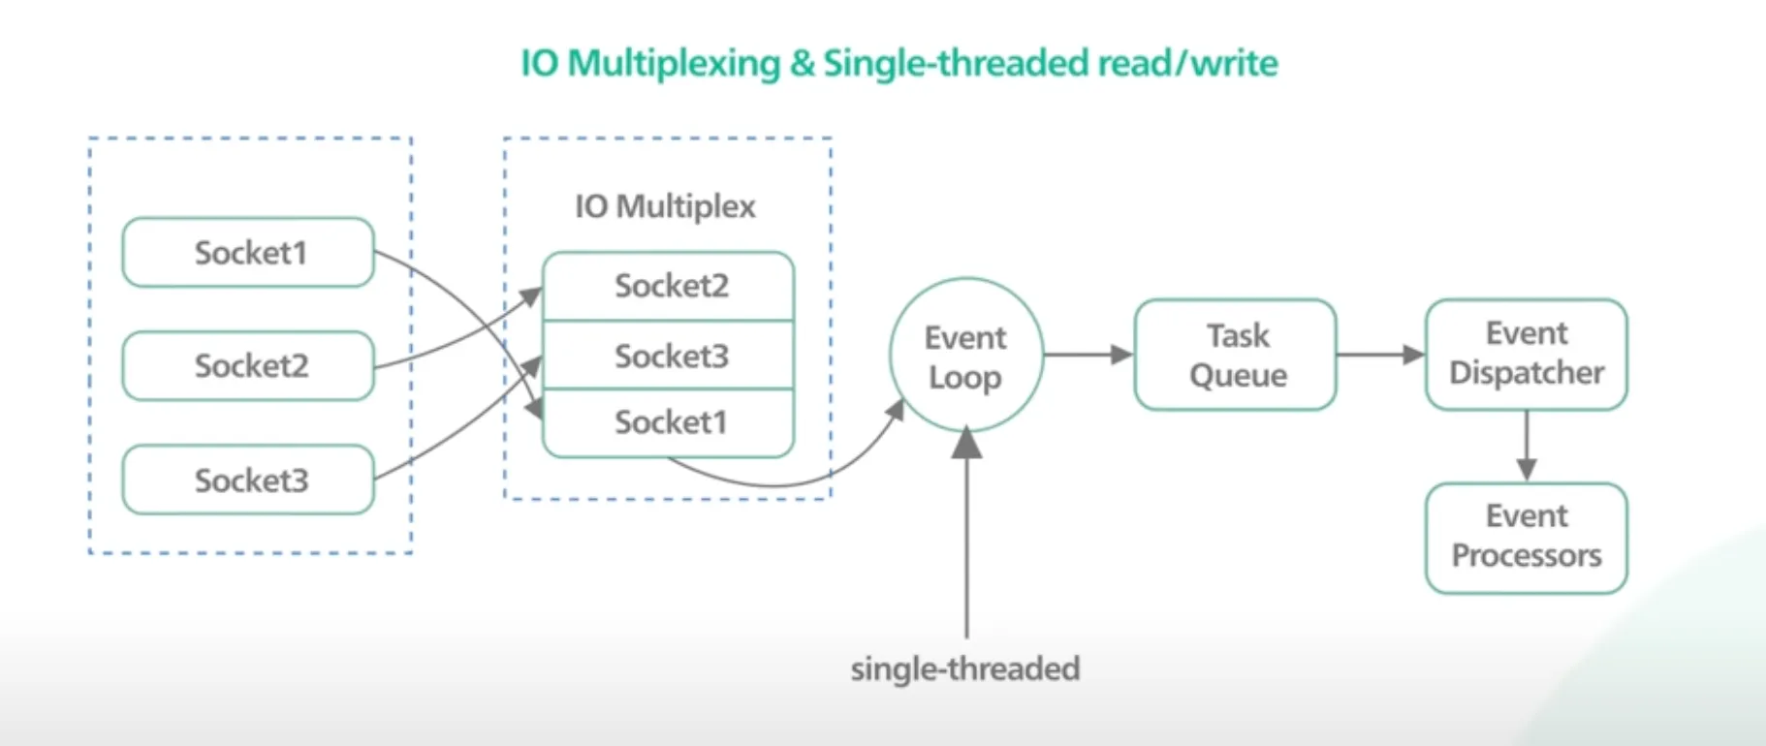
What Makes Redis Fast?
In-Memory Storage: Entire dataset in RAM for microsecond access.
Single-Threaded Model: Processes one command at a time
I/O Multiplexing: Handles thousands of client connections with a single thread and non-blocking I/O using epoll/kqueue/select.

Slide 4

Redis Data Types
String
Hash
List
Set
Sorted set
Vector set
Stream
SET bike:1 Deimos
HSET bike:1 model Deimos brand Ergonom type 'Enduro bikes' price 4972
LPUSH bikes:repairs bike:1
SADD bikes:racing:france bike:1
ZADD racer_scores 10 "Norem"
VADD points VALUES 2 1.0 1.0 pt:A
XADD race:france * rider Castilla speed 30.2 position 1 location_id 1

Slide 5
Redis Data Types
Bitmap
Bitfield
Geospatial
JSON
Probabilistic data types
Time series
BITCOUNT pings:2024-01-01-00:00
BITFIELD bike:1:stats SET u32 #0 1000
GEOSEARCH bikes:rentable FROMLONLAT -122.2612767 37.7936847 BYRADIUS 5 km WITHDIST
JSON.SET newbike $ '["Deimos", {"crashes": 0}, null]'
PFADD bikes Hyperion Deimos Phoebe Quaoar
TS.ADD sensor1 * 26

Slide 6
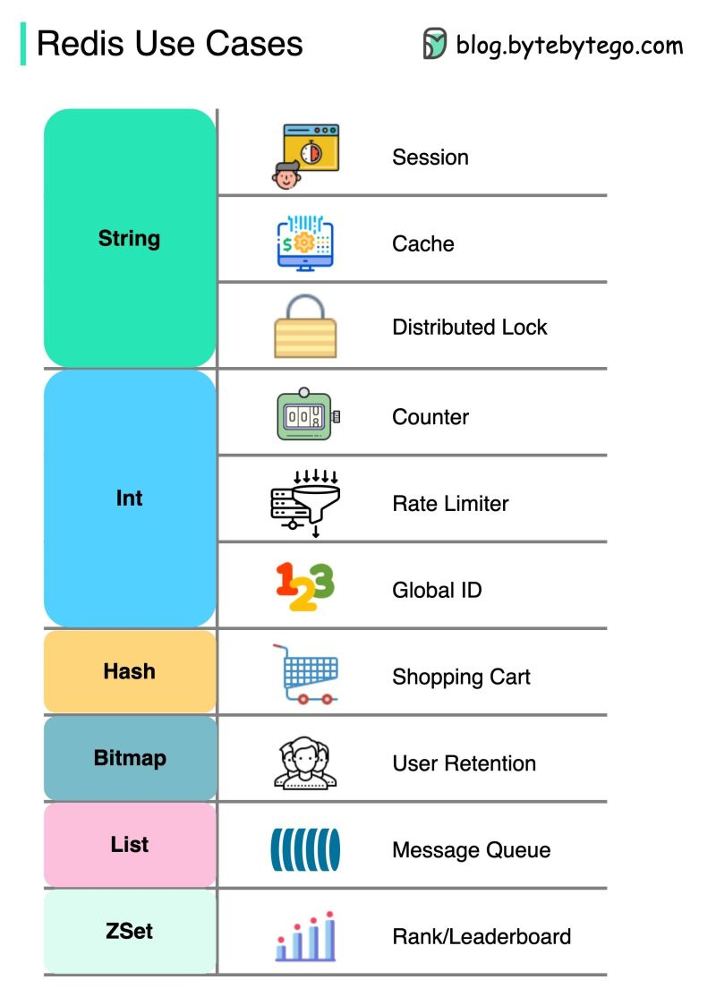
Common Use Cases
Caching
Analytics
Messaging (pub/sub w/ at most once delivery)
Session Management
Geolocation apps

Slide 7
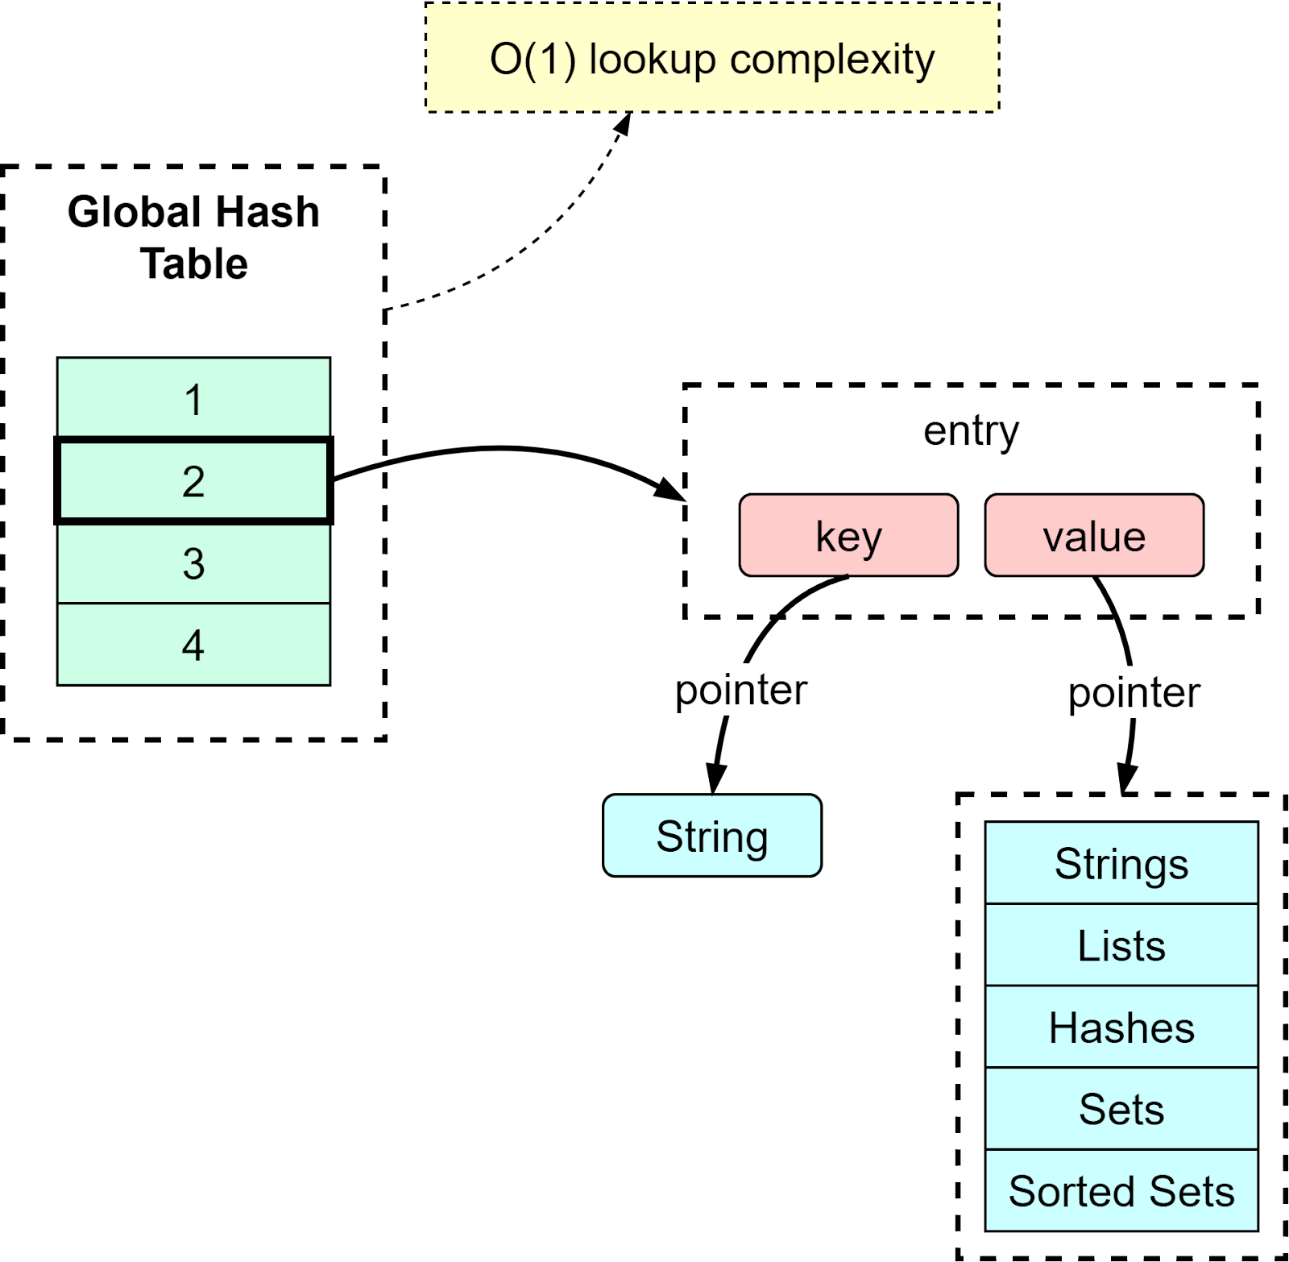
Redis Data Structure
typedef struct dict { dictType *type; dictEntry **ht_table[2]; unsigned long ht_used[2];
long rehashidx; }
- `ht[0]`: Main hash table- - `ht[1]`: Used during rehashin - `rehashidx`: Tracks incremental rehashing progress

Slide 8
Redis Rehashing
When the load factor is high Redis starts rehashing:
A new table is allocated in ht[1]
A few buckets are moved from ht[0] → ht[1] on each operation
When done, ht[1] replaces ht[0]
typedef struct dict { dictType *type; dictEntry **ht_table[2]; unsigned long ht_used[2];
long rehashidx; }
- `ht[0]`: Main hash table- - `ht[1]`: Used during rehashin - `rehashidx`: Tracks incremental rehashing progress

Slide 9
Redis LRU
Least Recently Used removes keys that haven't been accessed in the longest time:
Each key has an LRU timestamp
On memory pressure, Redis samples multiple keys and evicts the most stale ones
typedef struct redisObject {
unsigned type:4;
unsigned encoding:4;
unsigned lru:22;
…
}

Slide 10
Redis LRU
noeviction - Return error when memory is full
Allkeys-lru - LRU among all keys
Volatile-lru - LRU among keys with `expire` set
Allkeys-random - Evict random keys
Volatile-ttl - Evict keys with shortest TTL

Slide 11
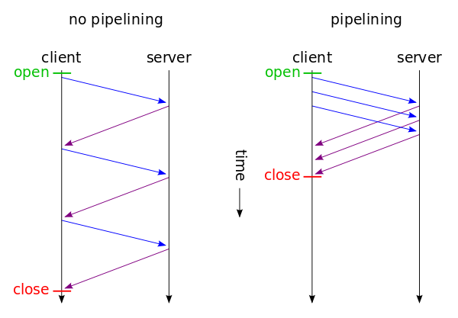
Redis Pipelining
Primarily a client-side optimization
(printf "PING\r\nPING\r\nPING\r\n"; sleep 1) | nc localhost 6379
+PONG
+PONG
+PONG

Slide 12
Redis Batch Processing
Transactions with MULTI/EXEC or Lua Scripts
> MULTI
OK
> INCR foo
QUEUED
> INCR bar
QUEUED
> EXEC
1) (integer) 1
2) (integer) 1

Slide 13
Optional Persistence
RDB (Redis Database): Point-in-time snapshots of your dataset. Compact and good for backups.
AOF (Append Only File): Logs every write operation. More durable than RDB.
You can use both RDB and AOF for enhanced data safety.

Slide 14
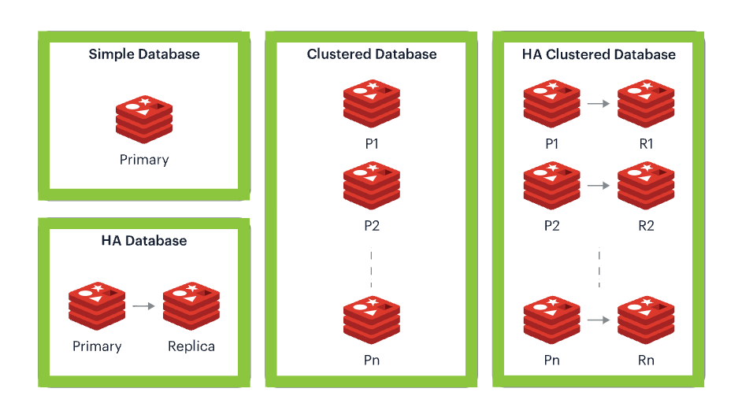
High Availability & Scalability
Replication (Master-Replica): Replicates data to one or more secondary servers for fault tolerance and read scaling.
Redis Sentinel: automatic failover if a master instance becomes unavailable.
Redis Cluster: Automatically shards data across multiple nodes for horizontal scaling.

Slide 15
Redis Cluster
16,384 hash slots for routing divided between master nodes
Clients can discover the cluster topology automatically.
MOVED Redirects
Online Resharding
Only support operations in multiple keys if they are in the same shard.

Slide 16
Pros of Using Redis
Speed
Rich Data Structures
Scalability
Extreme Versatility
Extensibility using modules
Configurable Persistence
High Availability

Slide 17
Cons of Using Redis
High Memory Usage
Limited Querying Capabilities
Single-Threaded Nature
Complexity in Clustering
Basic Security Model

Slide 18
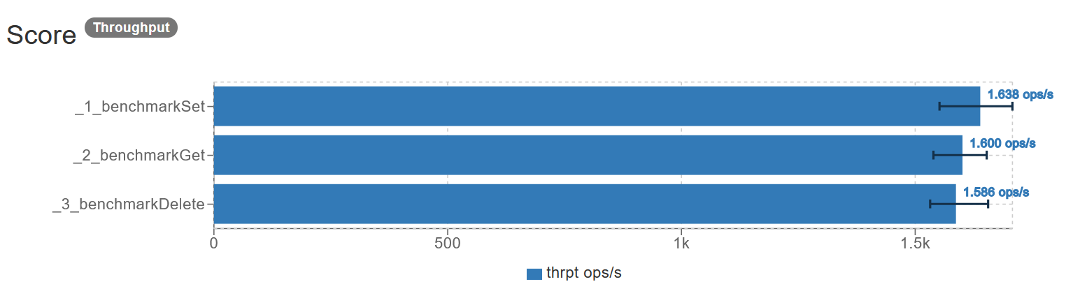
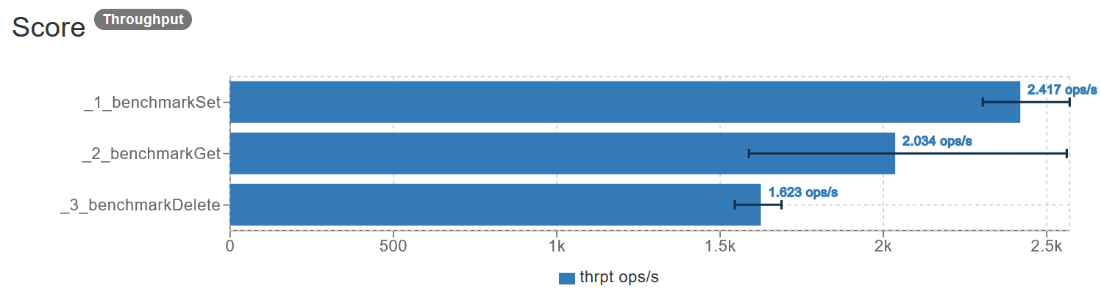
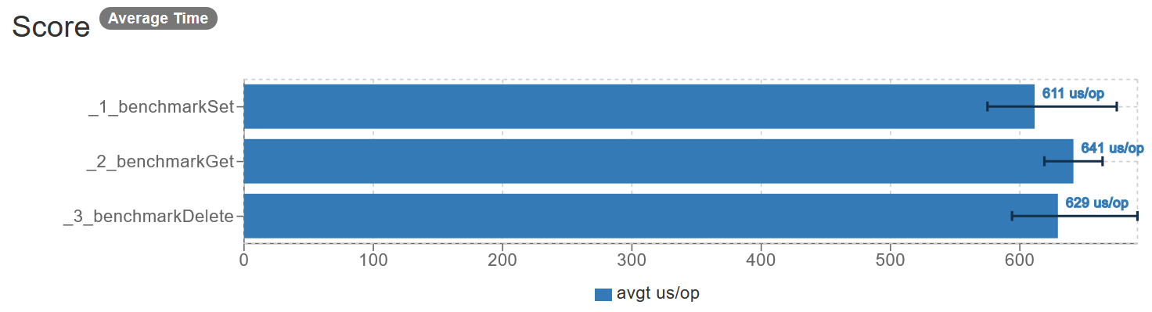
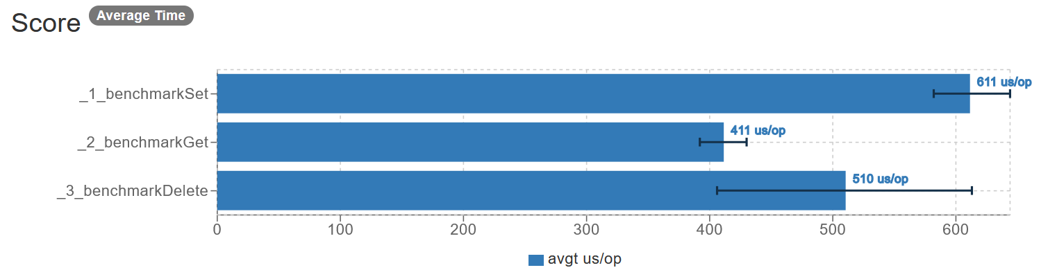
Benchmarks vs Valkey
Redis Valkey
4 Cpus, 2gb

Slide 19
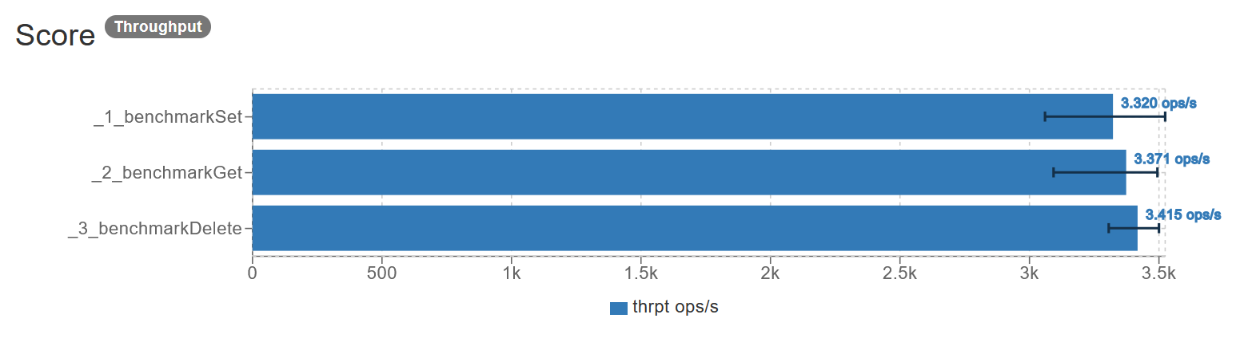
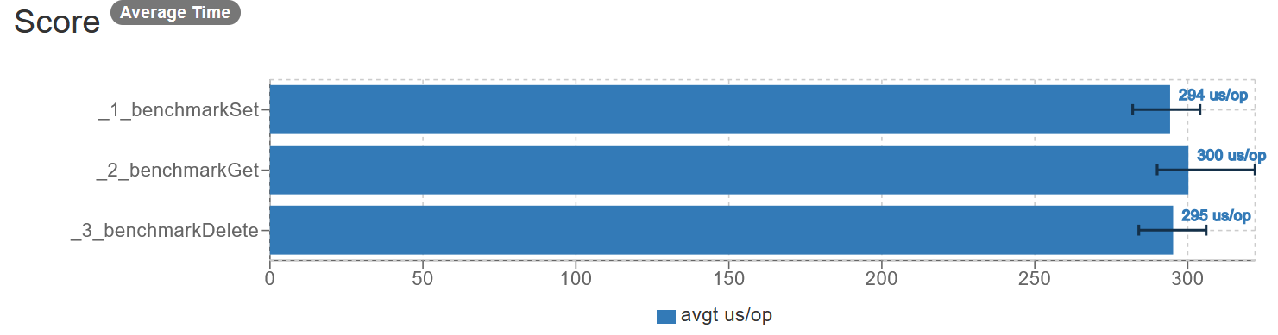
Benchmarks vs Memcached
Redis Memcached
4 Cpus, 2gb

Slide 20





Companies that use Redis

Slide 21
Links
How Roblox Keeps Millions of Users up to Date with Redis Pub/Sub: https://www.youtube.com/watch?v=nXTxXSWBayg
RedisConf 2021: Lessons learned operating Redis Clusters at Roblox: https://www.youtube.com/watch?v=KLOxSCpImdk
https://redis.io/glossary/redis-race-condition/
https://www.uber.com/en-BR/blog/how-uber-serves-over-40-million-reads-per-second-using-an-integrated-cache/https://www.uber.com/en-BR/blog/how-uber-serves-over-40-million-reads-per-second-using-an-integrated-cache/https://www.uber.com/en-BR/blog/how-uber-serves-over-40-million-reads-per-second-using-an-integrated-cache/:

