Slide 1
Spring Data Redis
Simplifying Redis Integration in Spring Applications

Slide 2
What is Spring Data Redis?
Part of the Spring Data Family
Simplifies Redis Integration;

Slide 3
Key features
RedisTemplate for low-level, flexible access
High-level abstractions like Repositories for object mapping.
Robust Pub/Sub messaging support.
Seamless integration with Spring's caching abstraction
Supports redis streams

Slide 4
Redis Template
Handles connection management and serialization for you.
You get specific "operations" objects from the template:
`opsForValue()` -> String operations
`opsForHash()` -> Hash operations
`opsForList()` -> List operations
`opsForSet()` -> Set operations
`opsForZSet()` -> Sorted Set operations

Slide 5
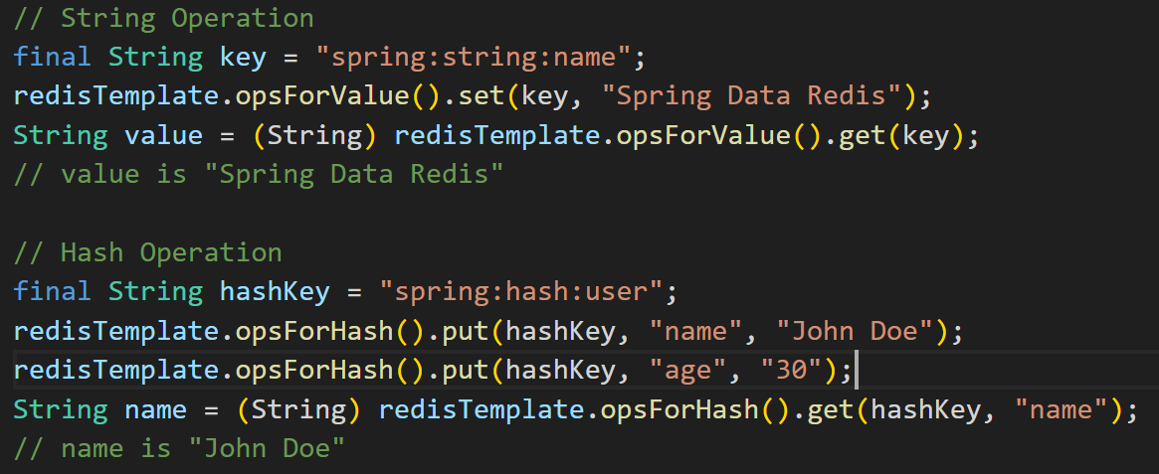
Redis Template

Slide 6
Repositories
Spring Data Redis allows you to use the familiar Repository pattern you may know from JPA.
It maps your Java objects directly to Redis Hashes.

Slide 7
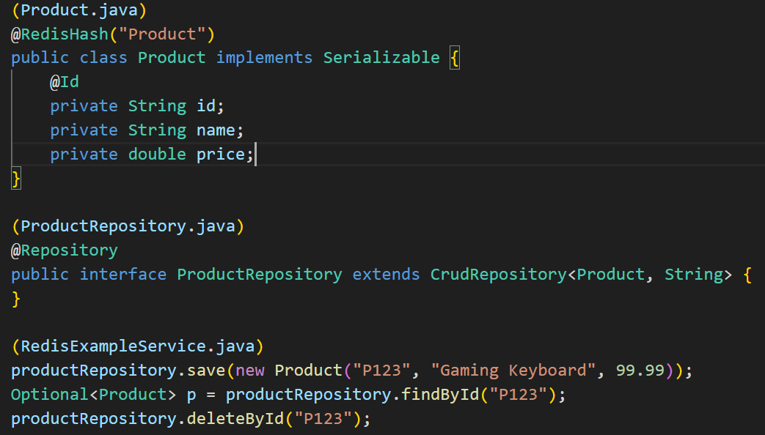
Repositories

Slide 8
Spring Data Rest with Redis
You can expose your Redis repositories over a REST API using Spring Data REST.
It's excellent for simple, key-value based CRUD operations.
Limitations:
Redis is not a query-focused database like SQL or MongoDB.
Spring Data REST cannot automatically generate complex query methods for Redis repositories (e.g., `findByNameContaining`)
Complex queries on nested data in Redis would often require fetching entire objects and then filtering them in memory

Slide 9
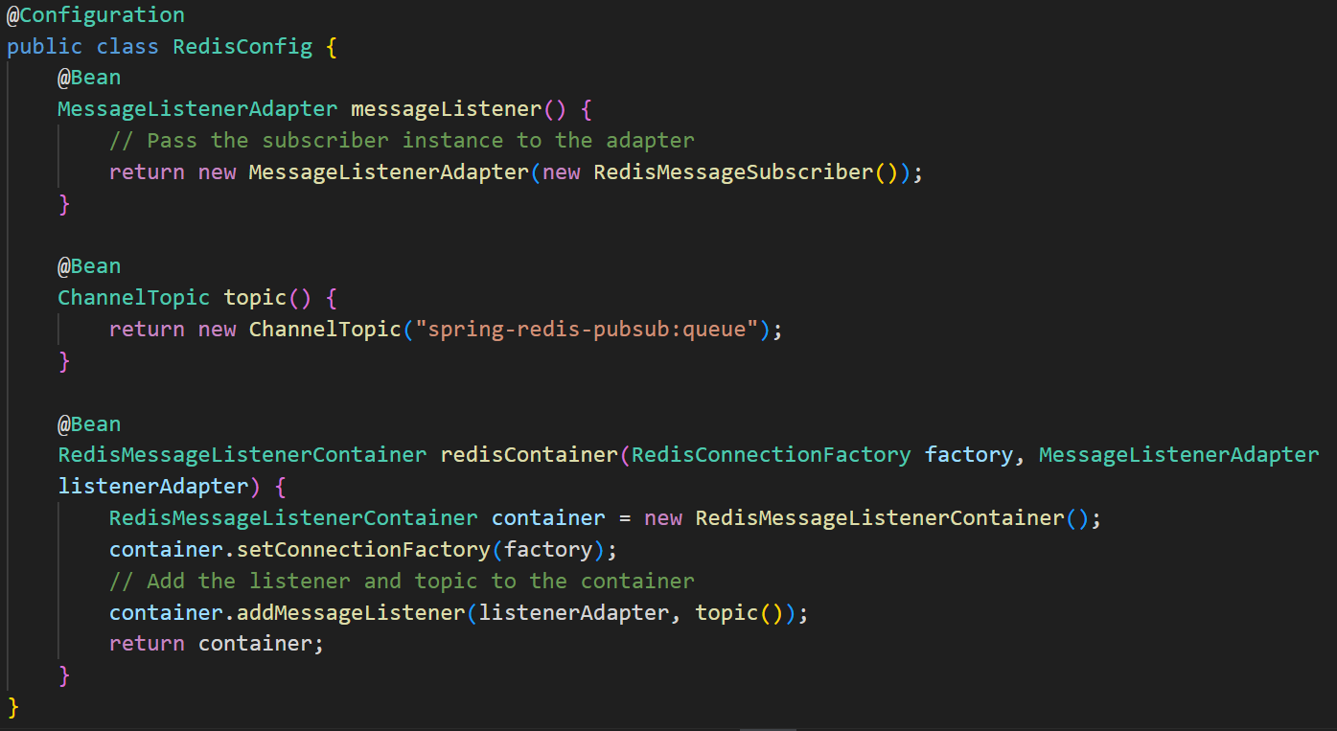
Redis Pub/Sub

Slide 10
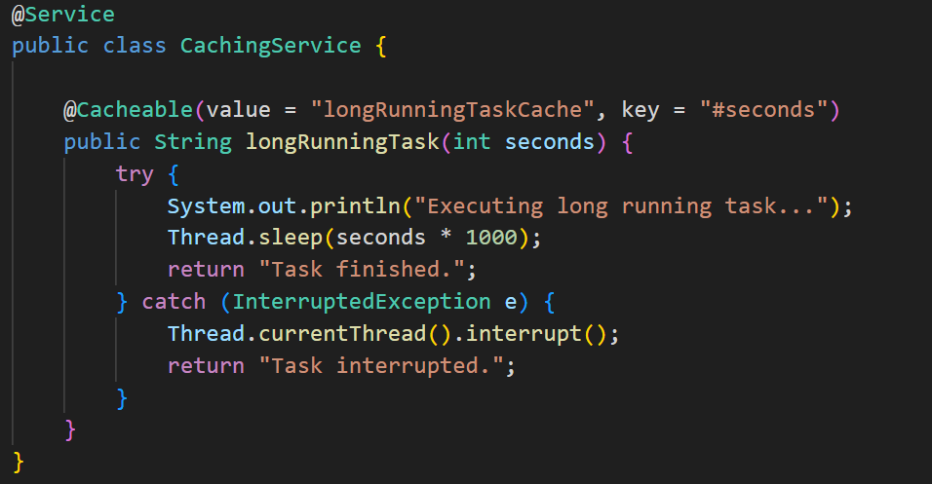
Caching
Spring Boot makes using Redis for caching incredibly simple.

Slide 11
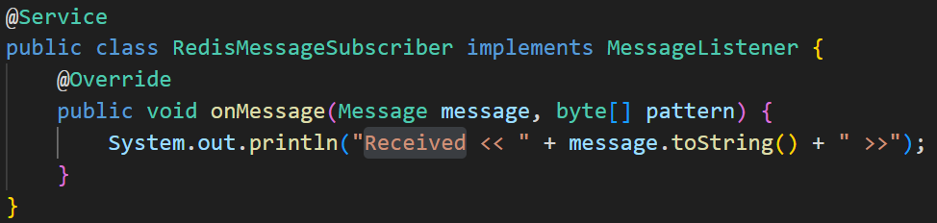
Redis Pub/Sub

Slide 12
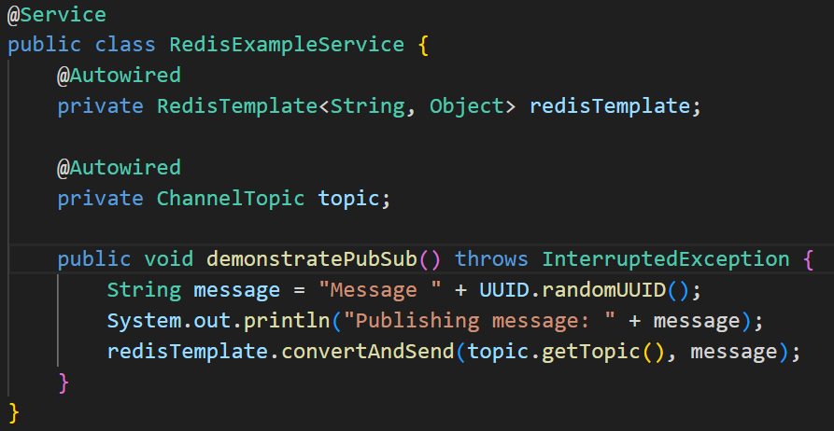
Redis Pub/Sub

Slide 13
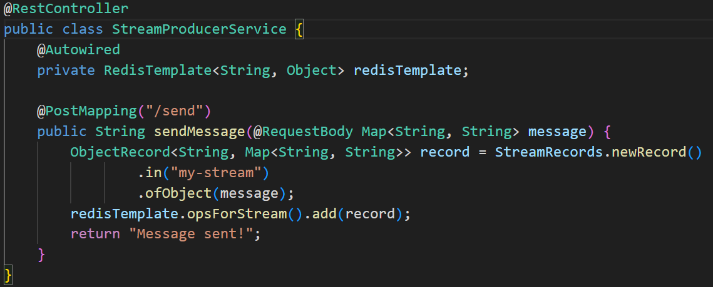
Redis Streams

Slide 14
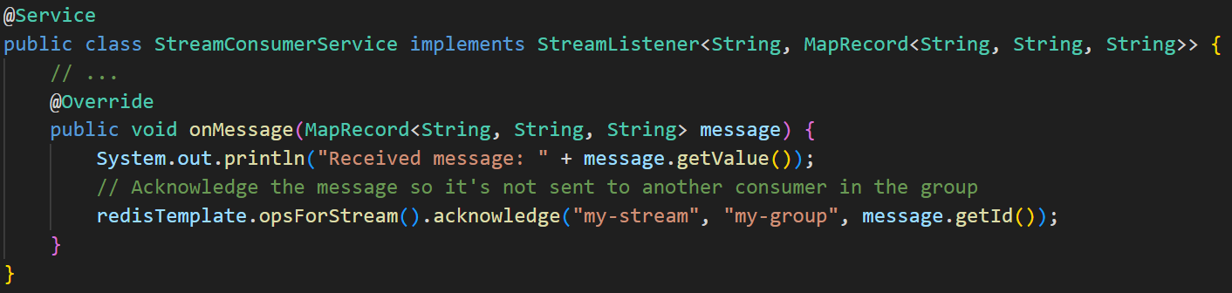
Redis Streams

Slide 15
Pros and cons
Pros
Productivity Boost
Consistent Data Access
High-Level Abstractions
Driver Management
Automatic Serialization
Cons
Abstraction Overhead
Limited Querying
Learning Curve for Advanced Features

