Slide 1
Spring Data Redis
Simplifying Redis Integration in Spring Applications

Slide 2
What is Spring Data Redis?
Part of the Spring Data Family
Simplifies Redis Integration
Uses Lettuce as the default driver, also supports Jedis
Supports cluster and sentinel for scalability and high availability

Slide 3
Key features
RedisTemplate for low-level, flexible access
High-level abstractions like Repositories for object mapping.
Robust Pub/Sub messaging support.
Seamless integration with Spring's caching abstraction
Supports redis streams

Slide 4
Redis Template
Handles connection management and serialization for you.
Serializers and connection factories can both be customized.
ReactiveRedisTemplate and ReactiveRedisOperations for reactive applications.

Slide 5
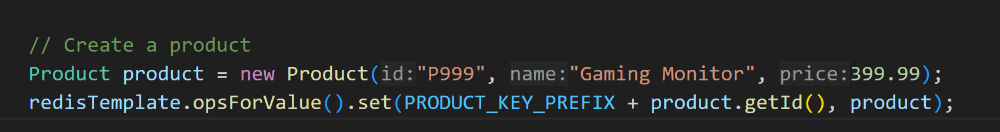
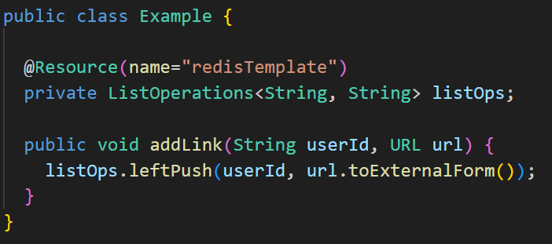
Redis Template

Slide 6
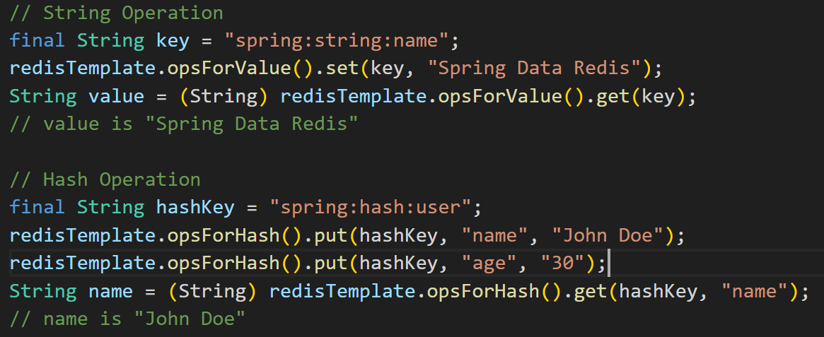
Redis Template

Slide 7
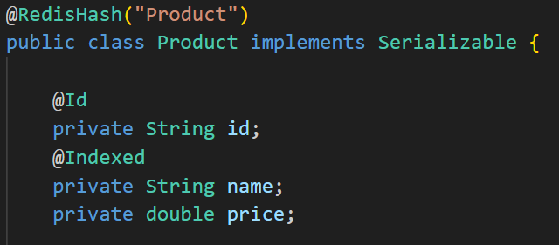
Repositories
Spring Data Redis allows you to use the familiar Repository pattern you may know from JPA.
It maps your Java objects directly to Redis Hashes.

Slide 8
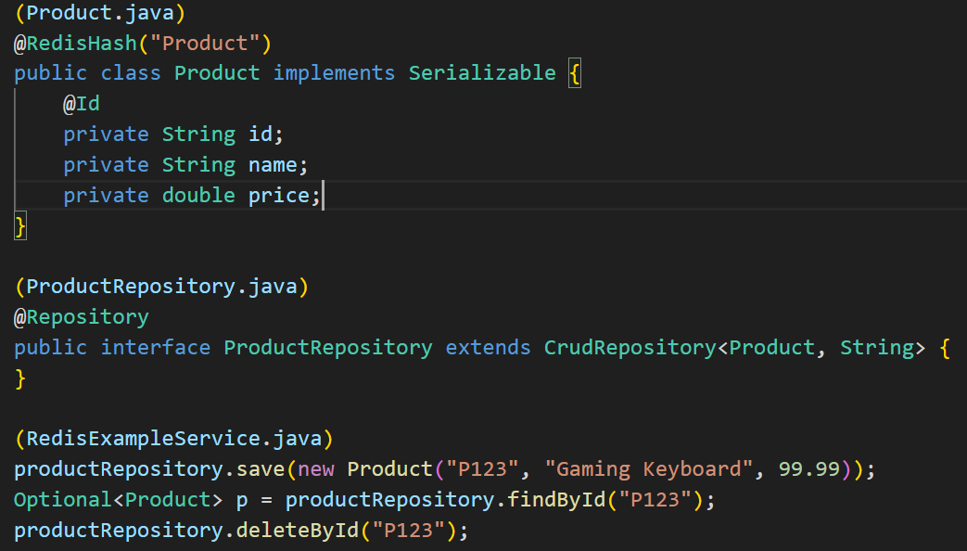
Repositories

Slide 9
Spring Data Rest with Redis
You can expose your Redis repositories over a REST API using Spring Data REST.
It's excellent for simple, key-value based CRUD operations.
Limitations:
Redis is not a query-focused database like SQL or MongoDB.
Spring Data REST cannot automatically generate complex query methods for Redis repositories (e.g., `findByNameContaining`)
Complex queries on nested data in Redis would often require fetching entire objects and then filtering them in memory

Slide 10
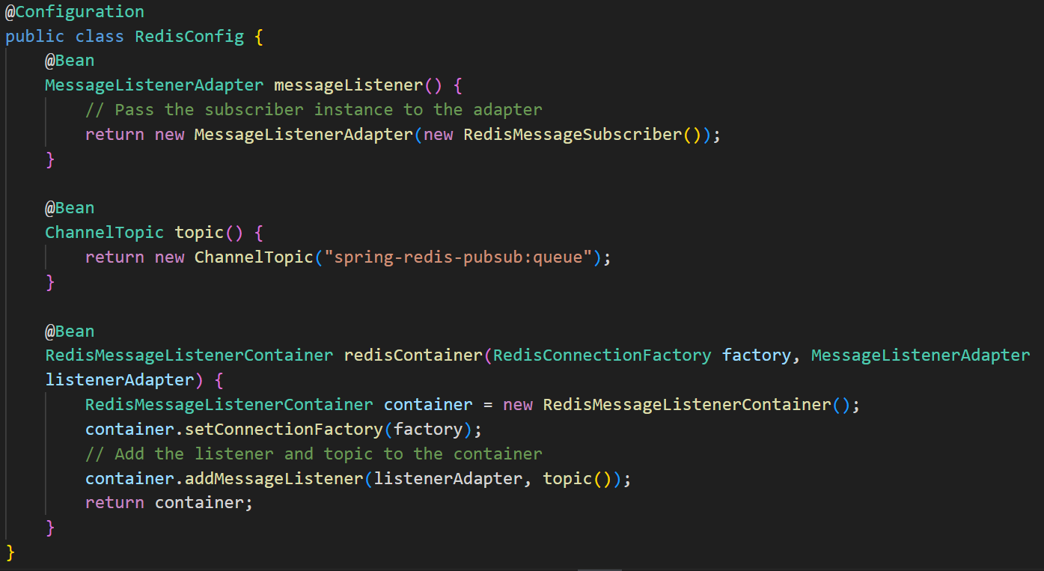
Redis Pub/Sub

Slide 11
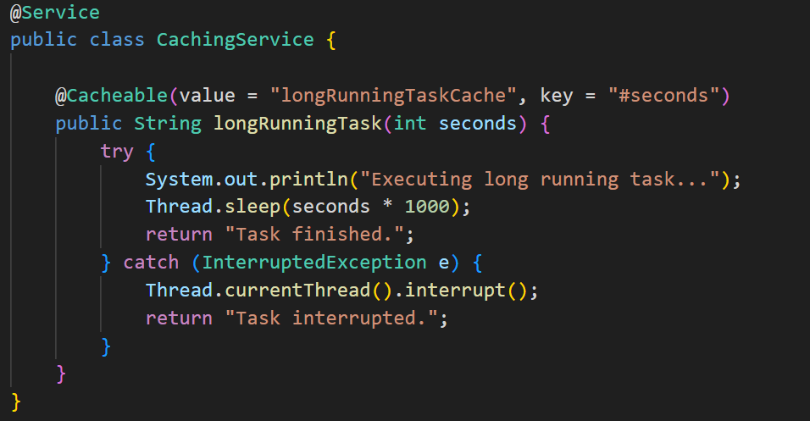
Caching
Spring Boot makes using Redis for caching incredibly simple.

Slide 12
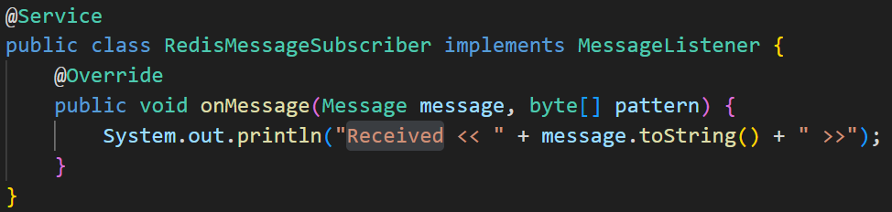
Redis Pub/Sub

Slide 13
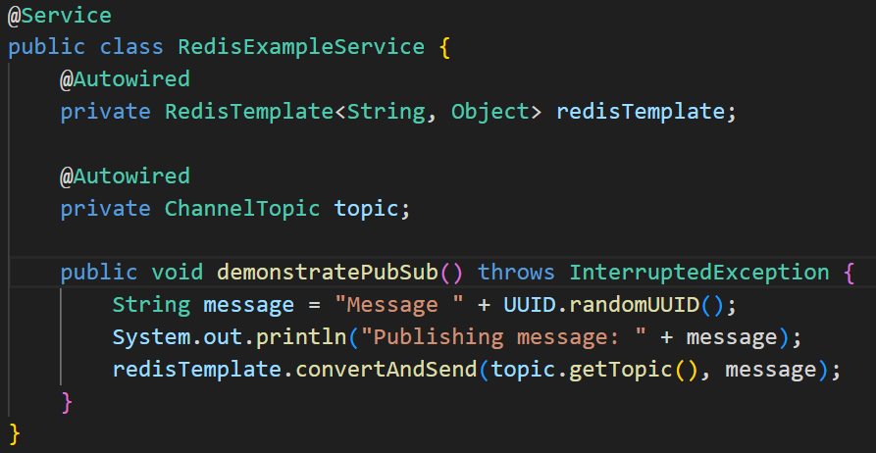
Redis Pub/Sub

Slide 14
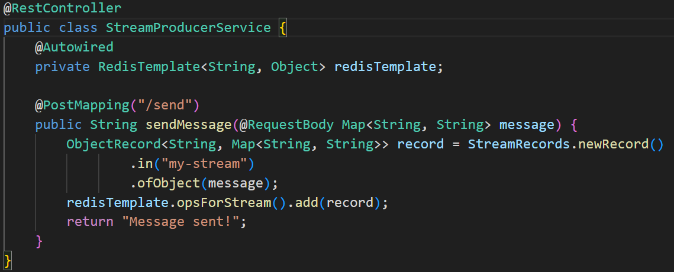
Redis Streams

Slide 15
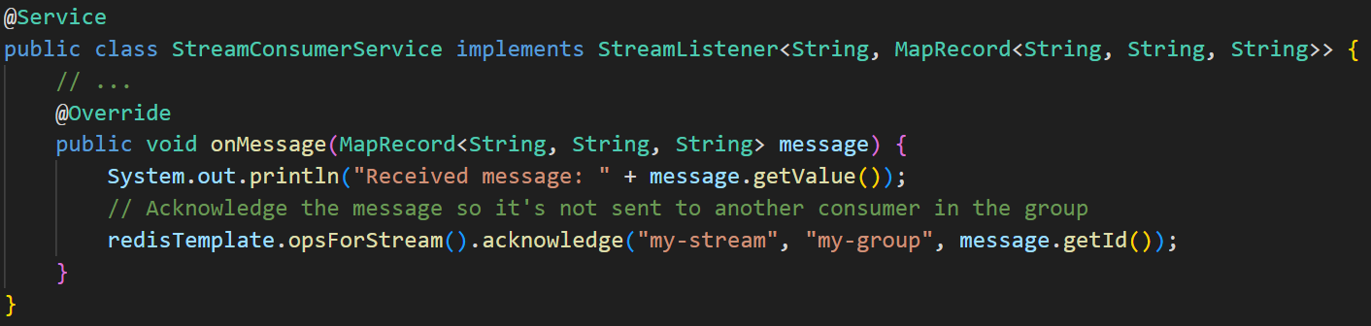
Redis Streams

Slide 16
Pros and cons
Pros
Productivity Boost
Consistent Data Access
Driver Management
Automatic Serialization
Cons
Abstraction Overhead
Learning Curve for Advanced Features

