Slide 1
Spring Data Redis
Simplifying Redis Integration in Spring Applications
https://github.com/JoaoGuilhermedeSa/spring-data-redis

Slide 2
What is Spring Data Redis?
Part of the Spring Data Family.
Handles connection management and serialization for you.
Serializers and connection factories can both be customized.
Uses Lettuce as the default driver, also supports Jedis.

Slide 3
Key features
RedisTemplate for low-level, flexible access.
High-level abstractions like Repositories for object mapping.
Pub/Sub messaging support.
Integration with Spring's caching abstraction.
Supports redis streams.

Slide 4
Other features
Can be used with spring-session-data-redis.
Also supports transactions and pipelining.
Supports cluster and sentinel for scalability and high availability

Slide 5
Redis Template
Provides abstractions for redis operations
ReactiveRedisTemplate and ReactiveRedisOperations for reactive applications.

Slide 6
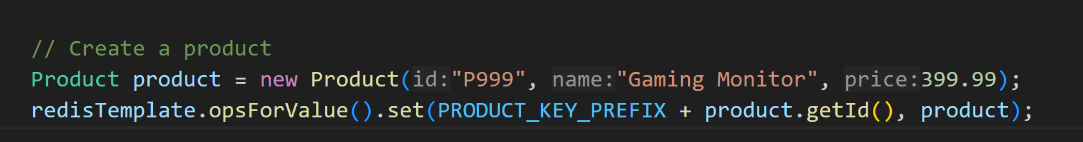
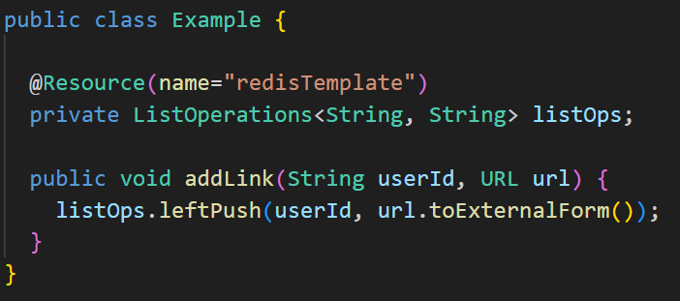
Redis Template

Slide 7
Spring Data Rest with Redis
You can expose your Redis repositories over a REST API using Spring Data REST.
Limitations:
Redis is not a query-focused database like SQL or MongoDB.
Spring Data REST cannot automatically generate complex query methods for Redis repositories (e.g., `findByNameContaining`)

Slide 8
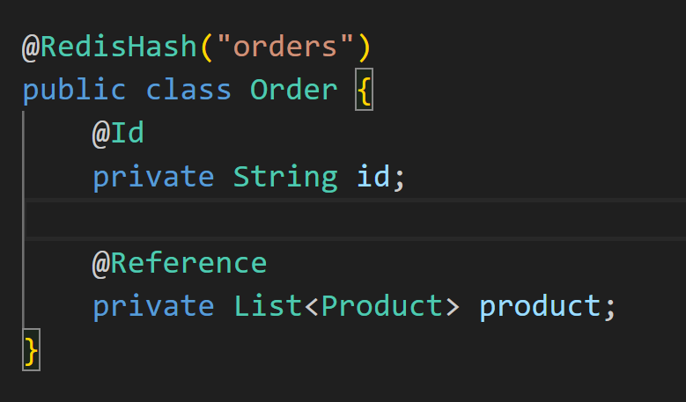
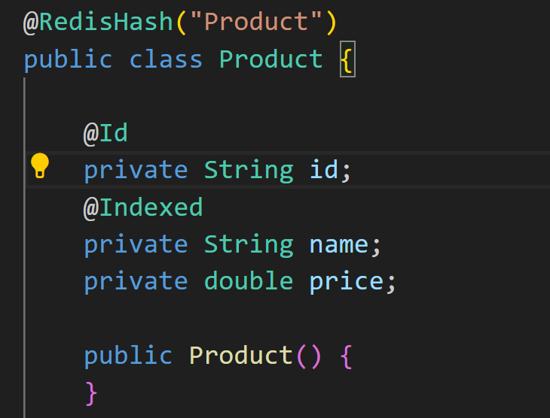
@Reference
For relationships between objects

Slide 9
Pros and cons
Pros
Productivity Boost
Driver Management
Automatic Serialization
Cons
Abstraction Overhead

