Slide 1
Chapter 12
ATM Case Study, Part 1: Object-Oriented Design with the UML
Java How to Program, 8/e
(C) 2010 Pearson Education, Inc. All rights reserved.

Slide 2
12.2 Examining the Requirements Document
A requirements document specifies the purpose of the ATM system and what it must do.
A local bank intends to install a new automated teller machine (ATM) to allow users (i.e., bank customers) to perform basic financial transactions
Each user can have only one account at the bank.
ATM users
  view their account balance
  withdraw cash
  deposit funds
(C) 2010 Pearson Education, Inc. All rights reserved.

Slide 3
12.2 Examining the Requirements Document (cont.)
ATM user interface:
  a screen that displays messages to the user
  a keypad that receives numeric input from the user
  a cash dispenser that dispenses cash to the user and
  a deposit slot that receives deposit envelopes from the user.
The cash dispenser begins each day loaded with 500 $20 bills.
(C) 2010 Pearson Education, Inc. All rights reserved.

Slide 4
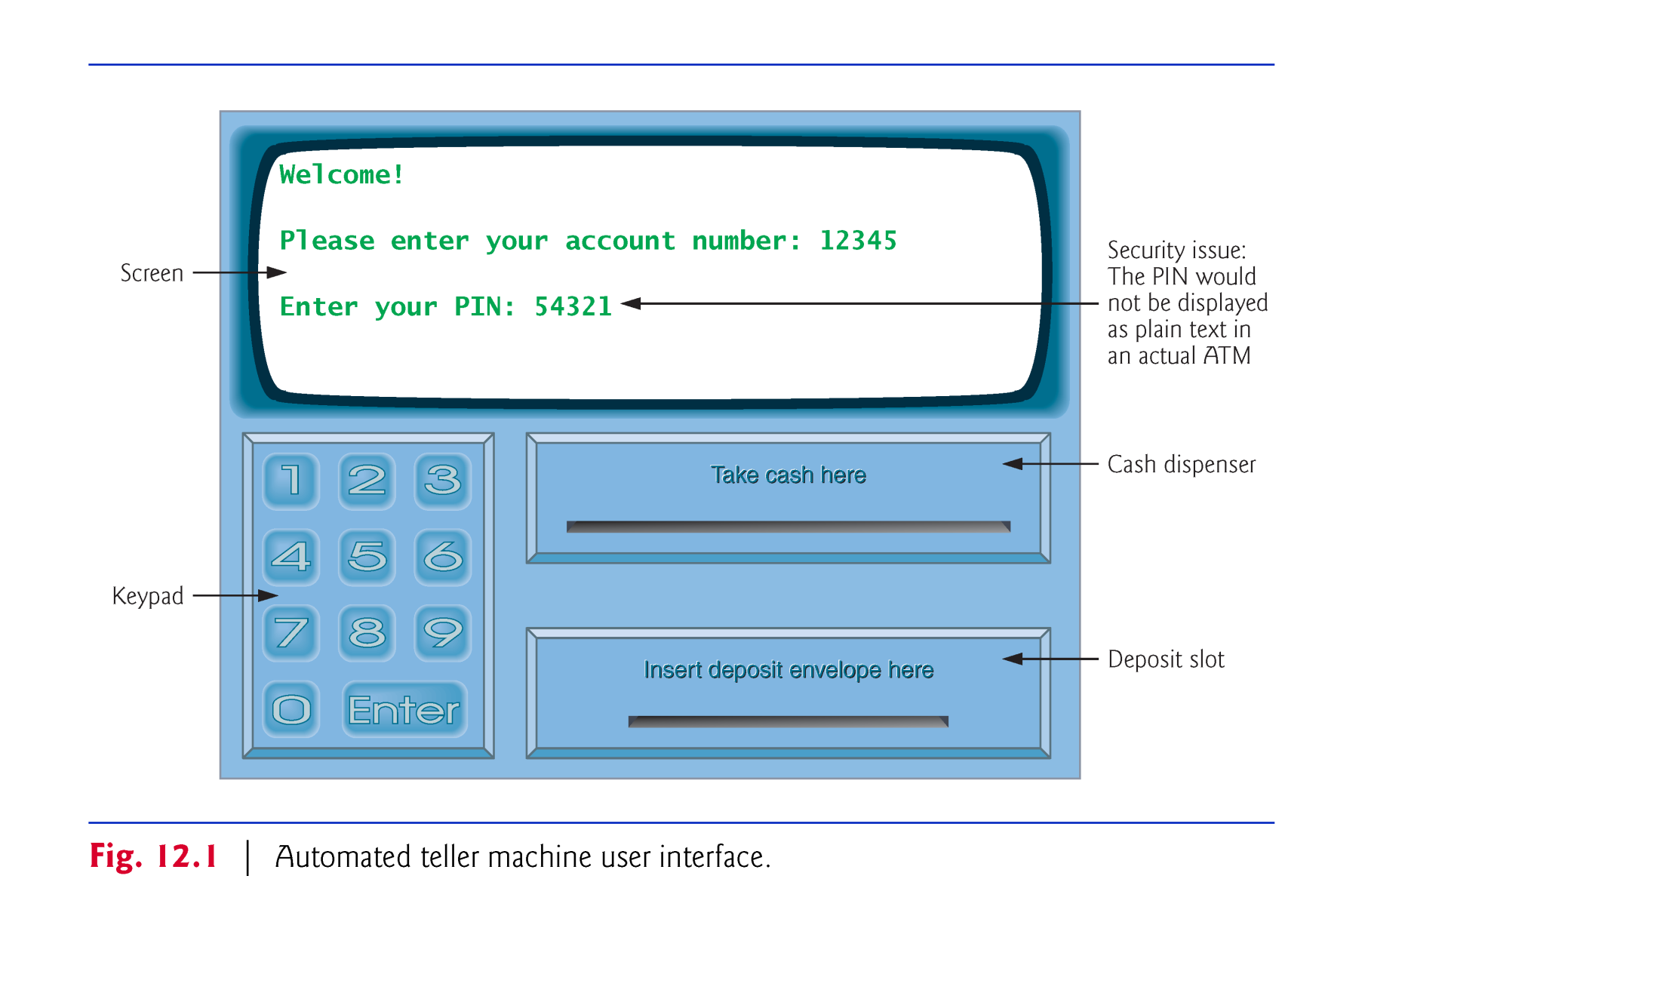
(C) 2010 Pearson Education, Inc. All rights reserved.

Slide 5
12.2 Examining the Requirements Document (cont.)
Develop software to perform the financial transactions initiated by bank customers through the ATM.
Use the computer’s monitor to simulate the ATM’s screen, and the computer’s keyboard to simulate the ATM’s keypad.
(C) 2010 Pearson Education, Inc. All rights reserved.

Slide 6
12.2 Examining the Requirements Document (cont.)
An ATM session consists of
  authenticating a user based on an account number and personal identification number (PIN)
  creating and executing financial transactions
To authenticate a user and perform transactions
  interact with the bank’s account information database
  For each account, the database stores an account number, a PIN and a balance indicating the amount of money in the account.
(C) 2010 Pearson Education, Inc. All rights reserved.

Slide 7
12.2 Examining the Requirements Document (cont.)
Simplifying Assumptions:
  the bank plans to build only one ATM, so we need not worry about multiple ATMs accessing this database at the same time
  the bank does not make any changes to the information in the database while a user is accessing the ATM.
  the bank trusts the ATM to access and manipulate the information in the database without significant security measures.
(C) 2010 Pearson Education, Inc. All rights reserved.

Slide 8
12.2 Examining the Requirements Document (cont.)
Upon first approaching the ATM, the user should experience the following sequence of events (shown in Fig. 12.1):
  The screen displays Welcome! and prompts the user to enter an account number.
  The user enters a five-digit account number using the keypad.
  The screen prompts the user to enter the PIN (personal identification number) associated with the specified account number.
  The user enters a five-digit PIN using the keypad.
  If the user enters a valid account number and the correct PIN for that account, the screen displays the main menu (Fig. 12.2). If the user enters an invalid account number or an incorrect PIN, the screen displays an appropriate message, then the ATM returns to Step 1 to restart the authentication process.
(C) 2010 Pearson Education, Inc. All rights reserved.

Slide 9
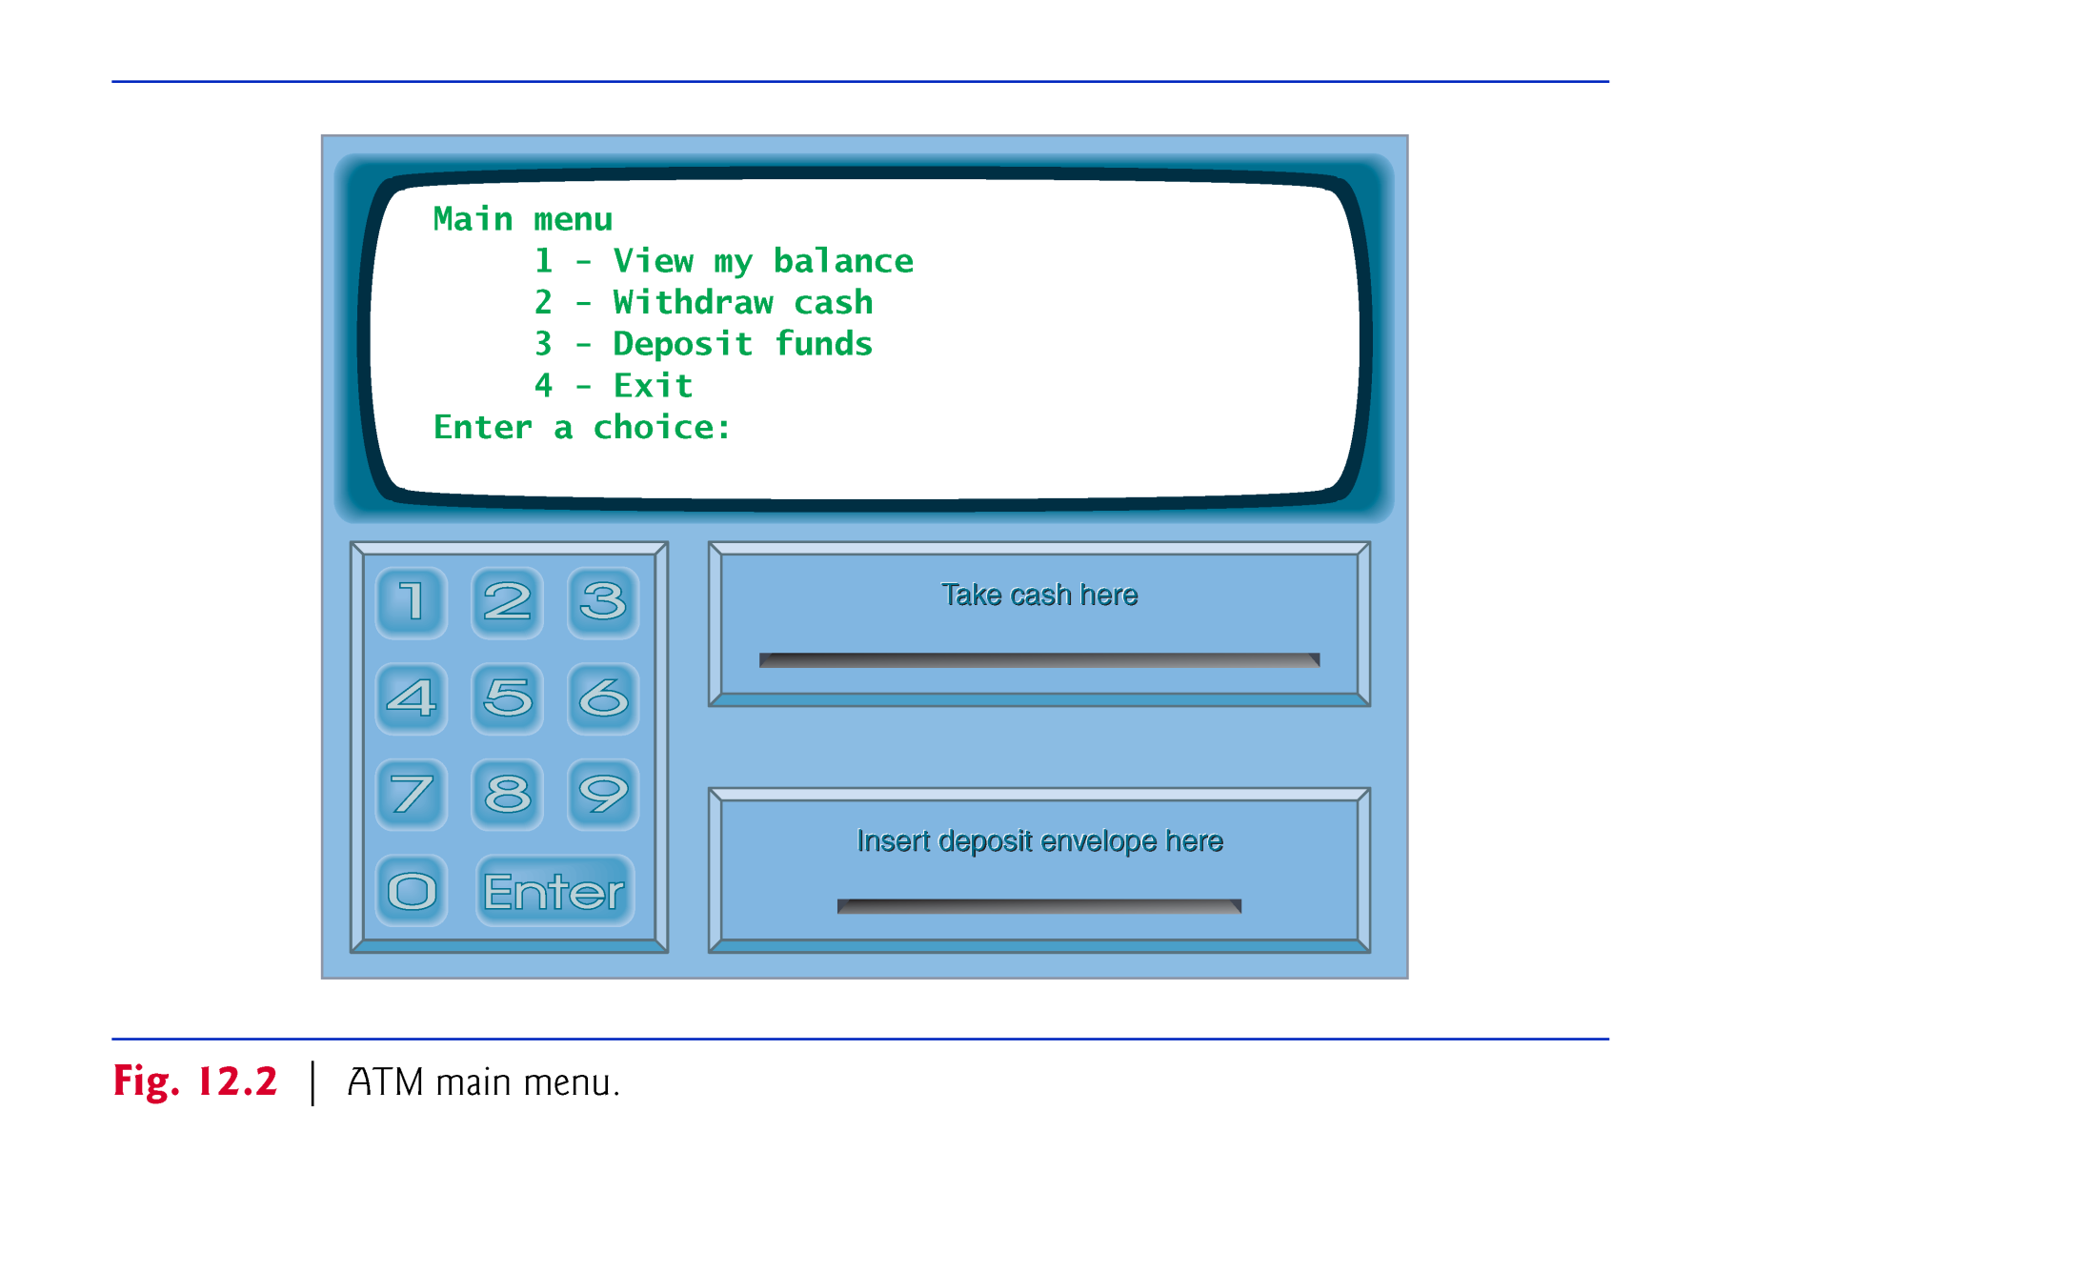
(C) 2010 Pearson Education, Inc. All rights reserved.

Slide 10
12.2 Examining the Requirements Document (cont.)
If the user enters 1 to make a balance inquiry, the screen displays the user’s account balance.
To do so, the ATM must retrieve the balance from the bank’s database.
(C) 2010 Pearson Education, Inc. All rights reserved.

Slide 11
12.2 Examining the Requirements Document (cont.)
The following steps describe what occurs when the user enters 2 to make a withdrawal:
  The screen displays a menu of standard withdrawal amounts and an option to cancel the transaction.
  The user enters a menu selection using the keypad.
  If the withdrawal amount is greater than the user’s account balance, the screen displays a message stating this and telling the user to choose a smaller amount. The ATM then returns to Step 1. If the withdrawal amount chosen is less than or equal to the user’s account balance (i.e., an acceptable amount), the ATM proceeds to Step 4. If the user chooses to cancel, the ATM displays the main menu and waits for user input.
(C) 2010 Pearson Education, Inc. All rights reserved.

Slide 12
12.2 Examining the Requirements Document (cont.)
  If the cash dispenser contains enough cash, the ATM proceeds to Step 5. Otherwise, the screen displays a message indicating the problem and telling the user to choose a smaller withdrawal amount. The ATM then returns to Step 1.
  The ATM debits the withdrawal amount from the user’s account in the bank’s database.
  The cash dispenser dispenses the desired amount of money to the user.
  The screen displays a message reminding the user to take the money.
(C) 2010 Pearson Education, Inc. All rights reserved.

Slide 13
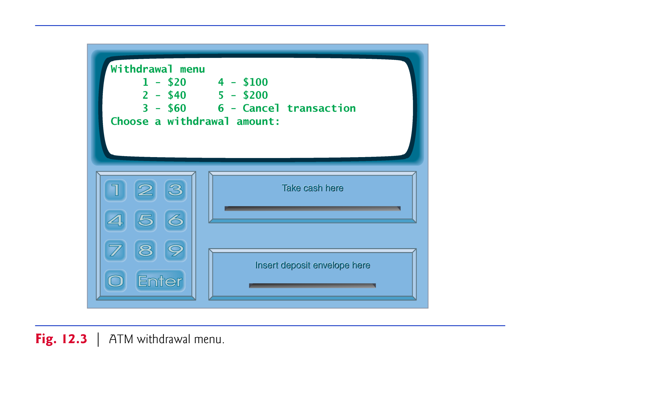
(C) 2010 Pearson Education, Inc. All rights reserved.

Slide 14
12.2 Examining the Requirements Document (cont.)
The following steps describe the actions that occur when the user enters 3 to make a deposit:
  The screen prompts the user to enter a deposit amount or type 0 (zero) to cancel.
  The user enters a deposit amount or 0 using the keypad.
  If the user specifies a deposit amount, the ATM proceeds to Step 4. If the user chooses to cancel the transaction (by entering 0), the ATM displays the main menu and waits for user input.
  The screen displays a message telling the user to insert a deposit envelope.
  If the deposit slot receives a deposit envelope within two minutes, the ATM credits the deposit amount to the user’s account in the bank’s database (i.e., adds the deposit amount to the user’s account balance).
(C) 2010 Pearson Education, Inc. All rights reserved.

Slide 15
12.2 Examining the Requirements Document (cont.)
After the system successfully executes a transaction, it should return to the main menu so that the user can perform additional transactions.
If the user exits the system, the screen should display a thank you message, then display the welcome message for the next user.
(C) 2010 Pearson Education, Inc. All rights reserved.

Slide 16
12.2 Examining the Requirements Document (cont.)
Analyzing the ATM System
The preceding statement is a simplified example of a requirements document
  Typically the result of a detailed process of requirements gathering
A systems analyst
  might interview banking experts to gain a better understanding of what the software must do
  would use the information gained to compile a list of system requirements to guide systems designers as they design the system.
(C) 2010 Pearson Education, Inc. All rights reserved.

Slide 17
12.2 Examining the Requirements Document (cont.)
The analysis stage focuses on defining the problem to be solved.
When designing any system, one must solve the problem right, but of equal importance, one must solve the right problem.
(C) 2010 Pearson Education, Inc. All rights reserved.

Slide 18
12.2 Examining the Requirements Document (cont.)
During the analysis stage, systems designers focus on understanding the requirements document to produce a high-level specification that describes what the system is supposed to do.
The output of the design stage—a design specification—should specify clearly how the system should be constructed to satisfy these requirements.
(C) 2010 Pearson Education, Inc. All rights reserved.

Slide 19
12.2 Examining the Requirements Document (cont.)
The UML 2 standard specifies 13 diagram types for documenting the system models.
Each models a distinct characteristic of a system’s structure or behavior—six diagrams relate to system structure, the remaining seven to system behavior.
We will only use class diagrams, which model the classes, or “building blocks,” used in a system.
(C) 2010 Pearson Education, Inc. All rights reserved.

Slide 20
12.3 Identifying the Classes in a Requirements Document
Identify the classes that are needed to build the system by analyzing the nouns and noun phrases that appear in the requirements document.
We may decide that some of these nouns and noun phrases are actually attributes of other classes in the system.
We may also conclude that some of the nouns do not correspond to parts of the system and thus should not be modeled at all.
Additional classes may become apparent to us as we proceed through the design process.
(C) 2010 Pearson Education, Inc. All rights reserved.

Slide 21
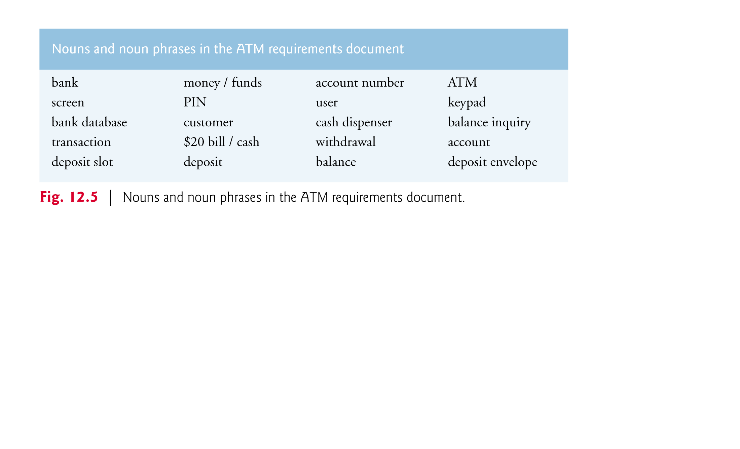
(C) 2010 Pearson Education, Inc. All rights reserved.

Slide 22
12.3 Identifying the Classes in a Requirements Document (cont.)
We create classes only for the nouns and noun phrases that have significance in the ATM system.
Though the requirements document frequently describes a “transaction” in a general sense, we do not model the broad notion of a financial transaction at this time.
  Instead, we model the three types of transactions (i.e., “balance inquiry,” “withdrawal” and “deposit”) as individual classes.
  These classes possess specific attributes needed for executing the transactions they represent.
(C) 2010 Pearson Education, Inc. All rights reserved.

Slide 23
12.3 Identifying the Classes in a Requirements Document (cont.)
Classes:
  ATM
  screen
  keypad
  cash dispenser
  deposit slot
  account
  bank database
  balance inquiry
  withdrawal
  deposit
(C) 2010 Pearson Education, Inc. All rights reserved.

Slide 24
12.3 Identifying the Classes in a Requirements Document (cont.)
The UML enables us to model, via class diagrams, the classes in the ATM system and their interrelationships.
Figure 12.6 represents class ATM.
Each class is modeled as a rectangle with three compartments.
  The top one contains the name of the class centered horizontally in boldface.
  The middle compartment contains the class’s attributes.
  The bottom compartment contains the class’s operations.
(C) 2010 Pearson Education, Inc. All rights reserved.

Slide 25
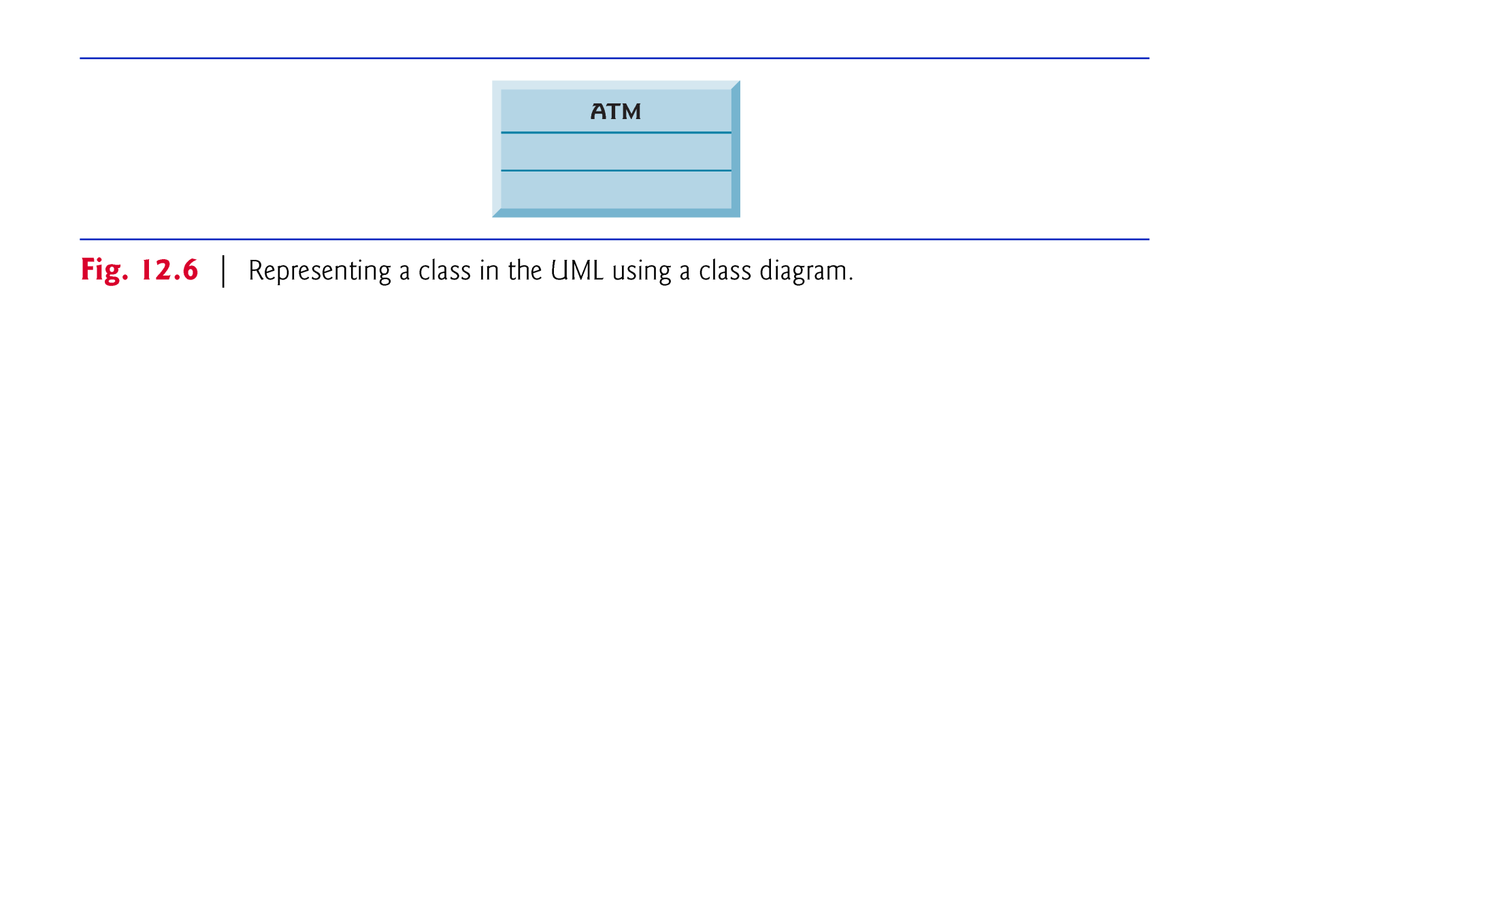
(C) 2010 Pearson Education, Inc. All rights reserved.

Slide 26
12.3 Identifying the Classes in a Requirements Document (cont.)
Class diagrams also show the relationships between the classes of the system.
Figure 12.7 shows how our classes ATM and Withdrawal relate to one another.
Notice that the rectangles representing classes in this diagram are not subdivided into compartments.
(C) 2010 Pearson Education, Inc. All rights reserved.

Slide 27
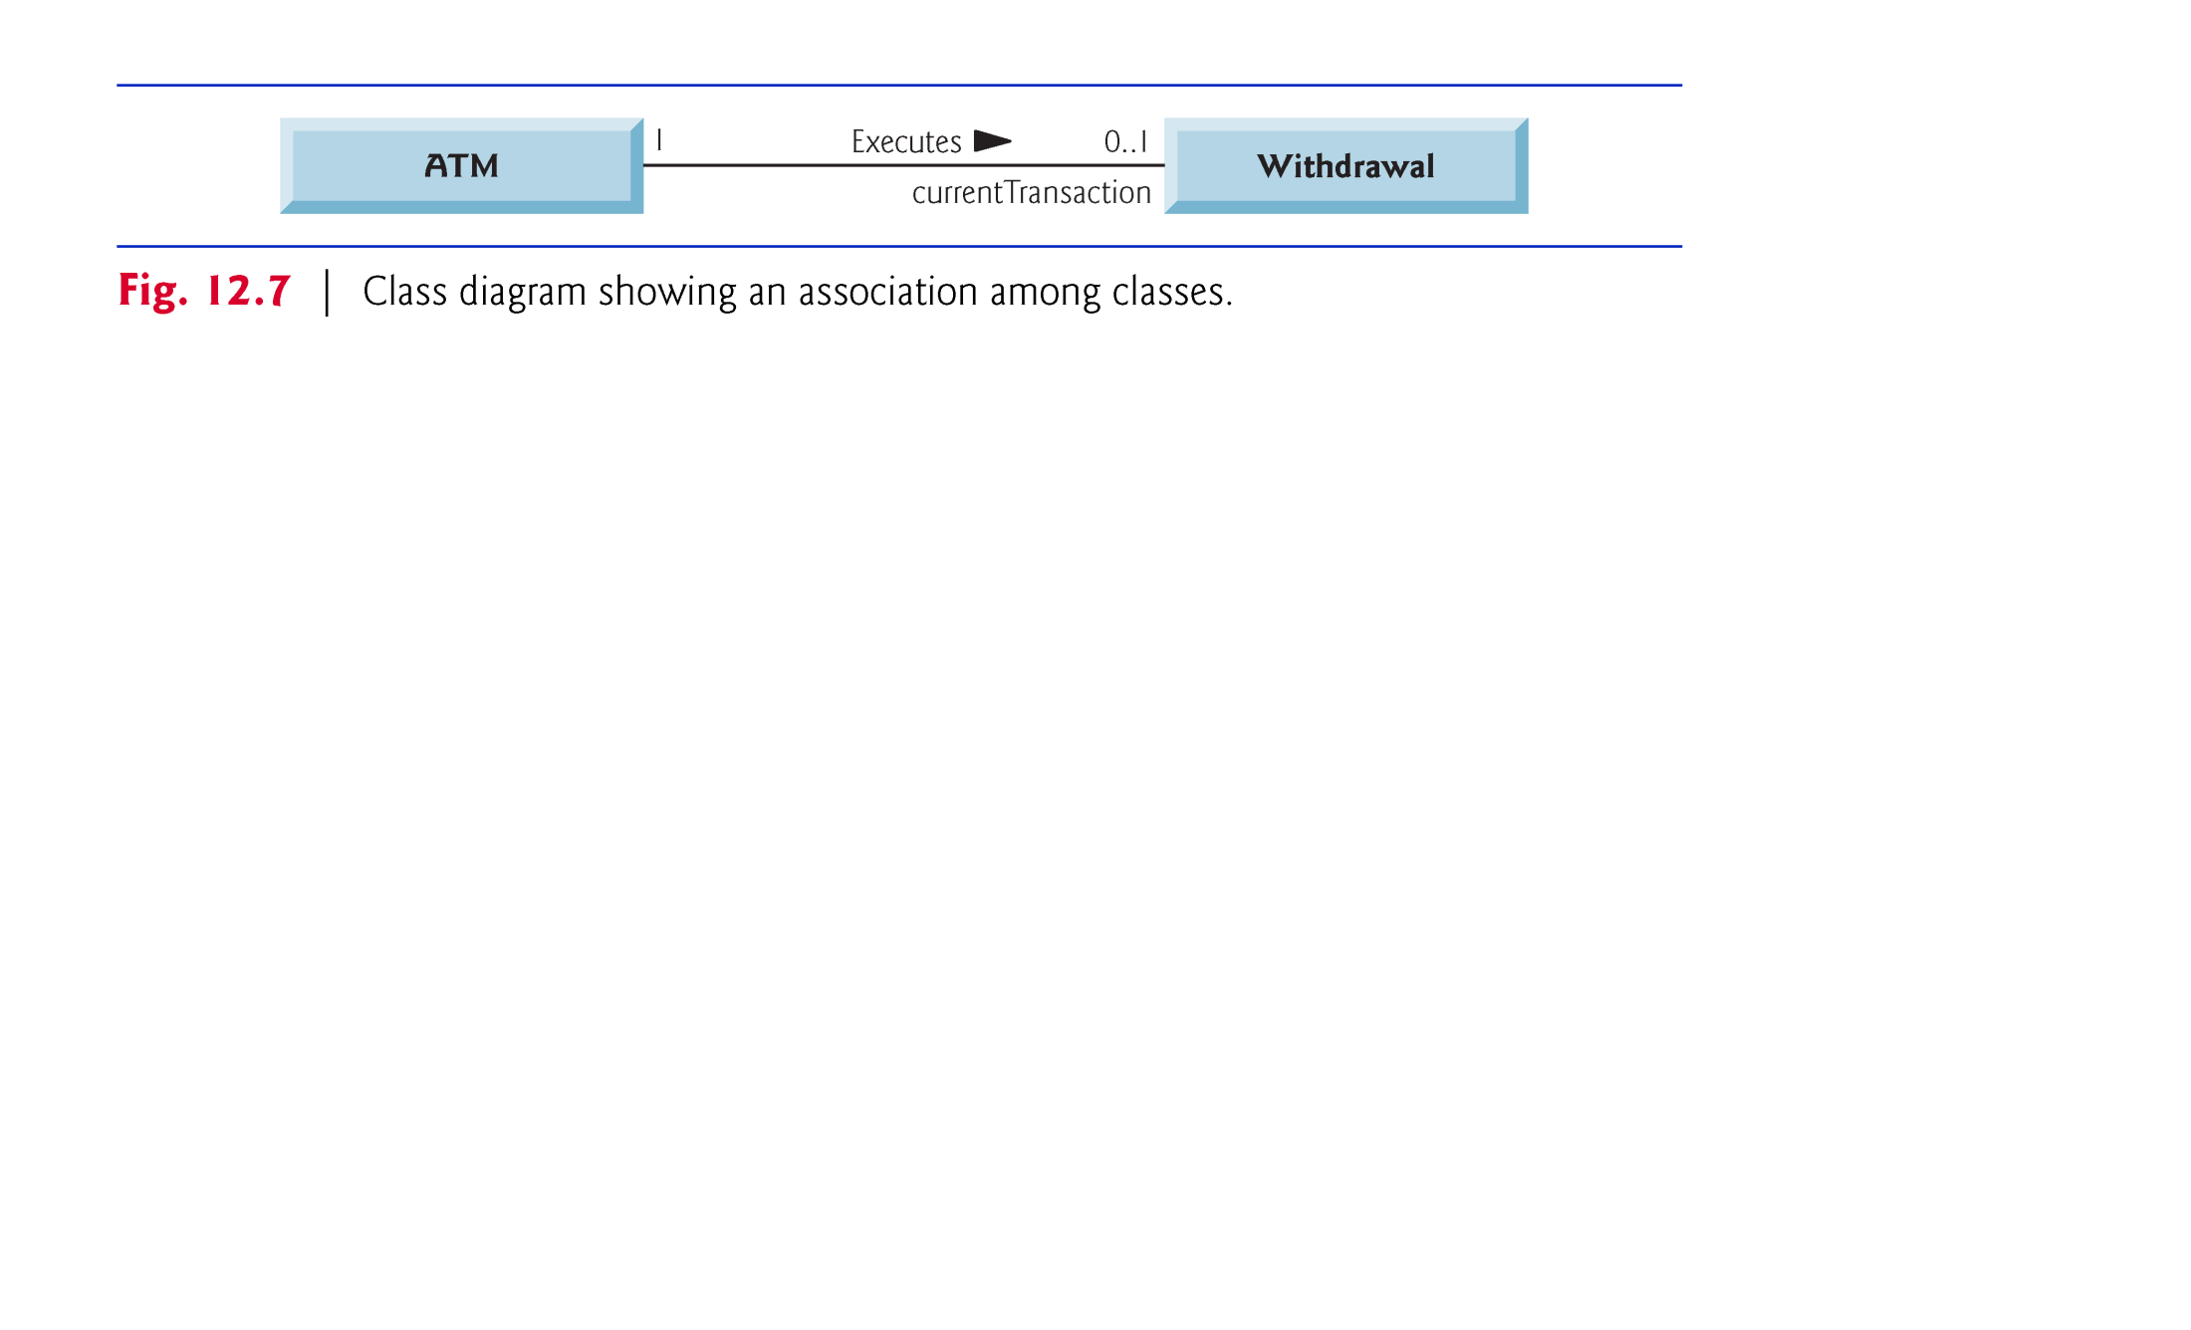
(C) 2010 Pearson Education, Inc. All rights reserved.

Slide 28
12.3 Identifying the Classes in a Requirements Document (cont.)
The solid line that connects the two classes represents an association—a relationship between classes.
The numbers near each end of the line are multiplicity values, which indicate how many objects of each class participate in the association.
  At any given moment, one ATM object participates in an association with either zero or one Withdrawal objects—zero if the current user is not currently performing a transaction or has requested a different type of transaction, and one if the user has requested a withdrawal.
Figure 12.8 lists and explains the multiplicity types.
(C) 2010 Pearson Education, Inc. All rights reserved.

Slide 29
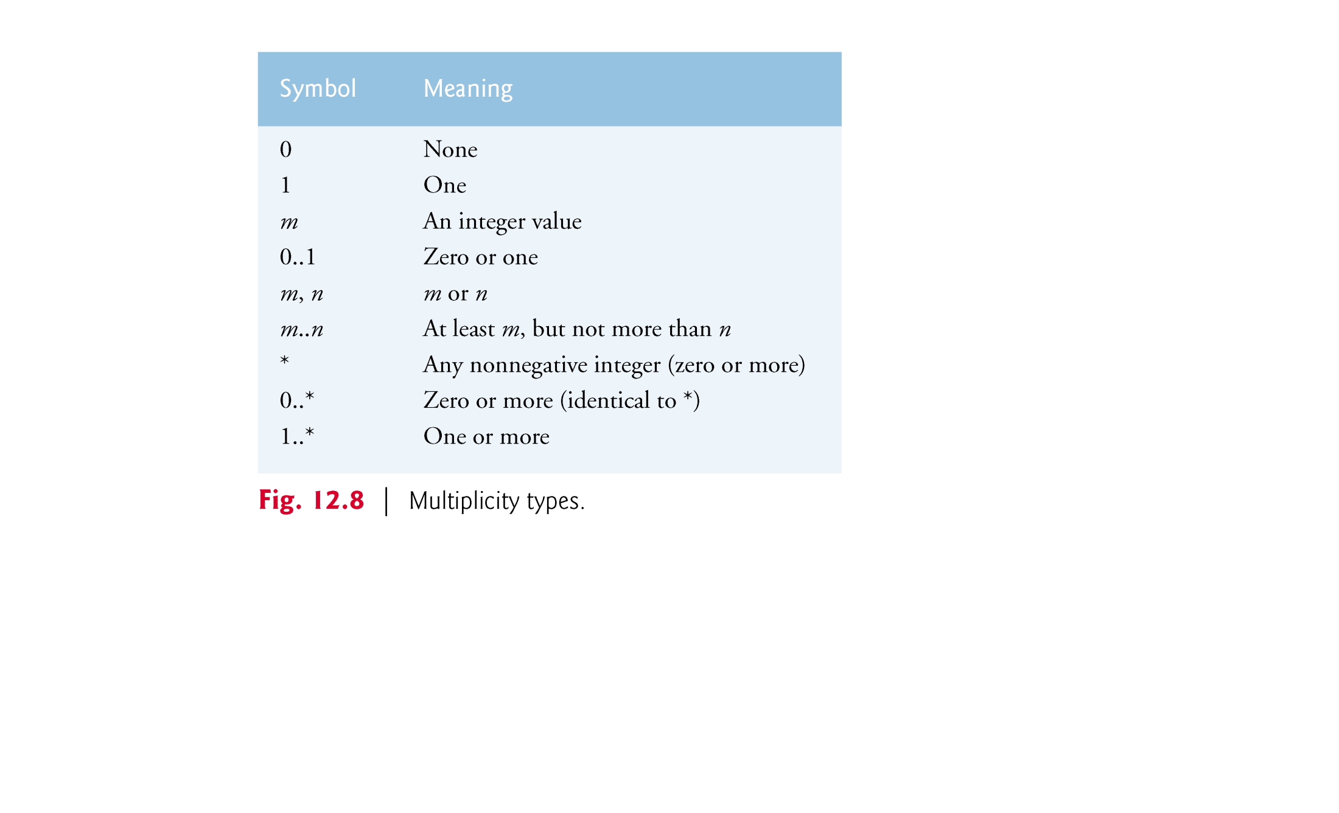
(C) 2010 Pearson Education, Inc. All rights reserved.

Slide 30
12.3 Identifying the Classes in a Requirements Document (cont.)
An association can be named.
  The word Executes above the line connecting classes ATM and Withdrawal in Fig. 12.7 indicates the name of that association.
  This part of the diagram reads “one object of class ATM executes zero or one objects of class Withdrawal.”
Association names are directional, as indicated by the filled arrowhead.
(C) 2010 Pearson Education, Inc. All rights reserved.

Slide 31
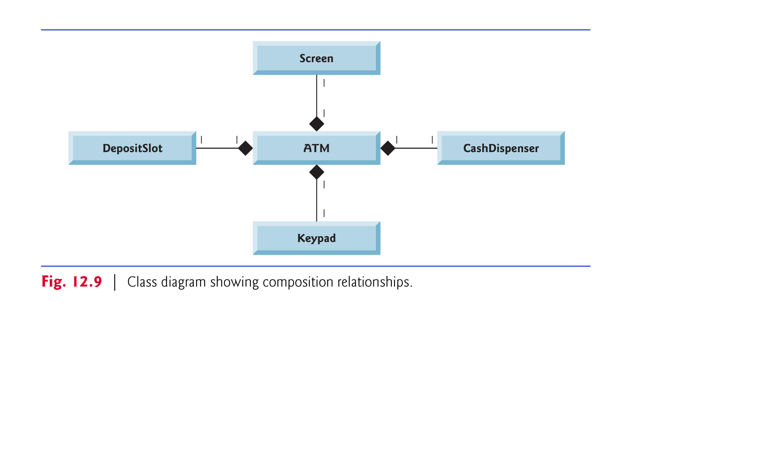
has-a relationship.
(C) 2010 Pearson Education, Inc. All rights reserved.

Slide 32
12.3 Identifying the Classes in a Requirements Document (cont.)
In Fig. 12.9, the solid diamonds attached to the ATM class’s association lines indicate that ATM has a composition relationship with classes Screen, Keypad, CashDispenser and DepositSlot.
Composition implies a whole/part relationship.
The class that has the composition symbol (the solid diamond) on its end of the association line is the whole (in this case, ATM), and the classes on the other end of the association lines are the parts.
(C) 2010 Pearson Education, Inc. All rights reserved.

Slide 33
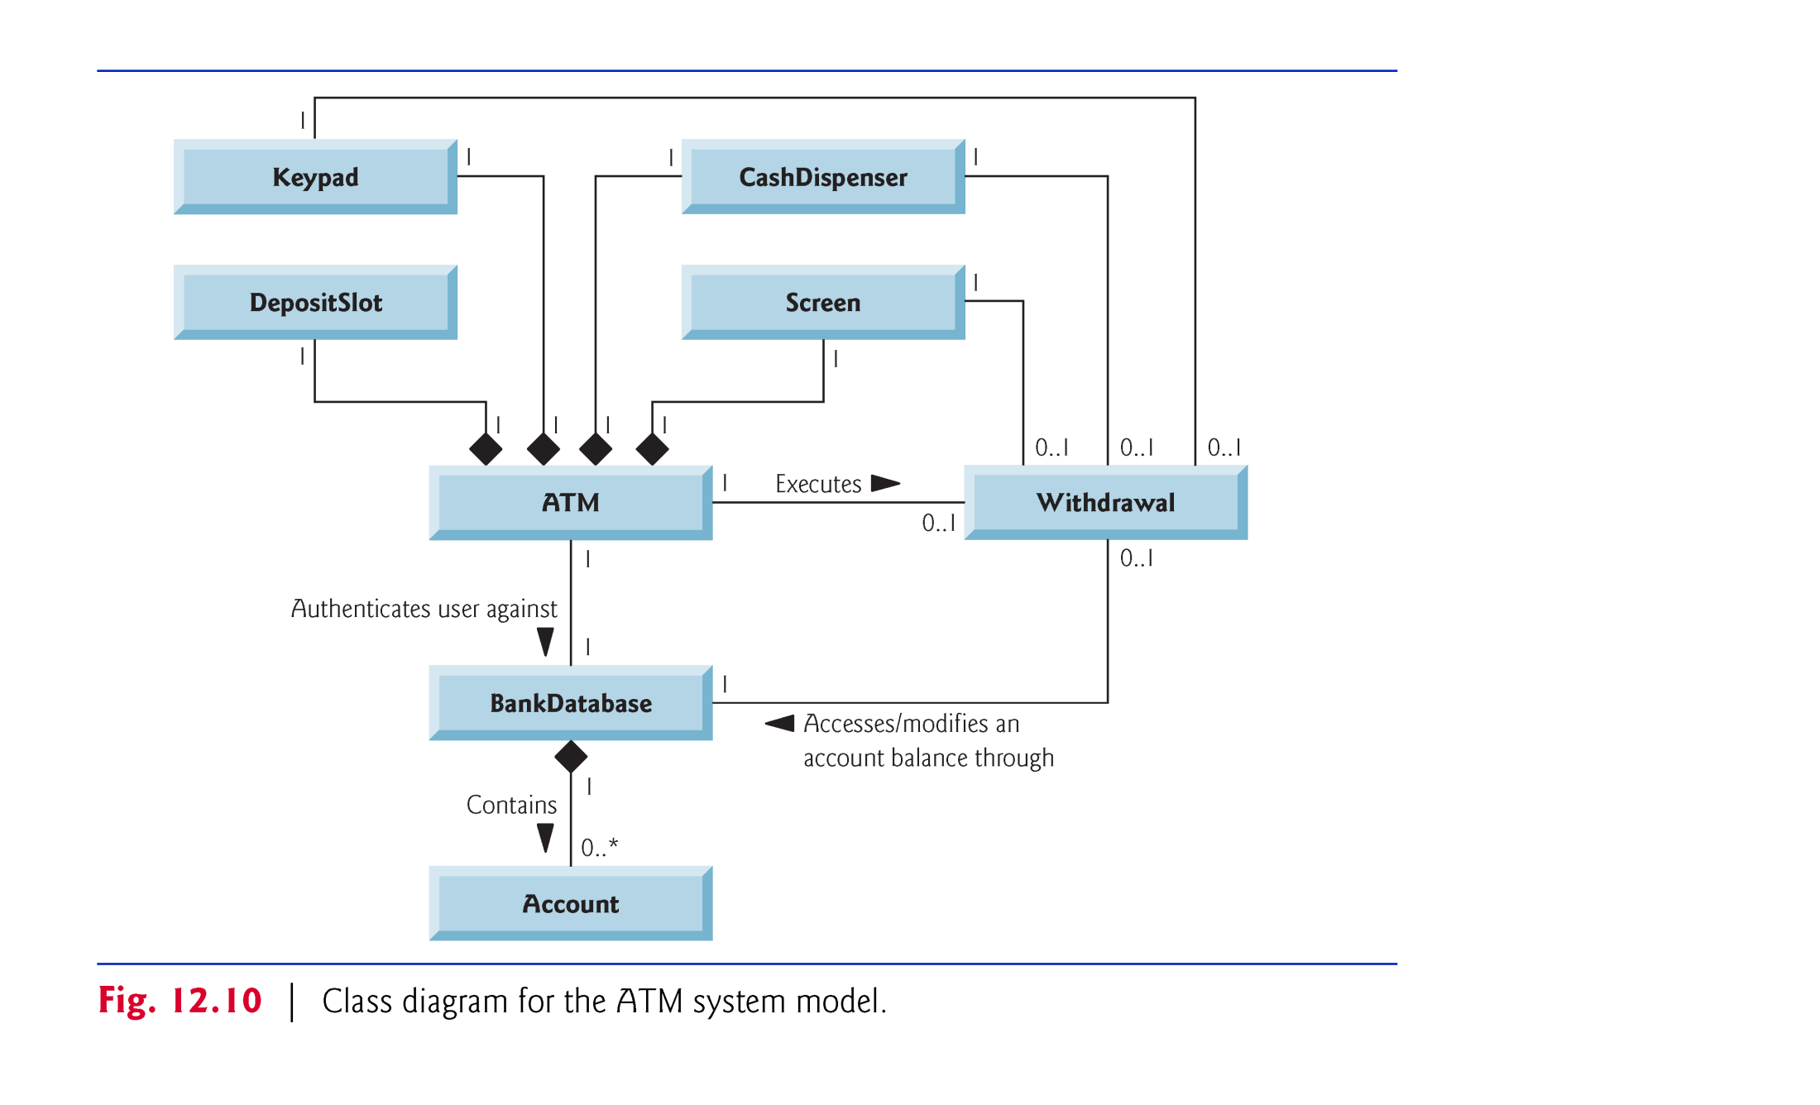
(C) 2010 Pearson Education, Inc. All rights reserved.

Slide 34
12.4 Identifying Class Attributes
Classes have attributes (data) and operations (behaviors).
Look for descriptive words and phrases in the requirements document.
For each such word and phrase we find that plays a significant role in the ATM system, we create an attribute and assign it to one or more of the classes identified in Section 12.3.
(C) 2010 Pearson Education, Inc. All rights reserved.

Slide 35
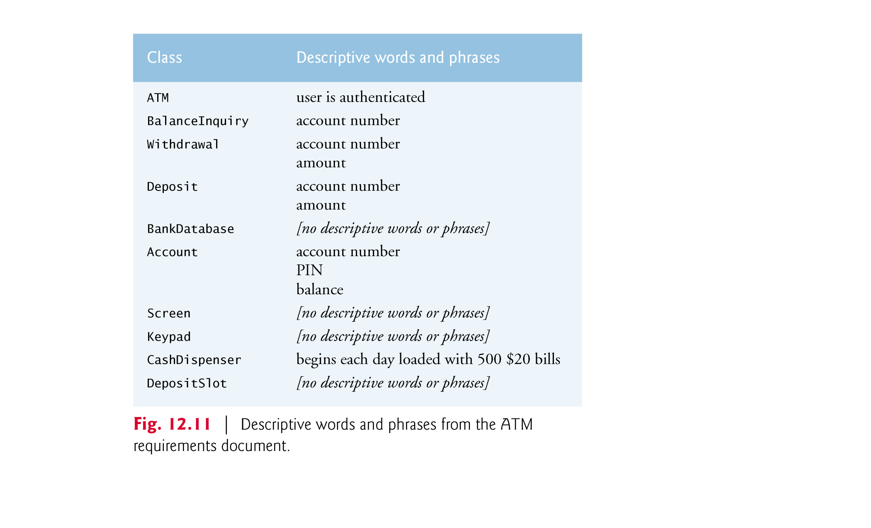
(C) 2010 Pearson Education, Inc. All rights reserved.

Slide 36
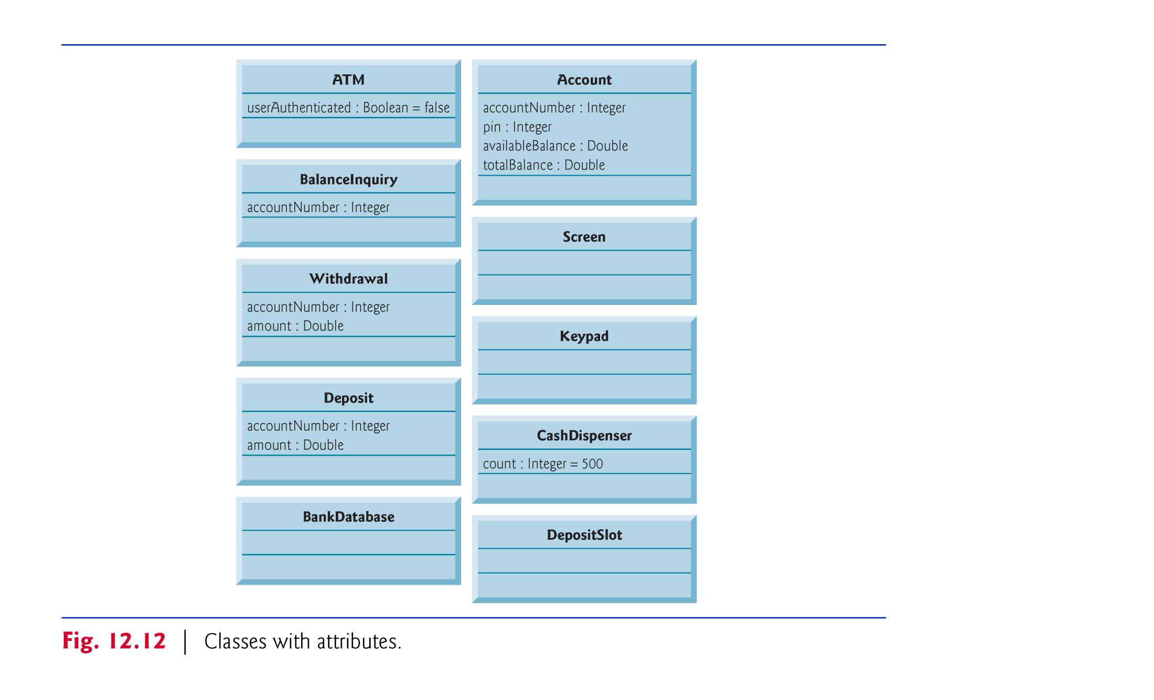
(C) 2010 Pearson Education, Inc. All rights reserved.

Slide 37
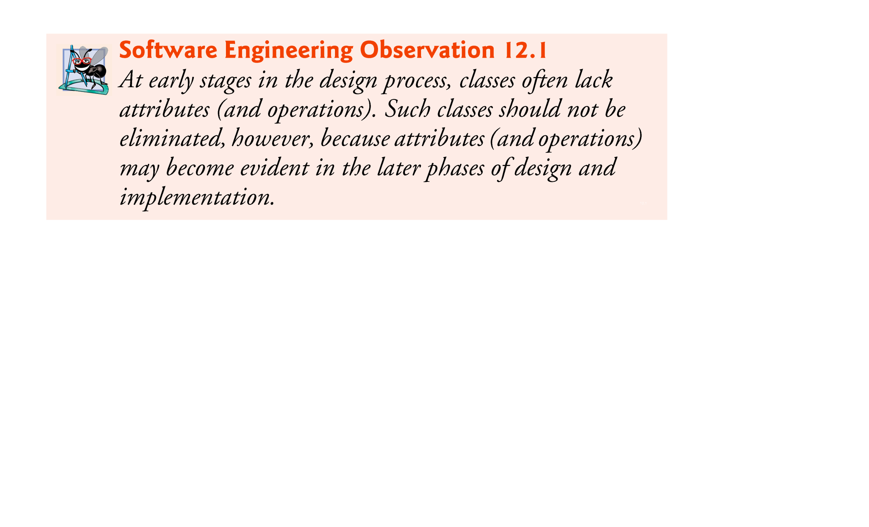
(C) 2010 Pearson Education, Inc. All rights reserved.

Slide 38
12.6 Identifying Class Operations
An operation is a service that objects of a class provide to clients (users) of the class.
We can derive many of the class operations by examining the key verbs and verb phrases in the requirements document.
The verb phrases in Fig. 12.16 help us determine the operations of each class.
(C) 2010 Pearson Education, Inc. All rights reserved.

Slide 39
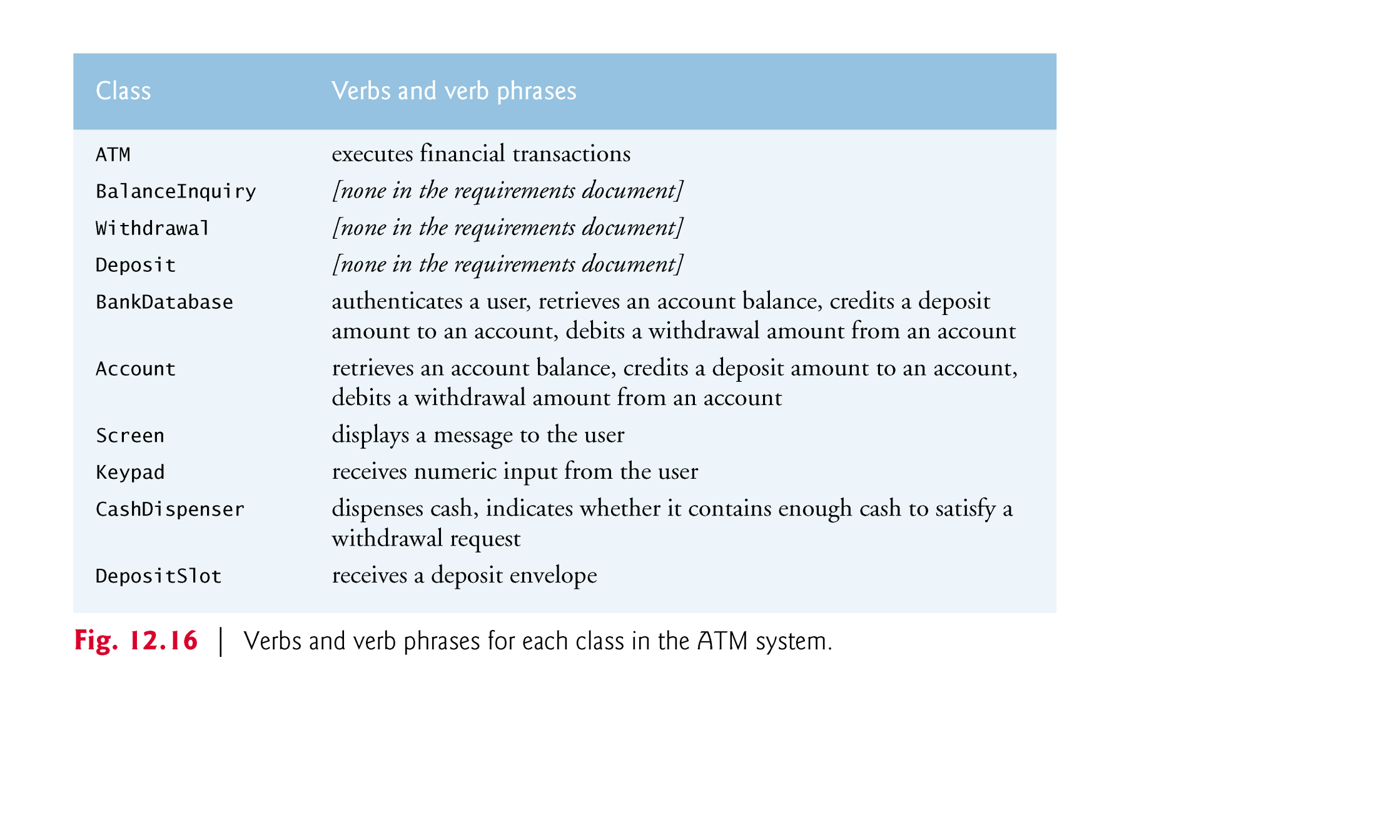
(C) 2010 Pearson Education, Inc. All rights reserved.

Slide 40
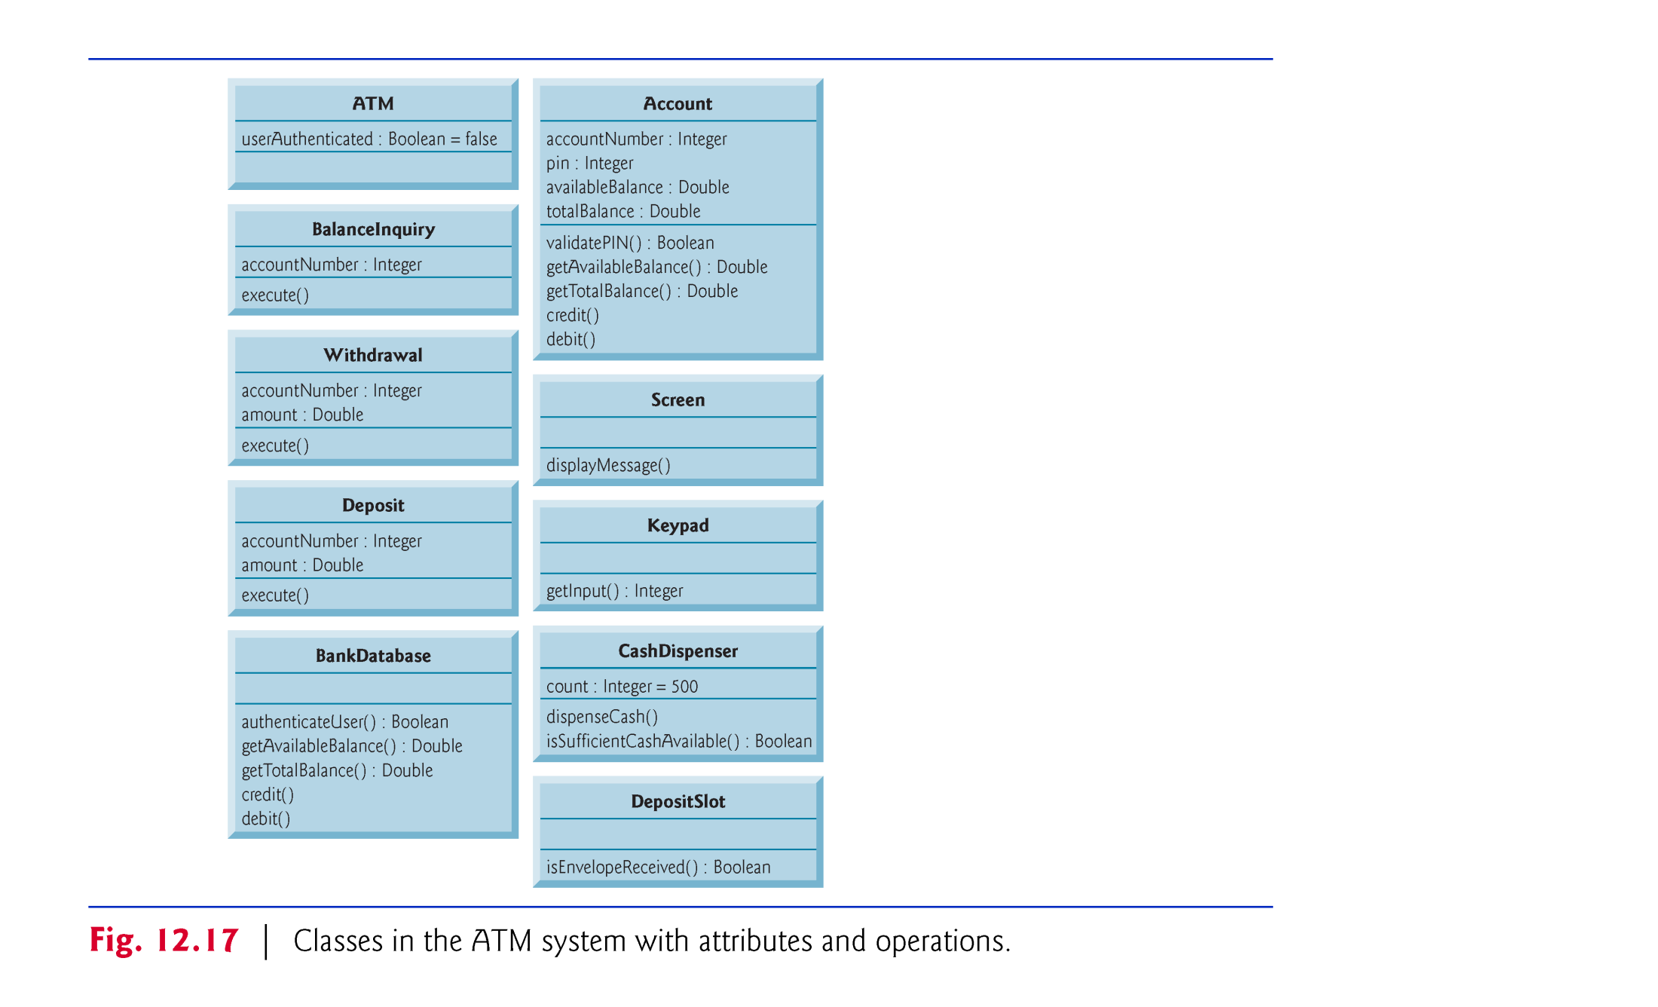
(C) 2010 Pearson Education, Inc. All rights reserved.

Slide 41
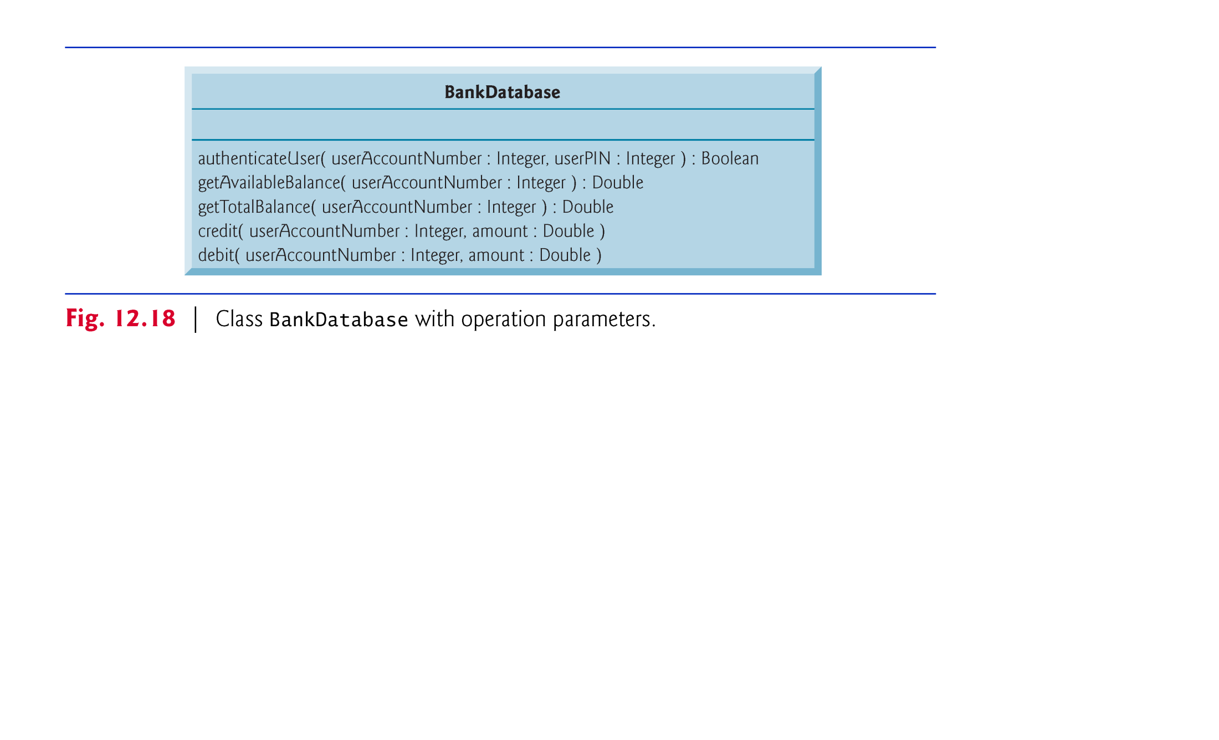
(C) 2010 Pearson Education, Inc. All rights reserved.

Slide 42
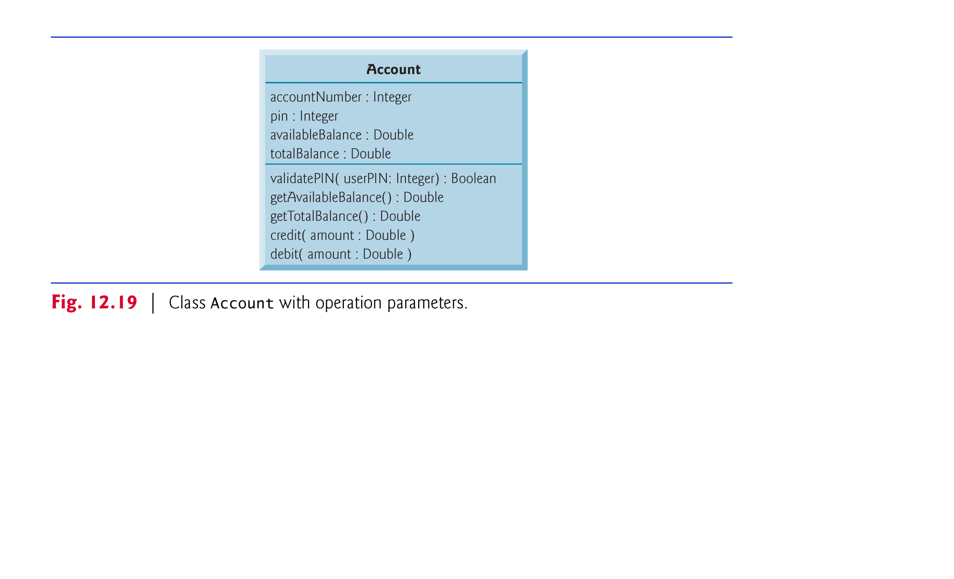
(C) 2010 Pearson Education, Inc. All rights reserved.

Slide 43
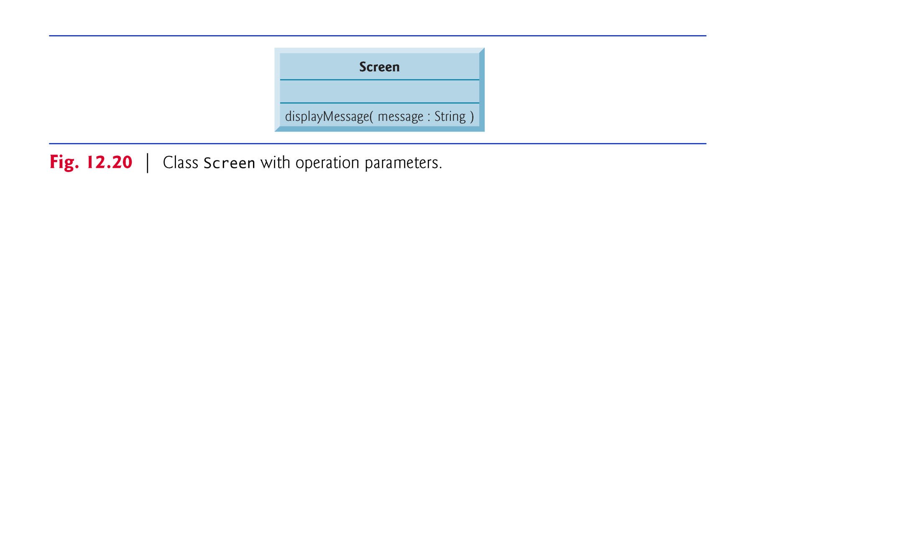
(C) 2010 Pearson Education, Inc. All rights reserved.

Slide 44
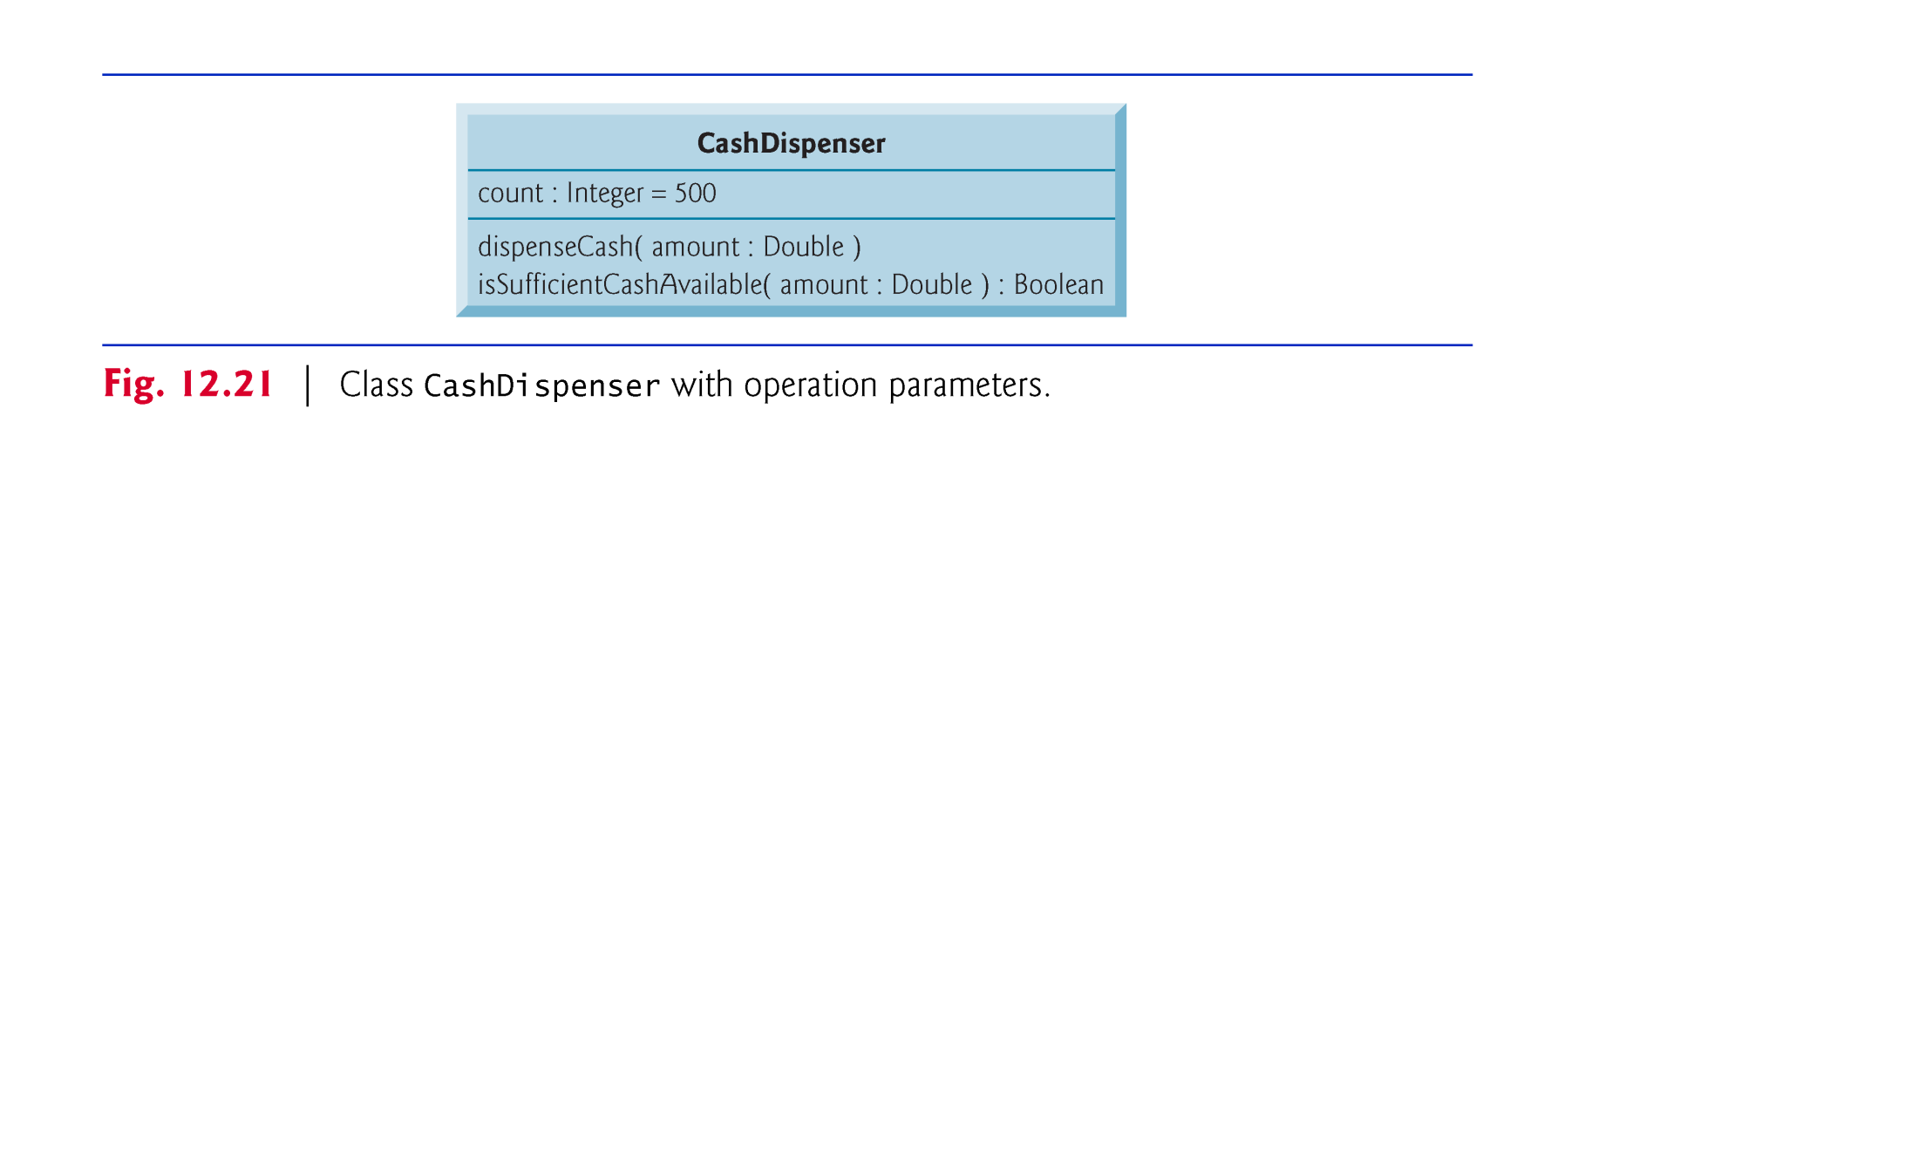
(C) 2010 Pearson Education, Inc. All rights reserved.

Slide 45
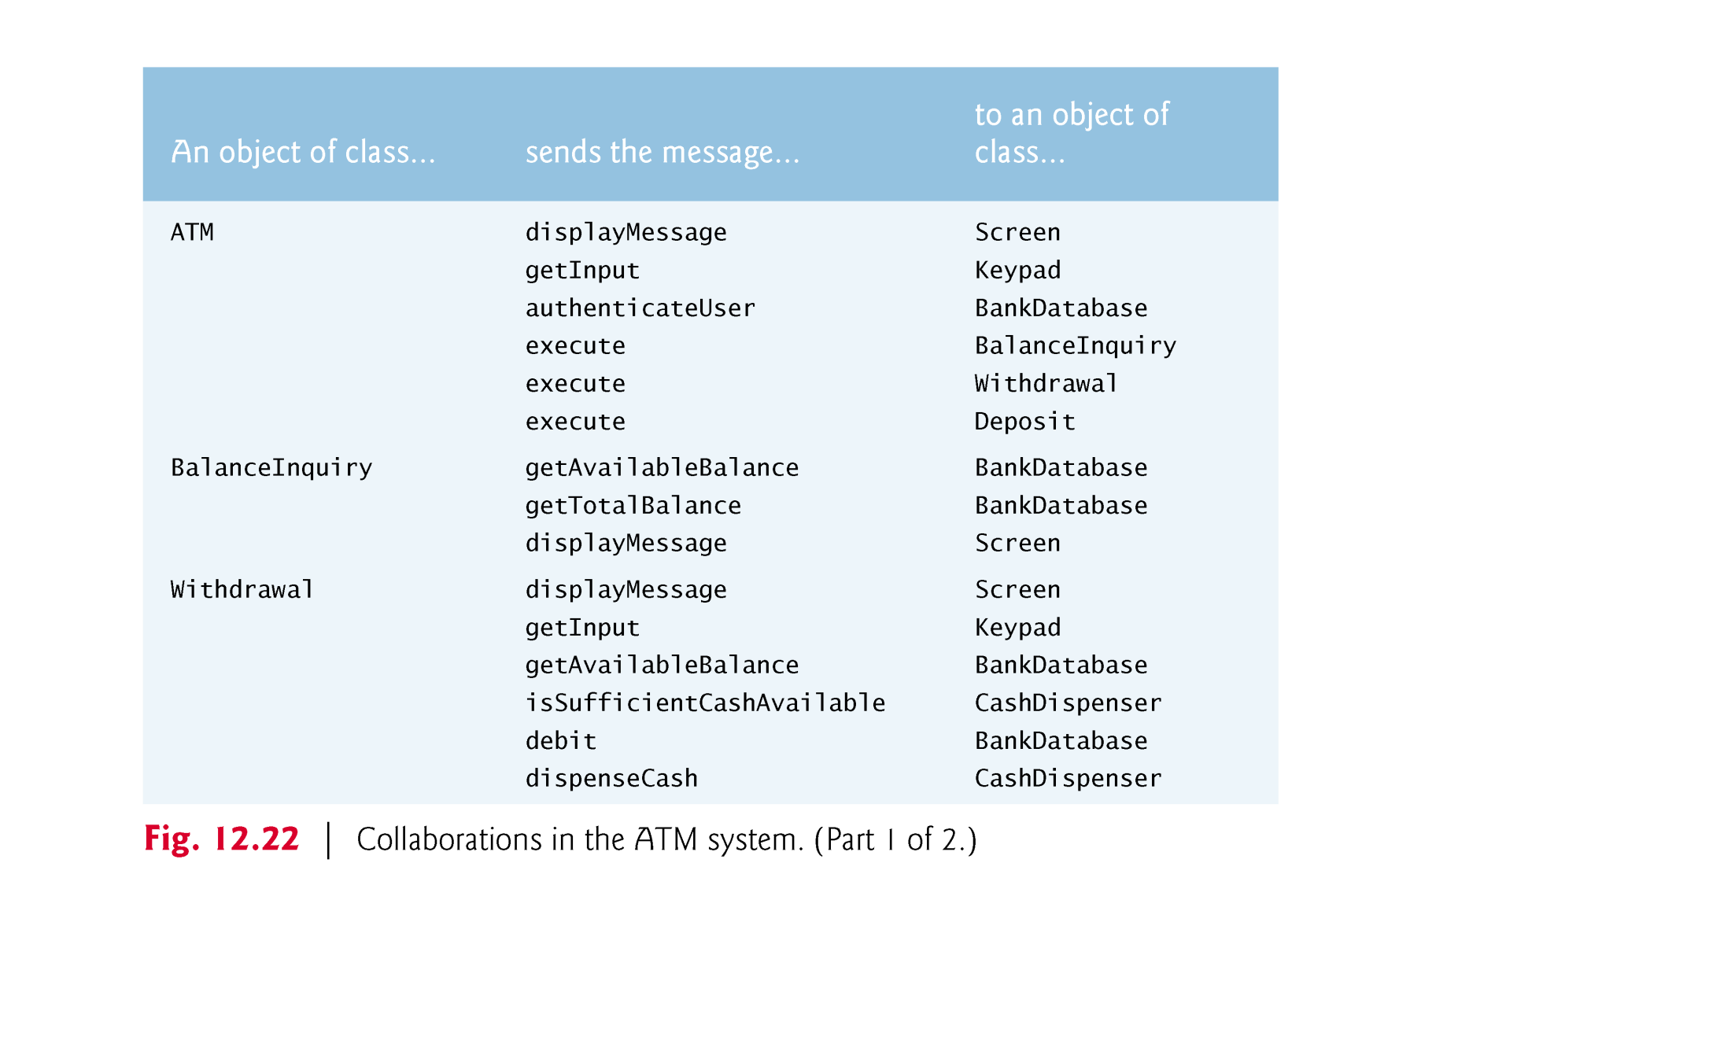
(C) 2010 Pearson Education, Inc. All rights reserved.

Slide 46
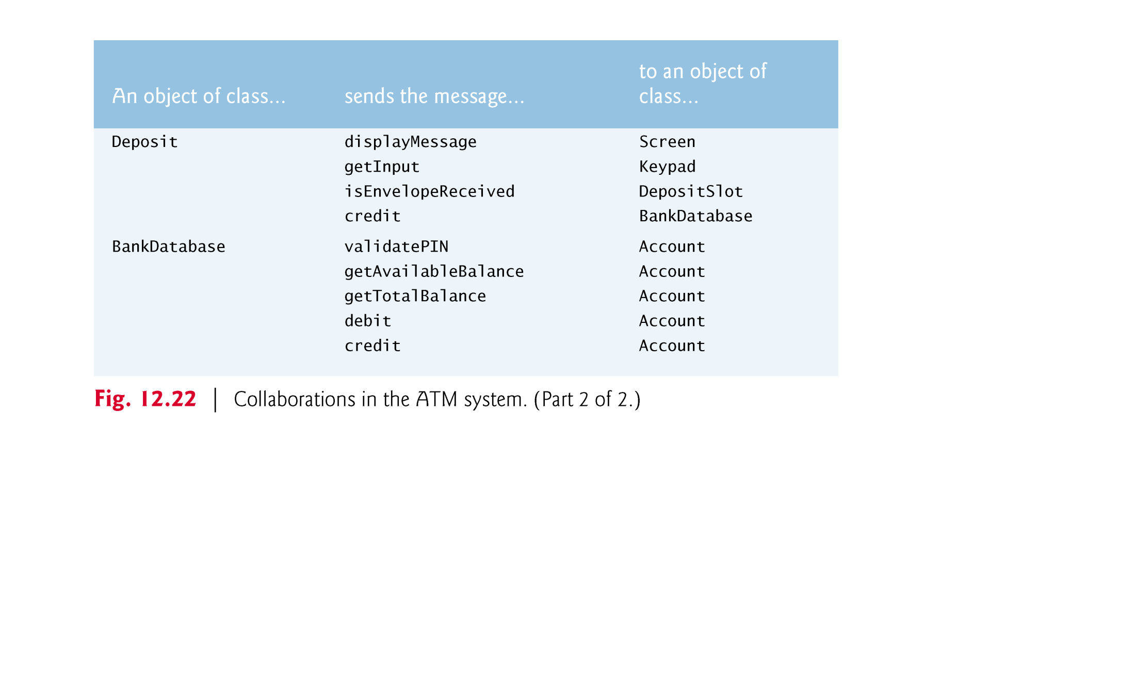
(C) 2010 Pearson Education, Inc. All rights reserved.

