Slide 1

Esquemático Maze Mapper
Master > Slave
Switch 0
Slave > Master
5V
4
ATMEGA 328P
Módulo Bluetooth RS232 HC-05
Slave <> Master
Energy
C (3,6V)
Micro
Sd
Micro SD Card Micro SDHC (Card Adapter Reader)
4
Switch
1/2
C (3,6V)
5V
5V
L293D
A (10,8V)
5V Regulator
5V
HC-SR04
HC-SR04
HC-SR04
A (3,6V x 3 = 10,8V)
5V
5V
5V
18650 - Bateria Cilíndrica Li-Ion - 3,6V
18650 - Bateria Cilíndrica Li-Ion - 3,6V
18650 - Bateria Cilíndrica Li-Ion - 3,6V
C (3,6V)
Motores de Passo NEMA 17

Slide 2
5V
ATMEGA 328P
Módulo Bluetooth RS232 HC-05
C (3,6V)
Micro
Sd
Micro SD Card Micro SDHC (Card Adapter Reader)
Switch
1/2
C (3,6V)
5V
5V
L293D
A (10,8V)
5V Regulator
5V
HC-SR04
HC-SR04
HC-SR04
A (3,6V x 3 = 10,8V)
5V
5V
5V
18650 - Bateria Cilíndrica Li-Ion - 3,6V
18650 - Bateria Cilíndrica Li-Ion - 3,6V
18650 - Bateria Cilíndrica Li-Ion - 3,6V
C (3,6V)

Slide 3
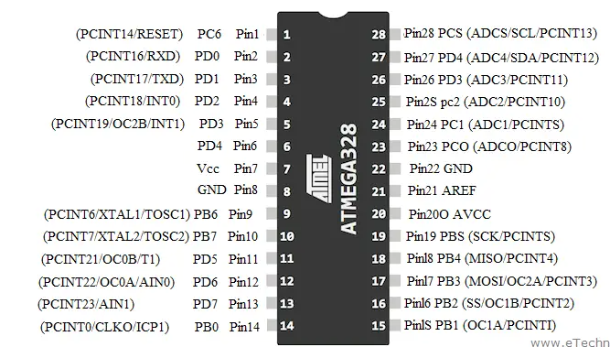
SD Reader
Sensores
Switches
Motor
Bluetooth

Slide 4
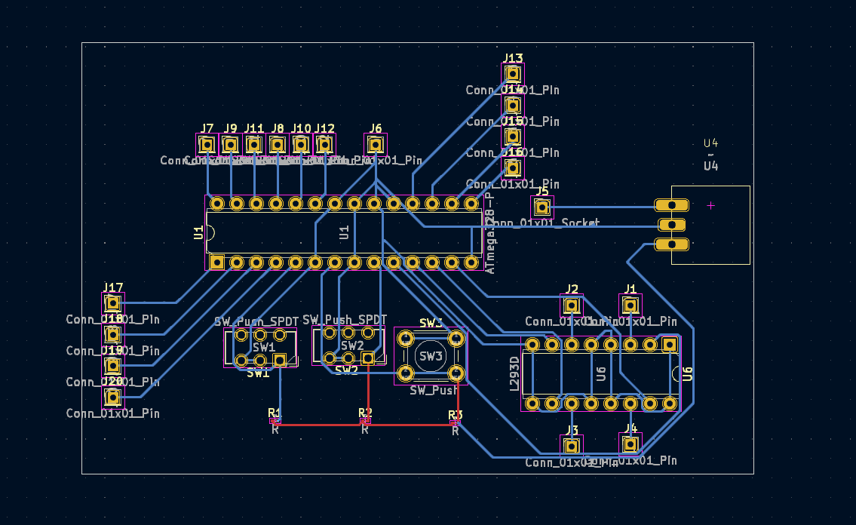
Bluetooth
Sensores
GND
5V Regulator
VCC
SD Reader
Motor
+
Ponte H
Switches

Slide 5
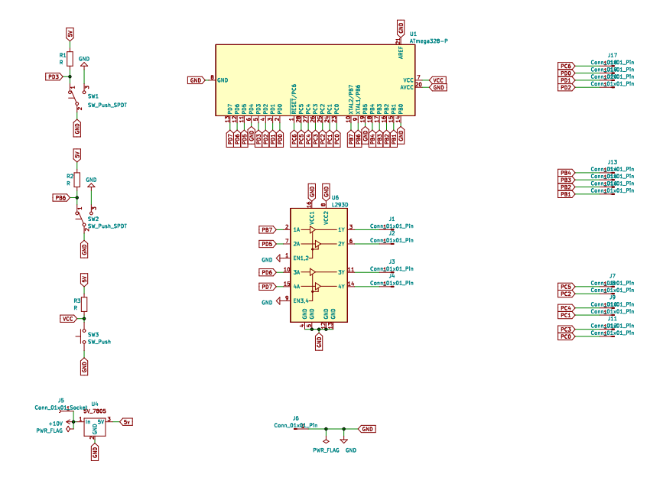
Microcontrolado
SD Reader
Ponte H
Switches
Bluetooth
Sensor
GND
5V Regulator

