Slide 1

Simulating Hospital Resource Management: Strategies and Challenges
João Figueiredo, 1230194
Tiago Nora, 1201050

Slide 2

Index
Introduction
Context/State of the art
Prisma
Research
R1
R2
R3
R4
Conclusion

Slide 3

Introduction
Importance of Resource Management in Healthcare Settings
Role of Simulation in Analyzing Complex Healthcare Systems
Overview of Simulation-Based Approaches for Resource Optimization
Objectives and Scope of the Research: Exploring Applications and Benefits

Slide 4

Context
Understanding Simulation Systems in Various Contexts
Focus on Simulation Systems in Healthcare Management
Introduction to Discrete Event Simulation (DES)
Applications of DES

Slide 5
Researches/Articles found
Article 1
Optimization of human resources.
Article 2
Optimization of personel and hospital resources.
Article 3
Optimization of hospital resources.
Article 4
Hospital resources’ optimization.

Slide 6
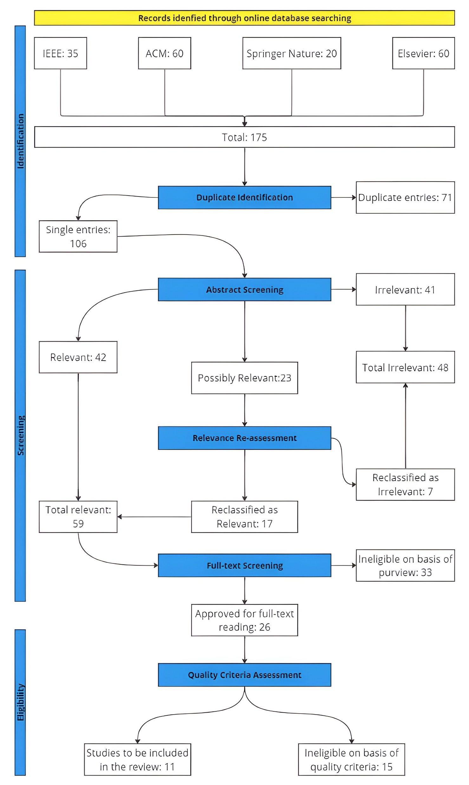






PRISMA

Slide 7
PRISMA Inclusion/Exclusion Criteria
Inclusion Criteria
Articles focusing on simulation techniques for optimizing hospital resource management.
Research discussing strategies for improving efficiency and effectiveness in hospital resource allocation through simulation.
Papers exploring challenges, limitations, and future directions in simulating hospital resource management.
Exclusion Criteria
Articles not related to hospital resource management or simulation techniques.
Studies lacking empirical evidence or not discussing practical implications.
Review articles without original research or studies unrelated to hospital resource management.

Slide 8
PRISMA Research Questions
Q1: How do different simulation techniques contribute to optimizing hospital resource allocation in the context of varying patient populations and healthcare demands
Q2: What are the key challenges and limitations faced in implementing simulation models for hospital resource management, and how can these challenges be addressed to enhance effectiveness?
Q3: What strategies can be employed to improve the accuracy and reliability of simulation-based predictions in hospital resource management, considering factors such as data quality, model complexity, and uncertainty?
• Q4: How do simulation-based decision support systems influence decision-making processes among healthcare administrators and clinicians in managing hospital resources effectively during crises such as pandemics or natural disasters?

Slide 9

Article 1
Estudo realizado na pandemia do covid 19 numa ala hospital dedicada para o efeito
Apresentados 10 cenários no qual foi feita a simulação para cada individualmente

Slide 10

Article 2
Arena Software
One of the primary findings of the simulation was the significant impact of bed availability on patient outcomes.
Analysis of the simulation outputs revealed that increasing the number of GPs in the ED had a direct effect on outpatient length of stay

Slide 11

Article 3
Patient Flow Analysis: Identified patterns in patient arrivals and departmental utilization, crucial for optimizing resource allocation.
Route Distribution: Revealed distribution of patients across departments, guiding effective resource allocation.
Simulation Model Development: Developed and validated a comprehensive simulation model to represent hospital operations accurately.
Addressing Bottlenecks: Identified and proposed interventions to address bottleneck areas, aiming to improve operational efficiency and reduce waiting times.

Slide 12
Article 4
Microsimulation in Healthcare Management:
Description of microsimulation as a modeling technique for healthcare systems.
Explanation of its application in simulating hospitals and analyzing various scenarios.
Resource Management Experiments and Insights:
Experimentation to understand the relationship between resources, patient queues, and system performance.
Demonstrating the impact of resource adjustments on patient outcomes and hospital operations.
Role of Hospital Management in Resource Optimization:
Importance of effective hospital management in optimizing resource allocation.
Utilization of microsimulation tools and insights for informed decision-making by healthcare managers.
Enhancing Healthcare Delivery Through Informed Decision-making:
Emphasizing how insights from resource management experiments guide strategic resource allocation.
Highlighting the role of informed decision-making in improving patient outcomes and streamlining healthcare processes.

Slide 13

Conclusions
Significance of Simulation Systems
Emphasizes the pivotal role of simulation systems for decision-making across sectors.
Hospital Management Application
Demonstrates the utilization of simulation systems in addressing staffing distribution challenges within hospital management, particularly in a Covid-19 unit.
Informed Decision-making through Comparison
Underlines the importance of conducting comparative analyses via simulations to enable informed decision-making by exploring diverse scenarios.

Slide 14

Perguntas?

