Slide 1

Robin K. Kammerlander, André Pereira and Simon Alexanderson "Using Virtual Reality to Support Acting in Motion Capture with Differently Scaled Characters“ 2021 IEEE Virtual Reality and 3D User Interfaces (VR)
João Torrinhas, 98435
Diogo Torrinhas, 98440
Human-computer interaction 27 March-1Abril 2021

Slide 2
Why did we choose this paper?
Currently, it is increasingly common in films to use characters that are not human, that is, virtual characters
In video games it is also very common to use virtual characters
We were interested in knowing how the production of this type of films and video games was done

Slide 3

Introduction
Motion capture (Mocap) technology has a long time to provide the movie and video game animation industry for digital characters and creatures. The technology allows for the digitization of an actor's performance and a subsequent complete transformation of the appearance
This type of metamorphosis brings many challenges for actors, who are forced to perform in empty studios, dressed in out-of-character costumes, portraying characters that do not match their natural appearances and bodies.
That said, the Virtual Reality (VR) headsets appear, autonomous and lightweight, which offer new possibilities to alleviate many of these problems. Using VR and combining it with full-body motion capture improves actors' performances, leading to more authentic acting, and results in less post-processing work.

Slide 4
Hypotheses
H1- Using virtual reality to support collaborative acting in virtual productions:
1. Results in a higher sense of body ownership when embodying differently scaled characters
2. Results in decreased social presence due to technological disadvantages when compared to face-to-face acting found in traditional mocap environments
3. Makes actors more mentally immersed in their acting experience
H2- The benefits from Hl a-c and improved context awareness will translate to improved acting performances.
H3- When portraying characters of different scales, acting in VR will lead to less animation cleanup

Slide 5

Related Work - 1
Lack of visual references is a well-known problem in visual effects and virtual production
When filming on green screen studios, for example, actors can see other physical actors and props but not digital characters and environments and in the case of film directors they cannot see the final image or evaluate the actors' performance during filming
That said, Bouville et al, to support the performance, proposed a system for testing in virtual reality. In the system, actors could familiarize themselves with the virtual environment and act towards an animated tiger. After rehearsal, they replayed the scene as normal in the green screen studio. The study showed that the actors preferred VR training to classical training, as the rehearsal gave the actors a better view of the virtual scenario and made it possible to experience different interactions with the virtual character

Slide 6
Related Work - 2
Kade et al proposed a system using a head-mounted projector to display an actor's virtual environment on the performance area. The results showed that the prototype support made the performances more oriented than without it, in the sense of allowing the actors to focus more on the emotions required and also helping to reduce the mental load needed to imagine the environment
Closer to the study carried out in this paper is the study by Normand et al, in which a system was developed for testing in a shared remote virtual environment. By connecting the participants (two actors and a director) in a network, they were able to rehearse through their virtual avatars in a shared virtual space
Finally, several studies indicate that VR can be seen as a way to achieve near-perfect presence with other people. However, there are still issues with VR. The lack of information about facial expressions, looks and body and finger movements are limiting factors. In this paper, only full body movement will be discussed in the VR condition, but not facial expression or look

Slide 7
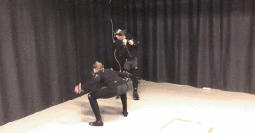
Design and implementation- System Hardware
Use an optical system with passive indicators for studio-grade motion capture
They use the Oculus Quest, because it's light, has high resolution and doesn't restrict movement
Use an Optitrack motion capture system with 16 Prime 41 cameras and a Prime 17W camera
Motive 2.2 software was used to track and interpret the motion data and transmit it to the headphones
Uses default setting of 37 markers for full body tracking

Slide 8
Design and implementation- Software Implementation
Implement the system in the Unity 2019.1.7 game engine using Oculus VR integration tools and plugins
For skeleton streaming, use a plugin from the motion capture system provider Optitrack
To align the HMD view with the virtual character's perspective, they created some custom scripts
To align the direction of the HMD they applied the rotations of the Quest's internal tracking system
To minimize body incompatibility issues, they used virtual characters with human proportions

Slide 9
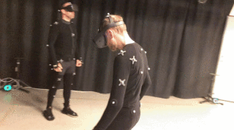
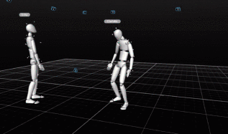
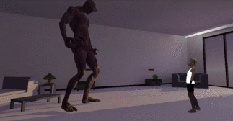
Design and implementation- Interface Design - 1
The interface consists of a virtual environment in which the staged scene would take place, as well as the two avatars to be incarnated by the actors
The space could also serve as a rehearsal space where the actors could find the right balance and movements for the character, but also as a training space to get used to the scenario
Each actor can see the other character as well as their own virtual body from a first-person perspective

Slide 10
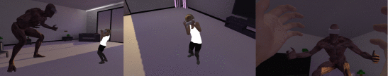
Design and implementation- Interface Design - 2

Slide 11
Acting Experiment
A controlled experiment was carried out within subjects with trained actors to obtain information about the advantages, disadvantages and future potential of the proposed VR setup. For this experiment, 22 actors were recruited, 7 men and 15 women, whose ages range from 24-60 years.
The task in this experiment consisted of having 2 actors perform a script that was written specifically for dealing with problems when actors play characters of a different scale.

Slide 12
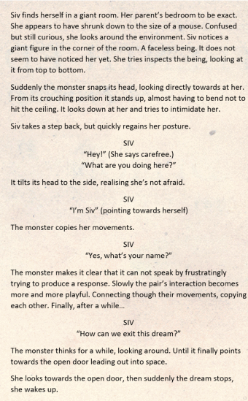
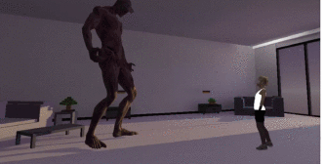
Acting Experiment - Scrip a dream sequence
Two characters of different scales were used, a taller one (monster) and a smaller one (girl siv) to Reflect difficulties experienced when portraying characters of different scales.
The scene was designed to test the interaction between the actors through dialogue and having the characters imitate each other's movements.

Slide 13
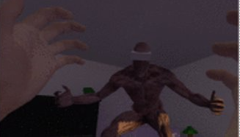
Conditions - Motion Capture (MC)
Explore and train with a projected mirror for up to 5 minutes. Learning the proper moves as the virtual setting and the characters were reflected on a projected screen
Perform the scene. The actors acted out the same scene three times. The projection was turned off and the actors were forced to perform a relative to each other in the physical room
Complete a post-condition questionnaire

Slide 14

Conditions - Virtual Reality+Motion Capture (VR)
Explore and train with a virtual mirror, up to five minutes. The actors use a virtual reality headset to view scenes from perspective of your characters
Realize the scene in VR. The actors acted out the same scene three times. They used the virtual environment and collaborated with the other virtual characteras reference
Complete a post-condition questionnaire

Slide 15
Procedure
The experiment started with the participants filling out a consent form and then the participants wore a motion capture suit.
The participants among themselves decided that they would play each character.
Participants experienced both conditions and at the end of each condition completed a post-condition questionnaire.
At the end, a semi-structured interview was carried out

Slide 16
Post-Condition Questionnaire
Questionnaire that is divided into three distinct measures:
Body Possession
Social Presence
Mental Immersion

Slide 17
Semi-Structured Interviews
What acting setup do you think led to better performances? Why
Has the VR app affected your acting? If yes, how?
Did the VR application influence your imagination? If yes, how?

Slide 18
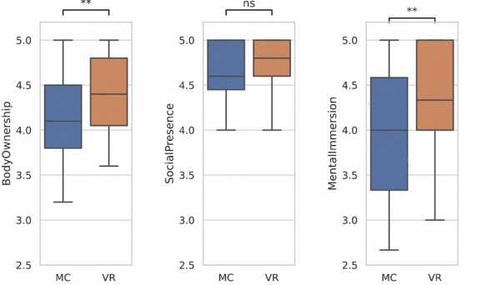
Results
Body Possession-participants reported an increased sense of body possession in the VR condition compared to Motion Capture.
Social Presence - similar results between the two conditions
Mental Immersion - Participants reported increased levels of immersion when comparing VR to Motion capture
Regarding the interviews , 12 participants believe that they had a better performance in motion capture(MC) while the remaining 10 preferred VR

Slide 19
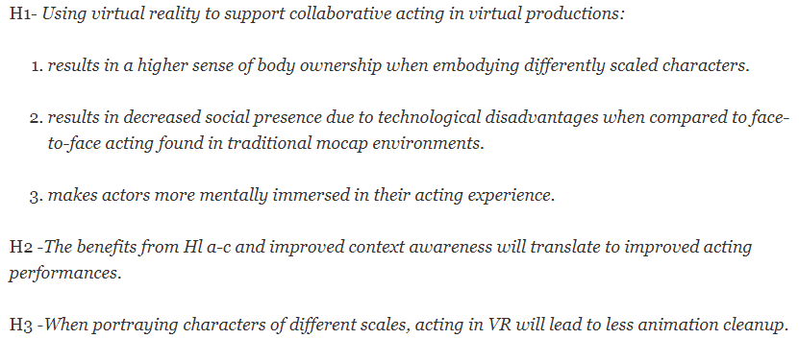
Discussion
In VR seems to have heightened the actors' sense of bodily ownership. The difference in social presence was inconclusive and remained at a similar level for both conditions. Mental immersion was significantly increased in the VR-sim condition.
This statement still remains inconclusive as 10 actors preferred their VR performances and 12 felt the same about the MC setup.
These results are clear when observing that the movements and the look of each character were correct in relation to the virtual scene in the generated animation videos

Slide 20
Future Work
The experiment garnered interesting results which could stand as the foundation for further research.
It would be beneficial to perform a similar experiment once again, using even more general scenarios for comparison
In future research, we are interested in exploring VR as an autonomous space for virtual production or live theatrical performances.

Slide 21
Conclusion
The experiment, conducted with 22 trained actors, found that our proposed VR setup significantly improved the sense of embodiment and immersion over a standard mocap setting
Interviews with the actors confirmed the efficiency of the system, both as a rehearsal and a production tool

