Slide 1
BombAppetit
SIRS - Group 14
ist192525 Miguel Nunes
ist199250 João Vieira
ist193460 João Lima

Slide 2
Introduction
Secure Document
Infrastructure
Secure Channels and Key Distribution
Security Challenge
Conclusion

Slide 3
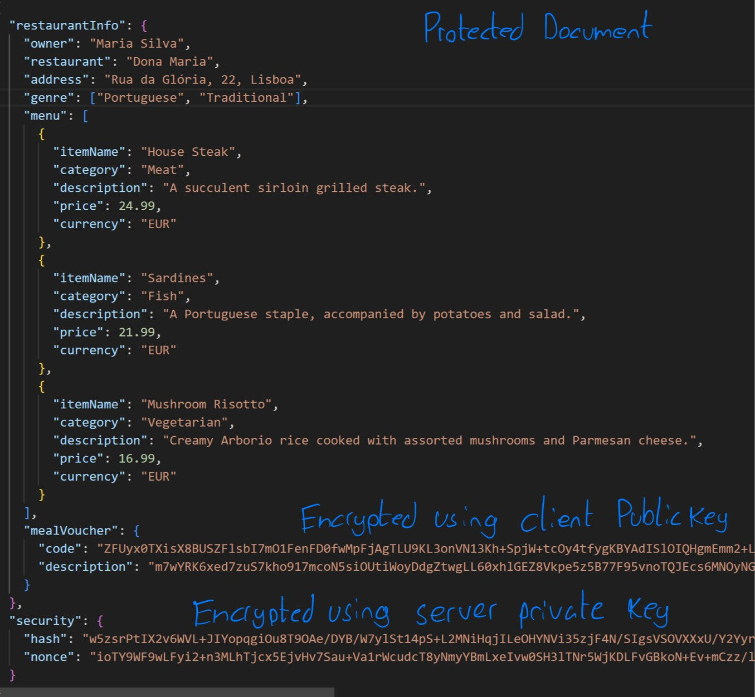
Secure Document Format - Protect
MealVoucher confidentiality: Encrypt with client public key
Restaurant data authenticity: Digital signature including cryptographic hash and random nonce
Client and Server keypair RSA encrypted with 2048 bits length

Slide 4
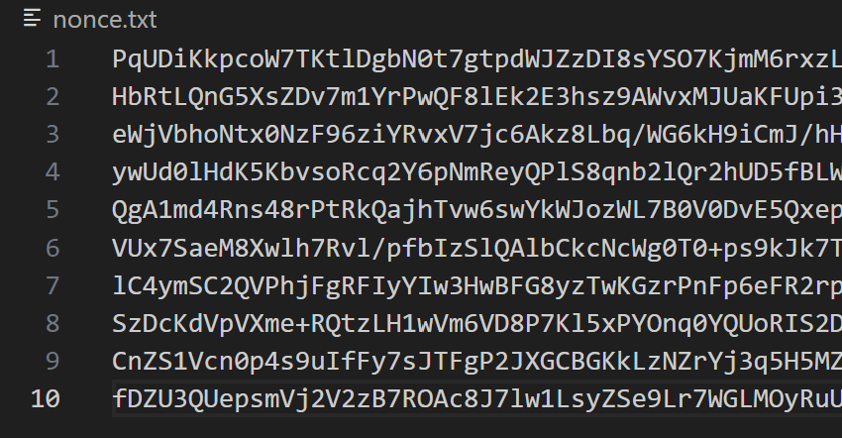
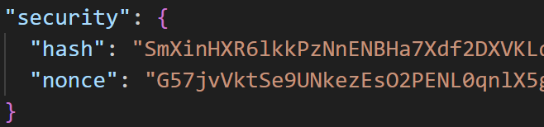
Secure Document Format - Check
Uses the server’s public key to decrypt the cryptographic hash and nonce.
Computes new hash and checks against received hash
Checks the decrypted nonce against existing nonces

Slide 5
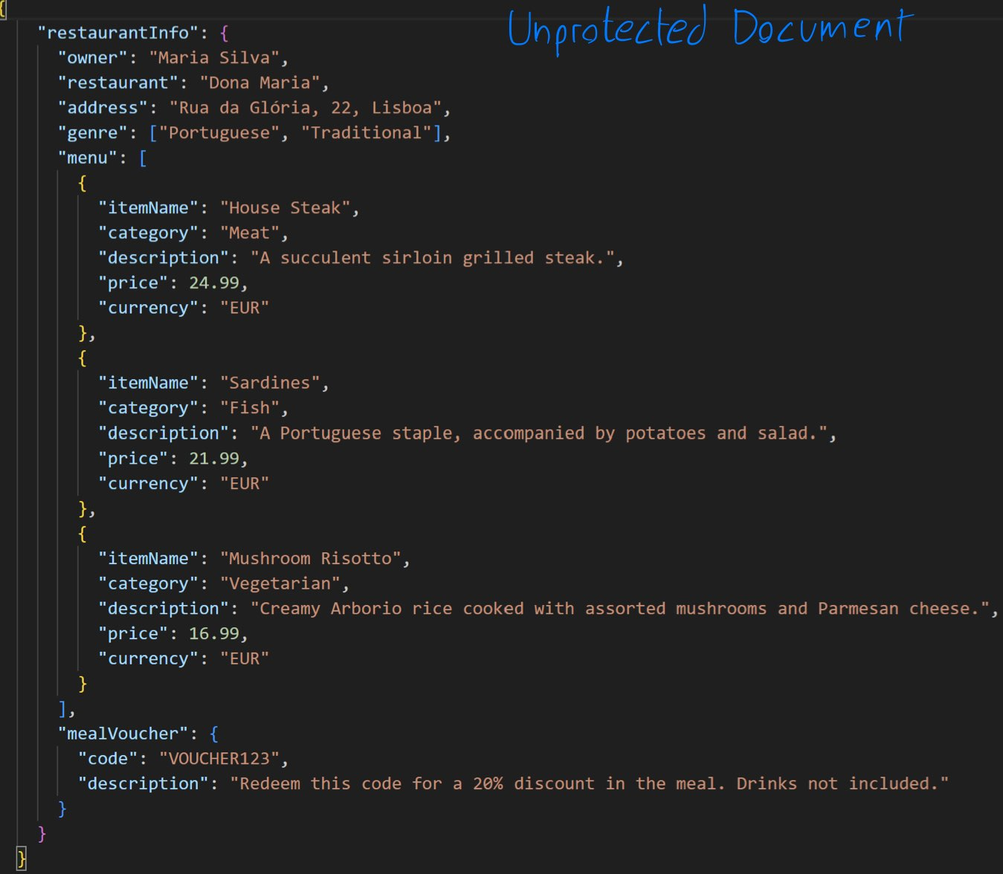
Secure Document Format - Unprotect
Removes the encryption from mealVoucher and removes the security field from a protected document.
Technologies used:
Java crypto library
Google Gson library
Maven

Slide 6
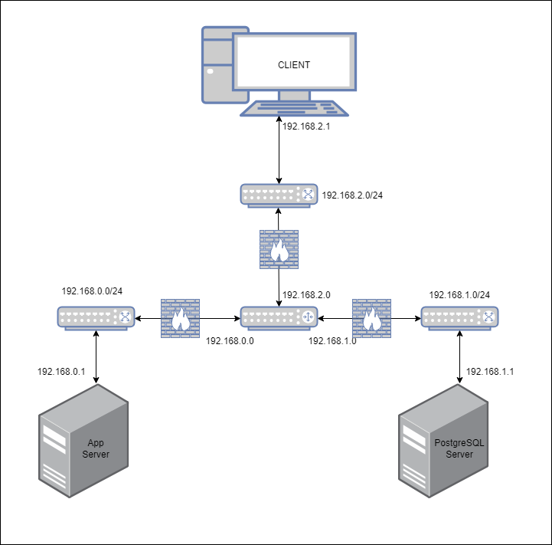
Infrastructure
4 Machines
Application Server
Database Server
Client
Router
3 Subnets
Application ⇔ Router (192.168.0.0/24)
Database ⇔ Router (192.168.1.0/24)
Client ⇔ Router (192.168.2.0/24)

Slide 7
Application Server
IP 192.168.0.1
Exposed in port 8443
Using the Spring framework in Java

Slide 8
Client
IP 192.168.2.1
Python command line application
Possible operations
Get Restaurant Information
Create Review
Transfer Vouchers

Slide 9
Database Server
IP 192.168.1.1
Exposed in port 5432
Using PostgreSQL as the DB

Slide 10
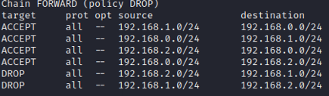
Router
An interface for each subnet
Firewall Rules

Slide 11
Secure channels and key distribution
TLS: Client ⇔ Server
No TLS: Server ⇔ DB
Keys-Pairs already created with Public Keys already exchanged.

Slide 12
Security Considerations
Assumptions
Communication channel between the Application and the Database can’t be compromised
The Application and the Database are fully trusted
Possible Limitations
No authentication service leads to possible impersonation

Slide 13
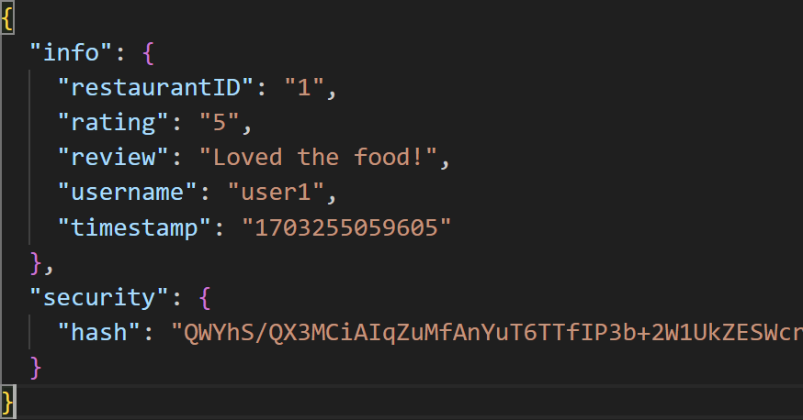
Security Challenge - Reviews
instead of a random nonce to guarantee freshness, we use a timestamp.
Authenticity is guaranteed by the digital signature
Reviews are necessarily non-repudiable since the author’s identity and message integrity are guaranteed

Slide 14
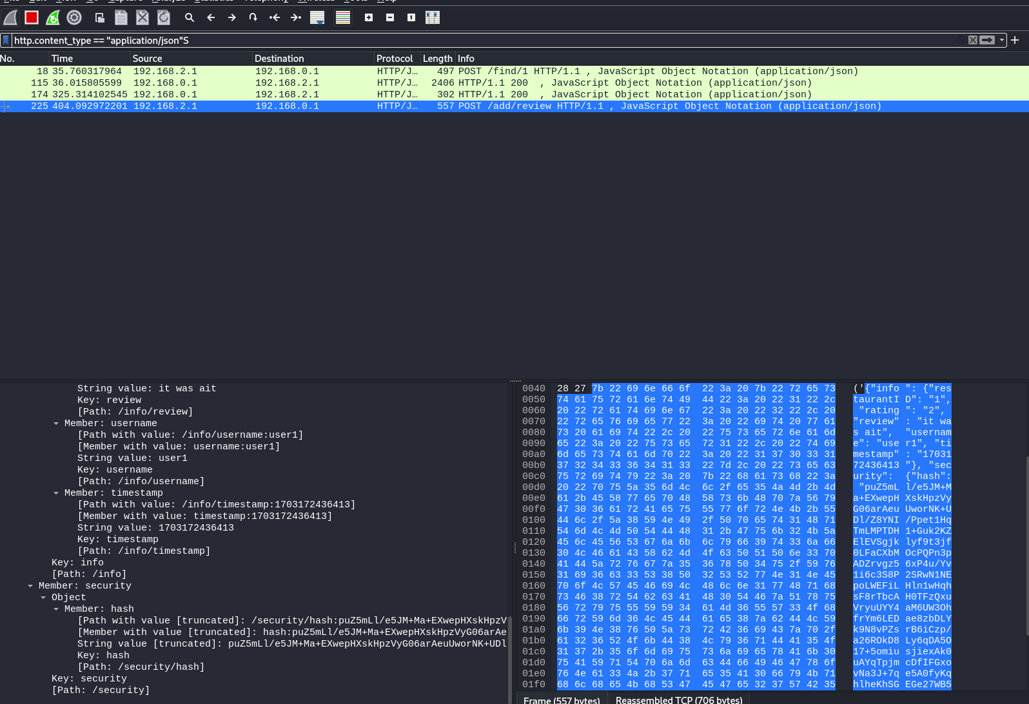

Slide 15
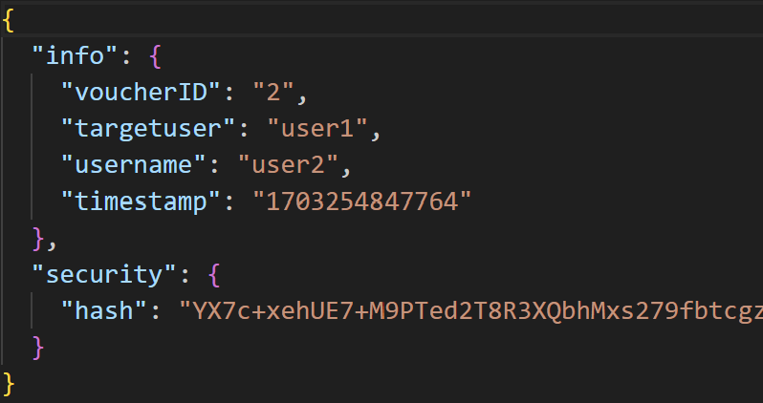
Security Challenge - Voucher Transfer
Since we assume the database is secure, our solution for the transfer of vouchers between clients is handled server side.
There is no need to create dynamic key distribution between clients since the only client involved in the process is the originator.

Slide 16
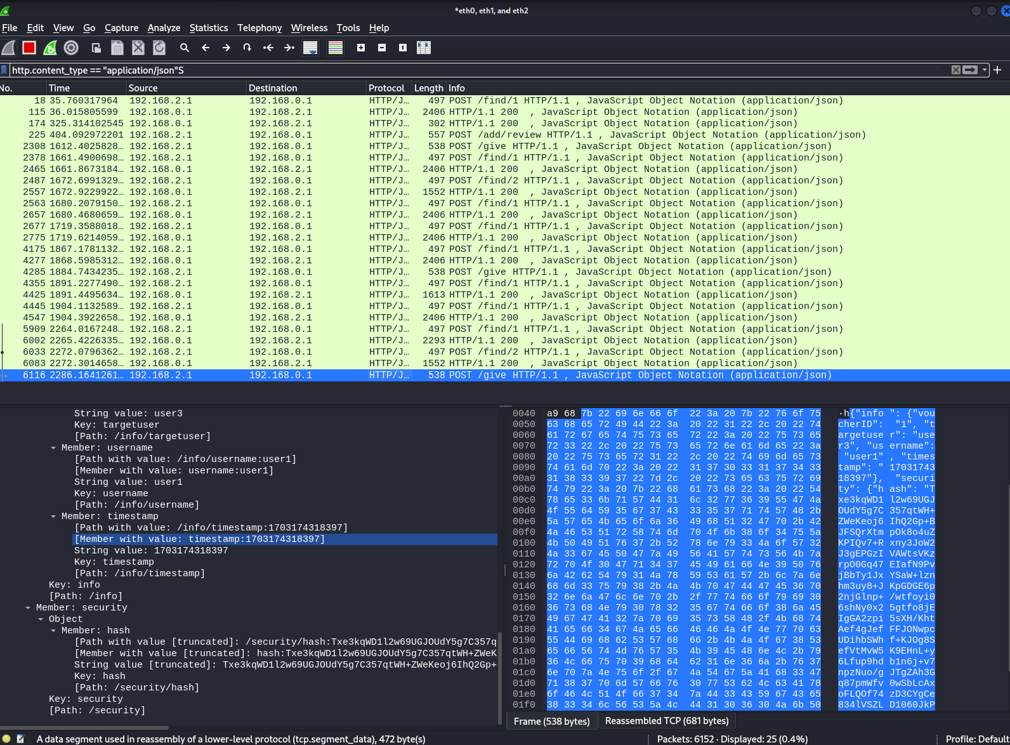

Slide 17
Conclusion
We developed a secure app that is able to send and receive encrypted data, while also verifying its integrity.
We are able to:
Send and receive reviews
Send voucher to other users
Protect and unprotect documents
Check authenticity and freshness of documents
Future work:
Add Gui interface to the user application
Add Authentication Service
Add TLS between Application Server and Database
Add the ability for more restaurants to register

Slide 18

Live Demonstration

Slide 19
The End

