Slide 1

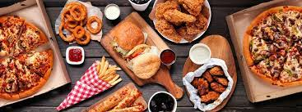
Using NLP and Deep Learning to
Boost the iFood Rocket!!
A work by:
João Silva
Lucas Neves
Miguel Bernardo

Slide 2
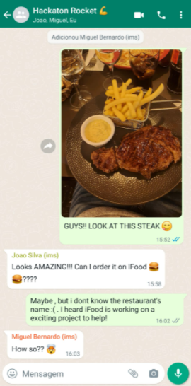
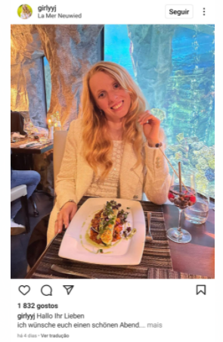
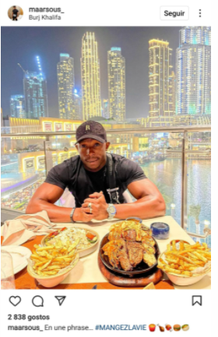

Slide 3
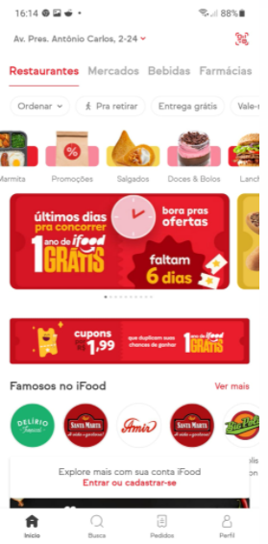
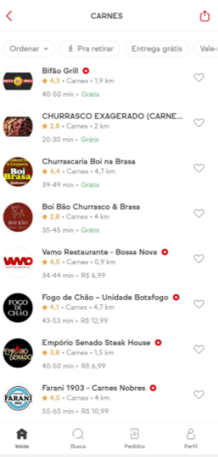

Can Joao find the right steak?

Slide 4

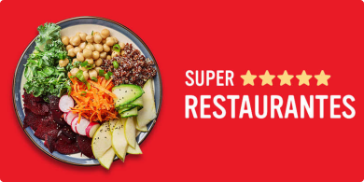

What if Joao could export dish images to the iFood app ?
iFood could return:
The right restaurant or restaurants that make that dish;
The recipe with the ingredientes on the dish;

Slide 5



Our hackaton solution
Datasources
Convolutional neural network
LDA algorithm
Recipes
Dish images
Grouping ingredients into recipe clusters
Uses the recipes clusters to classify dish images and return the recipes
Notes:
We used different datasources with recipes and dish images, then clustered the ingredients into clusters with LDA algorithm, and lastly we fed the récipe clusters to a CNN which will use them
To classify dish images and return the recipes

Slide 6
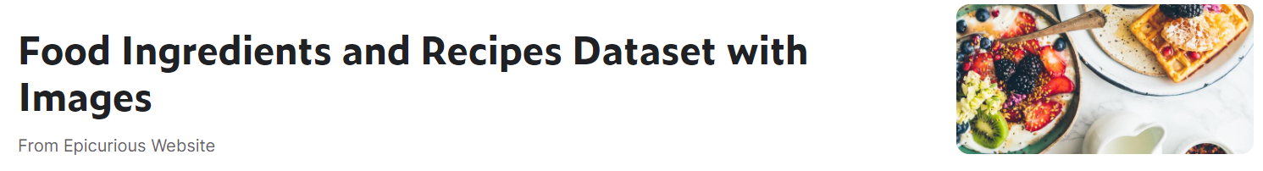
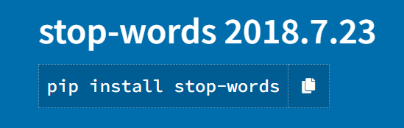
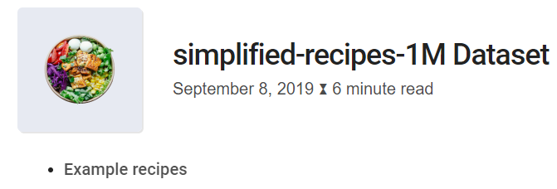

Datasources
Kaggle Dataset / Main Dataset
13582 dish images and recipes
Stop Words list
1298 stop words + 20 added words
Added extra words:
-Colours
-Verbs
Added recipes
+1M recipes to cross check
Notes:
1- We used a main kaggle dataset with 13582 récipes and images.
2- Then we extracted the récipes into ingredients, by cross-checking with the 1M récipe Dataset and string manipulation.
3- Then we filtered the ingredient wrods, using python stop-word list package plus some added words that were also showing up (colours+adjectives)

Slide 7
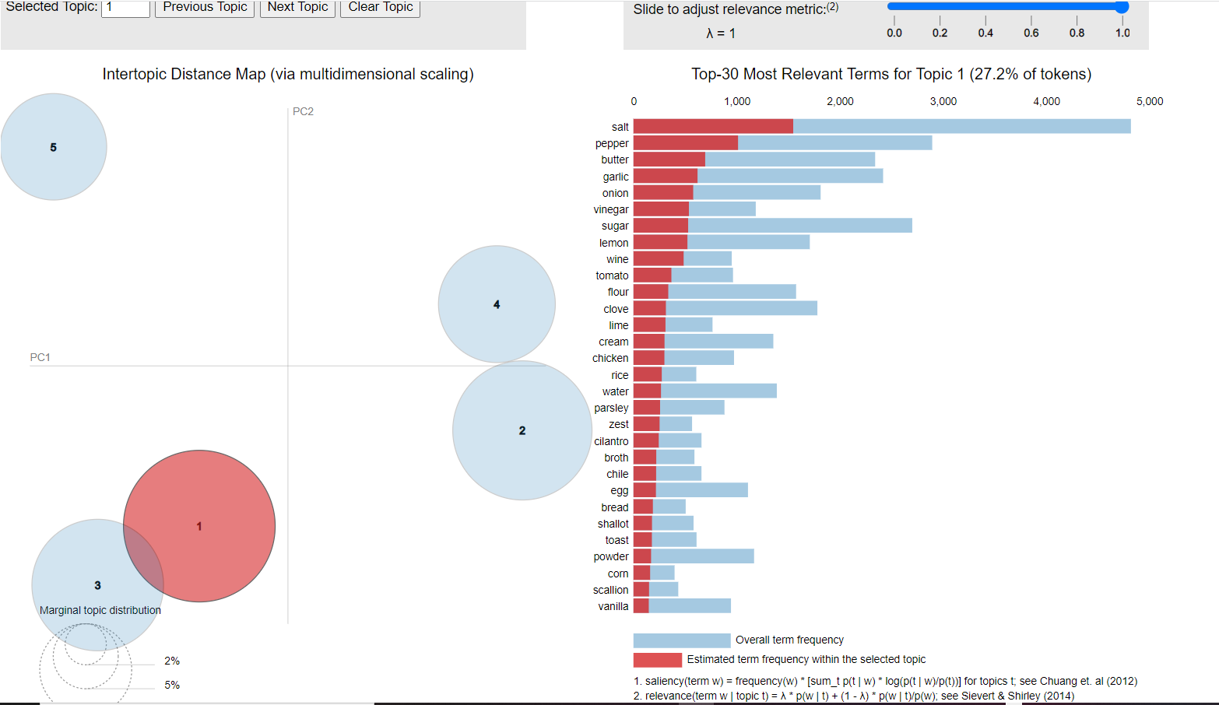

Latent Dirichlet Allocation - LDA
In natural language processing, LDA is a statistical model that is used to classify text in a document to a particular topic.
In this case, it was possible to use the final ingredient list from all recipes and make clusters of categories with it.
Notes:
Latent Dirichlet Allocation
1-In natural language processing, LDA is a statistical model that is used to classify text in a document to a particular topic.
2- In this case, it was possible to use the final ingredient list from all recipes and make clusters of categories with it.
3- As you can see in the PCA representation, we decided to go with a total of 5 recipe categories, since we had a limited number of images to train the model.
You can also see that the circles are big and almost don’t intercept, which means it seems to be a good model

Slide 8
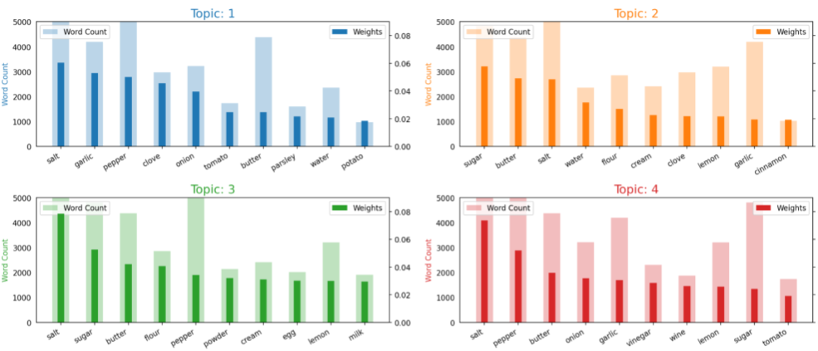
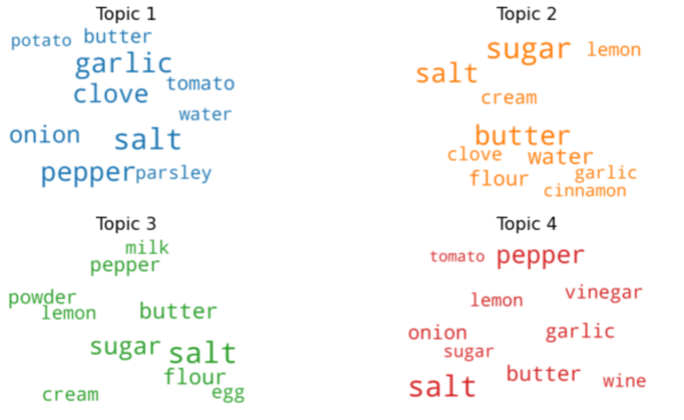
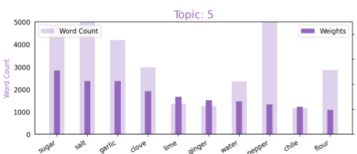

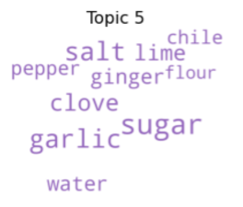
Latent Dirichlet Allocation - LDA
Notes:
These are the most important words in each recipe category. By frequency in the bar charts and by word size in the word clouds.
Sometimes the same ingredient can be in multiple clusters, but LDA looks at the combination of ingredients in each cluster.

Slide 9
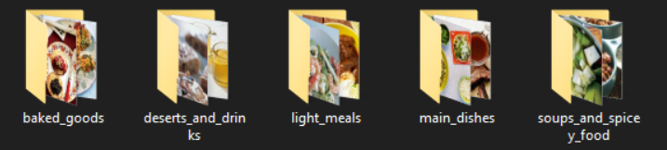
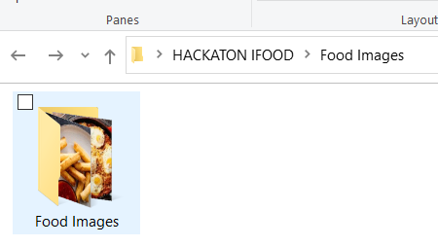
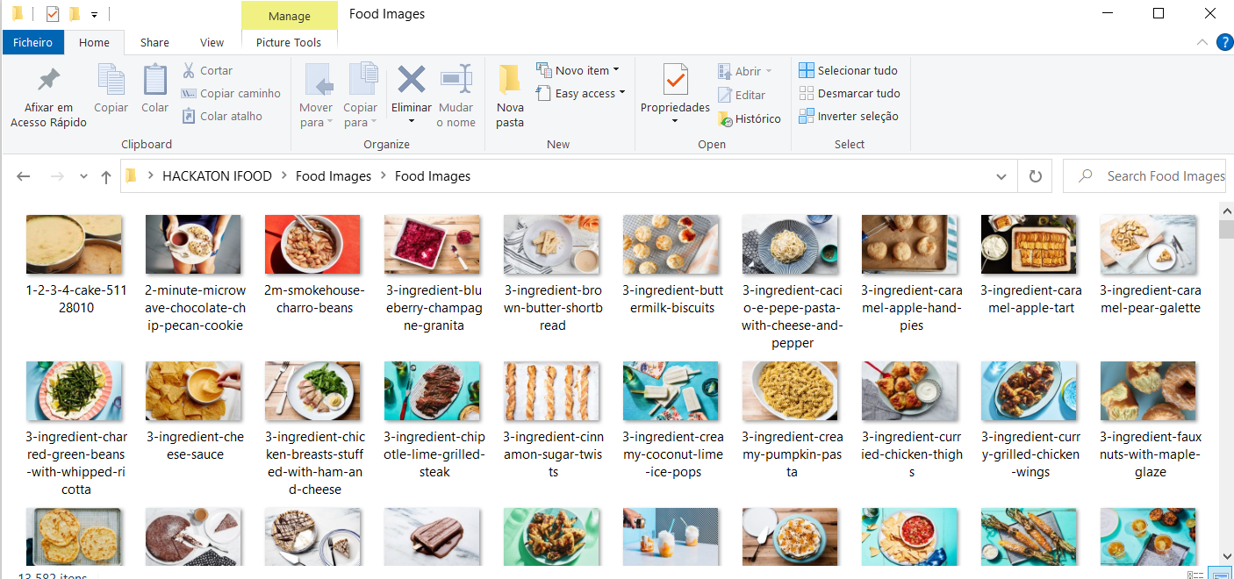
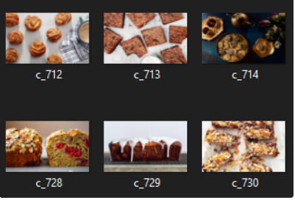
Unsupervised Labeling
Image split to train
Original Dataset
3280 2120 1420 3430 2450
13582 -> 12700 images
Using LDA labeling to train CNN
Example
Notes:
After having the LDA labels, we seperated and renamed our pictures accordingly.
Mostrar exemplos

Slide 10
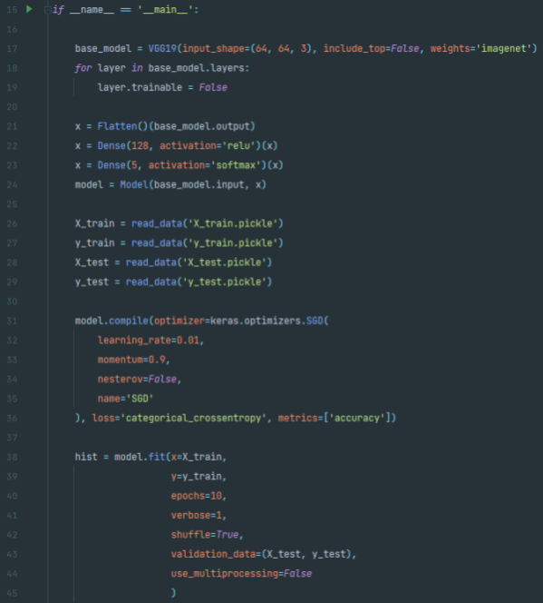
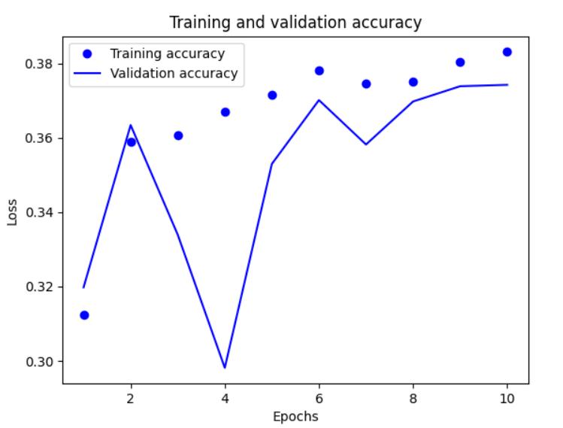
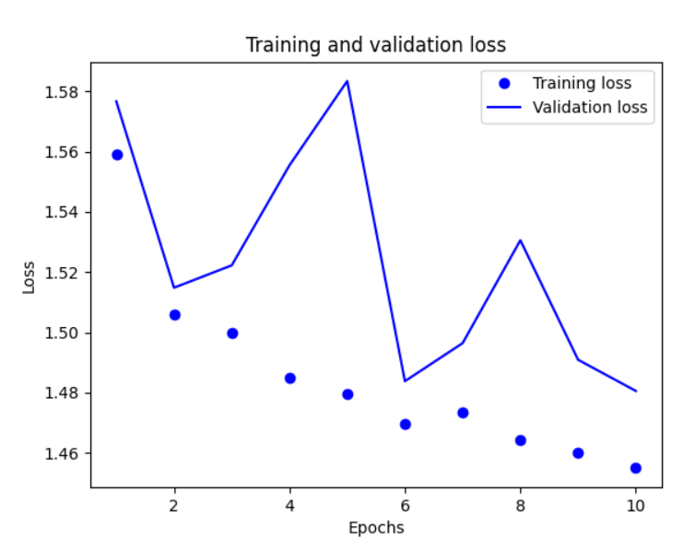
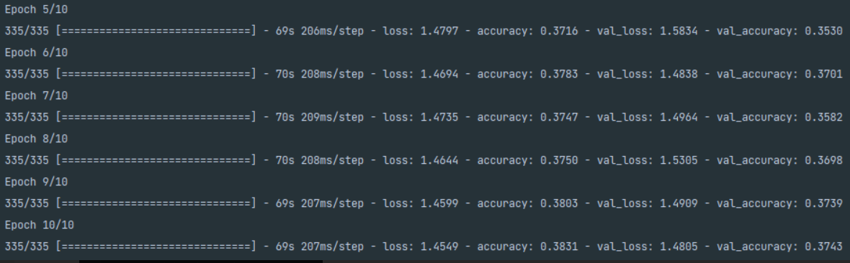
Convolutional Neural Network - CNN
Notes:
We trained a CNN based on the VGG19 model which was used on the image net competition and was trainned on millions of images to compensate our small dataset.
With only 10 epochs, we already saw some decent performance. Although, with more time we could have improved it further.

Slide 11
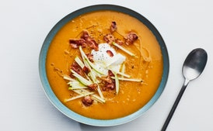
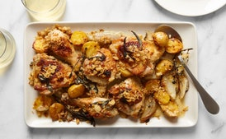
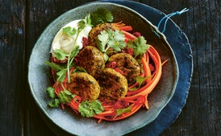
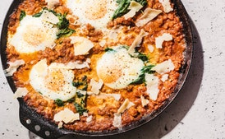
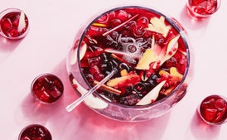
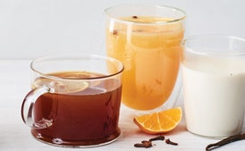
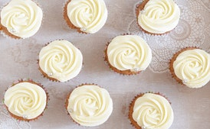
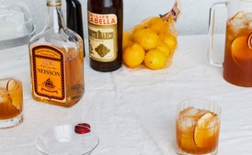
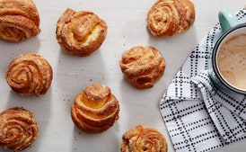
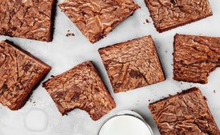
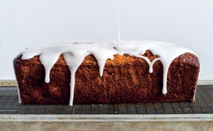
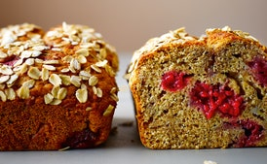
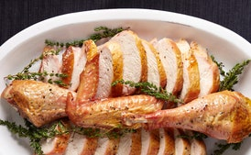
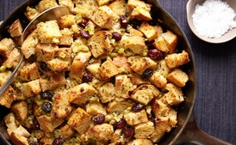
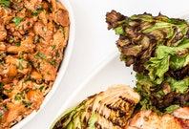
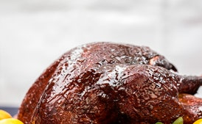
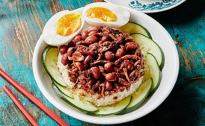
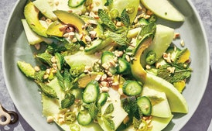
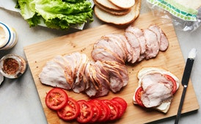
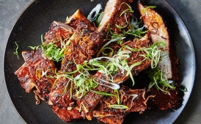
1-Soups and Spicy foods
salt, garlic, pepper, clove, onion, butter, tomato, water, parsley, potato
2-Deserts and Drinks
sugar, butter, salt, water, flour, cream, clove, lemon, garlic, cinnamon
3-Baked goods
salt, sugar, butter, flour, pepper, powder, cream, egg, milk, lemon
4-Main dishes
salt, pepper, butter, onion, garlic, vinegar, wine, lemon, sugar, tomato
5-Light Meals
sugar, garlic, salt, clove, lime, pepper, water, ginger, chile, onion
Notes:
This an exemple of image classification by the CNN.
As you can see the images were attributed to the LDA categories based on the main ingredients bellow
Dar exemplo BAKED GOODS: You can see images of cakes being assigned to the baked goods category, because of ingredientes like egg, milk and flour

Slide 12


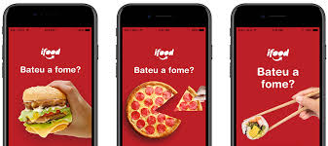
Let’s end with a Demonstration!
Thank you ☺

Slide 13
Sources
Dataset do Kaggle :
https://www.kaggle.com/datasets/pes12017000148/food-ingredients-and-recipe-dataset-with-images
Stop words:
https://pypi.org/project/stop-words/
Dataset dos ingredients:
http://dominikschmidt.xyz/simplified-recipes-1M/
Notes:
Latent Dirichlet Allocation
Convolutional neural network

