Slide 1
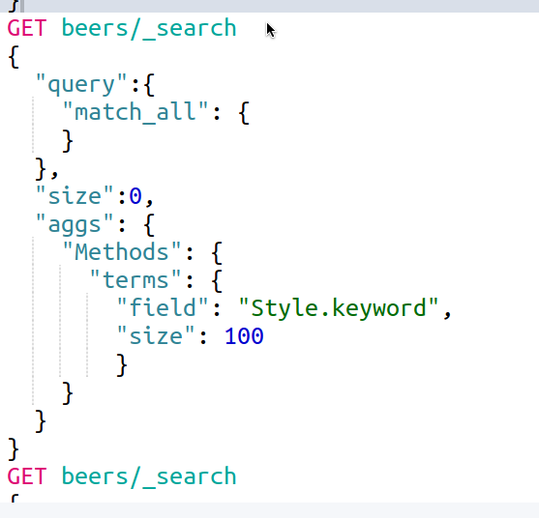
Query Language
Elastic search queries use a structure similar to JSON. All features of the query are nested within within the “query” field, and sub-fields such as “match”, “bool”, “and “wildcard” are there to match the needs of the user. Within the query, filters, modifications, and precision adjustments can also be implemented.
Attributes of the query such as “size” are beneath and not nested directly in the original query. The size field will control the number of results of the query or “buckets” during aggregation. Additionally, actions such as aggregations are also outside and below the query. Additional aggregations, can also be added to the end or within other aggregations..

Slide 2
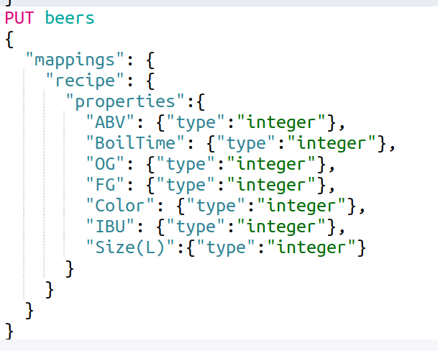
Mapping
Data being stored in Elasticsearch is a stringified JSON format. Mappings are needed to provide the structure to values that are to be extracted and evaluated in methods other than those of plain text. JSON Mappings allow for basic types beyond strings such as integers, dates, Boolean values, and range data. There are also more complex types, like arrays and dictionaries (or other JSON structured data), and additionally, there more specific data types such as Geo-point and IP data types.
For values that are integers or a more complex data type and would like to be use for searches, aggregations within a range, plotted over a geographical map. A mapping of the index must be used to create the index.
In this mapping, the index “beers” has seven fields where the values will be type “integer” the remaining as well as any additional fields will be recognized as type “string”.

Slide 3
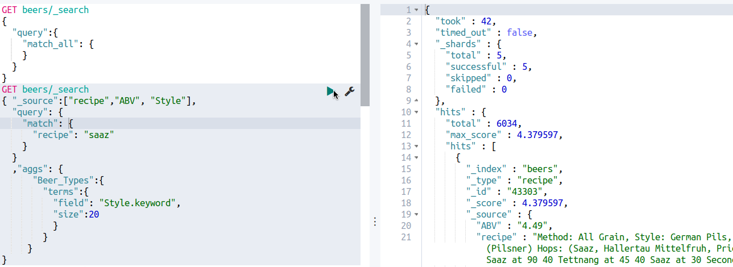
Basic search
The basic search allows to match a value to specific fields or just searched over the whole of each document in the index. In the queries above, there is a basic search for all items in the index and a query for the string value “saaz” from the specific field “recipe” . The second search also has limit to which fields of the document within the index will be presented within the query results. By selecting “_source”, we specified the fields “recipe”, “ABV”, and “Style” to be present in the query results.

Slide 4
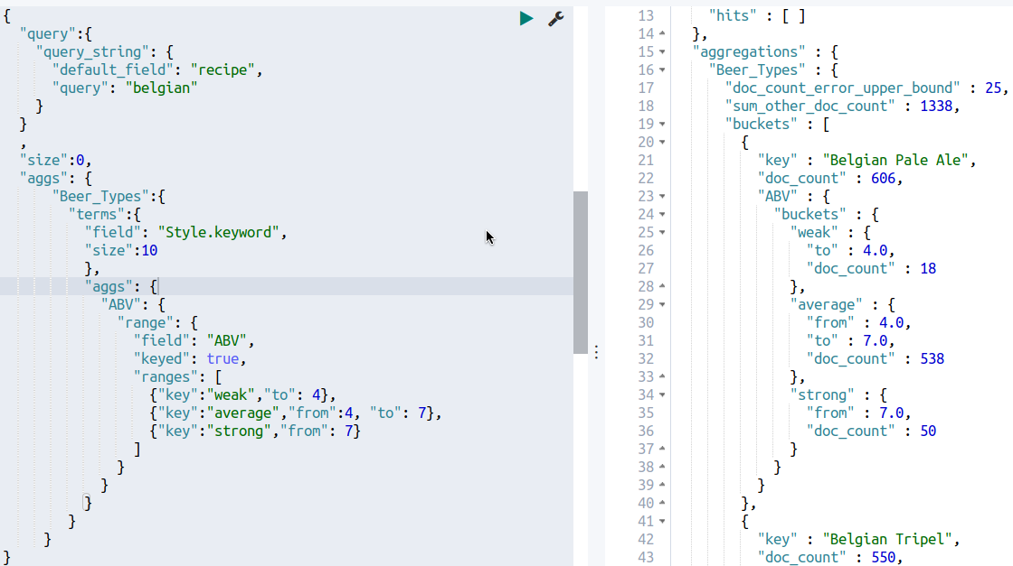
Aggregations
Elasticsearch allows for quick aggregations from a variety of different means. Aggregations can made on unique field values or ranges as well as a filter value that can be applied to a given aggregation. Limits can also be set with the “size” field within the query to limit or expand the number of query and/or aggregation results.
In this query above, we have utilized the unique values of within the field “Style” to first aggregate the result documents of a string-query for the value “belgian” . The number of styles was limited to ten style “buckets”, and within those buckets, we were once again able to aggregate them according the range value of “ABV”. We have only three ranges here, but the limit is at least one, with an indetermined upper-bound limit.

Slide 5
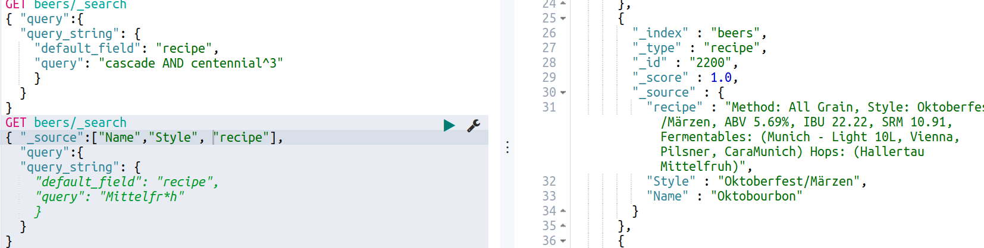
Weighted and Wildcard Queries
Elasticsearch allows for weighting or boosting the significance of a query term. In the a query, the “^” symbol is used to begin the boosting of a specific term. This boosting can occur over many values and each will adjust the weighted ranking of the result documents. In this instance, we made the value of “centennial” three times more significant in the ranked results than the value “cascade”.
Wildcard queries are also easily performed in Elasticsearch. The “*” character is used for wildcard queries. In the query above, we used a wildcard for the value “Middlefrüh” . Terms with characters that are less common, in this case the “u” with an umlaut, might return results with correct and incorrect spellings of the term.

Slide 6
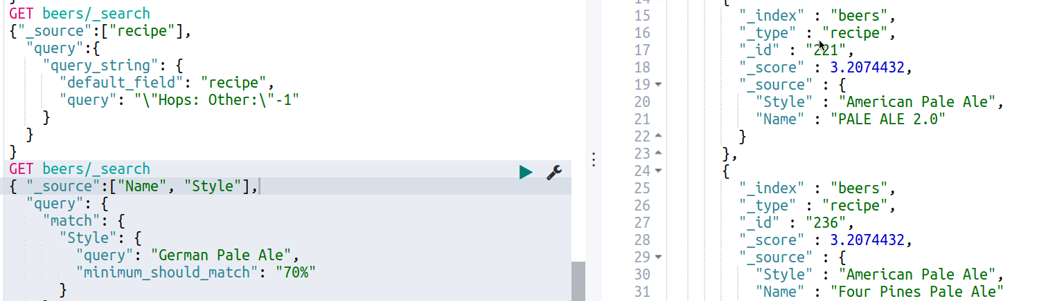
Proximity and Precision
A feature of Elasticsearch text search is proximity searches. The use of boundary “\” and quotes can define the values and a number outside will define the proximity space between the two terms. In the query above, it queries for “Hops:” and “Other:” separated by no more than one additional term between.
Additionally, precision within the searches can be improved by targeting a minimum match. Using the field “minimum_should_match”, a string percentage value is given by which Elasticsearch tries to match to as a minimum. The percentage may be decreased to the nearest evenly distributed percentage based on the length of the query. In our query “German Pale Ale”, our likely distribution is that each word constitutes 33.33% of the query. If we match to “70”, it will try to match at least 66.67%. Within the results, “Pale Ale” is most likely to occur and returns many results with style “American Pale Ale”.

Slide 7
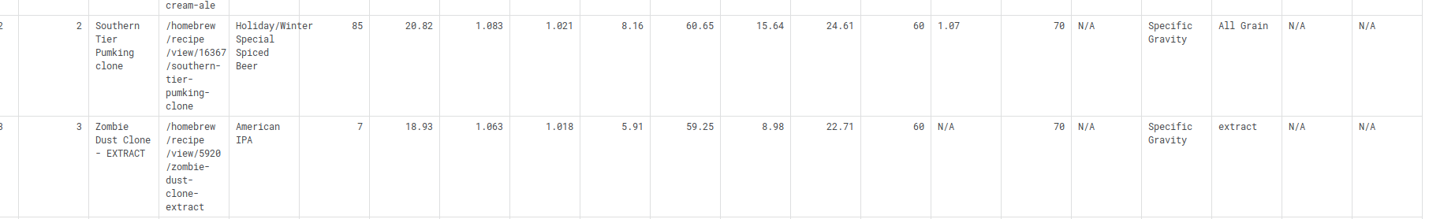
Beer Dataset
The Brewer’s Friend Beer recipe dataset that was selected started from Kaggle.com. It contained several fields already, including several aspects of a beers color, alcohol content, style, etc. The dataset was, however, lacking in areas involving methodology and ingredients. To make a more comprehensive and interesting dateset, more data needed to be gathered. For each entry, there was a link the recipe page where more information about the recipe could be ascertained. Extracting the data for each recipe would be the most effective way to compile more data into this data set.

Slide 8
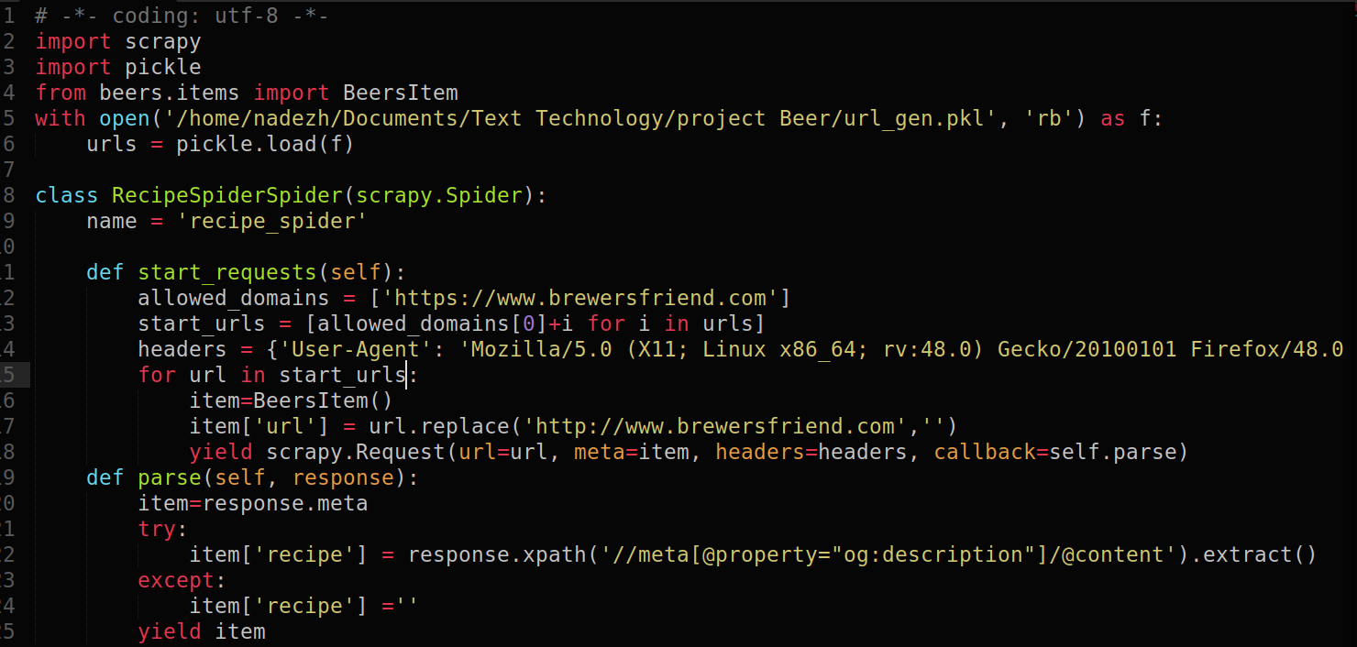
Crawler
For this particular website, the recipe data was in several tables throughout the page. The corresponding data was also located in meta tags within the Html. This spider was constructed via Scrapy. It sifted through the list of urls created from the Brewer’s friend website and the recipe extension from the dataset. It extracted the attribute data from the meta tags. This data contained some of the data found in the original data set as well as various types of ingredients in up to four different categories and notes that the author felt necessary. All data was extracted to CSV files in smaller batches as the process of scraping 73,000 recipes took over 70 hours.

Slide 9
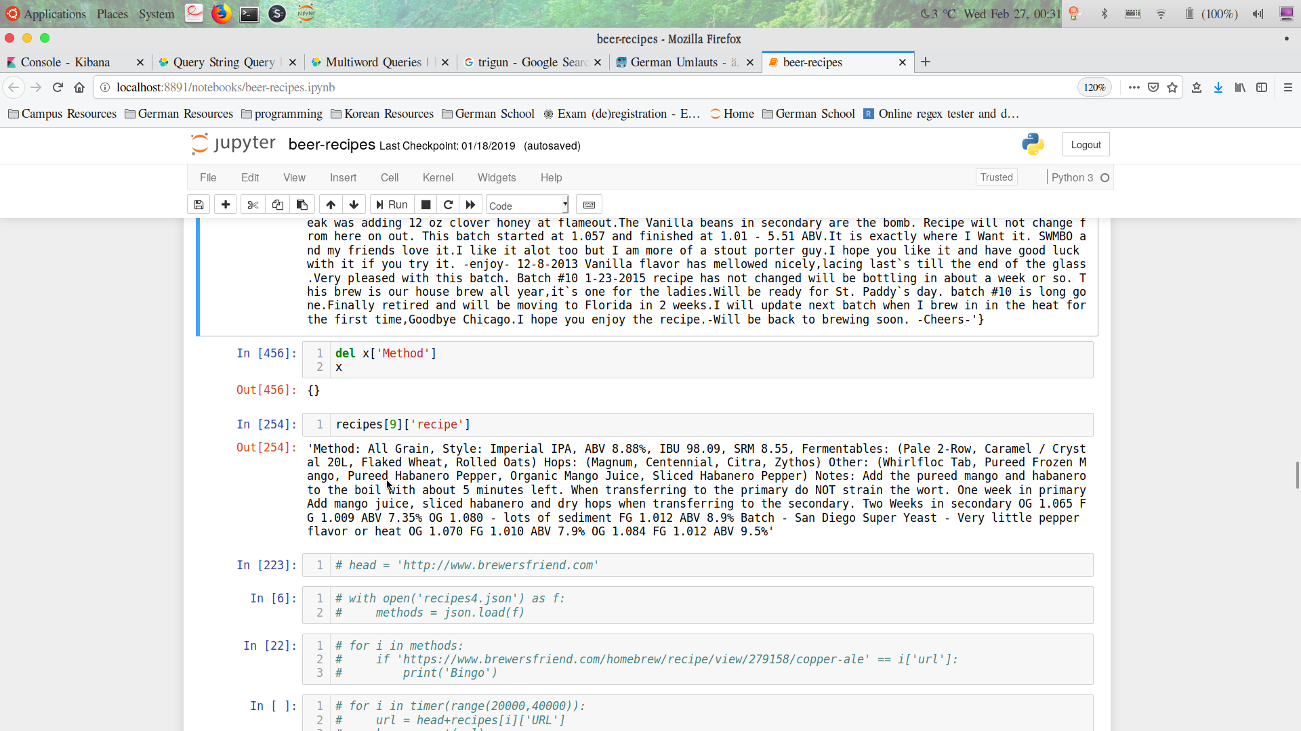
Extraction
As stated, some of the data that was extracted was identical to that which came in the original dataset. The additional data here often contained the author Username, fermentable ingredients, Steeping grains, Hops selection, additional ingredients, and notes from the author. This format was suitable for Elasticsearch full text queries, but it was limited in its use for further data analysis outside of aggregation counts of terms that occurred in the data.

Slide 10
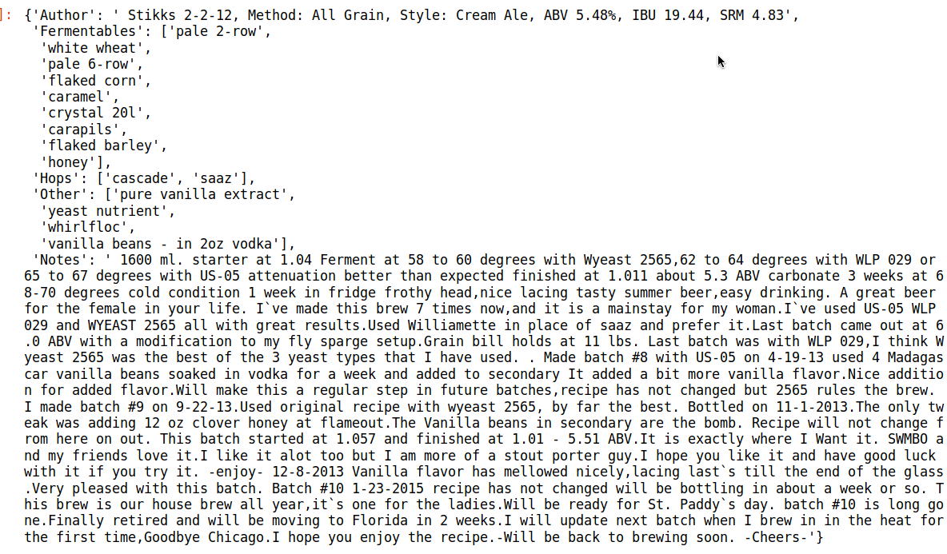
Data Processing
Beyond extraction, there was a significant amount of cleaning and preprocessing that need to be done to make it more usable for analysis. From the sing string that was extracted, there were several aspects that should have been extracted, such as ingredients and notes. There were four different categories of ingredients to extract and in addition, much of the data contained typos and short hand for different ingredients and descriptions in the notes. Much further refinements would also be necessary to make the data more presentable.

