Slide 1
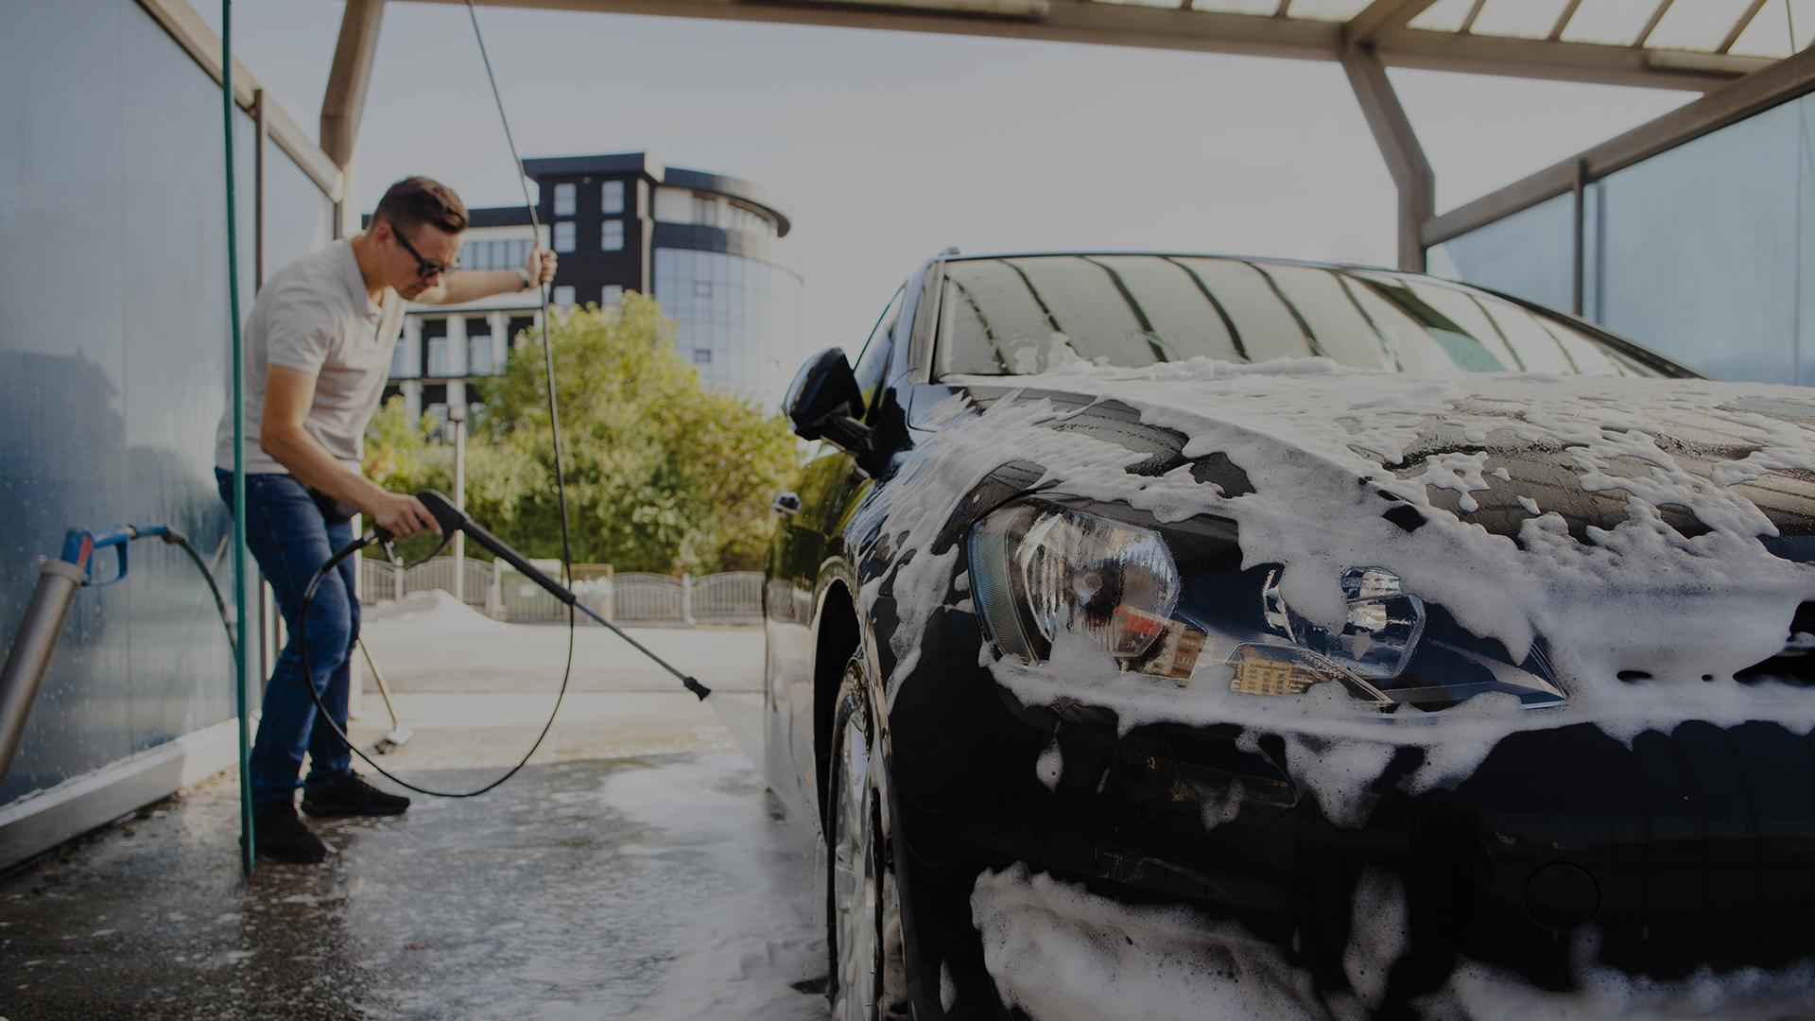
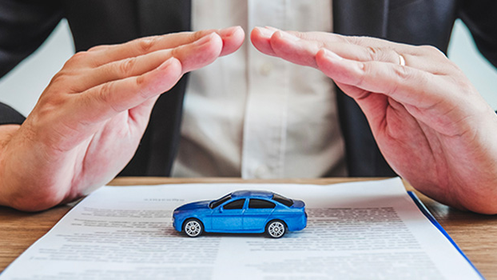
Car Insurance Claim
Joaquín González
27-May-2022
Notes:
Hello, Good afternoon all, I am going to start this presentation in a different way that I usually do; and doing something that I do not like to do:
Talking a Little bit about myself.

Slide 2





Professional experience
Notes:
I am the oldest member of this cohort, with 37 years, and I have had several years of experience in different industries, including insurance.

Slide 3
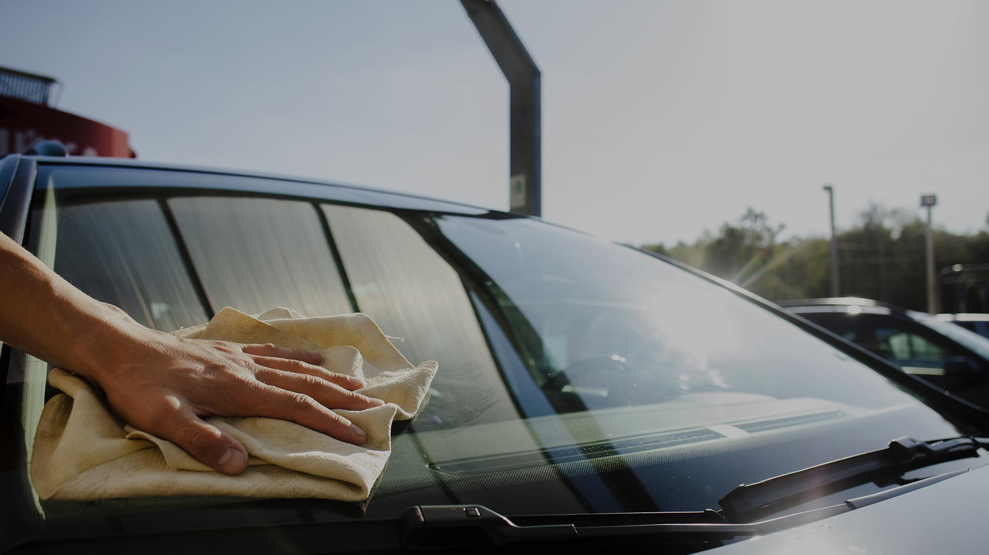
Background
How many people do not have car insurance to be able to claim in the case of an accident?
Notes:
During that time, I heard some users complaining that their counterparts in an accident, did not have insurance policy
I am not really focusing on the amount, but on the fact of being covered or not, is that really necessary?
Claim is the important part

Slide 4
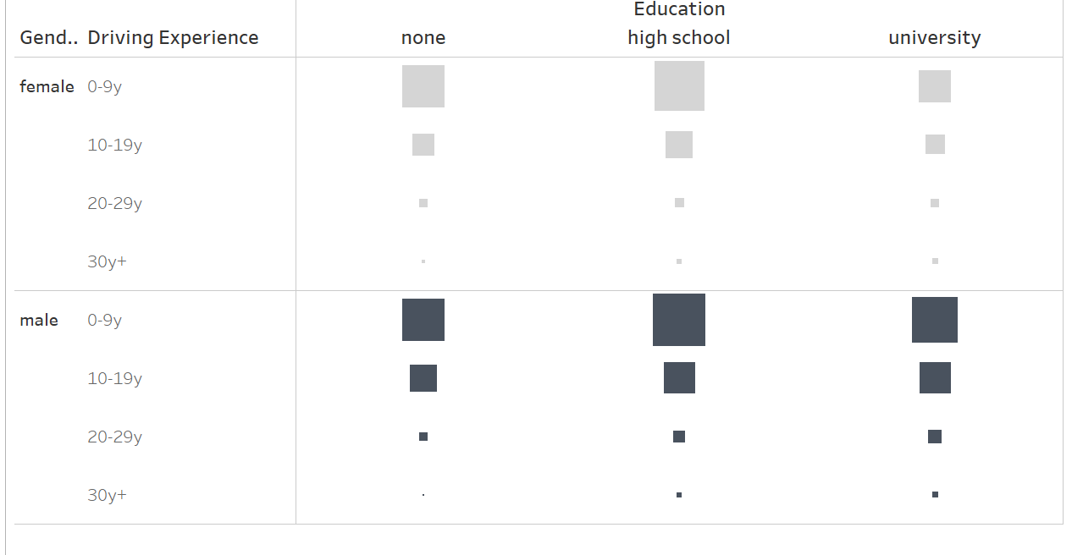
GENERAL INFORMATION
Insurance claims by gender, driving experience and education level
Notes:
Based on the general information presented
One of the main characteristics that have an impact is the driving experience
The less experienced the driver, the more prone to insurance claim, particularly in Males in High School level

Slide 5



IMPACT OF DUIS, OVERSPEEDING AND PAST ACCIDENTS
23%
Claim without events
12%
13%
12%
Notes:
Then, ok, what about the responsibility of the drivers?
What is the relationship between claims and these events? All these were statistically confirmed
‘Hey Joaquin, Im a responsible driver, I will not drink and drive, or go over the speed limit’
I developed a model to classify the events to lead to a claim

Slide 6
CLASSIFICATION MODEL: LOGISTIC REGRESSION
Model Training
Model Definition
Model Results
.
Two models were trained to determine the best option: Logistic Regression and Random Forest
Based on the hyperparameter definition and data rebalancing, Logistic Regression was chosen
Based on F1 Score of 73% to identify the cases where a claim is executed
Notes:
For this model I trained two different scenarios.
Rebalancing by SMOTE
How do all this comes together?

Slide 7
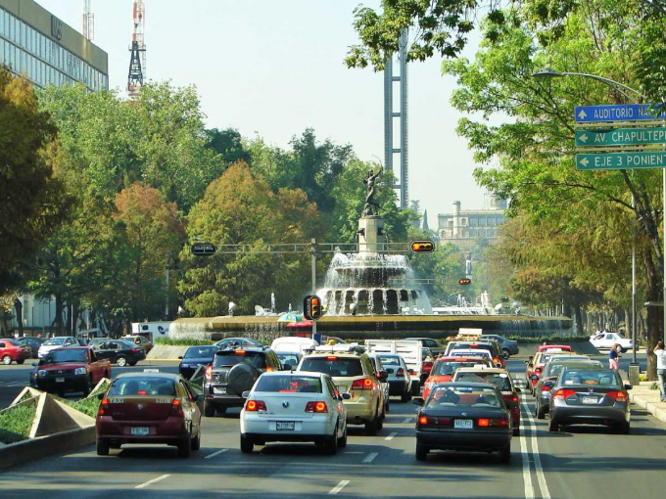
8 OUT OF 10 CARS IN MEXICO DO NOT HAVE INSURANCE¹
CAR INSURANCE COVERAGE IS IN THE BEST INTEREST OF ANY DRIVER
Notes:
This amounts for 28 million cars in Mexico
Sounds obvious but we see that 80% of the people does not think so

Slide 8
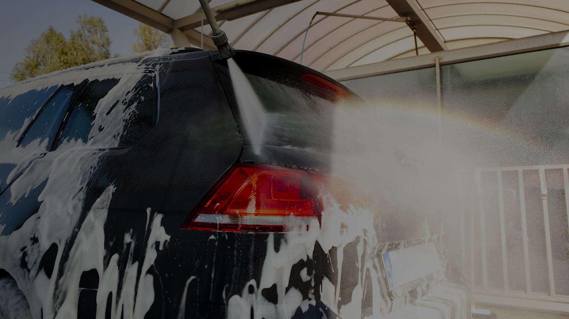
THANK YOU
Do you have any questions?
Please keep this slide for attribution.

Slide 9
SOURCES:
https://www.forbes.com.mx/35-millones-de-autos-en-mexico-y-solo-7-millones-tienen-seguro/, extracted on 26-May-2022

