Slide 1
Workshop C – MAD - DHA
Parliamentary Debate

Slide 2
Agenda for today
What is parliamentary debate?
Debate simulation

Slide 3
Do you have any experience with debating?

Slide 4
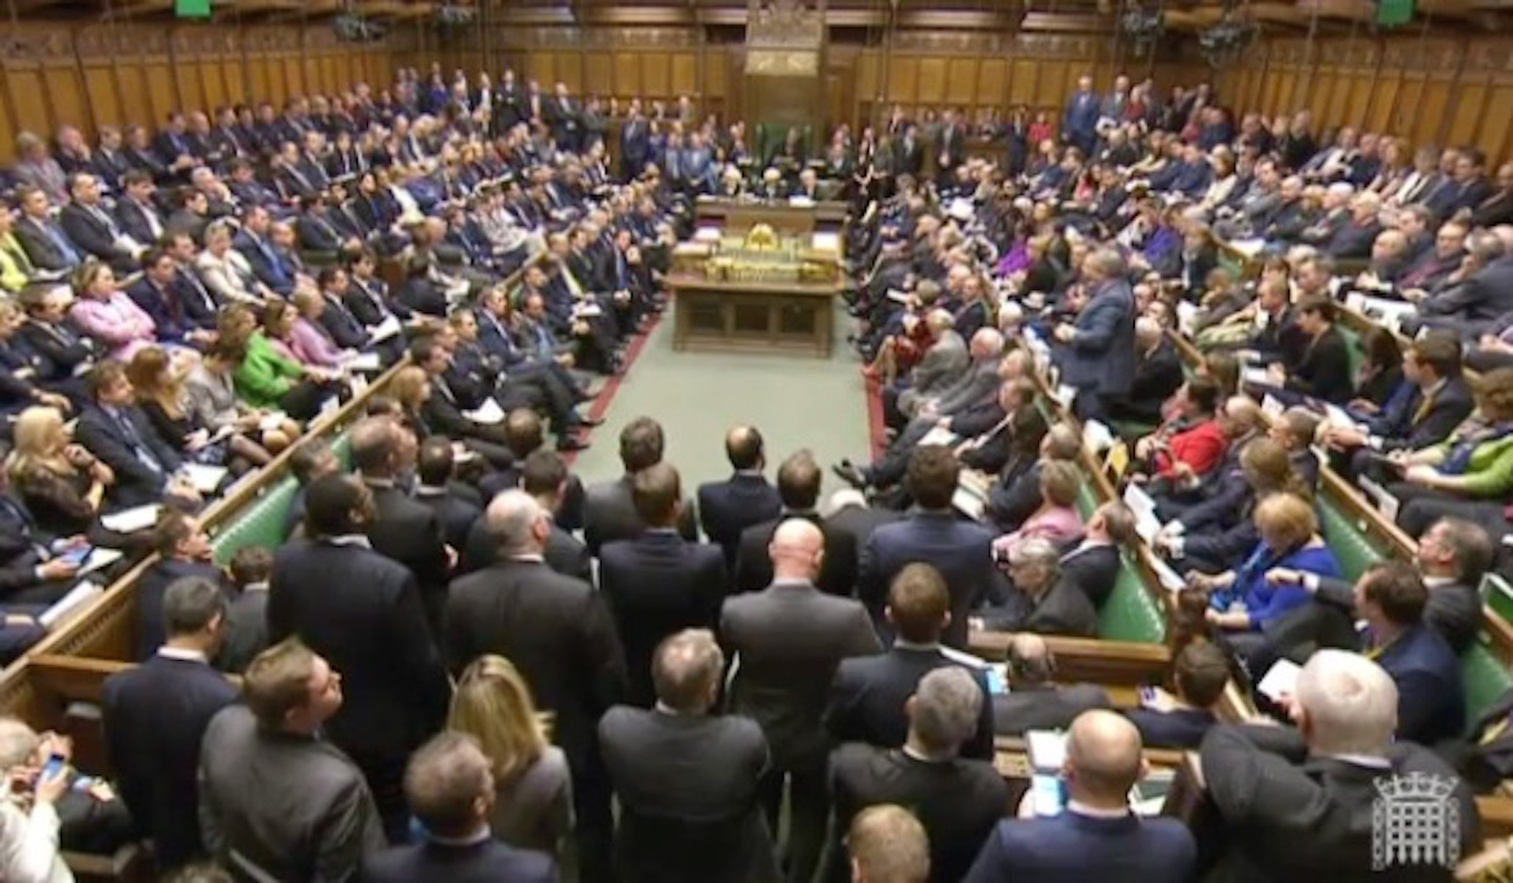
Parliamentary Debate
Notes:
https://www.youtube.com/watch?v=w_1-YCbVip4

Slide 5
Motion
A topic in a form of statement that is debated.
Example:
This house believes that the Netherlands should stop taking refugees.
This house believes that old media forms will dissapear in the near future.
This house believes that money can buy happiness.

Slide 6
Actors
Speaker of the house (chair)
Time keeper
The government
The opposition
Adjudicators

Slide 7
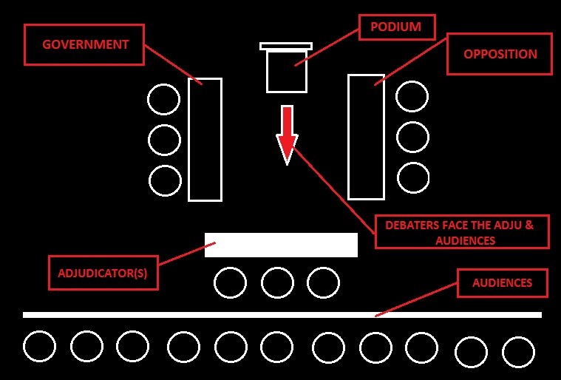

Slide 8
Rules
Government
Defining the motion
Defending the motion
Opposition
Accepting/challenging the definition of the government
Oppossing the motion

Slide 9
Speaker roles
Goverment
1st speaker
- Defining the motion
- Explaining the team lines and main arguments
2nd speaker
- Giving rebuttals
- Explaining team arguments
3rd speaker
- Giving rebuttals
- Is not allowed to bring a new argument
Opposition
1st speaker
- Giving rebuttals
- Explaining the team lines and main arguments
2nd speaker
- Giving rebuttals
- Explaining team arguments
3rd speaker
- Giving rebuttals
- Is not allowed to bring a new argument

Slide 10
Reply speech
Conclusion
Last chance to convince the adjudicator that your case is stronger than your opponent
No new argument allowed
Delivered by either the first or second speaker

Slide 11
Interruption
Part of debating strategy
Only allowed between 1st and 4th minute
Short
A speaker is obliged to take at least one interruption.
No interruption during the reply speech

Slide 12
Time
5 minutes for each speaker
3 minutes reply speech

Slide 13
Judging
Deciding the winner of the debate
Explaining the decision
Choosing the best speaker

Slide 14
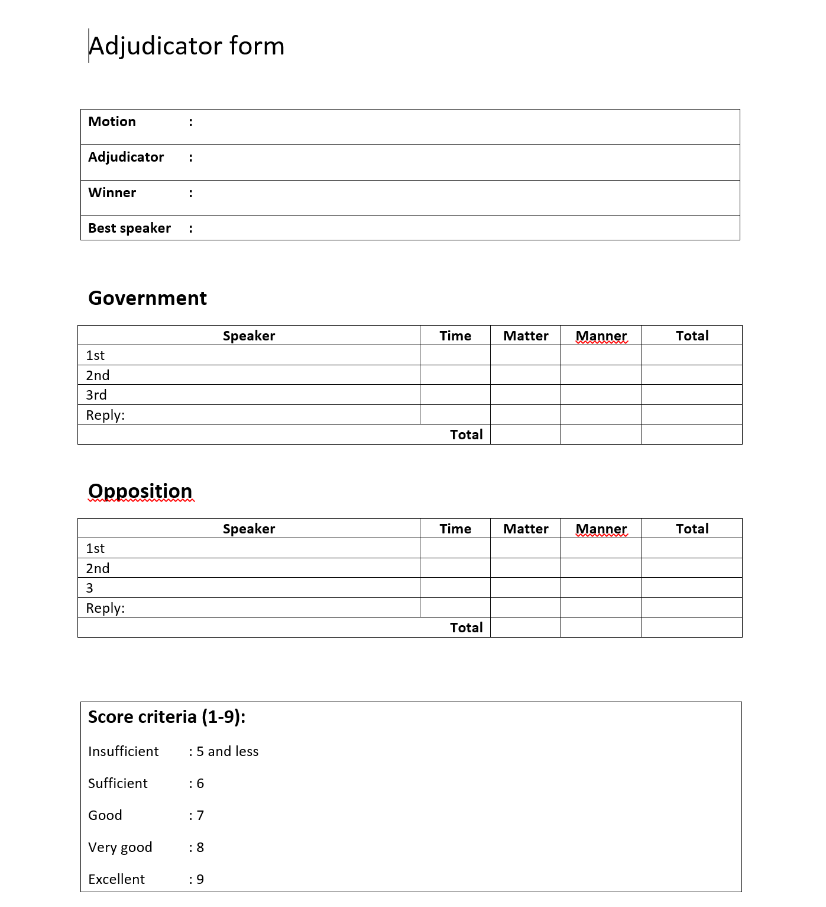

Slide 15
Assessment
Exam
(50%)
Knowledge of theories
Debating
(50%)
1x per period
End of period 2
Multiple choice (40 questions)
Group of 2/3 students
Group/individual grade

Slide 16
Assessment criteria debating
Debating
Content (group 60%)
Manner
(Individual 40%)
Judging
1x per block
No grade but required to get the debating grade

Slide 17
Assessment criteria
Criteria | Grade | Weighting factors | Final Grade
Content (team) The arguments are clear (well-researched and supported by data/examples). The arguments are relevant (supporting the stance) The rebuttals (counter argument) are clear and relevant. |  | 60%
Manner (individual) The speaker fulfils his/her role. The speaker delivers the speech clearly in a good structure and convincingly. | Speaker 1 | 40%
 | Speaker 2
 | Speaker 3

Slide 18
Forming debating team
Week | Group | Team A | Team B
1-1 and 2-1 | One | 1. 2. 3. | 1. 2 3.
1-2 and 2-2 | Two | 1. 2. 3. | 1. 2. 3.
1-3 and 2-3 | Three | 1. 2. 3. | 1. 2. 3.
1-4 and 2-4 | Four | 1. 2. 3. | 1. 2. 3.
1-5 and 2-5 | Five | 1. 2. 3. | 1. 2. 3.

Slide 19
Judging
Week | Name | Week | Name
1-1 | 1. 2. 3 | 2-1
1-2 | 1. 2 | 2-2
1-3 |  | 2-3
1-4 |  | 2-4
1-5 |  | 2-5

Slide 20
Questions?

Slide 21
Sources
http://uk.businessinsider.com/syria-bombing-uk-decision-debate-live-highlights-tv-2015-12
http://mscience-education.blogspot.nl/2016/04/debat.html

