Slide 1
Fully Automatic
The journey of making a fully automatic 3D Printer
and a brief introduction to CrystalScad
by Joachim Glauche
https://github.com/Joaz/talks/
License: GNU FDL 1.3
http://www.gnu.org/licenses/fdl.txt

Slide 2
Running a print farm (in 2012)
Running a print farm is hard work
Printed parts need to be removed from the plate when finished
Lots of machine downtime when nobody is around to remove the parts
Tape on beds had to be replaced constantly

Slide 3
Solution
Build a machine extension that removes the parts without human interaction
Precondition: Find a suitable bed material: laminated carbon plates

Slide 4
Prototype
Combine:
Box version Prusa i3
Aluminium Profiles
Some leftover rods & linear bearings
DC Gearbox motor
Small electronics addon
2 microswitches

Slide 5
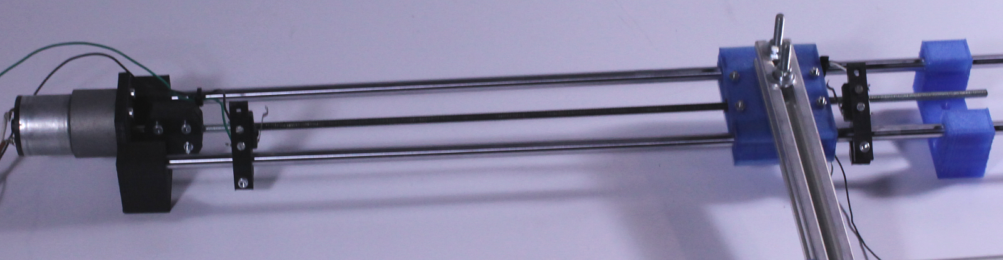
Prototype

Slide 6
Workflow
After the print has finished:
- Turn on a big fan
- Wait for 5-6 minutes
- Send M42 command to start the part removing axis
- The DC gearmotor will run until the max endstop is hit
- Turn off the fan
- The DC gearmotor will reverse and run until the min endstop is hit
And we're hoping that this will clear all parts successfully. What could possibly go wrong?

Slide 7
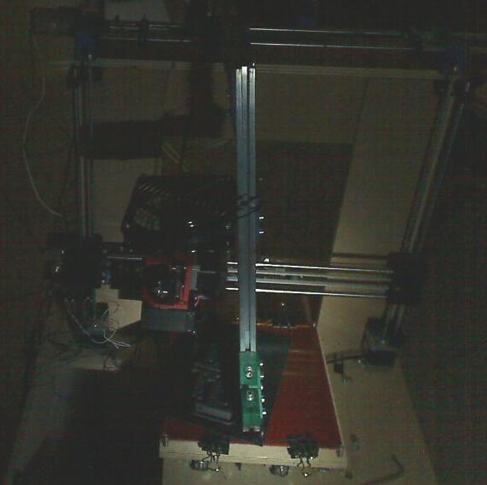
Fully Automatic Failure

Slide 8
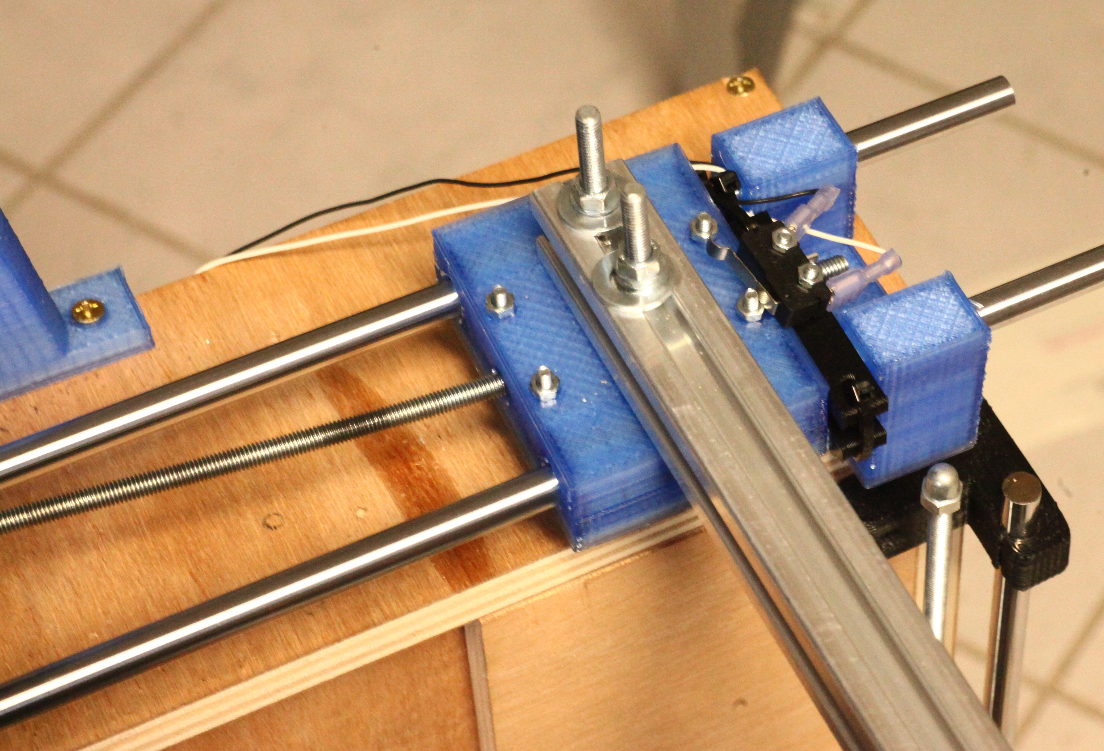
Fully Automatic Failure

Slide 9
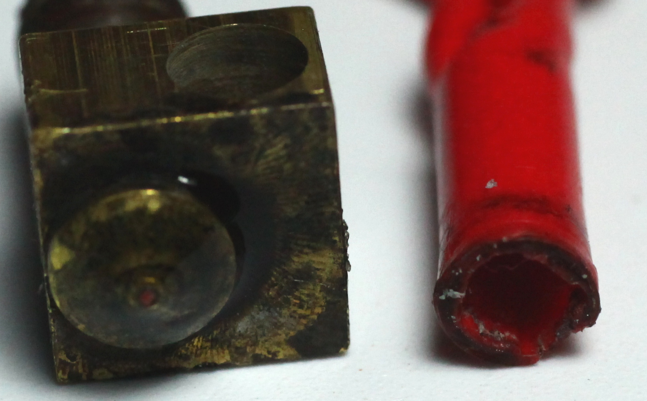
Fully Automatic Failure

Slide 10
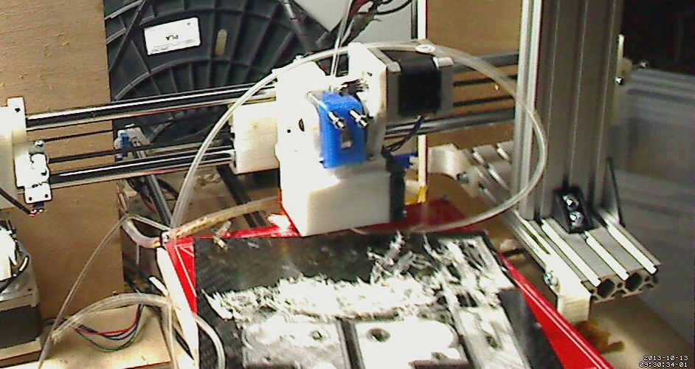
Fully Automatic Failure

Slide 11
Other failures
Linear bearings got out of the bearing holders
Tangled filament causing the Z axis to lift out of the couplings
Loose bolts

Slide 12
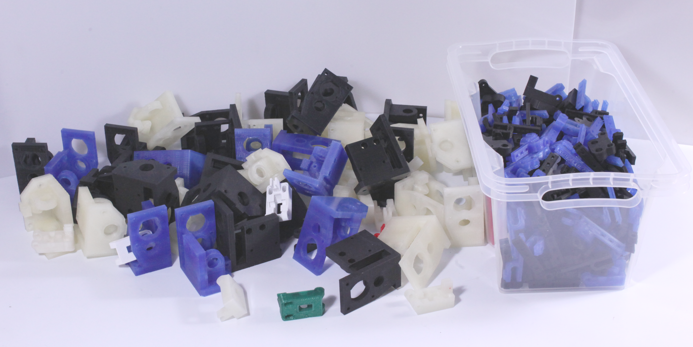
It works!

Slide 13
It broke!
First prototype didn't survive the move
Second prototype did take too long to get running reliably
=> Idea to make my own 3d printer that is more suitable for 24/7 (ab)use (and will survive a move)

Slide 14
Wishlist for a new bot
Faster construction
Less calibration
Better reliability
Better integration
Open Hardware

Slide 15
Better integration
Prusa3 complete_printer.scad is outdated and a total mess
Also renders extremly slowly
Does not easily display/hide things
Shows only single plate

Slide 16
Choosing a CAD software
Avoiding proprietary CAD programs
Open source CAD program options are limited
I like to program my 3D models
=> OpenSCAD is probably the answer

Slide 17
OpenSCAD limitations
Poor language
Code easily gets messy
No way to generate BOMs automatically
But: there are frameworks available!

Slide 18
Frameworks for OpenSCAD:
Solidpython
Write OpenSCAD models in Python
Quite good, but inconvenient syntax (too many braces):
res = translate([15,5,0])(rotate([45,0,0])(cylinder(r=4.2, h=10)))
res -= translate([10,5.5,-0.1])(cylinder(r=2.8,h=4))

Slide 19
RubyScad:
Write OpenSCAD models in Ruby
Writes code instantly to STDOUT on each method call/block that is called
Code too „OpenSCAD-ish“:
module Example
extend RubyScad
difference() {
union() {
cube(size: 30, center: true)
cube(size: [40, 15, 15], center: true)
}
cube(size: [50, 10, 10], center: true)
}

Slide 20
Fixing RubyScad
The ideas/wishes:
Override the STDOUT output
Put each transformation of an object into a tree and walk it for output.
Include a standard library for common hardware
Automatically generate BOMs

Slide 21
Syntax comparison
Solidpython:
res = translate([15,5,0])(rotate([45,0,0])(cylinder(r=4.2, h=10)))
res -= translate([10,5.5,-0.1])(cylinder(r=2.8,h=4))
CrystalScad:
res = cylinder(r:4.2, h:10).rotate(x:45).translate(x:15,y:5)
res -= cylinder(r:2.8,h:4).translate(x:10,y:5.5,z:-0.1)

Slide 22
Syntax comparison
CrystalScad:
res = cylinder(r:4.2, h:10).rotate(x:45).translate(x:15,y:5)
res -= cylinder(r:2.8,h:4).translate(x:10,y:5.5,z:-0.1)
OpenSCAD:
difference(){
translate([15, 5, 0])
rotate(a = [45, 0, 0])
cylinder(r = 4.2, h = 10);
translate([10, 5.5, -0.1])
cylinder(r = 2.8, h = 4);
}

Slide 23
Assemblies in CrystalScad
class MyPart < CrystalScad::Assembly
def show
part(true)
end
def output
part(false)
end
def part(show)
res = cube([20,20,5]).center_xy
bolt = Bolt.new(3,10)
res-= bolt.output # produces a d = 3.3mm cylinder
res+= bolt.show if show # produces a d = 3mm bolt
res
end
end

Slide 24
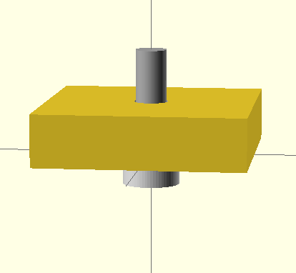
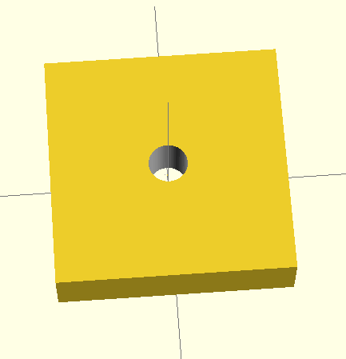
show vs. output

Slide 25
My workflow with CrystalScad
Define what you have and what you want
Make printed parts that fits your needs
Check if it fits

Slide 26
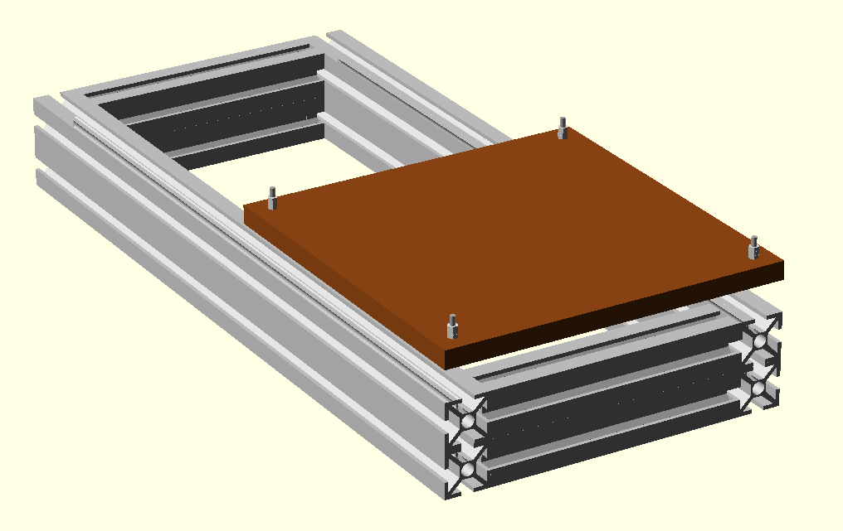

Slide 27
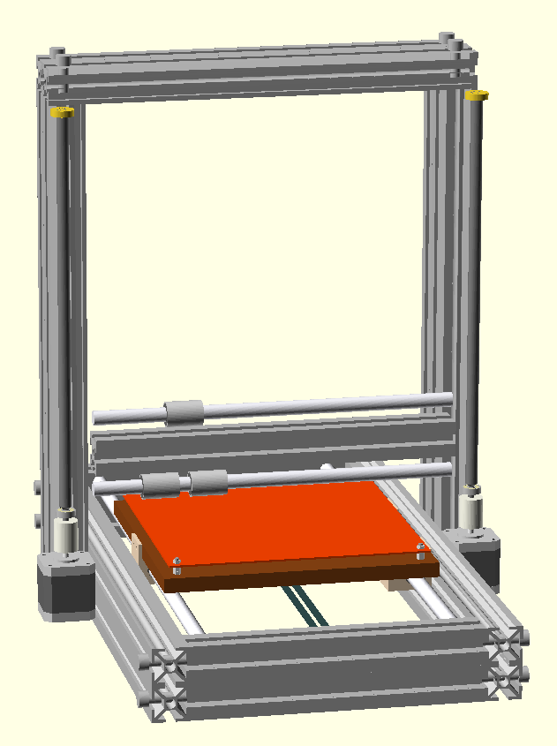

Slide 28
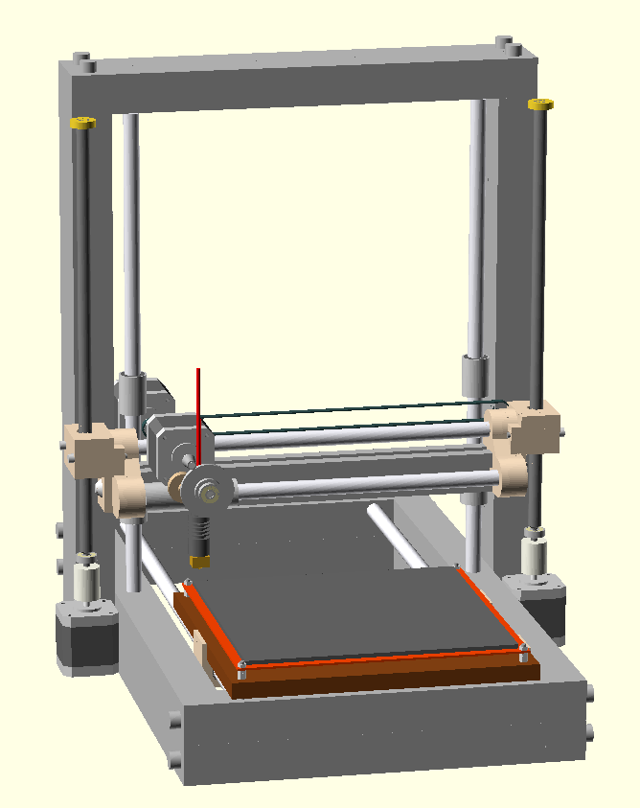

Slide 29
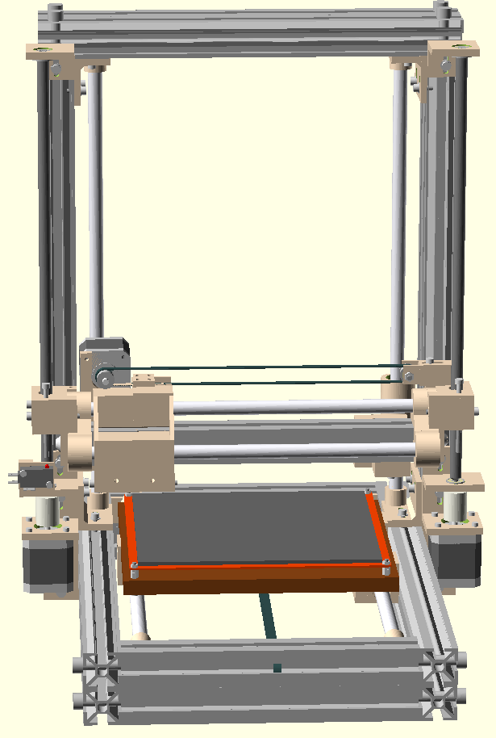

Slide 30
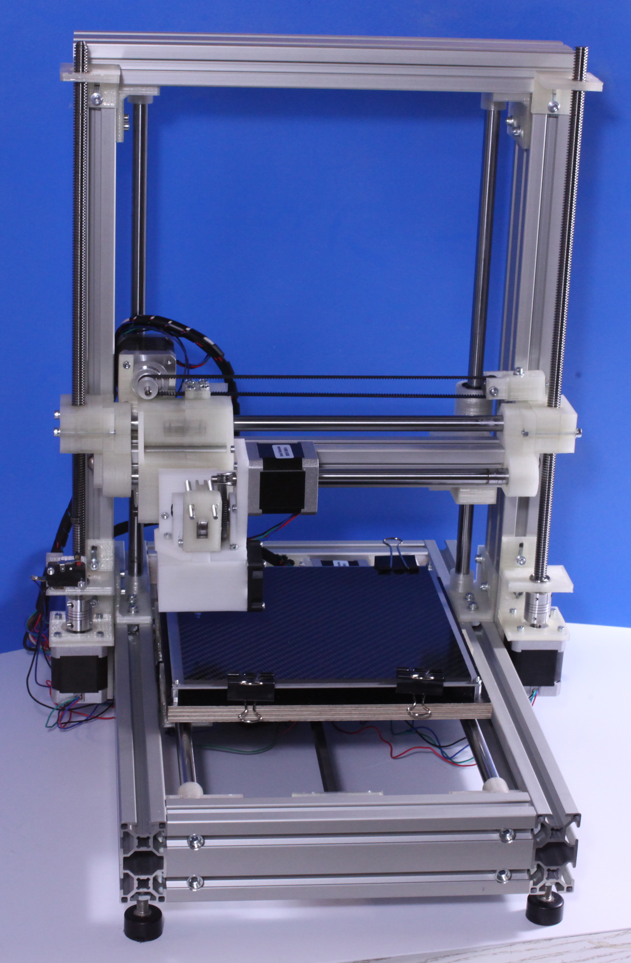

Slide 31
The TODO list
Build a part removing mechanism for this bot
Mandetory extras: Spool holder, filament endstop
Find a better wiring solution
Get more prototypes built and running
Test.

Slide 32
Test.
The problem:
The printers need to be tested 24/7 for a long time to ensure that everything works reliably.
One automatic printer at 24/7 produces more printed parts than I need. Who does?

Slide 33
Further ideas
Use a camera to check if parts have successfully cleared the build plate
Check the filament diameter before extrusion
Implement a method of putting the ejected parts into different bins

Slide 34
Fully Automatic
by Joachim Glauche
http://www.reprapsource.com
Ideas/comments/inquiries:
info@gli-concept.de
Development machine:
https://github.com/Joaz/bulldozer/
CrystalScad:
https://github.com/Joaz/CrystalScad
https://github.com/Joaz/talks/
License: GNU FDL 1.3
http://www.gnu.org/licenses/fdl.txt

