Slide 1
Fully Automated
The journey of making a fully automated 3D Printer
and a brief introduction to CrystalScad.
© 2013 by Joachim Glauche
License: GNU FDL

Slide 2
Uses for automated 3D Printers
Run an automated production for parts which can only be made by 3d printing
Make small production runs on your own, without tooling costs

Slide 3
Running a plastic part production with RepRaps, pre-automation
Printed parts need to be removed from the plate when finished
Lots of machine downtime when nobody is around to remove the parts

Slide 4
Prototype
Combine:
Box version Prusa i3
Aluminium Profiles
Some leftover rods & linear bearings
DC Gearbox motor
Small electronics addon

Slide 5
Fully Automated Failure

Slide 6
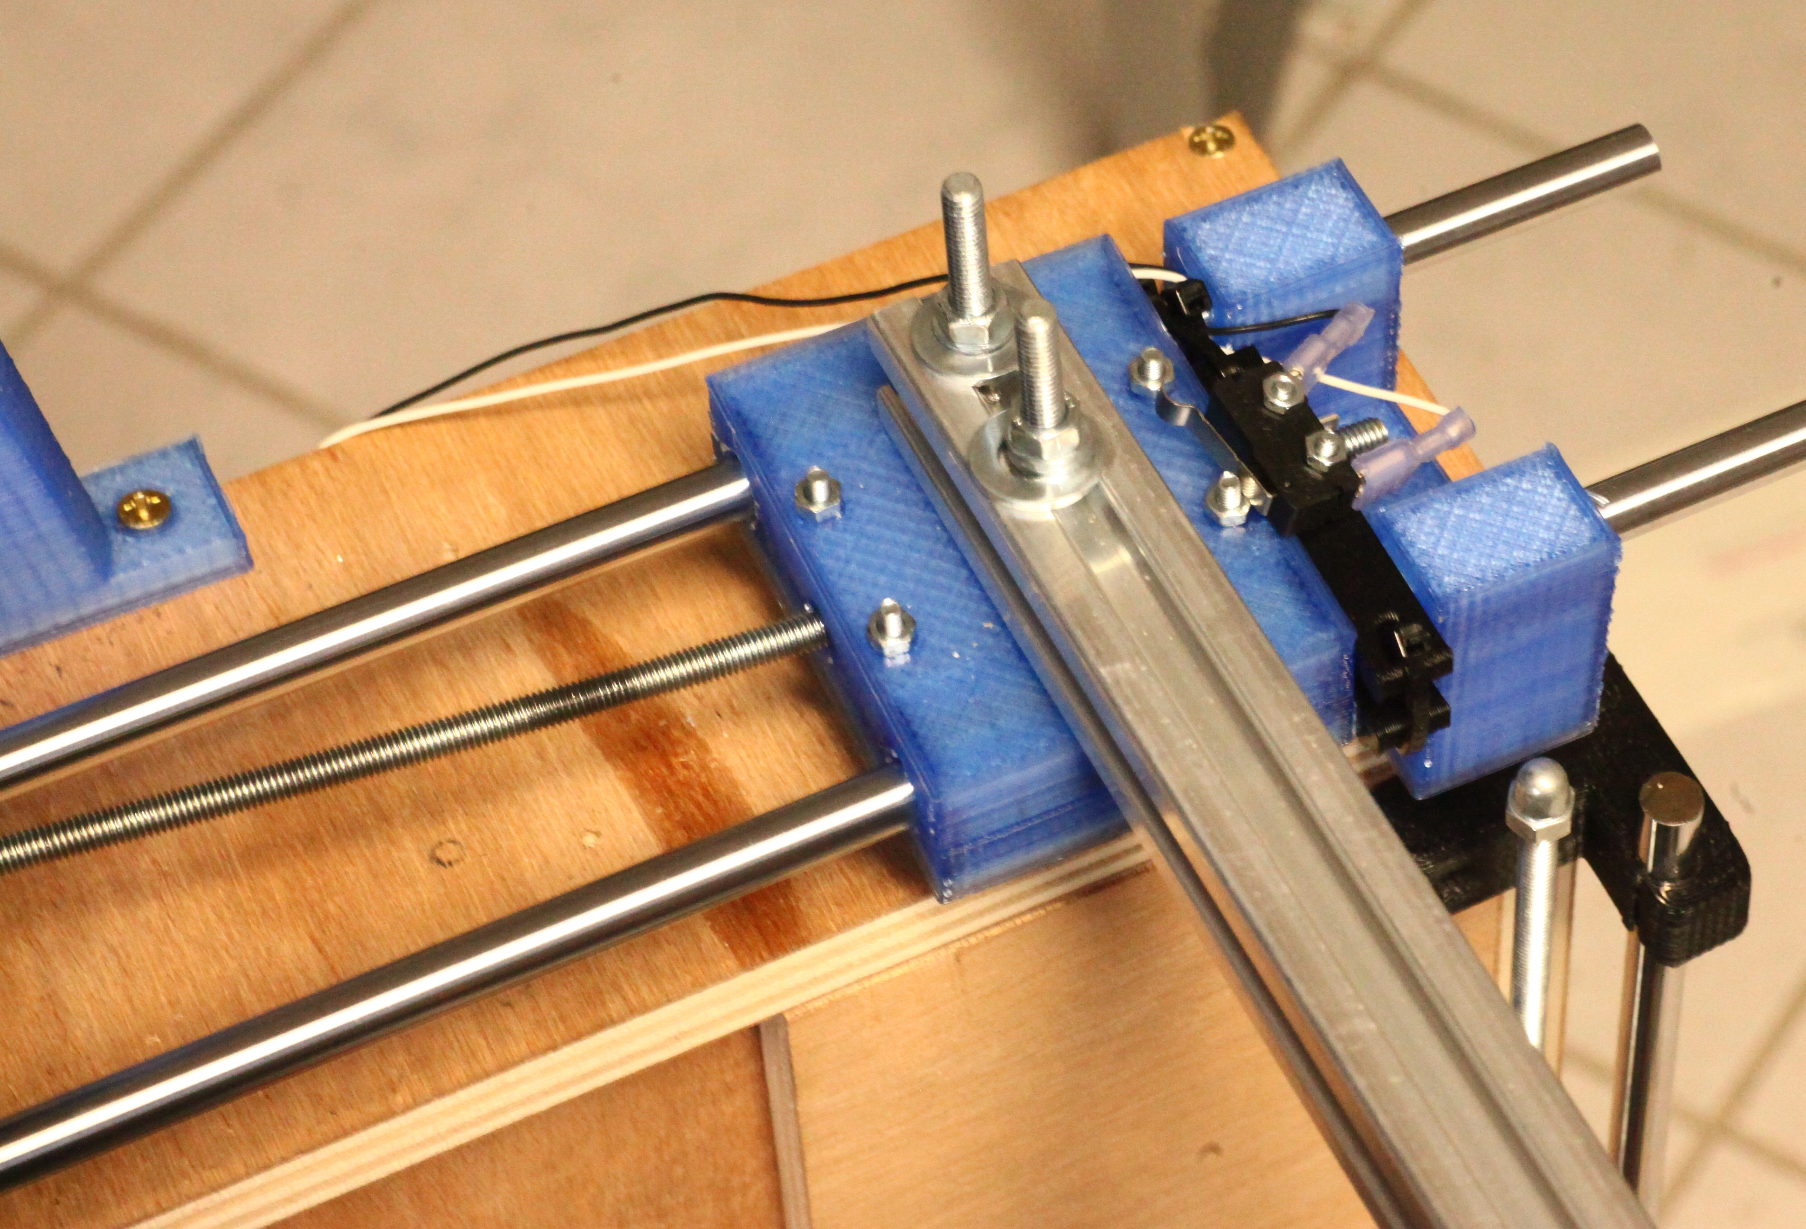
Fully Automated Failure

Slide 7
Fully Automated Failure

Slide 8
Problems to solve
(on this machine)
Stronger mechanical construction
More reliable hotend assembly
Make some parts less prone to wear

Slide 9
Wishlist for the machine if I actually want to produce it
Faster construction
Less calibration
Better reliability
Better looks
Better hackability
Open Hardware

Slide 10
Choosing a CAD software
Open source CAD program options are limited
Proprietary CAD programs are bad for open hardware
I like to program my models
=> OpenSCAD is probably the answer

Slide 11
OpenSCAD limitations
Poor language
Code easily gets messy
No way to generate BOMs automatically

Slide 12
Frameworks for OpenSCAD:
Solidpython
Python framework
High level language
Quite good, but inconvenient syntax (too many braces):
res = translate([15,5,0])(rotate([45,0,0])(cylinder(r=4.2, h=10)))
res -= translate([10,5.5,-0.1])(cylinder(r=2.8,h=4))

Slide 13
RubyScad:
Code too „OpenSCAD-ish“
Writes code instantly on each method call
module Example
extend RubyScad
difference() {
union() {
cube(size: 30, center: true)
cube(size: [40, 15, 15], center: true)
}
cube(size: [50, 10, 10], center: true)
}

Slide 14
Fixing RubyScad
The ideas/wishes:
Put each transformation of an object into a tree and walk it for output.
Include a standard library for common hardware
Include a method for generating BOMs automatically

Slide 15
Syntax comparison
Solidpython:
res = translate([15,5,0])(rotate([45,0,0])(cylinder(r=4.2, h=10)))
res -= translate([10,5.5,-0.1])(cylinder(r=2.8,h=4))
CrystalScad:
res = cylinder(r:4.2, h:10).rotate(x:45).translate(x:15,y:5)
res -= cylinder(r:2.8,h:4).translate(x:10,y:5.5,z:-0.1)

Slide 16
Syntax comparison
CrystalScad:
res = cylinder(r:4.2, h:10).rotate(x:45).translate(x:15,y:5)
res -= cylinder(r:2.8,h:4).translate(x:10,y:5.5,z:-0.1)
OpenScad:
difference(){
translate([15, 5, 0])
rotate(a = [45, 0, 0])
cylinder(r = 4.200, h = 10);
translate([10, 5.500, -0.100])
cylinder(r = 2.800, h = 4);
}

Slide 17
Hardware library

Slide 18
Assemblies in CrystalScad
class MyPart < CrystalScad::Assembly
def show
part(true)
end
def output
part(false)
end
def part(show)
res = cube([20,20,5]).center_xy
bolt = Bolt.new(3,10)
res-= bolt.output # produces a d = 3.3mm cylinder
res+= bolt.show if show # produces a d = 3mm cylinder
res
end
end

