Slide 1
The state of art and the future of
Programmable Parametric 3D Models (in english)
Rated R for Rants
[Citation needed]
by Joachim Glauche
from Reprapsource.com
https://github.com/Joaz/talks/
License: GNU FDL 1.3
http://www.gnu.org/licenses/fdl.txt

Slide 2
Upload STL to share your Thing!
STLs print different on different hard- and software configurations
People in different parts of the world often need to substitute hardware parts in order to build it
You just don't have the perfect solution for everybody. People want to hack it!

Slide 3
So you want to make a design.
Why not use AutoCAD?
But Solidworks!
Or Sketchup?

Slide 4
Proprietary Software
Can someone without a license for your CAD program use your sources?
Is your CAD program available for my platform?
Does your software support non-proprietary file formats? And does it work? If so use, it!
Avoid if possible for Open Hardware otherwise!

Slide 5
(Some of the) options for 3D Modeling
FreeCAD
ImplicitCAD
OpenSCAD (+frameworks)
and more!

Slide 6
FreeCAD: The rant?
GUI actually usable since 0.13 release
Can export OpenSCAD files (experimental and incomplete yet)

Slide 7
OpenSCAD: the rant!
Large user base in the Reprap community
Powerful tool
Poor language
Poor rendering performance

Slide 8
ImplicitCAD
Syntax looks very similar to OpenSCAD
Proper variable support
For GUI, use or fork website

Slide 9
OpenSCAD frameworks
Solidpython:
Write code in Python
RubyScad:
Write code in Ruby (OpenSCAD-ish)
CrystalScad:
Write code in Ruby (More Ruby-ish)

Slide 10
CrystalScad
Another framework?
Ruby makes it easy to make it have a nice syntax which can be read easily
It has a standard part library containing Bolts, Nuts, Washers, T-Slots and Gears.
Made not to be bound to OpenSCAD.

Slide 11
g1 = Gear.new(module:0.5,teeth:80,bore:5,height:4)
g2 = Gear.new(module:0.5,teeth:14,bore:5,height:8)
result = g1.show
result = g2.show.translate(x:g1.distance_to(g2))

Slide 12
Frameworks for OpenSCAD:
Solidpython
Write OpenSCAD models in Python
Quite good, but inconvenient syntax (too many braces):
res = translate([15,5,0])(rotate([45,0,0])(cylinder(r=4.2, h=10)))
res -= translate([10,5.5,-0.1])(cylinder(r=2.8,h=4))

Slide 13
RubyScad:
Write OpenSCAD models in Ruby
Writes code instantly to STDOUT on each method call/block that is called
Code too „OpenSCAD-ish“:
module Example
extend RubyScad
difference() {
union() {
cube(size: 30, center: true)
cube(size: [40, 15, 15], center: true)
}
cube(size: [50, 10, 10], center: true)
}

Slide 14
Fixing RubyScad
The initial ideas/wishes:
Override the STDOUT output
Put each transformation of an object into a tree and walk it for output.
Include a standard library for common hardware
Automatically generate BOMs

Slide 15
Done.

Slide 16
Syntax comparison
Solidpython:
res = translate([15,5,0])(rotate([45,0,0])(cylinder(d=8.4, h=10)))
res -= translate([10,5.5,-0.1])(cylinder(d=5.6,h=4))
CrystalScad:
res = cylinder(d:8.4, h:10).rotate(x:45).translate(x:15,y:5)
res -= cylinder(d:5.6,h:4).translate(x:10,y:5.5,z:-0.1)

Slide 17
Syntax comparison
CrystalScad:
res = cylinder(d:8.4, h:10).rotate(x:45).translate(x:15,y:5)
res -= cylinder(d:5.6,h:4).translate(x:10,y:5.5,z:-0.1)
OpenSCAD:
difference(){
translate([15, 5, 0])
rotate(a = [45, 0, 0])
cylinder(r = 4.2, h = 10);
translate([10, 5.5, -0.1])
cylinder(r = 2.8, h = 4);
}

Slide 18
Making Parts in CrystalScad
class MyPart < CrystalScad::Printed
def description
“Printed part: MyPart“
end
def part(show)
res = cube([20,20,5]).center_xy
bolt = Bolt.new(3,10)
res-= bolt.output # produces a d = 3.3mm cylinder
res+= bolt.show if show # produces a d = 3mm bolt
res
end
end

Slide 19
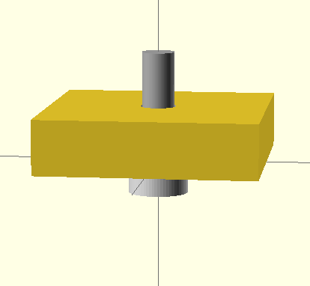
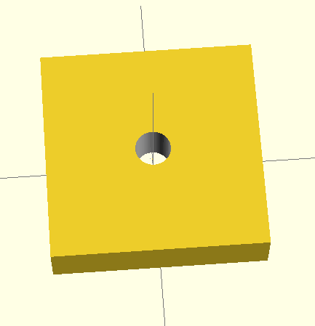
show vs. output

Slide 20
Saving files, BOM
assembly = MyPart.new.show
assembly.save(“output.scad“)
@@bom.save

Slide 21
The future of CrystalScad
More export options!
Better documentation!
A GUI?
(hint: I need help!)

Slide 22
Interoperability
Parametric file formats need to be standardised!
STL export is not good enough!

Slide 23
The future in 3D CAD software
(gazing at the crystal ball)
Better GUIs!
Better documentation!
An interface (or a software combo) that is both easy to use for beginners and really useful for power users!

Slide 24
Help needed everywhere
Your help is needed making open source development tools better!

Slide 25
The state of art and the future of
Programmable Parametric 3D Models
by Joachim Glauche
http://www.reprapsource.com
Ideas/comments/inquiries:
info@gli-concept.de
CrystalScad:
http://www.crystalscad.org
Special Thanks to the organizers of
Trieste Mini Maker Fair!
https://github.com/Joaz/talks/
License: GNU FDL 1.3
http://www.gnu.org/licenses/fdl.txt

