Slide 1
Series1 Numerical Methods Laboratory
Numerical Series and Convergence Analysis
Course: Numerical Methods Laboratory
Student: [Student Name]
Date: [Date]

Slide 2
Introduction
Numerical approximation is the process of finding approximate solutions to mathematical problems using computational methods.
Convergence refers to the tendency of a sequence or series to approach a specific value as the number of terms or iterations increases.
Mathematical series are fundamental in numerical methods because they allow us to compute transcendental functions (e, ln, e^x) to arbitrary precision.
This laboratory investigates three key convergence phenomena:
• (1 + 1/n)^n → e
• (a^h - 1)/h → ln(a)
• e^x = Σ(x^n / n!)

Slide 3
Exercise 1: Theory — (1 + 1/n)^n → e
The mathematical constant e ≈ 2.718281828459045 is one of the most important constants in mathematics.
The sequence a_n = (1 + 1/n)^n converges to e as n approaches infinity.
For small n, the value is far from e:
• n = 1: (1 + 1/1)^1 = 2.0
• n = 2: (1 + 1/2)^2 = 2.25
• n = 4: (1 + 1/4)^4 = 2.4414
As n increases, the value approaches e more closely.
The error |(1 + 1/n)^n - e| decreases approximately as 1/n.

Slide 4
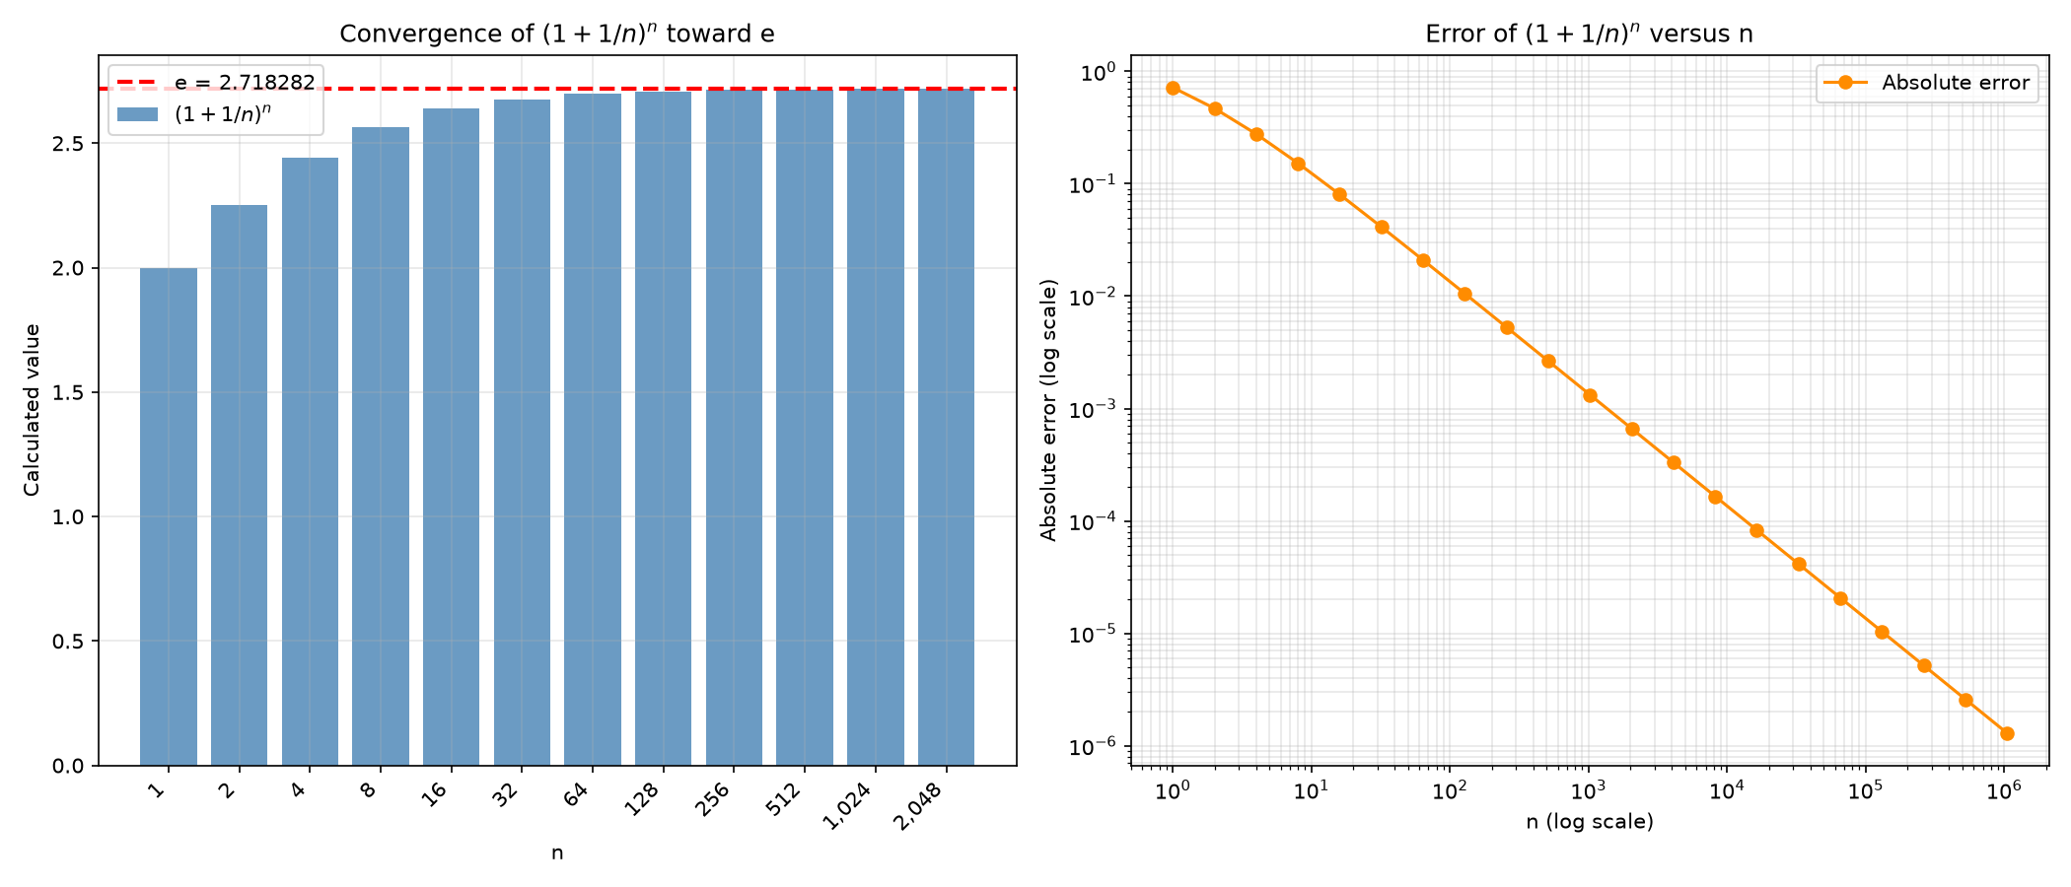
Exercise 1: Results
The bar chart shows (1 + 1/n)^n approaching the dashed line at e.
At n = 1,048,576, the value is 2.718280532282396.
The absolute error at this n is 1.30 × 10⁻⁶.
The error decreases approximately linearly on a log-log scale.
This demonstrates steady, predictable convergence toward e.

Slide 5
Exercise 2: Theory — (a^h - 1)/h → ln(a)
The natural logarithm ln(a) is the inverse of the exponential function e^x.
The difference quotient (a^h - 1)/h approximates the derivative of a^x at x = 0.
As h approaches zero, this quotient converges to ln(a).
This is a direct application of the definition of the derivative:
f'(0) = lim_{h→0} (a^h - a^0)/h = lim_{h→0} (a^h - 1)/h = ln(a)
We test this for a = 2, a = e, and a = 3.
A convergence tolerance of 1 × 10⁻⁶ is used.

Slide 6
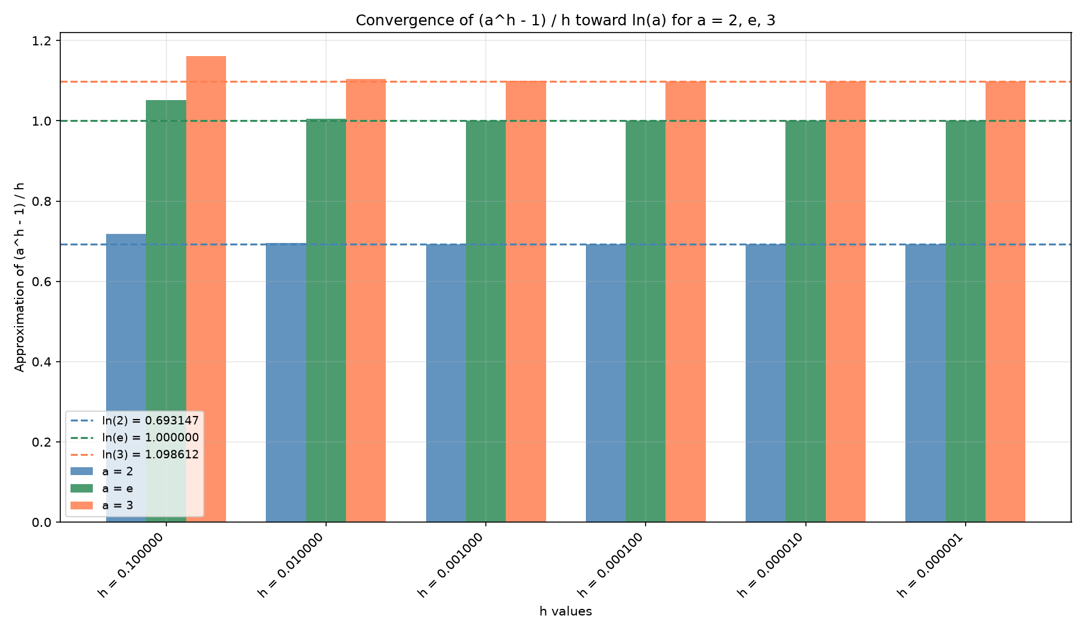
Exercise 2: Results
The grouped bar chart shows (a^h - 1)/h for a = 2, e, 3.
As h decreases from 0.1 to 10⁻⁶, each approximation approaches its respective ln(a).
All three values reach the 1 × 10⁻⁶ tolerance at h = 10⁻⁶.
The error decreases approximately linearly with h.
This confirms first-order convergence of the difference quotient.

Slide 7
Exercise 3: Theory — e^x = Σ(x^n / n!)
The exponential function e^x can be expressed as an infinite power series:
e^x = Σ_{n=0}^{∞} (x^n / n!)
A partial sum S_N = Σ_{n=0}^{N} (x^n / n!) approximates e^x.
As N increases, S_N converges to e^x.
To avoid numerical overflow from huge factorials, we use the recurrence:
term_{n+1} = term_n × x / (n + 1)
partial_sum = partial_sum + term
This is numerically stable and supports N up to 10,000.

Slide 8
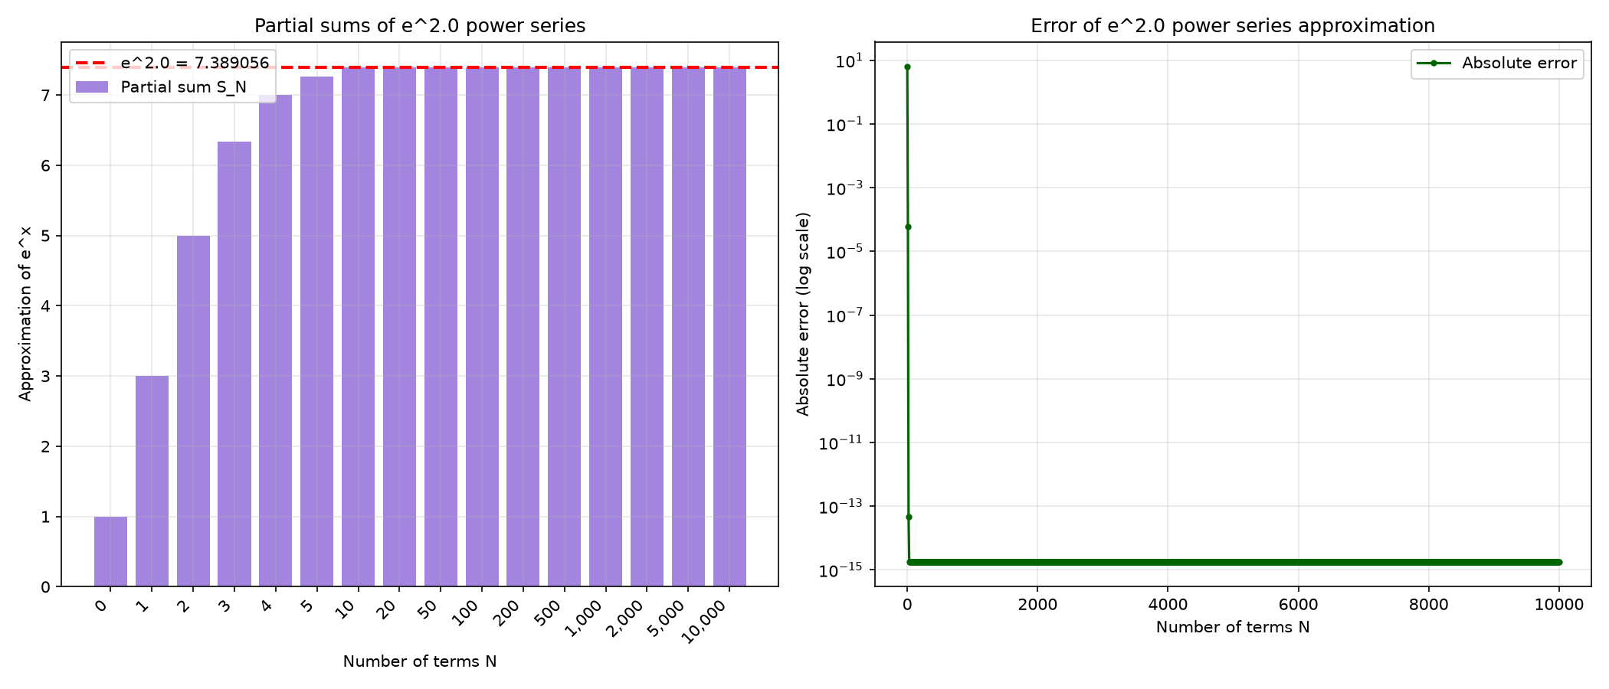
Exercise 3: Results
The bar chart shows partial sums S_N approaching e² = 7.389056098930650.
Error < 10⁻² is achieved at N = 7 terms.
Error < 10⁻⁶ is achieved at N = 13 terms.
Error < 10⁻¹⁰ is achieved at N = 17 terms.
The final error at N = 10,000 is 1.78 × 10⁻¹⁵ (machine precision).

Slide 9
Numerical Accuracy and Stability
Floating-point precision limits the accuracy of numerical computations.
Directly computing huge factorials (e.g., 10000!) causes overflow.
The recurrence relation term_{n+1} = term_n × x / (n + 1) avoids this problem.
Convergence tolerance (1 × 10⁻⁶) provides a practical stopping criterion.
Numerical stability ensures that small errors do not grow during computation.
These principles are essential for reliable scientific computing.

Slide 10
Conclusions
Exercise 1: (1 + 1/n)^n converges to e as n increases.
Exercise 2: (a^h - 1)/h converges to ln(a) as h approaches zero.
Exercise 3: The power series Σ(x^n / n!) converges to e^x as N increases.
Numerical methods can approximate mathematical functions accurately.
Increasing resolution (n or h) or the number of terms (N) generally improves approximation accuracy.
Numerical stability and floating-point precision are critical considerations.

