Slide 1

CSE 4128: Image processing and Computer Vision Laboratory
Basketball Shot Trajectory Predictor
Presented by -
Jobair Al Nahian
Roll: 1907071
Year: 4th
Semister: 1st
Department of Computer Science & Engineering
Khulna University of Engineering & Technology

Slide 2
Contents of Presentation
Introduction
Objectives
Methodology
Result
Recorded Project
Conclusion

Slide 3
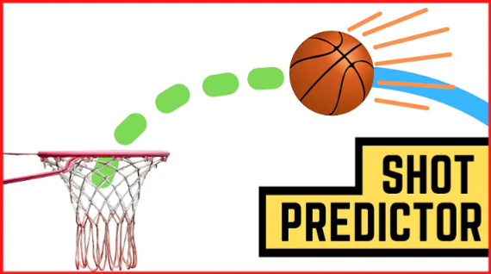
Introduction
Traditional ways of predicting basketball shot trajectories are not accurate or consistent because they rely on subjective judgments.
Utilize Image Processing to track and predict the trajectory of a basketball in video footage.
Fig 1: Basket ball trajectory Predicton.

Slide 4
Objectives
Taking image frames from the video.
Process it by different image processing techniques.
Determine the basketball’s trajectory.
Predict Weather the ball will make basket or not.

Slide 5
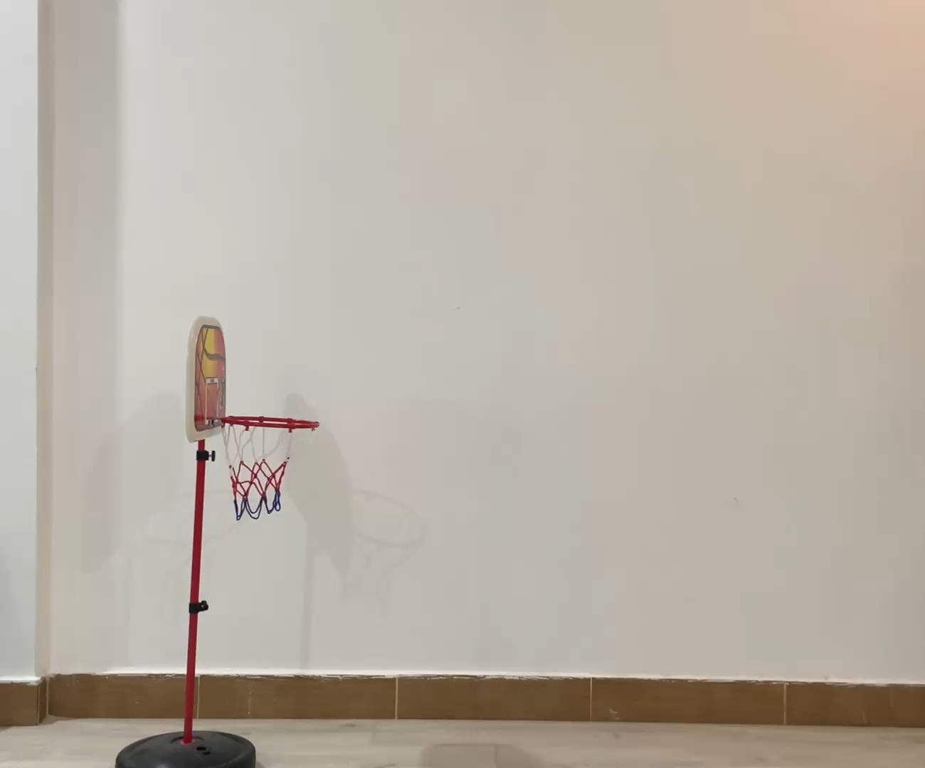
Methodology
Video Capture and Frame Extraction:
Captured a video from a predefined source.
Extract the frame images from the video for further processing.
Crop the image as needed.
Fig 2: basket ball throwing video

Slide 6


Methodology..
Basketball Detection using color:
Detecting ball by color finder hsv values.
Converted the image from BGR to HSV color space.
Created a mask to isolate the ball's color.
Applying the mask to the original image to get the color segmented image
Fig 3.1: Mask image to isolate the ball
Fig 3.2: color segmented image

Slide 7
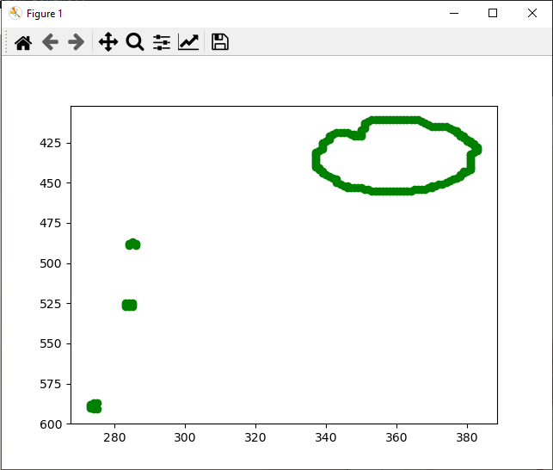
Methodology..
Contour Detection:
Apply canny edge detection on the mask.
Iterate over each pixel in the edge-detected image.
Trace contour points from each non-zero pixel neighbors pixel.
Fig 4: contour points of the mask.

Slide 8
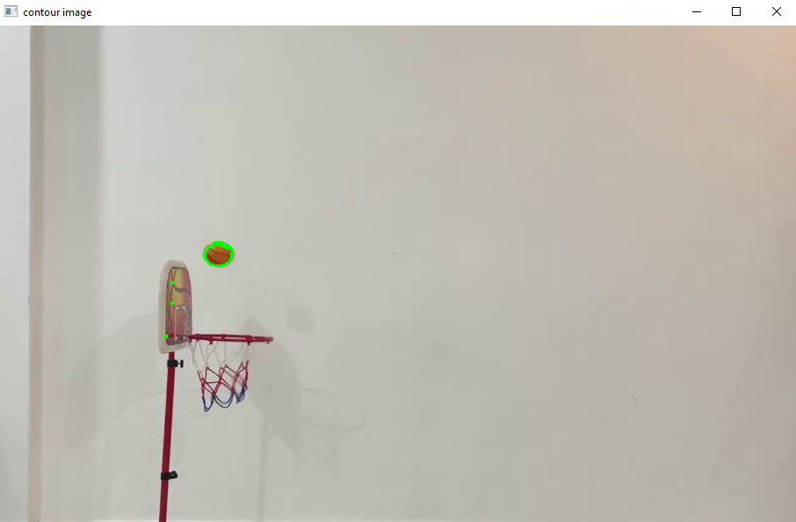
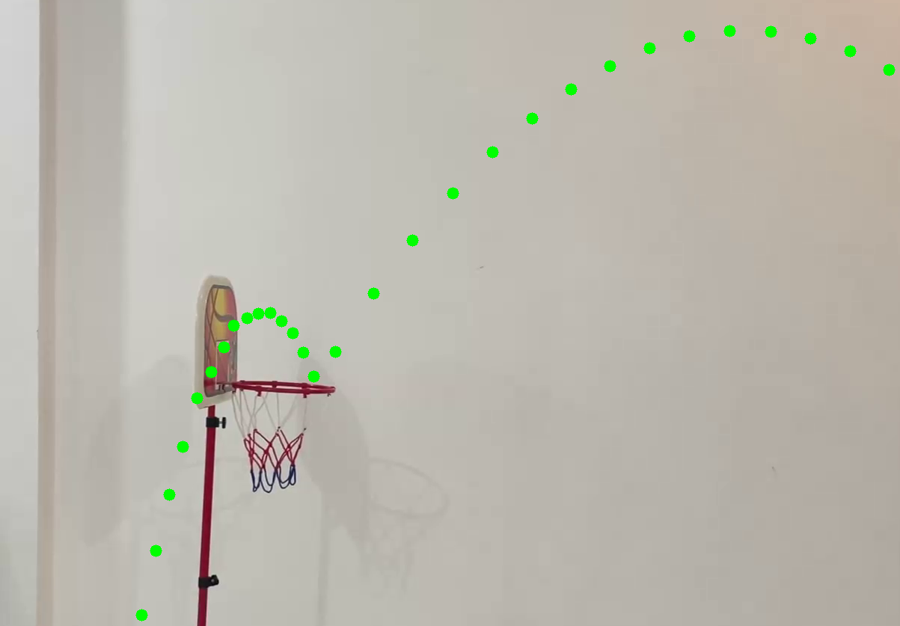
Methodology..
Contour Detection(cont.):
Find contour points.
Filter contours by area.
Extract contour details like area, center points.
Draw Contours around the ball.
Fig 5.1: contour points around the ball.
Fig 5.2: center points of the ball in different frames.

Slide 9
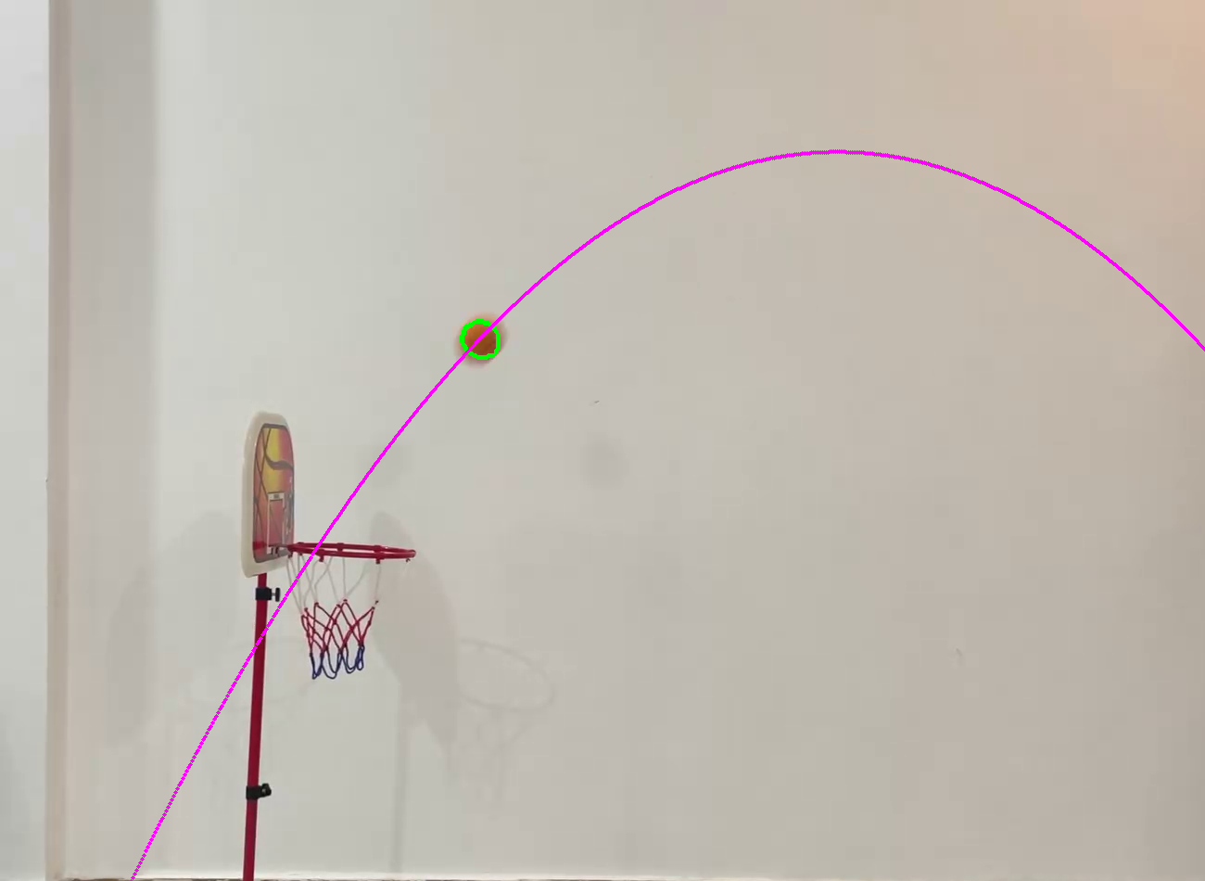
Methodology..
Trajectory Prediction:
Use polynomial regression to fit a curve to the ball’s initial center positions.
The Polynomial equation of degree 2 is y=Ax2+Bx+C where A,B and C are the coefficients of the polynomial.
Using coefficients the future trajectory is calculated.
Fig 6: Regression curve from initial center points.

Slide 10
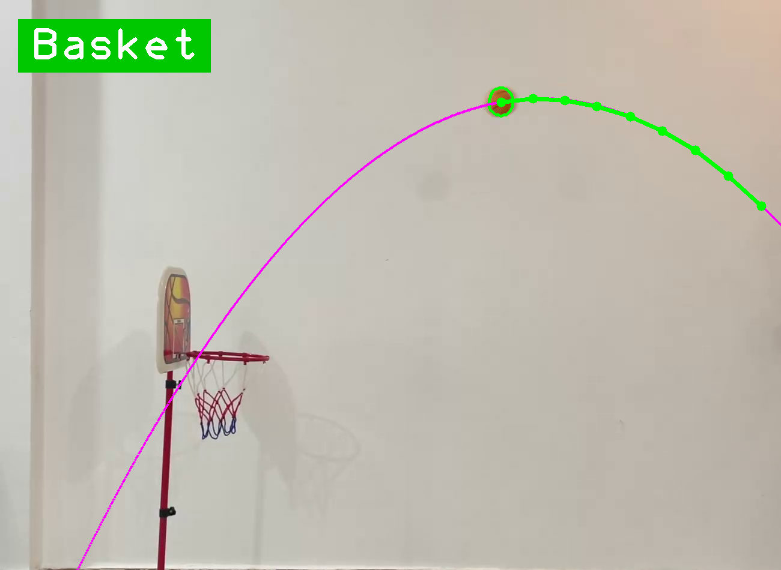
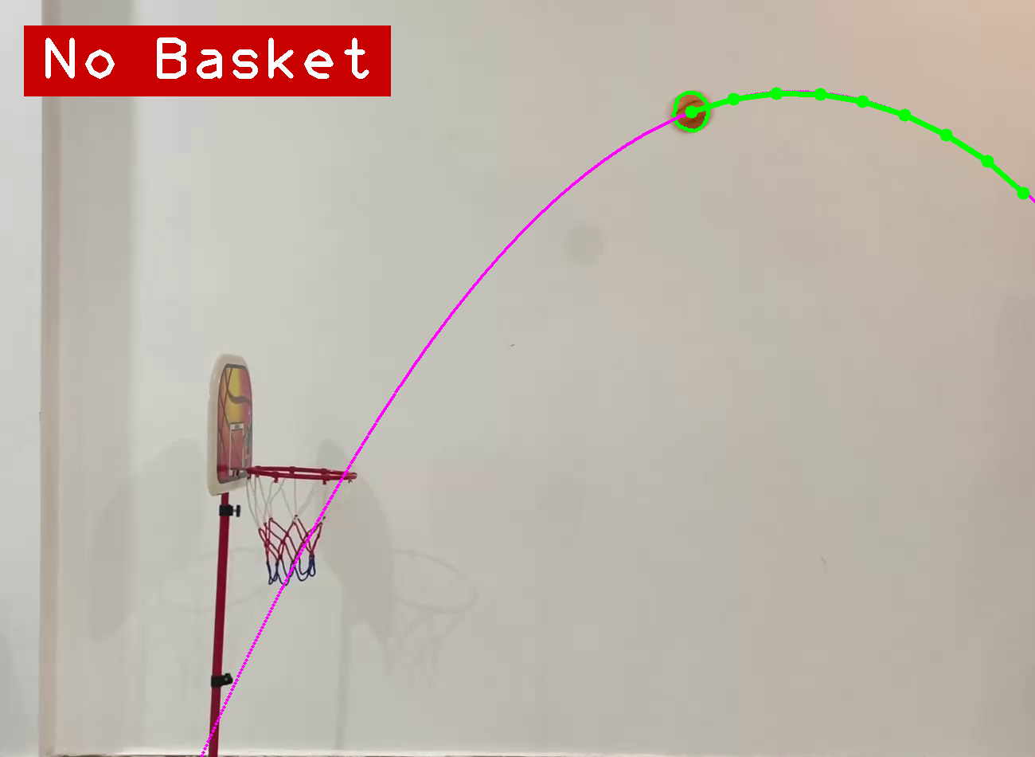
Result
Display the result:
Using the basket’s position the and the trajectory it is predicted that will it make it into the hoop.
Fig 7: Result when the ball will make basket
Fig 8: Result when the ball will not make basket

Slide 11
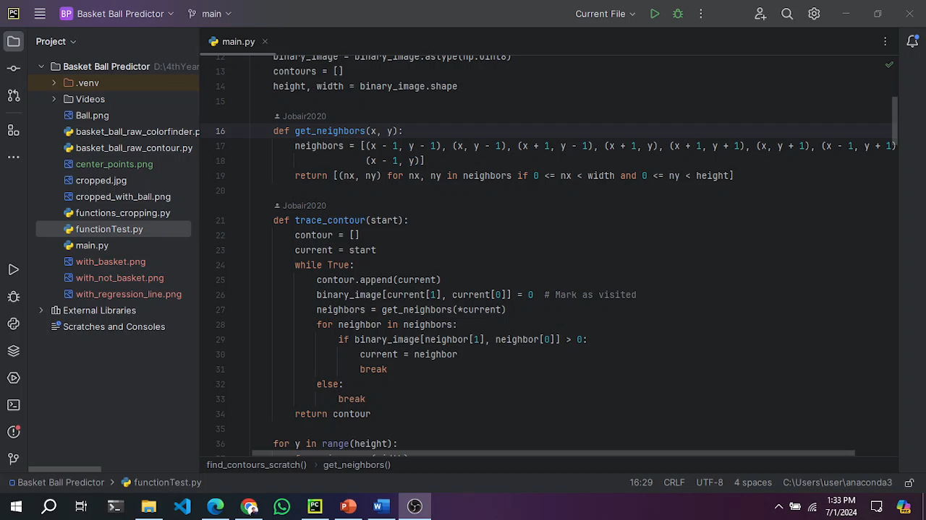
Recorded Project..

Slide 12
Conclusion:
This project focuses on predicting basketball trajectories using image processing techniques, automating the detection process.
It employs edge detection, custom contour tracing, and filtering to accurately identify and highlight the basketball's position.
The system calculates trajectory paths, and overlays results on the original video frames, providing a clear and detailed analysis.

Slide 13
Thank you

