Slide 1
SYNTAX CHECKER
Software Project Lab I
Presented by
BSSE0502 Jobayer Ahmmed
BSSE0517 Shadiqur Rahaman
BSSE0518 Sauvik Bhowmik Anik
Supervised by
Dr. Kazi Muheymin-Us-Sakib
Associate Professor
Institute of Information Technology
University of Dhaka

Slide 2
TOPICS
Overview
Reasons behind taking this project
Design
Implementation
User Manual
Achievements
Future Work

Slide 3
OVERVIEW
We have developed a software where one can test a C code. Our SYNTAX CHECKER includes the following features:
Checks a C code
Checks the basic syntax errors
Reports the error in easy language
More user friendly
Specially useful for the beginners

Slide 4
Reasons behind taking this project
When we were first year first semester students, we started learning C programming. We used GEDIT to edit the code and GCC to compile the code. It was troublesome to us. Besides it gave a large and complicated error log. So keeping this in mind, we decided to make a user friendly platform for the beginners to test C code. Here the reasons are:
C , a widely used programming language
We start programming with C
Important to develop programming logic
To give an efficient platform to beginners
To help beginners learn C easily

Slide 5
DESIGN
We first design our project with pen and paper. Then we divide the whole project into modules and distribute the whole work among us.
The following flow chart shows the design of the whole program

Slide 6
Design (continue...)
Flow chart of the whole program
start
input
Stop
null
true
false
Check comment
Erase spaces from first and last
Check header
true
# include

Slide 7
false
Pick the first token using ‘ ’ ( =
Token
true
true
While + (
type
For + (
t
f
(
{ }
Name + =
While
Printf + (
For
Check function
Check declaration
If + (
Scanf + (
else
Check braces
Print undetermined
If
Else if
Assignment
Else
return
Printf
end
Scanf
Else if
Return

Slide 8
DESIGN (continue...)
Hardware requirements
RAM 512 MB
Processor 2 GHz
Software requirements
Compiler: g++
Editor: Codeblocks-13.12
Visual Studio 2010

Slide 9
IMPLEMENTATION
After completing the design we devoted to implement the design in code. We made this task in three subtasks
Made a main function and gave it to all the members
Fixed the input and output format of the functions
Implemented the functions

Slide 10

USER MANUAL
Run in Windows OS

Slide 11
USER MANUAL (continue...)
We deliver two .exe file:
1. Console based .exe file
2. GUI based .exe file
Two different ways to use

Slide 12
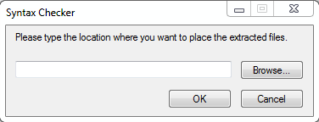
USER MANUAL (continue...)
Installation Process
Double click on the .exe file
A file browser will open

Slide 13
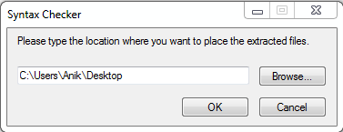
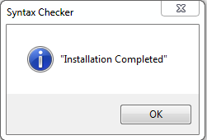
USER MANUAL (continue...)
3. We give the name where we want to install
4. Click ok

Slide 14
USER MANUAL (continue...)
CONSOLE Based
exe
File name
enter
Error message
Exit

Slide 15
USER MANUAL (continue...)
Input file name

Slide 16
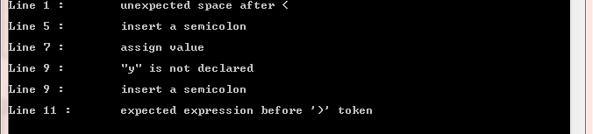
USER MANUAL (continue...)
Error message

Slide 17
USER MANUAL (continue...)
GUI Based
exe
Browse
Error message
Ok

Slide 18
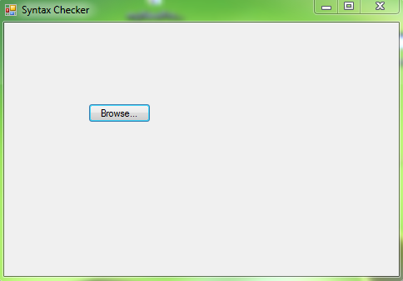
USER MANUAL (continue...)
Browse the file

Slide 19
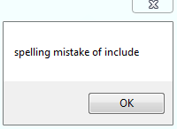
USER MANUAL (continue...)
Error message

Slide 20
ACHIEVEMENTS
Technical Achievements:
Learn C language properly
Enhance programming skill
Learn the art of module programming
Learn to manage large code like over 3000 lines

Slide 21
ACHIEVEMENTS (continue...)
Professional Achievements:
Enjoy the flavor of group working
Develop communication skill
Learn how to maintain timescale
Learn how to make a good presentation

Slide 22
FUTURE WORK
In future we want to enhance the capability of the Syntax Checker as follows:
Upgrade the software to check all types of errors
Add auto correction
Make an editor

Slide 23


Slide 24


