Slide 1
WEEK 10 PCAP ANALYSIS
Ransomware Attack Chain Investigation
CARLFORCE.COM · Subnet 172.16.1.0/24 · 2017-12-23
Team Members: Jay-Byrd Mystic, Joseph D Scalissi, Brian Olson, Daniel A Garcia-Rivera
Date: 04/01/2026 | Course: Network Forensics
PCAP FILE
DATE
DURATION
PACKETS
Week10.pcap
2017-12-23
37 min 49 sec
8,159
Patient Zero · Drive-by Download · RIG Exploit Kit · DynDNS C2 · Ransomware
CARLFORCE.COM | Week 10 Network Forensics | Title Slide

Slide 2
ABSTRACT
Executive Summary of the Investigation
This report presents a forensic analysis of a ransomware attack against CARLFORCE.COM captured on December 23, 2017. Network traffic analysis of Week10.pcap (8,159 packets over approximately 38 minutes) reveals a multi-stage infection chain originating from internal host 172.16.1.67 (JERSEY-SHORE-1A), identified as Patient Zero. The infection began with a drive-by download of a malicious Word document (Invoice[1].doc) from fundtel.es, followed by exploit kit payload delivery (2042[1].exe) from enjoyveganrecipes.com via the RIG Exploit Kit. Command-and-control infrastructure leveraged dynamic DNS providers including DynDNS and No-IP (gabby4u.linkpc.net), triggering ET_DYN_DNS Suricata alerts. Ransomware indicators including Tor-based payment pages (topyzscsu5poprxy.onion.link) and Bitcoin redirect services (coinurl.com) were observed. A total of four internal hosts showed indicators of compromise across the 38-minute capture window.
CARLFORCE.COM | Week 10 Network Forensics | Abstract

Slide 3
INTRODUCTION
Background, Scope & Tools
BACKGROUND
SCOPE
CARLFORCE.COM is a fictional organization operating on subnet 172.16.1.0/24 with domain controller 172.16.1.4 (CARLFORCE-DC1).
On December 23, 2017, a ransomware attack was launched via a drive-by download targeting internal workstations. The attack resulted in multiple hosts becoming compromised, with ransomware indicators observed across the network within 38 minutes of initial infection.
Week10.pcap · 8,159 packets
Capture: 2017-12-23 01:05–01:43 UTC
Subnet: 172.16.1.0/24 · 4 hosts affected
TOOLS USED
Wireshark — packet filtering & HTTP analysis
NetworkMiner — host & file extraction
Security Onion — IDS alert investigation
VirusTotal — IOC reputation lookup
tshark — command-line PCAP parsing
CARLFORCE.COM | Week 10 Network Forensics | Introduction

Slide 4
METHODOLOGY
Forensic Investigation Workflow
Host Identification
Traffic Triage
01
Loaded Week10.pcap into NetworkMiner. Examined the Hosts tab to identify all internal machines, their hostnames, OS, and traffic volume. Filtered on 172.16.1.0/24 to isolate CARLFORCE hosts.
02
Used tshark to extract DNS queries, HTTP requests, and IP conversations. Sorted by volume to identify high-traffic suspicious external IPs and anomalous outbound connections.
HTTP Deep Dive
IDS Alert Review
03
Applied Wireshark filters (http.host, http.request.method) to isolate drive-by download traffic (fundtel.es), exploit kit delivery (enjoyveganrecipes.com), and C2 beaconing (POST to :8080/:7080).
04
Loaded PCAP into Security Onion. Reviewed Suricata alerts for ET_DYN_DNS, ET EXPLOIT_KIT RIG EK, and onion.link indicators. Correlated alerts to specific source IPs and timestamps.
IOC Corroboration
Attack Chain Assembly
05
Submitted key domains and IPs to VirusTotal (fundtel.es, 62.210.253.72). Confirmed malicious reputation to support findings and provide external validation.
06
Correlated all findings chronologically to reconstruct the full kill chain: Initial Access → Exploit Kit → C2 Beacon → Ransomware → Lateral Movement.
CARLFORCE.COM | Week 10 Network Forensics | Methodology

Slide 5
NETWORK DIAGRAM
CARLFORCE.COM — 172.16.1.0/24 — 2017-12-23
INTERNAL — 172.16.1.0/24
EXTERNAL — MALICIOUS
172.16.1.4
www.fundtel.es
CARLFORCE-DC1
Domain Controller
185.2.4.53 · ① Drive-by / Word Doc
172.16.1.67
enjoyveganrecipes.com
JERSEY-SHORE-1A
⚠ PATIENT ZERO
78.46.96.236 · ② RIG Exploit Kit
62.210.253.72
172.16.1.89
:8080 · ③ C2 Beacon (POST)
JERSEY-SHORE-2C
⚠ Secondary
gabby4u.linkpc.net
172.16.1.141 / .201
174.127.99.158 · ④ ET_DYN_DNS C2
JERSEY-1F / NEWARK-1A
⚠ Lateral Movement
topyzscsu5poprxy.onion.link
coinurl.com · ⑤ Ransom Payment
CARLFORCE.COM | Week 10 Network Forensics | Network Diagram

Slide 6
ATTACK TIMELINE
2017-12-23 | 01:05 – 01:43 UTC
01:06
RECON
172.16.1.201
NCSI & Office connectivity checks — hosts come online
01:08
INITIAL ACCESS
172.16.1.67
GET /Purchases-2017/ from fundtel.es → Invoice[1].doc dropped
GET /j7iHZm/ from enjoyveganrecipes.com → 2042[1].exe delivered
01:12
C2 BEACON
172.16.1.89
DNS to checkip.dyndns.org — malware probes external IP
HTTP POST to 62.210.253.72:8080 — Dridex-style C2 beaconing begins
01:16
CALLBACK
172.16.1.201
HTTP to bodyclassics.org (encoded params, 155KB payload)
HTTP to psoeiras.net /js/count.php — payload tracking
01:17
RANSOMWARE
172.16.1.201
DNS to topyzscsu5poprxy.onion.link — Tor ransom payment page
DNS/HTTP to coinurl.com — Bitcoin payment redirect
01:42
LATERAL MOVE
172.16.1.141
DNS to gabby4u.linkpc.net — new host infected
ET_DYN_DNS Suricata alert triggered on No-IP domain
CARLFORCE.COM | Week 10 Network Forensics | Attack Timeline

Slide 7
ET_DYN_DNS — WHAT IS IT?
Emerging Threats Suricata Signature Category
ET_DYN_DNS alerts fire when a host makes DNS queries to free dynamic DNS providers (DynDNS, No-IP, LinkPC, etc.). Attackers use these because the domain is free/anonymous, the IP behind it can change at any time, and they help hide C2 servers from static blocklists. Suricata rule category: ET POLICY DNS Query to a *.dyndns.org Domain is a classic trigger.
01
IP Agility
02
Free & Anonymous
03
Blends In
04
Persistence
Attacker changes C2 server IP at will — domain stays the same, blocklists lag behind.
No-cost registration with minimal identity verification — low barrier for threat actors.
Legitimate tools (webcams, remote access) also use DynDNS — adds noise to detection.
Even if one IP is blocked, attacker simply updates the DNS record — resilient infrastructure.
CARLFORCE.COM | Week 10 Network Forensics | ET_DYN_DNS Explainer

Slide 8
ET_DYN_DNS — FINDINGS IN WEEK10.PCAP
Dynamic DNS & Suspicious Domain Queries Detected
TIME
SRC HOST
DOMAIN QUERIED
TYPE
SEVERITY
01:08:21
172.16.1.67
www.fundtel.es
Drive-by
HIGH
01:12:34
172.16.1.89
checkip.dyndns.org
DynDNS Recon
MEDIUM
01:12:05
172.16.1.89
temizlikhizmetleri.net
C2 Beacon
HIGH
01:17:24
172.16.1.201
topyzscsu5poprxy.onion.link
Tor Proxy
CRITICAL
01:17:54
172.16.1.201
onion.link / coinurl.com
Bitcoin C2
CRITICAL
01:42:24
172.16.1.141
gabby4u.linkpc.net
No-IP DynDNS
HIGH
⚠ gabby4u.linkpc.net is the classic ET_DYN_DNS trigger — No-IP domain used as C2 hop confirming lateral movement to 172.16.1.141 (Jersey-Shore-1f)
CARLFORCE.COM | Week 10 Network Forensics | ET_DYN_DNS Findings

Slide 9
ATTACK CHAIN SUMMARY
Kill Chain Mapping — Drive-by → Exploit Kit → Ransomware → Lateral Movement
1
INITIAL
ACCESS
2
EXPLOIT
KIT
3
C2
BEACON
4
RANSOM
WARE
5
LATERAL
MOVE
172.16.1.67 visits
fundtel.es
/Purchases-2017/
→ Invoice[1].doc
Redirect to
enjoyveganrecipes
/j7iHZm/
→ 2042[1].exe
checkip.dyndns.org
POST :8080/:7080
bodyclassics.org
temizlikhizmetleri
onion.link Tor page
coinurl.com Bitcoin
payment demanded
4 hosts affected
172.16.1.141 infected
gabby4u.linkpc.net
ET_DYN_DNS alert
fired by Suricata
KEY IOCs
185.2.4.53 (fundtel.es) · 78.46.96.236 (enjoyveganrecipes.com) · 62.210.253.72:8080 (C2) · topyzscsu5poprxy.onion.link · coinurl.com · gabby4u.linkpc.net · checkip.dyndns.org
CARLFORCE.COM | Week 10 Network Forensics | Attack Chain Summary

Slide 10
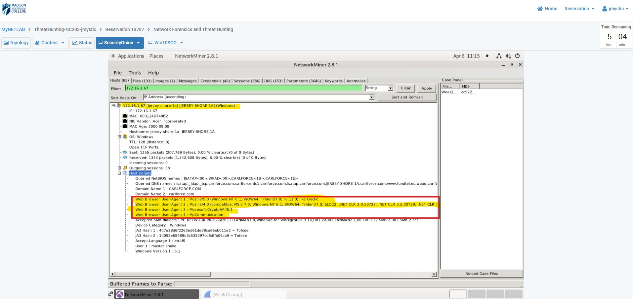
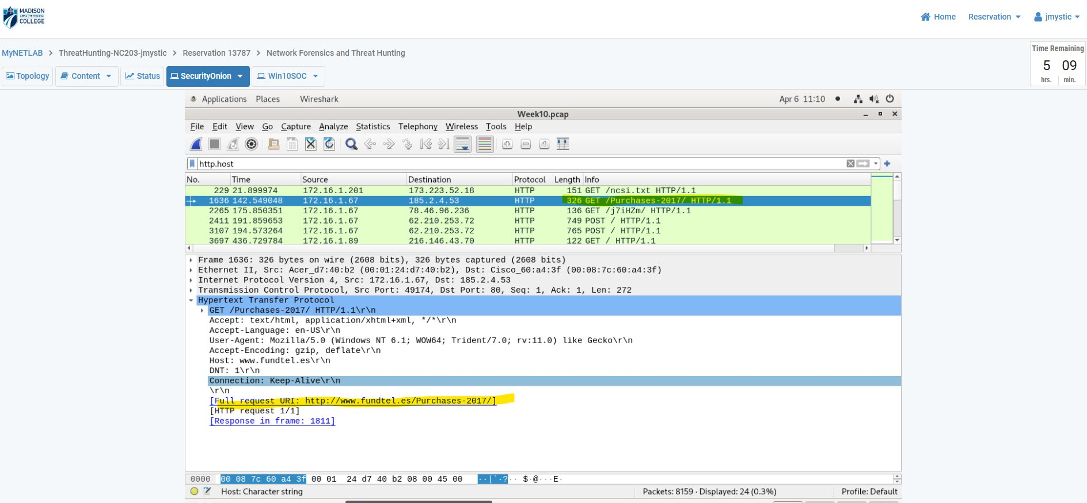
EVIDENCE — HOST IDENTIFICATION & INITIAL ACCESS
Figures 1 & 5: NetworkMiner Hosts Tab + Wireshark fundtel.es GET
FIG. 1 — Patient Zero: NetworkMiner Hosts Tab
FIG. 5 — Wireshark: GET /Purchases-2017/ (fundtel.es)
172.16.1.67 (JERSEY-SHORE-1A) is Patient Zero. Dual user-agents (IE11 + spoofed IE7 Dridex UA) and JA3=Tofsee confirm compromise. Host GETs Invoice[1].doc from fundtel.es — social engineering lure.
CARLFORCE.COM | Week 10 Network Forensics | Evidence — Patient Zero & Initial Access

Slide 11
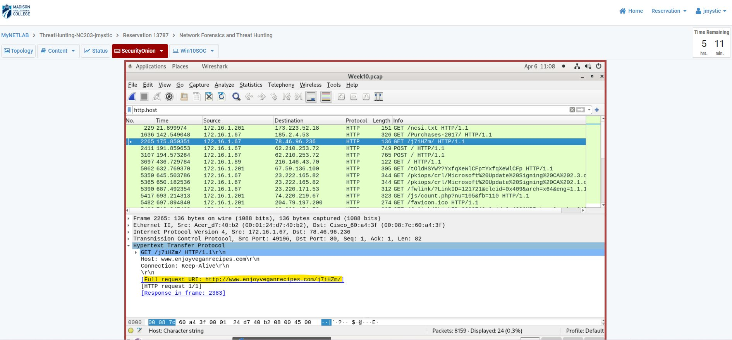
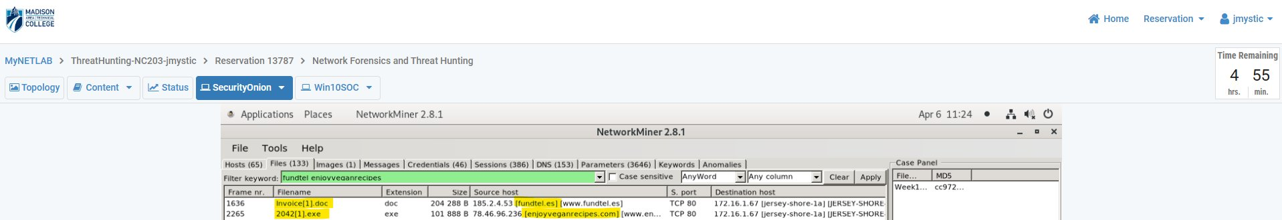
EVIDENCE — EXPLOIT KIT DELIVERY & FILE EXTRACTION
Figures 4 & 6: Wireshark enjoyveganrecipes + NetworkMiner Files Tab
FIG. 4 — Wireshark: GET /j7iHZm/ (enjoyveganrecipes.com)
FIG. 6 — NetworkMiner Files Tab: Extracted Malicious Files
RIG Exploit Kit delivers 2042[1].exe (101KB) to 172.16.1.67 from enjoyveganrecipes.com. NetworkMiner extracts both malicious files: Invoice[1].doc (204KB dropper) and 2042[1].exe (binary payload).
CARLFORCE.COM | Week 10 Network Forensics | Evidence — Exploit Kit & Files

Slide 12
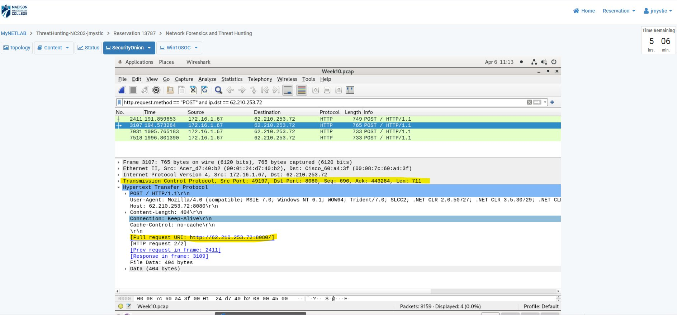
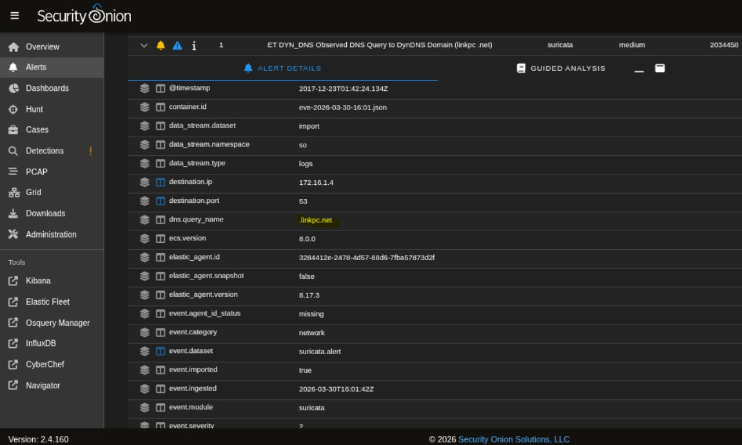
EVIDENCE — C2 BEACONING & IDS ALERTS
Figures 2 & Security Onion: POST Requests + ET_DYN_DNS Alert
FIG. 2 — Wireshark: C2 POST to 62.210.253.72:8080
Security Onion: ET_DYN_DNS gabby4u.linkpc.net Alert
172.16.1.67 sends 4 repeated POST requests to 62.210.253.72:8080 using spoofed IE7 UA — classic Dridex C2 beaconing pattern. Suricata fires ET_DYN_DNS on gabby4u.linkpc.net confirming lateral C2 hop.
CARLFORCE.COM | Week 10 Network Forensics | Evidence — C2 & IDS Alerts

Slide 13
KEY TAKEAWAYS
Defensive Lessons from This Investigation
1
Drive-by download was the entry point
User on .67 browsed fundtel.es → RIG EK on enjoyveganrecipes.com delivered Invoice[1].doc + 2042[1].exe. Web filtering and macro policy enforcement would have blocked this chain entirely.
2
DynDNS = red flag in enterprise traffic
No legitimate internal application should query checkip.dyndns.org or gabby4u.linkpc.net. Block DynDNS/No-IP categories at the DNS resolver.
3
.onion.link confirms ransomware deployment
topyzscsu5poprxy.onion.link is a Tor2Web proxy for a ransomware payment page. This DNS query is a definitive ransomware IOC — detect and alert immediately.
4
Lateral movement via ET_DYN_DNS
gabby4u.linkpc.net queried by 172.16.1.141 (Jersey-Shore-1f) — a new host not previously involved. Infection spread confirms network segmentation was absent.
5
Multi-stage C2 infrastructure
bodyclassics.org, psoeiras.net, 62.210.253.72:8080, and coinurl.com — resilient multi-server C2. Blocking one IP alone is insufficient; domain category blocking is required.
CARLFORCE.COM | Week 10 Network Forensics | Key Takeaways

Slide 14
CONCLUSIONS, RECOMMENDATIONS & REFERENCES
Week 10 Network Forensics Investigation
CONCLUSIONS
RECOMMENDATIONS
Patient Zero confirmed: 172.16.1.67 (JERSEY-SHORE-1A)
Attack chain: fundtel.es → Invoice[1].doc → 2042[1].exe via RIG EK
C2 established via Dridex-style POST to 62.210.253.72:8080
Ransomware confirmed: onion.link + coinurl.com indicators
4 internal hosts showed IoCs within 38 minutes
ET_DYN_DNS lateral movement confirmed on .141
Block DynDNS / No-IP categories at DNS resolver
Deploy web content filtering to block EK domains
Disable Office macro execution via Group Policy
Segment network to prevent lateral movement
Alert on .onion.link and coinurl.com DNS queries
Deploy endpoint detection for Dridex UA patterns
REFERENCES
Emerging Threats — ET_DYN_DNS Ruleset: https://community.emergingthreats.net
Suricata Rule SID 2034458 — ET DYN_DNS Observed DNS Query to DynDNS Domain (linkpc.net)
Suricata Rule SID 2024048 — ET EXPLOIT_KIT RIG EK URI Struct Mar 13 2017
VirusTotal IOC Reports — fundtel.es (Fortinet: Malware) | 62.210.253.72 (MalwareURL: Malware)
MITRE ATT&CK: T1566.002 (Spearphishing Link), T1204.002 (Malicious File), T1071.001 (Web Protocols C2)
CARLFORCE.COM | Week 10 Network Forensics | Conclusions · Recommendations · References

Slide 15
ANALYSIS & INTERPRETATION
False Positive Assessment & VirusTotal Corroboration
CORROBORATING SIGNATURES
HIGH CONFIDENCE METADATA
RIG EK URI Struct fired 15x, ET_DYN_DNS on 2 separate hosts, onion.link on .201 -- independent corroboration across different rule sets eliminates coincidental triggering.
All critical Suricata rules carry confidence: High and signature_severity: Major -- well-established, low false-positive signatures from the Emerging Threats ruleset.
FILE EVIDENCE
VIRUSTOTAL + DUAL USER-AGENT
NetworkMiner physically extracted Invoice[1].doc (204KB) and 2042[1].exe (101KB) from the PCAP -- binary-level confirmation of payload delivery, not just alert-based.
fundtel.es: Malware (Fortinet). 62.210.253.72: Malware (MalwareURL). Spoofed IE7 UA alongside real IE11 on the same host is a definitive Dridex infection indicator.
CARLFORCE.COM | Week 10 Network Forensics | Analysis & Interpretation

Slide 16
INDICATORS OF COMPROMISE -- FULL TABLE
All IOCs identified across Week10.pcap
IOC
Value
Type
Verdict
Patient Zero
172.16.1.67 (JERSEY-SHORE-1A)
Internal IP
Confirmed infected
Dropper Server
185.2.4.53 (fundtel.es)
External IP
Malicious (Fortinet)
Dropper File
Invoice[1].doc 204 KB
File
Malicious Word macro
EK Server
78.46.96.236 (enjoyveganrecipes)
External IP
RIG Exploit Kit
Payload
2042[1].exe 101 KB
File
Ransomware binary
Primary C2
62.210.253.72:8080
IP:Port
Malware (MalwareURL)
Secondary C2
220.227.247.35/39:7080
IP:Port
Malicious
Tertiary C2
153.149.153.41:8080
IP:Port
Malicious
DynDNS Recon
checkip.dyndns.org
Domain
ET_DYN_DNS alert
Lateral C2
gabby4u.linkpc.net
Domain
ET_DYN_DNS alert
Ransom Page
topyzscsu5poprxy.onion.link
Domain
Tor2Web ransomware
Bitcoin Redirect
coinurl.com
Domain
Ransom payment
C2 Callback
bodyclassics.org
Domain
Payload delivery
Dridex UA
Spoofed MSIE 7.0 string
User-Agent
Dridex signature
JA3 Hash
4d7a28d6...011e3 = Tofsee
TLS Hash
Malware fingerprint
MITRE T1566.002
Spearphishing Link
ATT&CK
Confirmed
MITRE T1204.002
User Execution: Malicious File
ATT&CK
Confirmed
MITRE T1071.001
Web Protocol C2
ATT&CK
Confirmed
CARLFORCE.COM | Week 10 Network Forensics | Indicators of Compromise

Slide 17
NON-TECHNICAL SUMMARY
What Happened -- Plain Language Explanation
WHAT HAPPENED?
WHAT DID THE RANSOMWARE DO?
A staff member's computer at CARLFORCE.COM was infected with ransomware after a malicious Word document disguised as an invoice was downloaded from a compromised website. When the document was opened and macros were enabled, it silently installed ransomware.
Once installed, the ransomware communicated with attacker-controlled servers and displayed payment pages demanding Bitcoin in exchange for a decryption key. Security monitoring detected the attack in real time through multiple automated alerts.
HOW FAR DID IT SPREAD?
WHAT SHOULD BE DONE?
The infection spread indicators to three additional computers on the same internal network within 38 minutes. A total of four internal hosts showed signs of compromise during the capture window. No external spread was observed.
All four affected computers should be wiped and rebuilt immediately. Staff should not enable macros in Office documents from unknown sources. Web filtering and Dynamic DNS blocking should be deployed -- no legitimate CARLFORCE.COM application requires them.
CARLFORCE.COM | Week 10 Network Forensics | Non-Technical Summary

