Slide 1
WEEK 11 INVESTIGATION
TrickBot Trojan Infection
via Disguised PDF Delivery
Team Members: Jobayer & Ari
Date:
04/09/2026 | Course: Network Forensics
Assignment:
Team PCAP Analysis, Week 11
7,300+
~25 min
5
High
Total Packets
Attack Window
Attack Stages
Alert Confidence

Slide 2
Abstract
Investigation overview and key findings
This investigation analyzed a PCAP file captured on 2021-08-19 containing network traffic from host DESKTOP-M1TFHB6 (10.8.19.101), a Windows 10 Pro machine on the 10.8.19.0/24 network within the fuzzylizards.com domain.
DESKTOP-M1TFHB6 was infected with the
TrickBot trojan following a disguised malware delivery via HTTP. The infection began when a file named ooiwy.pdf was downloaded from 185.244.41.29 using curl. Despite its .pdf extension, the file was a PE32 executable (DLL). VirusTotal confirmed the file as malicious with a 60/72 detection rate.
Post-infection, TrickBot established encrypted C2 channels to three external servers (103.148.41.195, 46.99.175.149, 182.253.210.130) using self-signed "Internet Widgits Pty Ltd" certificates. The malware exfiltrated system reconnaissance data including process lists, system information, network configuration, and domain enumeration via HTTP POST requests with User-Agent: Ghost.
Key tools used: Security Onion (Suricata IDS), Wireshark, NetworkMiner, and VirusTotal. All IOCs were validated. False positive probability is extremely low.
Week 11 PCAP Analysis | TrickBot Trojan | Network Forensics

Slide 3
Introduction
Background, objective, scope, and toolset
Background & Objective
Tools Used
A PCAP file from 2021-08-19 was analyzed to investigate a reported malware infection on an internal Windows host.
Objective: Identify the malware type, trace the full attack chain from initial delivery to data exfiltration, extract all IOCs, and evaluate IDS alert accuracy.
Scope: Single host DESKTOP-M1TFHB6 (10.8.19.101) on the 10.8.19.0/24 network within the fuzzylizards.com domain. Timeframe: 19:40 to 20:24 UTC. No lateral movement detected.
Security Onion (Suricata IDS)
Alert dashboard, grouped alerts by source IP and rule severity
Wireshark / PCAP Analysis
Packet-level inspection, HTTP stream reconstruction, Export Objects
NetworkMiner
Host enumeration, OS fingerprinting, file extraction, certificate analysis
VirusTotal
IOC validation: IPs, domains, file hashes cross-referenced against 72+ vendors
Week 11 PCAP Analysis | TrickBot Trojan | Network Forensics

Slide 4
The Network
Internal topology and external connections identified from PCAP
Network Summary
Internet
185.244.41.29
Malware Source
Subnet:
10.8.19.0/24 (fuzzylizards.com)
Victim Host:
Router / Gateway
10.8.19.1
103.148.41.195
Primary C2
DESKTOP-M1TFHB6, 10.8.19.101
Windows 10 Pro, Intel NIC
MAC: 00-08-02-1C-47-AE
46.99.175.149
Secondary C2
Gateway:
DESKTOP-M1TFHB6
10.8.19.101
Windows 10 Pro
10.8.19.1 (DNS + NAT)
DNS Server:
182.253.210.130
Tertiary C2
10.8.19.8
Malware Source:
185.244.41.29 (Apache/Debian)
Primary C2:
103.148.41.195 (BD, AS 140076)
Secondary C2:
46.99.175.149 (12/94 VT)
Week 11 PCAP Analysis | TrickBot Trojan | Network Forensics
Tertiary C2:
182.253.210.130 (11/94 VT)

Slide 5
Methodology
Analytical process used to reconstruct the attack
1
Alert Triage
4
Host Enumeration
Reviewed Security Onion Alerts dashboard. Grouped alerts by source IP and rule name. Identified Suricata signatures for PE download, ipconfig/nltest exfiltration, external IP lookup, and OpenSSL Demo CA as starting points.
Loaded PCAP into NetworkMiner to identify hostnames, OS fingerprints, MAC addresses, extracted files, and TLS certificates from C2 servers.
2
OSINT Validation
5
IOC Extraction
Queried each IOC (IPs, domains, file hashes) in VirusTotal. Obtained independent vendor verdicts across 72-94 engines to confirm or rule out false positives.
Extracted all IP addresses, file hashes, hostnames, user agents, certificate details, and MITRE ATT&CK technique mappings from correlated evidence across all tools.
3
PCAP Deep-Dive
6
Timeline Construction
Applied Wireshark display filters to isolate malicious traffic. Reconstructed HTTP streams to identify the disguised PDF delivery, curl user agent, and C2 POST data containing reconnaissance commands.
Cross-referenced packet timestamps, DNS queries, HTTP requests, and IDS alerts to build a precise UTC timeline from initial delivery through data exfiltration and persistent beaconing.
Week 11 PCAP Analysis | TrickBot Trojan | Network Forensics

Slide 6
Timeline of Events
All times UTC, 2021-08-19 | Capture window: 19:40 to 20:24+ UTC
Time (UTC) | Stage | Source IP | Event Description | Significance
19:40:36 | Initial Access | 10.8.19.101 | HTTP GET /ooiwy.pdf via curl from 185.244.41.29 | Disguised DLL delivered as PDF
19:40:57 | TLS Initiation | 10.8.19.101 | Encrypted session to 46.99.175.149:443 | First C2 callback (self-signed cert)
19:40:58 | Recon Prep | 10.8.19.101 | DNS + HTTP to api.ipify.org | External IP discovery
19:44:17 | C2 Beaconing | 10.8.19.101 | HTTPS to 103.148.41.195:443 | Primary TrickBot C2 channel
19:45:38 | Data Exfil | 10.8.19.101 | POST: proclist, systeminfo, ipconfig, nltest | System/network recon exfiltrated
19:45:43 | C2 Response | 103.148.41.195 | TrickBot check-in response (text/plain) | Bidirectional C2 control confirmed
19:50:18+ | Persistence | 10.8.19.101 | Repeated OpenSSL Demo CA TLS to 3 C2 IPs | Ongoing beaconing with self-signed certs
Week 11 PCAP Analysis | TrickBot Trojan | Network Forensics

Slide 7
Indicators of Compromise (IOCs)
All IOCs extracted from PCAP and validated via VirusTotal
Type | Indicator | Description / Relevance
File | ooiwy.pdf (PE32 DLL) | Disguised executable, 323kB, delivered via HTTP
Hash (SHA256) | f25a78009573...ae606404 | 60/72 VT detections (RegistryDemo.EXE)
IP | 185.244.41.29 | Malware delivery server (Apache/Debian)
IP | 103.148.41.195 | Primary C2 (AS 140076, BD), 1/94 VT
IP | 46.99.175.149 | Secondary C2, 12/94 VT flagged
IP | 182.253.210.130 | Tertiary C2, 11/94 VT flagged
User-Agent | curl/7.55.1 | Download agent (suspicious for PDF)
User-Agent | Ghost | TrickBot C2 exfiltration agent
Certificate | Internet Widgits Pty Ltd | Self-signed cert on all C2 servers
Additional IOCs
Hostname:
DESKTOP-M1TFHB6
Domain:
fuzzylizards.com
User:
user1
Exfil Commands:
tasklist, systeminfo,
ipconfig /all, net config
workstation, nltest
MITRE:
T1566.001 Spearphishing
T1059 Command Execution
T1041 Exfil Over C2
T1071 App Layer Protocol
T1573 Encrypted Channel
Malware:
TrickBot Trojan
(RegistryDemo.EXE)
Week 11 PCAP Analysis | TrickBot Trojan | Network Forensics

Slide 8
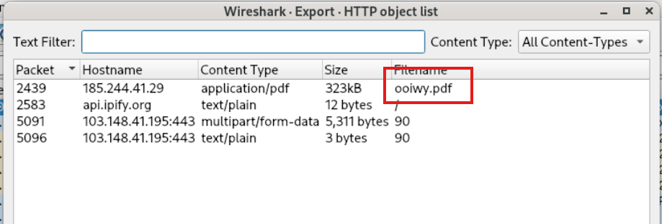
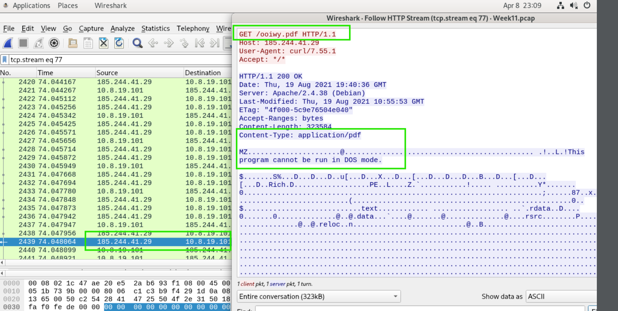
Evidence: Malicious File Download
Stage 1: Disguised executable delivered as PDF via HTTP
Fig 1: Wireshark HTTP Export Objects listing ooiwy.pdf (323kB) from 185.244.41.29, plus multipart/form-data POST to 103.148.41.195:443.
Fig 2: HTTP stream (tcp.stream eq 77) showing GET /ooiwy.pdf with curl/7.55.1 User-Agent. Response contains MZ header (PE executable) despite Content-Type: application/pdf.
Finding: The file ooiwy.pdf was downloaded via curl from a direct IP address (no domain name), which is inherently suspicious. The response body starts with an MZ header, confirming it is a Windows executable disguised with a .pdf extension.
Week 11 PCAP Analysis | TrickBot Trojan | Network Forensics

Slide 9
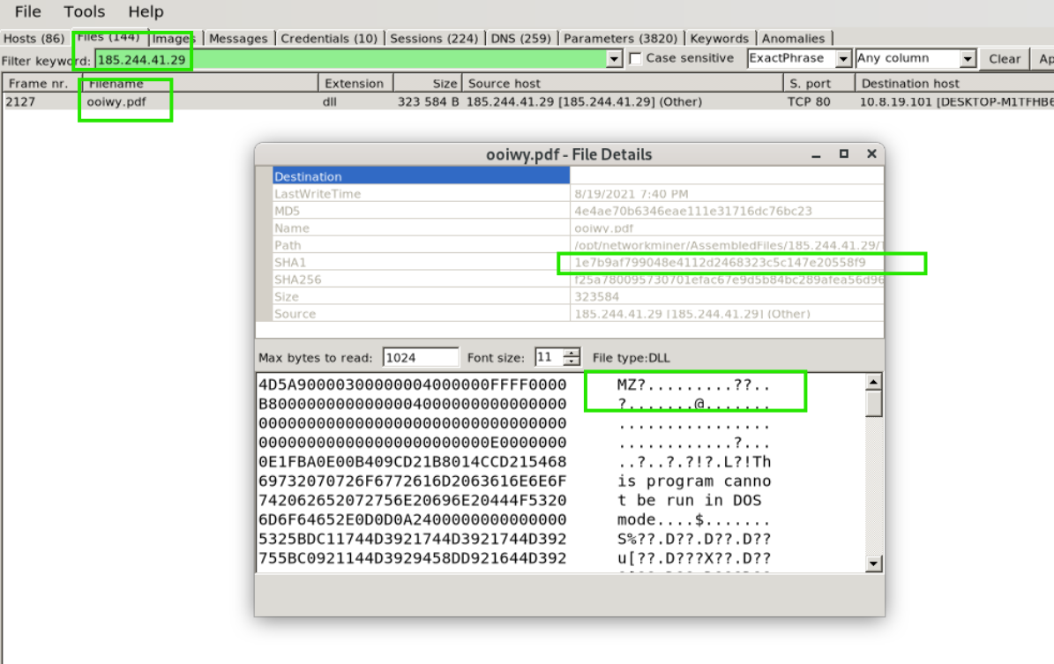
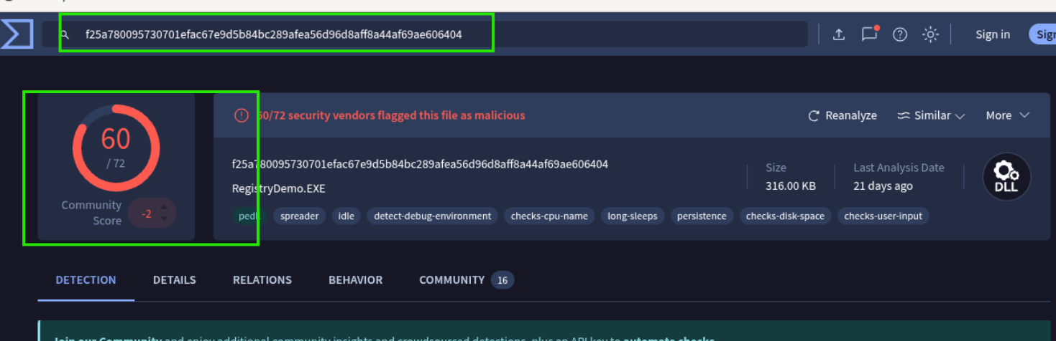
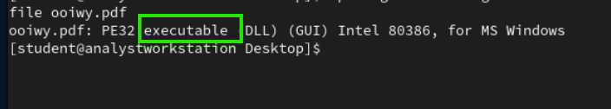
Evidence: File Analysis and VirusTotal Confirmation
NetworkMiner extraction, file type verification, and malware classification
Fig 4: VirusTotal detection for ooiwy.pdf file hash. 60 out of 72 security vendors flagged this file as malicious. Identified as RegistryDemo.EXE with tags: spreader, persistence, detect-debug-environment.
Fig 3: NetworkMiner file extraction showing ooiwy.pdf with DLL extension, MZ header, SHA1 and SHA256 hashes, and File type: DLL. Source: 185.244.41.29. Destination: DESKTOP-M1TFHB6.
Fig 5: Linux file command confirms PE32 executable (DLL)
Week 11 PCAP Analysis | TrickBot Trojan | Network Forensics

Slide 10
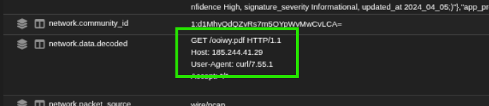
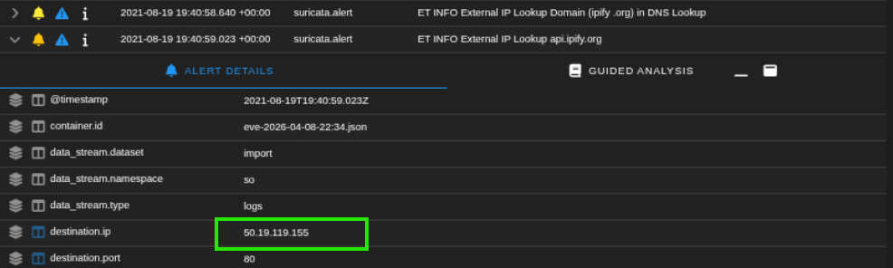
Evidence: Security Onion Alert Correlation
Suricata alerts confirming malicious download and external IP lookup
Fig 6: Security Onion alert detail showing GET /ooiwy.pdf with curl/7.55.1 User-Agent in network.data.decoded field. Confirms the download mechanism was curl, not a browser.
Fig 7: Security Onion alerts for ET INFO External IP Lookup. The infected host queried api.ipify.org at 19:40:58 UTC to identify its public-facing IP address, a common TrickBot reconnaissance behavior.
Finding: The use of curl as a download agent (rather than a web browser) indicates scripted or automated malware retrieval, consistent with a TrickBot loader stage. The immediate external IP lookup via api.ipify.org is a well-documented TrickBot fingerprinting behavior used to profile the victim's network position.
Week 11 PCAP Analysis | TrickBot Trojan | Network Forensics

Slide 11
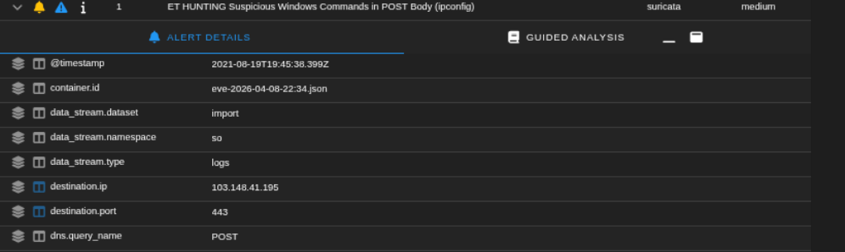
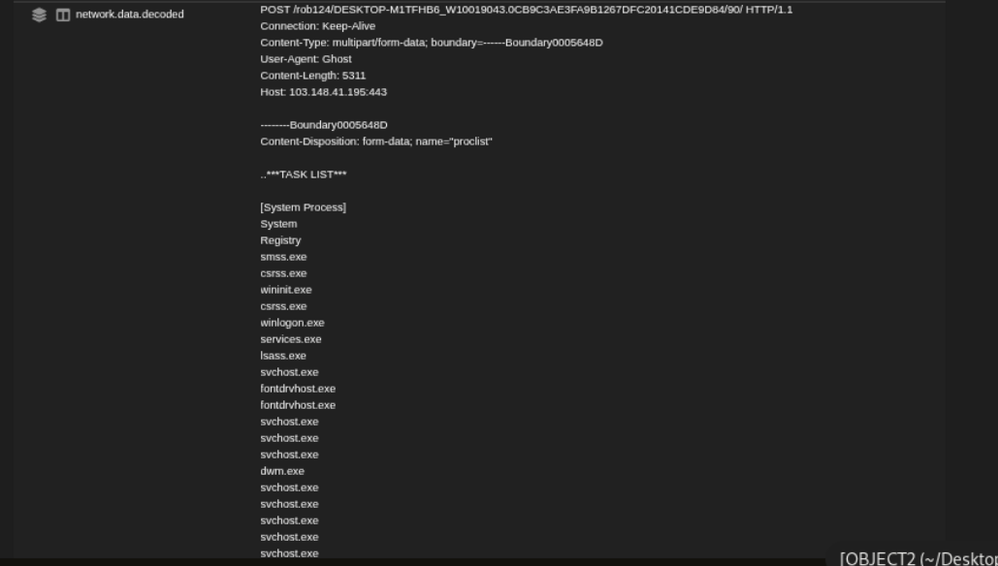
Evidence: Data Exfiltration via HTTP POST
TrickBot exfiltrating system reconnaissance to C2 server 103.148.41.195
Fig 8: Security Onion Suricata alert: ET HUNTING Suspicious Windows Commands in POST Body (ipconfig). Destination: 103.148.41.195:443. Method: POST.
Fig 9: Decoded POST data showing exfiltrated TASK LIST (process listing) sent to /rob124/DESKTOP-M1TFHB6_W10019043... with User-Agent: Ghost and Content-Type: multipart/form-data.
Finding: TrickBot exfiltrated a full process listing via HTTP POST to 103.148.41.195. The URL path contains the victim hostname and a unique identifier. User-Agent: Ghost is a known TrickBot signature. The process list allows attackers to identify security software, running services, and opportunities for privilege escalation.
Week 11 PCAP Analysis | TrickBot Trojan | Network Forensics

Slide 12
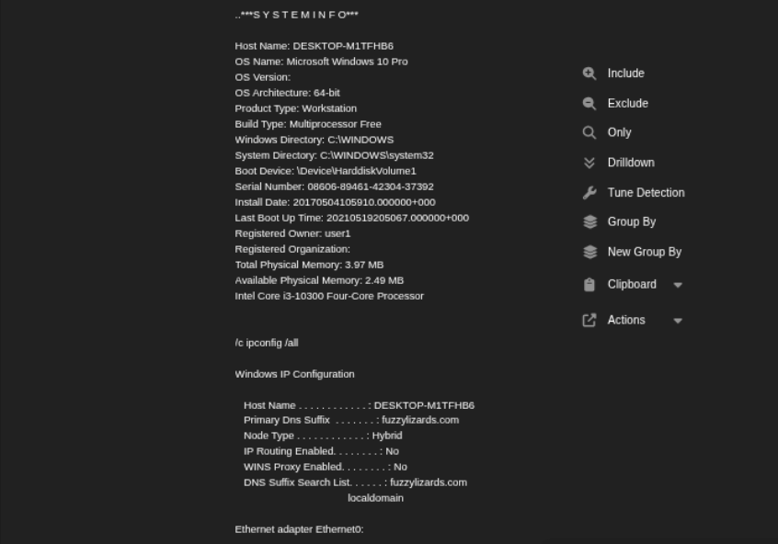
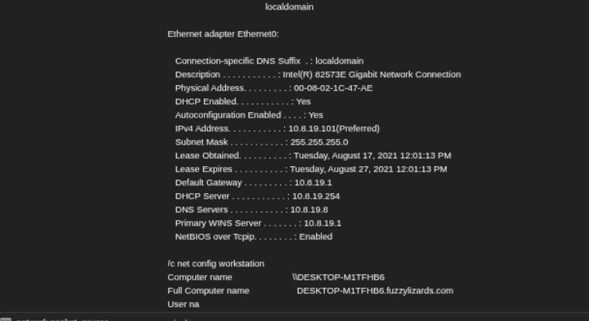
Evidence: System and Network Configuration Exfiltration
SYSTEMINFO, ipconfig /all, and net config workstation data sent to C2
Fig 10: Exfiltrated SYSTEMINFO showing hostname DESKTOP-M1TFHB6, Windows 10 Pro 64-bit, Intel Core i3-10300, user1, and ipconfig /all output with Primary DNS Suffix: fuzzylizards.com.
Fig 11: Continued ipconfig /all output showing Ethernet0 adapter: IP 10.8.19.101, MAC 00-08-02-1C-47-AE, Gateway 10.8.19.1, DNS 10.8.19.8, DHCP 10.8.19.254. Also shows net config workstation output.
Finding: TrickBot exfiltrated comprehensive system/network data: OS version, hardware specs, IP configuration, domain membership, and DNS settings. This provides the attacker with a complete victim profile for lateral movement planning.
Week 11 PCAP Analysis | TrickBot Trojan | Network Forensics

Slide 13
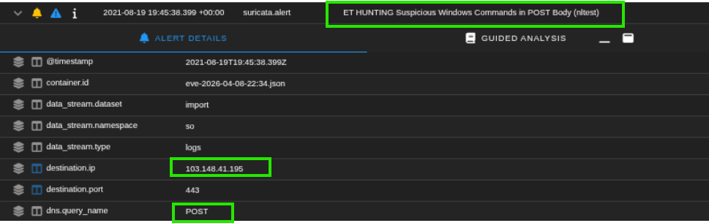
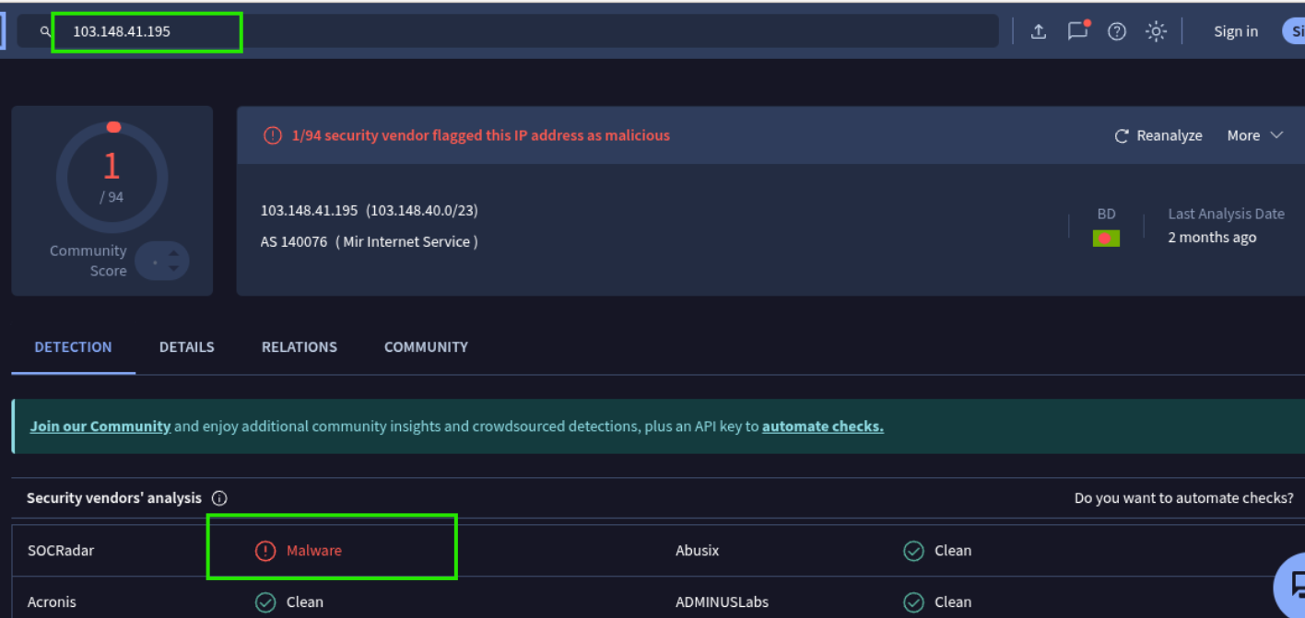
Evidence: Domain Recon and C2 Server Validation
nltest enumeration alert and VirusTotal confirmation of primary C2
Fig 12: Security Onion alert: ET HUNTING Suspicious Windows Commands in POST Body (nltest). Destination: 103.148.41.195:443. nltest is used for Active Directory domain enumeration, indicating lateral movement preparation.
Fig 13: VirusTotal report for 103.148.41.195. 1/94 vendor flagged (SOCRadar: Malware). AS 140076, Mir Internet Service, Bangladesh. This is the primary TrickBot C2 server receiving all exfiltrated data.
Week 11 PCAP Analysis | TrickBot Trojan | Network Forensics

Slide 14
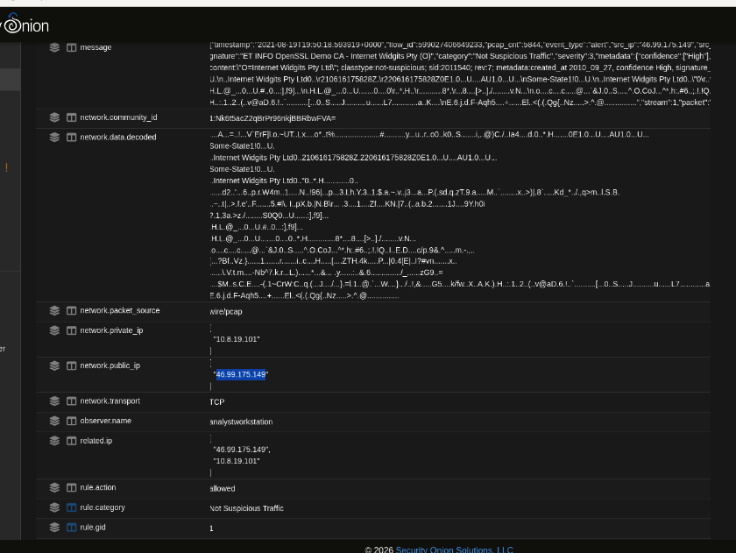
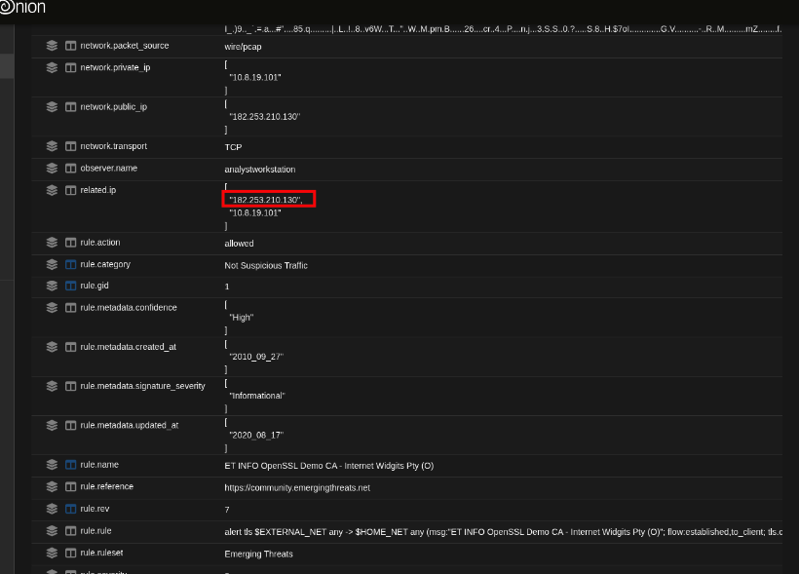
Evidence: Secondary C2 Servers and Self-Signed Certificates
OpenSSL Demo CA alerts and VirusTotal validation of C2 infrastructure
Fig 14: Security Onion detail and VirusTotal for 46.99.175.149. 12/94 VT vendors flagged malicious. SO shows ET INFO OpenSSL Demo CA alert with self-signed certificate, network.public_ip confirms C2 communication.
Fig 15: Security Onion and VirusTotal for 182.253.210.130. 11/94 VT vendors flagged malicious. BizNetNetworks AS 17451. Same OpenSSL Demo CA self-signed certificate pattern confirming TrickBot infrastructure.
Finding: All three C2 servers use identical self-signed "Internet Widgits Pty Ltd" certificates (OpenSSL Demo CA), a well-known TrickBot fingerprint. Repeated beaconing from 19:50 to 20:24+ UTC across all three IPs confirms persistent, redundant C2 infrastructure. Multi-vendor VirusTotal confirmation eliminates false positive possibility.
Week 11 PCAP Analysis | TrickBot Trojan | Network Forensics

Slide 15
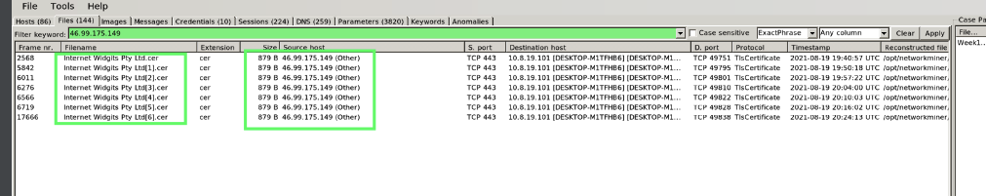
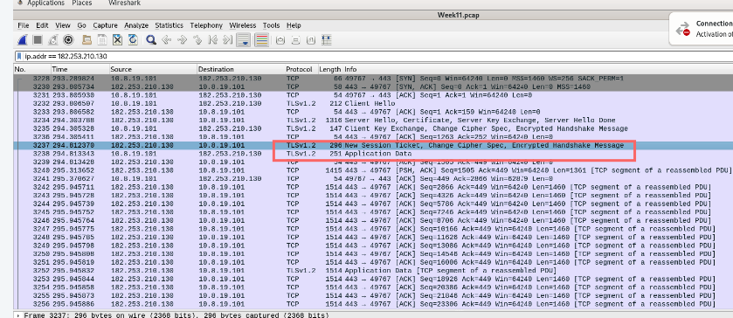
Evidence: Certificate Extraction and TLS C2 Sessions
NetworkMiner certificate analysis and Wireshark TLS session capture
Fig 16: NetworkMiner Files tab showing "Internet Widgits Pty Ltd.cer" certificates extracted from both 46.99.175.149 (7 sessions) and 182.253.210.130 (2 sessions), all TlsCertificate protocol to DESKTOP-M1TFHB6.
Fig 17: Wireshark packet capture showing TLSv1.2 sessions to both C2 servers. New Session Ticket and Application Data exchanges confirm active encrypted C2 communication channels from DESKTOP-M1TFHB6.
Week 11 PCAP Analysis | TrickBot Trojan | Network Forensics

Slide 16
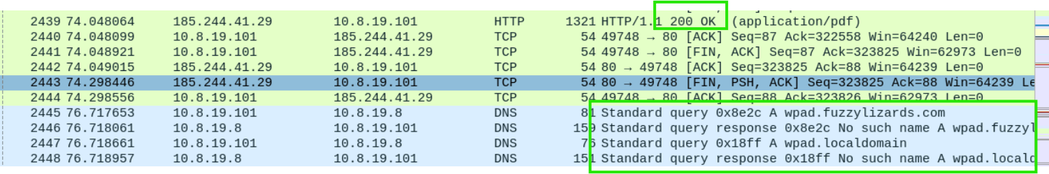
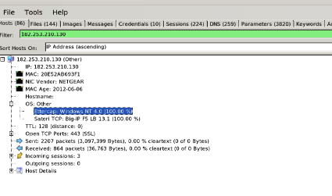
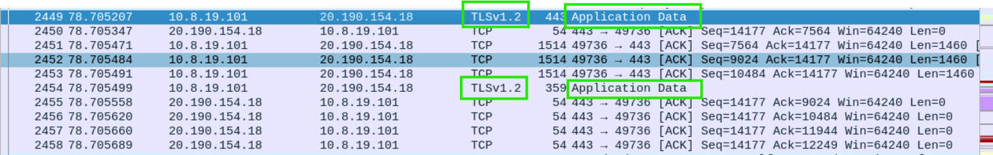
Evidence: DNS Activity and Host Enumeration
WPAD discovery, C2 host fingerprinting via NetworkMiner
Fig 18: Wireshark DNS filter showing WPAD queries (wpad.fuzzylizards.com, wpad.localdomain) immediately after infection, confirming domain awareness and proxy auto-discovery attempts.
Fig 19: NetworkMiner host details for both C2 servers (182.253.210.130 and 46.99.175.149). Both show Ettercap: Windows NT 4.0, Satori TCP: Big-IP F5 LB 13.1, TTL: 128, Open TCP Ports: 443 (SSL). Identical fingerprints confirm coordinated infrastructure.
Week 11 PCAP Analysis | TrickBot Trojan | Network Forensics

Slide 17
Analysis & Interpretation
Attack flow, exfiltrated data, and false positive assessment
Attack Flow Summary
MITRE ATT&CK Techniques
Stage 1 - Delivery (T1566.001):
T1566.001 Spearphishing Attachment
T1059 Command and Scripting Interpreter
T1016 System Network Config Discovery
T1057 Process Discovery
T1041 Exfiltration Over C2 Channel
T1071.001 Web Protocols
T1573 Encrypted Channel
A PE32 DLL disguised as ooiwy.pdf was downloaded from 185.244.41.29 via curl/7.55.1. The use of curl rather than a browser, combined with delivery from a bare IP, indicates automated or script-driven retrieval.
Stage 2 - Reconnaissance (T1016, T1057):
TrickBot queried api.ipify.org for external IP, then exfiltrated tasklist, systeminfo, ipconfig /all, net config workstation, and nltest to 103.148.41.195 via HTTP POST with User-Agent: Ghost.
False Positive Assessment
Stage 3 - C2 Establishment (T1573, T1071):
60/72 VT vendors confirmed the file as malicious. Multiple independent Suricata rules (PE download, ipconfig/nltest in POST body, External IP Lookup, OpenSSL Demo CA) corroborate the same event chain. All three C2 IPs independently flagged by VirusTotal. The combination of disguised file delivery, curl-based download, User-Agent: Ghost, and self-signed certificate infrastructure makes false positive probability extremely low.
Encrypted TLS channels established to three C2 servers using self-signed "Internet Widgits Pty Ltd" certificates: 46.99.175.149, 103.148.41.195, 182.253.210.130.
Stage 4 - Persistence (T1071.001):
Repeated OpenSSL Demo CA TLS beaconing from 19:50 to 20:24+ UTC across all three C2 servers, maintaining redundant communication channels.
Week 11 PCAP Analysis | TrickBot Trojan | Network Forensics

Slide 18
Non-Technical Summary
Plain-language explanation for non-forensic readers
What happened?
A computer on the internal network (DESKTOP-M1TFHB6) was infected with malware called TrickBot after a malicious file disguised as a PDF document was downloaded to the machine.
How did it happen?
The file appeared to be a normal PDF (ooiwy.pdf) but was actually a harmful program. It was downloaded using an automated tool (curl), not through normal web browsing. Once the file ran, it immediately began contacting criminal servers overseas.
What did the malware do?
TrickBot collected detailed information about the infected computer: what programs were running, the computer's name, network settings, and what other computers were on the network. All of this information was sent to servers controlled by the attackers in Bangladesh, Indonesia, and elsewhere.
Was it contained?
Yes. No other computers on the internal network were affected. The infection was isolated to a single machine. However, the system data already exfiltrated could enable the attacker to plan further attacks against the network.
Week 11 PCAP Analysis | TrickBot Trojan | Network Forensics

Slide 19
Conclusions
Key findings proven through forensic analysis
✓
DESKTOP-M1TFHB6 (10.8.19.101) was infected with TrickBot trojan on 2021-08-19 via a disguised executable (ooiwy.pdf), confirmed by Suricata, Wireshark, NetworkMiner, and VirusTotal (60/72 detections).
✓
The infection vector was a PE32 DLL delivered as a fake PDF file from 185.244.41.29 via curl/7.55.1, indicating automated or scripted delivery rather than user-initiated browsing.
✓
TrickBot exfiltrated comprehensive system reconnaissance data (tasklist, systeminfo, ipconfig /all, net config workstation, nltest) to primary C2 server 103.148.41.195 via HTTP POST with User-Agent: Ghost.
✓
Three C2 servers were identified: 103.148.41.195 (BD), 46.99.175.149 (12/94 VT), and 182.253.210.130 (11/94 VT). All used identical self-signed "Internet Widgits Pty Ltd" certificates.
✓
External IP reconnaissance via api.ipify.org and domain enumeration via nltest indicate the attacker was profiling the network for potential lateral movement.
✓
No lateral movement detected. Infection contained to a single machine on the 10.8.19.0/24 network. False positive probability: extremely low, with multiple independent signatures and VirusTotal corroboration.
Week 11 PCAP Analysis | TrickBot Trojan | Network Forensics

Slide 20
Recommendations
Remediation steps tied to specific findings
1
Isolate & Reimage DESKTOP-M1TFHB6
4
Block Suspicious User-Agents
Finding: TrickBot confirmed. Immediately isolate 10.8.19.101 from the network. Wipe and reimage. System reconnaissance data was already exfiltrated, so assume credentials and network topology are compromised.
Finding: curl and Ghost user agents used. Web proxy rules should flag or block curl, Ghost, and other non-standard user agents initiating outbound HTTP/HTTPS connections from workstations.
2
Block Malicious IPs & Monitor
5
Restrict External IP Lookup Services
Finding: Multiple C2 servers identified. Block 185.244.41.29, 103.148.41.195, 46.99.175.149, and 182.253.210.130 at the perimeter firewall. Monitor for any connection attempts from other hosts.
Finding: api.ipify.org used for recon. Block or alert on connections to known external IP lookup services (ipify, ifconfig.me, ipecho.net) from internal workstations.
3
Alert on Self-Signed Certificate Patterns
6
Conduct Enterprise-Wide IOC Sweep
Finding: All C2 used "Internet Widgits Pty Ltd" certs. Implement TLS inspection or JA3 fingerprinting to detect connections using default/self-signed OpenSSL certificates.
Finding: TrickBot may have spread via other vectors. Search all endpoints for the extracted file hash, C2 IP connections, and Ghost user agent in proxy logs.
Week 11 PCAP Analysis | TrickBot Trojan | Network Forensics

Slide 21
References
Tools, documentation, and authoritative sources
Emerging Threats Ruleset (2025). ET INFO PE EXE or DLL Windows file download HTTP; ET HUNTING Suspicious Windows Commands in POST Body (ipconfig, nltest); ET INFO External IP Lookup Domain; ET INFO OpenSSL Demo CA, Internet Widgits Pty (O) -- Suricata IDS signatures.
VirusTotal (2025). IP analysis reports for: 185.244.41.29, 103.148.41.195, 46.99.175.149, 182.253.210.130. File hash analysis for SHA256: f25a780095730701efac67e9d5b84bc289afea56d96d8aff8a44af69ae606404.
MITRE ATT&CK Framework (2025). T1566.001: Spearphishing Attachment; T1059: Command and Scripting Interpreter; T1016: System Network Configuration Discovery; T1057: Process Discovery; T1041: Exfiltration Over C2 Channel; T1071.001: Web Protocols; T1573: Encrypted Channel.
Wireshark Foundation (2025). Wireshark Display Filter Reference and HTTP Object Export documentation. Available at: wireshark.org
Security Onion Solutions (2025). Security Onion 2.4 documentation: Alerts, Hunt, and PCAP analysis modules. Available at: securityonionsolutions.com
Netresec (2025). NetworkMiner: Network Forensic Analysis Tool, host enumeration, file extraction, and certificate analysis. Available at: netresec.com
Malpedia / MITRE. TrickBot: Banking Trojan and modular malware platform. Known indicators: User-Agent Ghost, Internet Widgits Pty Ltd certificates, /rob/ URI patterns for C2 check-ins.
Week 11 PCAP Analysis | TrickBot Trojan | Network Forensics

