Slide 1
Week 11
Jobayer & Ari

Slide 2
Network Topography
JB

Slide 3
Timeline of attack
Time (UTC) | Stage | Source IP | Destination IP | Event Description | Significance
2021-06-19 19:40:36 | Initial Access | 10.8.19.101 | 185.244.41.29:80 | HTTP request to dotted-quad IP (PDF lure) | Suspicious IP-based delivery (no domain)
2021-06-19 19:40:36 | Payload Delivery | 10.8.19.101 | 185.244.41.29:80 | PE EXE/DLL downloaded over HTTP | Malicious file successfully retrieved
2021-06-19 19:40:57 | TLS Communication | 10.8.19.101 | 46.99.175.149:443 | Encrypted session established | Possible staging or callback traffic
2021-06-19 19:40:58 | Recon Prep | 10.8.19.101 | api.ipify.org | External IP lookup | Host identifying public-facing IP

Slide 4
Timeline Cntd.
Time (UTC) | Stage | Source IP | Destination IP | Event Description | Significance
2021-06-19 19:44:17 | C2 Beaconing | 10.8.19.101 | 103.148.41.195:443 | HTTPS communication begins | Establishes TrickBot C2 channel
2021-06-19 19:45:38 | Data Exfiltration | 10.8.19.101 | External (POST) | Suspicious POST with process names | System/process data being exfiltrated
2021-06-19 19:45:38 | Host Recon | 10.8.19.101 | External (POST) | Commands: ipconfig, netstat, net view | Internal network enumeration
2021-06-19 19:45:39 | Malware Activity | 10.8.19.101 | External | TrickBot data exfiltration detected | Confirmed malware behavior
2021-06-19 19:45:43 | C2 Response | 103.148.41.195 | 10.8.19.101 | TrickBot check-in response | Active bidirectional C2 control
2021-06-19 20:01+ | Persistence / Beaconing | 10.8.19.101 | 46.99.175.149:443 | Repeated encrypted traffic | Ongoing communication with infrastructure

Slide 5
Questions to answer:
Initial Injection:
Downloaded pdf file but was .exe
File type:
Pdf/.exe
Where from/to which workstation:
185.244.41.29 to 10.8.19.101 [DESKTOP-M1]
Proof of Recon:
Exfiltration? (maybe encoded)
Name of malware:

Slide 6
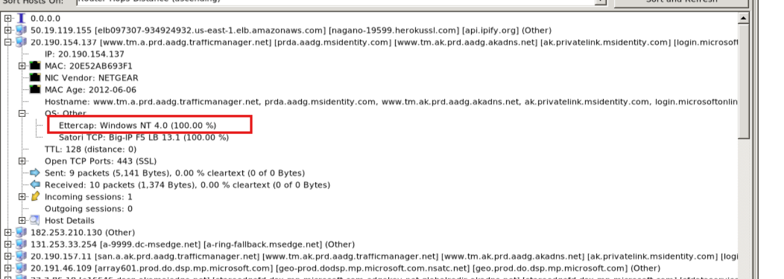

Slide 7
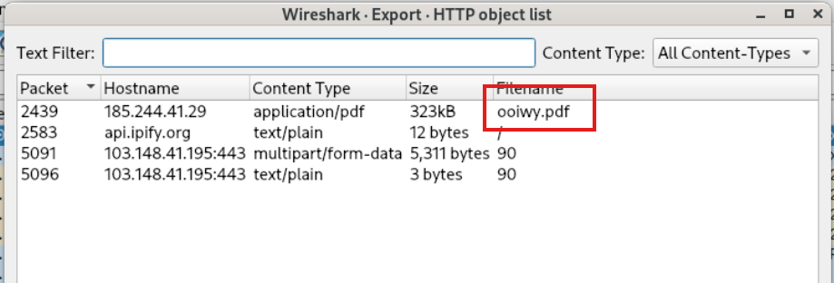

Slide 8
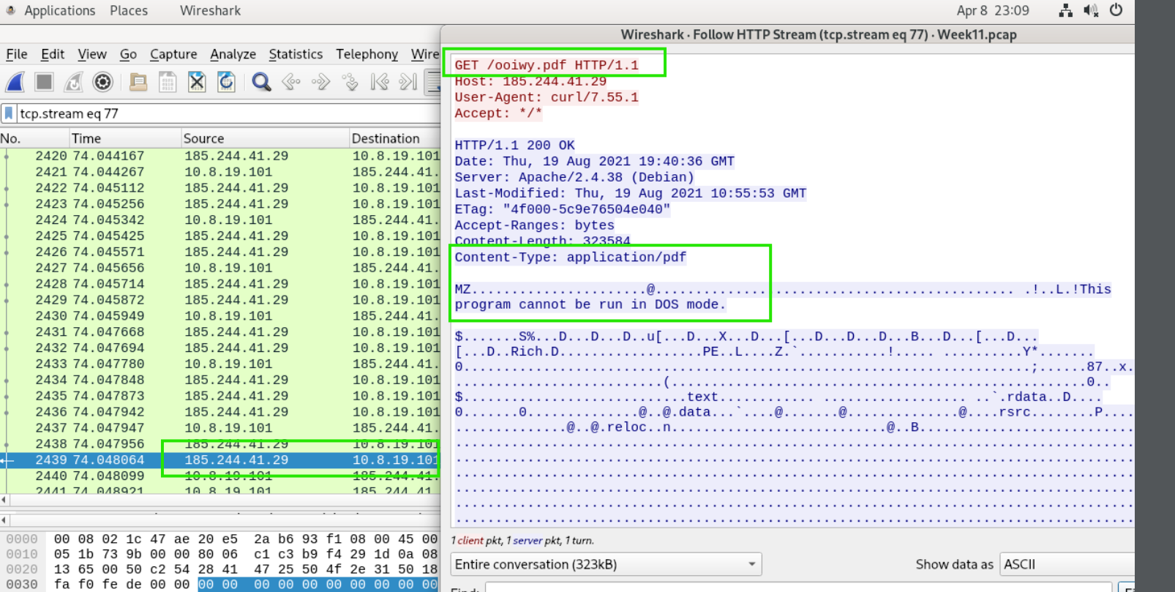

Slide 9
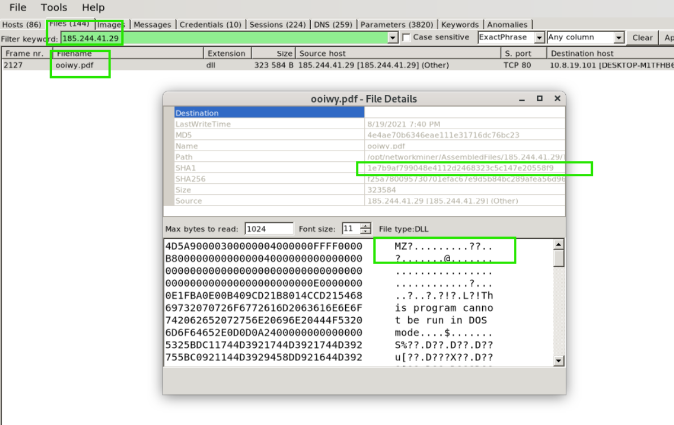

Slide 10
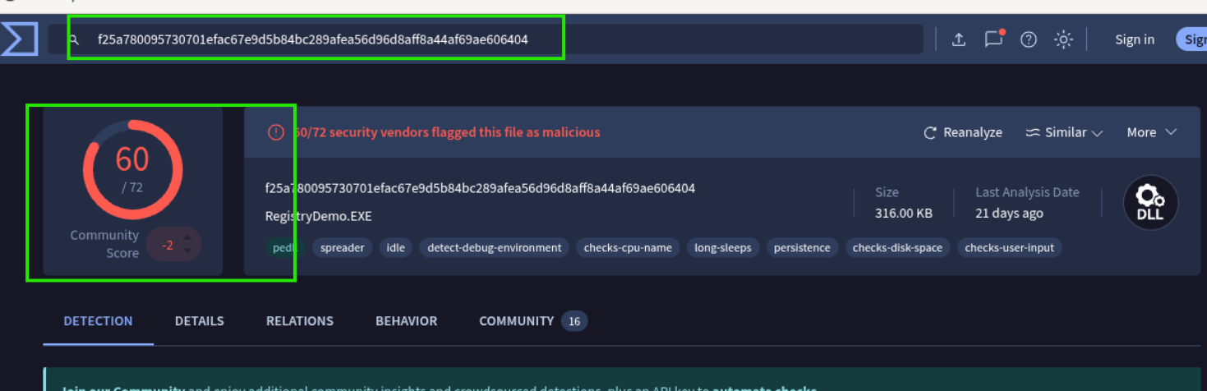
Ip not malicious but file hash for ooiwv.pdf is flagged as trogan

Slide 11
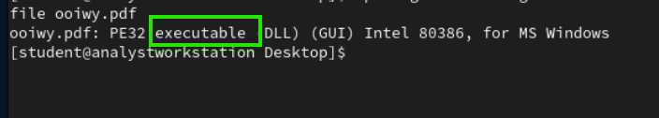
File type: .exe

Slide 12
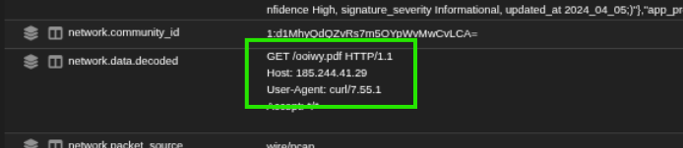
Pdf imported via curl?

Slide 13
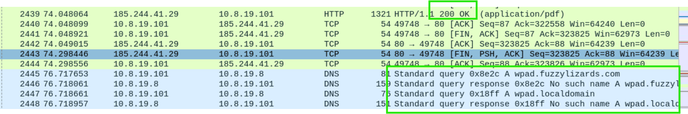
2. DNS Activity (Environment Awareness / Setup)
10.8.19.101 → 10.8.19.8 : DNS query wpad.fuzzylizards.com
→ Response: No such name
→ Query: wpad.localdomain

Slide 14
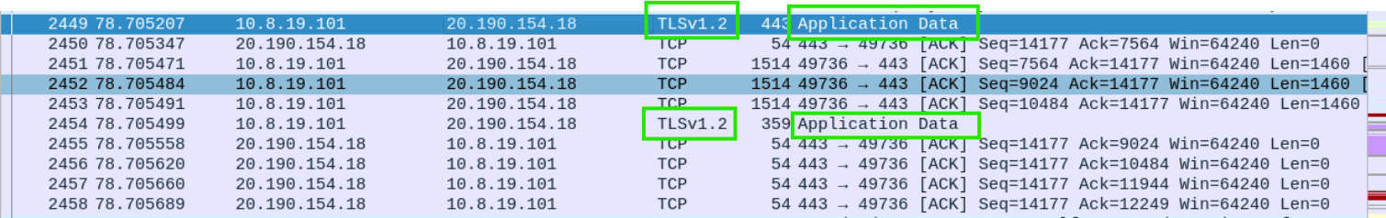
Immediate Outbound Encrypted Traffic (C2 Initiation)
10.8.19.101 ↔ 20.190.154.18 : TLSv1.2 (port 443)
Multiple Application Data packets
👉 This is critical:
The infected host quickly establishes encrypted outbound communication
This IP (Microsoft-owned range) may be:
Legitimate traffic blending (living off the land)
OR staging / proxying behavior

Slide 15
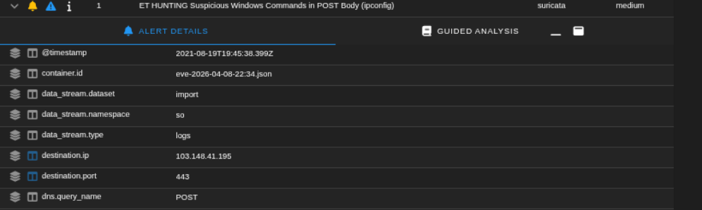
Evidence of data exfiltration

Slide 16
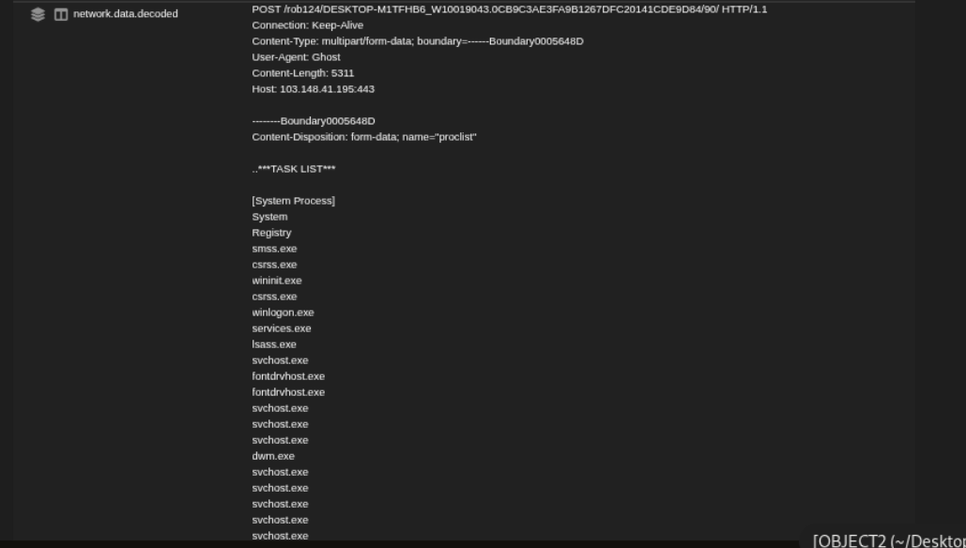

Slide 17
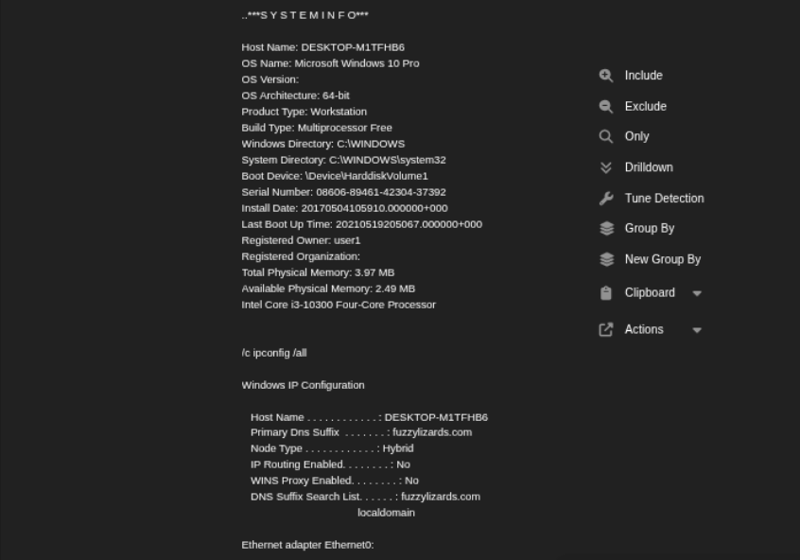

Slide 18
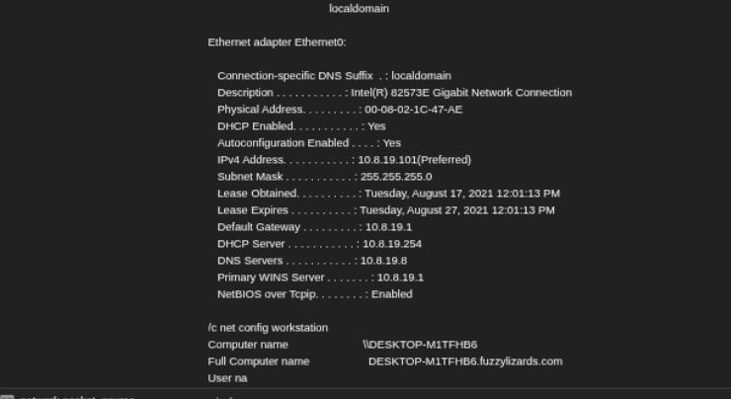

Slide 19
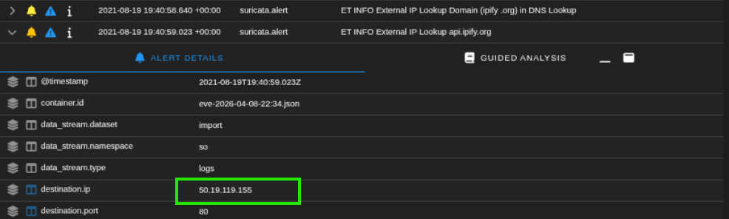
External Ip address from the infectd workstation

Slide 20
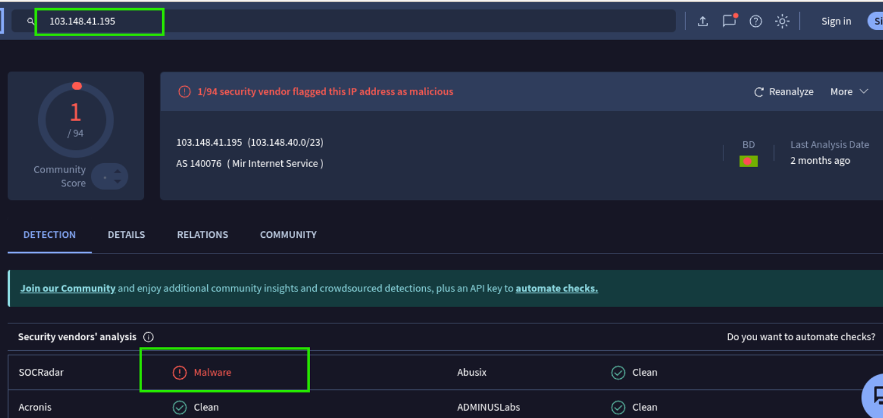

Slide 21
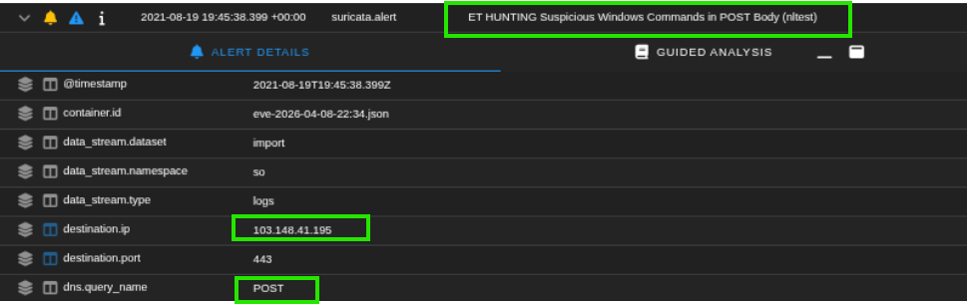

Slide 22
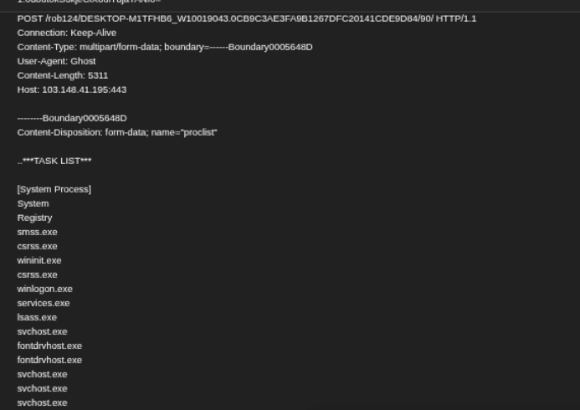

Slide 23
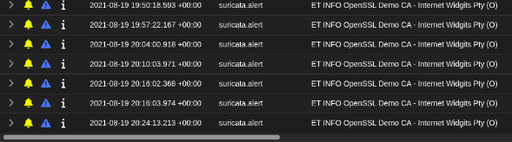
JB

Slide 24
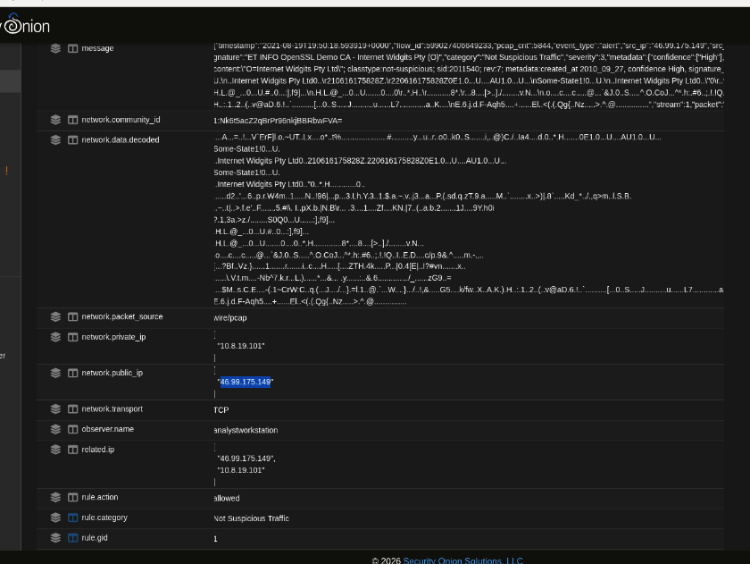
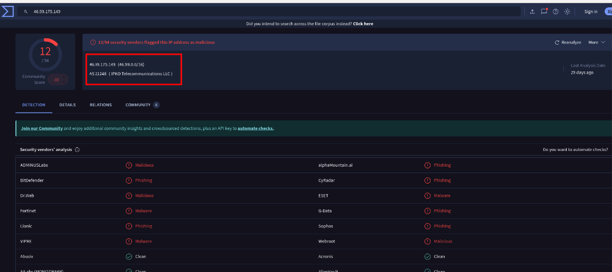
JB

Slide 25
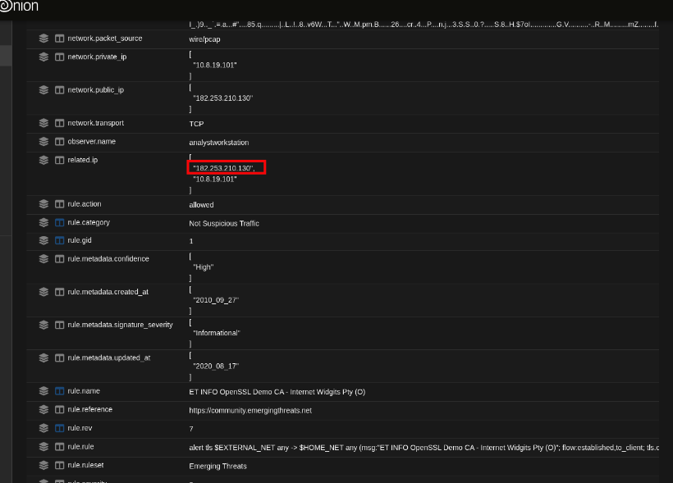
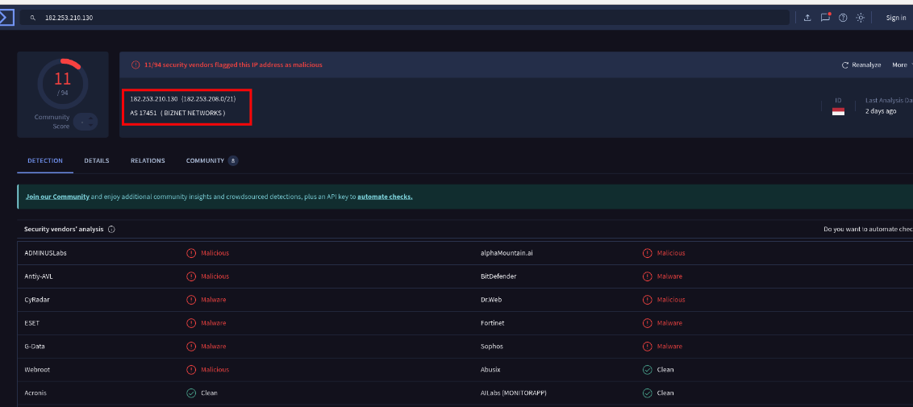
JB

Slide 26
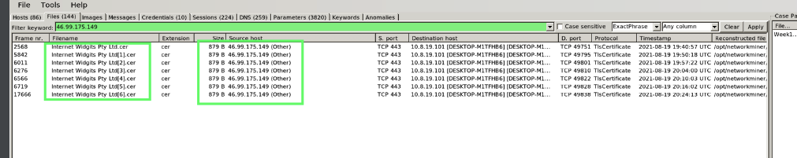
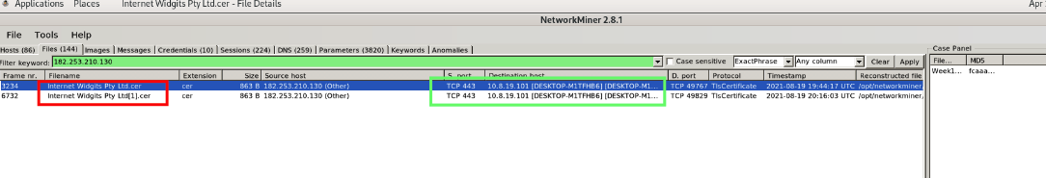
JB

Slide 27
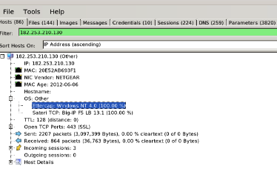
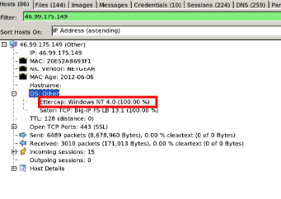
JB

Slide 28
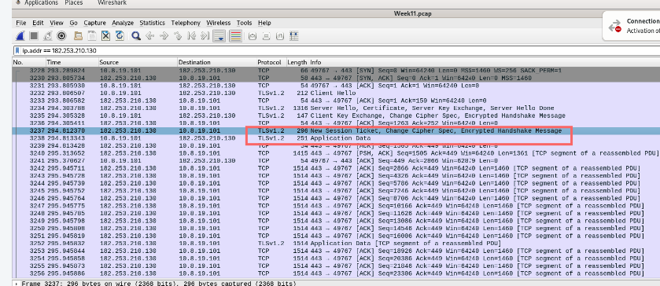
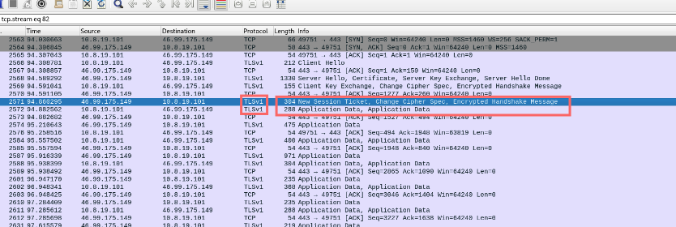
JB

