Slide 1
Week 9 Team: Jobayer & Ari
Assignment: Team PCAP Analysis 1

Slide 2
Abstract
This report analyzes malicious network activity captured in a PCAP file.
The investigation identified a drive-by compromise that led to ransomware-related activity.
Analysis of DNS traffic, HTTP requests, and external communications revealed suspicious domains, exploit kit behavior, and malware delivery.
The findings help explain how the victim host was infected and how it communicated with attacker-controlled infrastructure.

Slide 3
Introduction
Background: The case involves suspicious network traffic captured in a PCAP during a malware infection investigation.
Objective: Determine how the infection occurred, what systems were involved, and what indicators of compromise were present.
Scope: Focus on the internal host, gateway, malicious domains, exploit kit activity, payload delivery, and follow-up communications.
Tools Used: Wireshark, NetworkMiner, Security Onion, and VirusTotal.

Slide 4
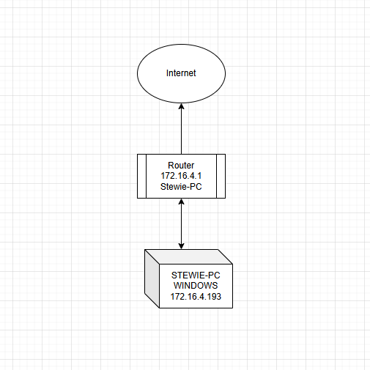
The Network
The network shown in NetworkMiner is a small SOHO (Small Office/Home Office) network using the private subnet 172.16.4.0/24. A Cisco device at 172.16.4.1 serves as the default gateway and likely performs NAT, while a single Windows host (172.16.4.193, Stewie-PC) generates outbound traffic to external services such as Akamai and Bing. The topology is a simple flat network in a star configuration with no evidence of segmentation.

Slide 5
Methodology
• NetworkMiner Review
Imported the PCAP into NetworkMiner and identified the main hosts, IP addresses, and observed connections. Used host details, DNS data, and sessions to build an initial picture of the network structure.
• Topology Identification
Reviewed the discovered devices and their communication patterns to determine how the network is organized. Identified a small SOHO-style network with one router acting as the gateway and one Windows endpoint generating traffic.
• IP and Gateway Analysis
Examined the private subnet addressing scheme to determine the likely default gateway and endpoint roles. Confirmed that 172.16.4.1 appears to function as the router, while 172.16.4.193 is the active host on the internal network.
• Traffic Behavior Review
Analyzed outbound connections from the Windows host to external services on the internet. Observed normal client-to-internet communication patterns, suggesting a simple flat network with no visible internal segmentation.
• Diagram Construction
Created a visual map of the network based on the evidence recovered from NetworkMiner. Represented the internet, router, and Windows host in a clear layout to summarize the topology and communication flow

Slide 6
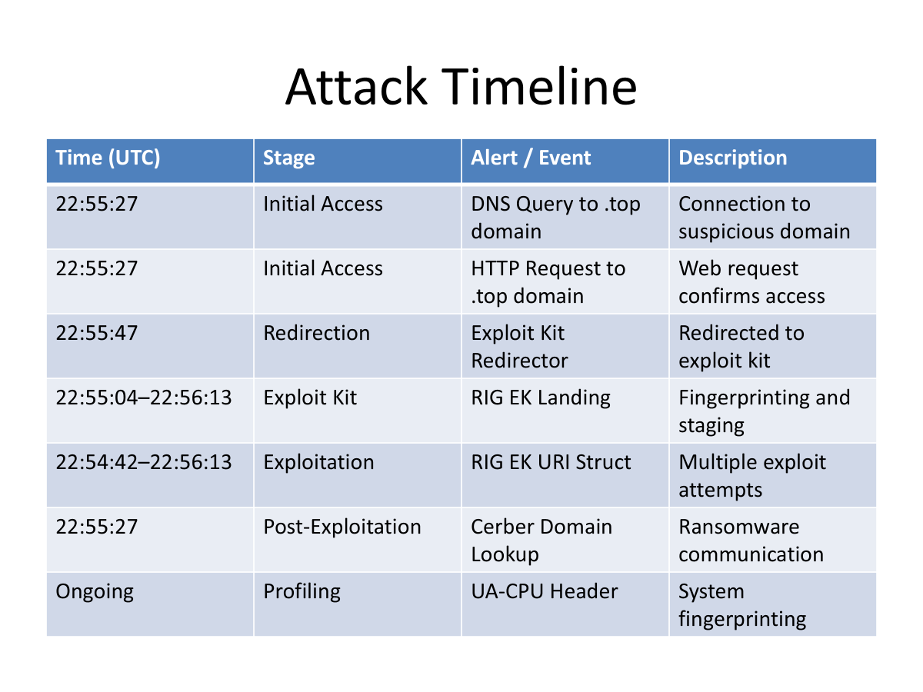

Slide 7
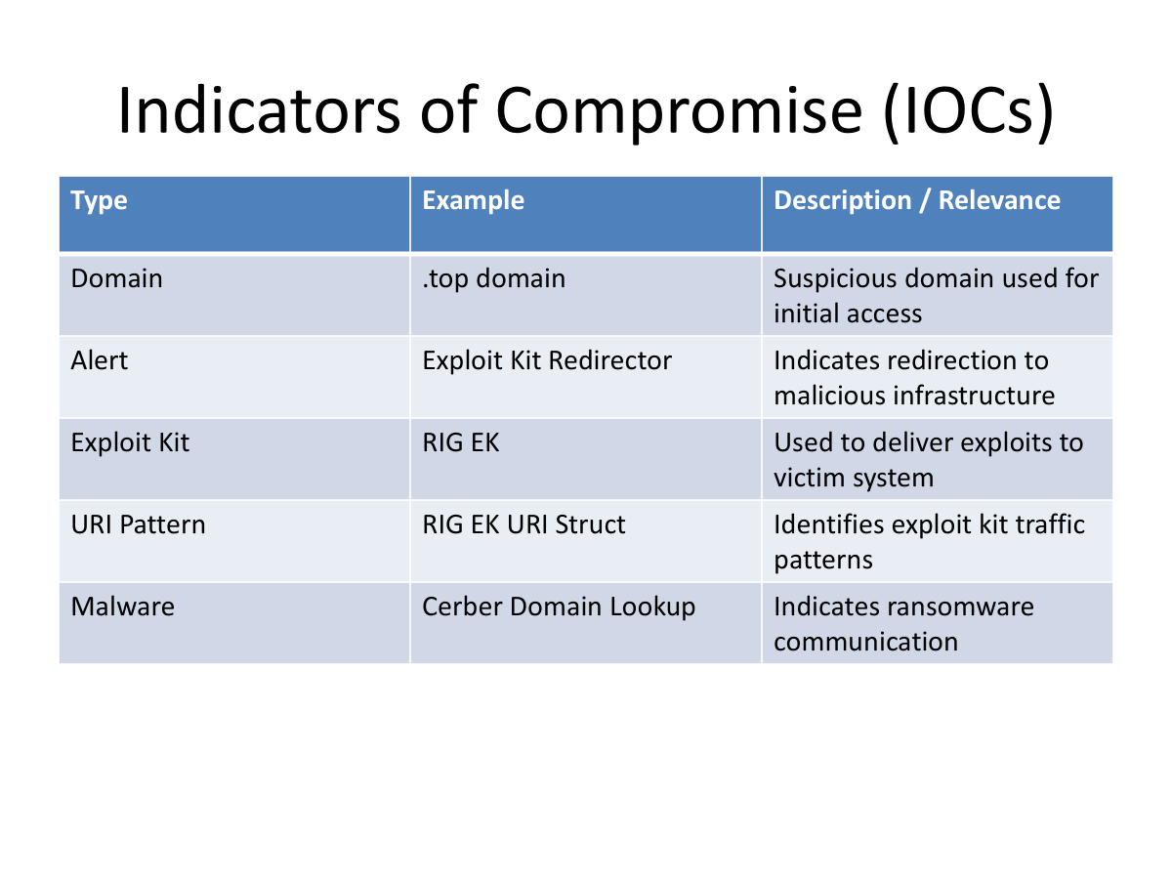

Slide 8
Analysis: Drive-By Attack to Ransomware Sequence
Step | Stage | Domain / Indicator | Activity | Purpose / Outcome
1 | Initial Access | homeimprovement.com | User visits site | Entry point (benign/malvertising)
2 | Redirection | tyu.benme.com | Silent redirect | Attacker-controlled redirect
3 | Exploit Kit Landing | spotsbill.com | Landing page loads | System fingerprinting (EK staging)
4 | Infrastructure | api.blockcypher.com | Background requests | Blends with legit traffic
5 | Exploit Delivery | p27d0khpz2n7nvgr.1jw2lx.top | Multiple requests | RIG exploit kit delivery
6 | Exploitation | RIG EK URI Struct | Exploit triggered | Vulnerability exploited
7 | Payload Assist | fpdownload2.macromedia.com | Flash interaction | Exploit support
8 | Payload Download | tyu.benme.com | Executable delivered | Malware downloaded
9 | C2 Communication | p27d0khpz2n7nvgr.1jw2lx.top | Beaconing activity | Attacker communication
10 | Impact | Cerber Indicators | Ransomware runs | System encrypted

Slide 9
Analysis, continued
The analysis shows that the attack followed a structured drive-by infection chain targeting the host 172.16.4.193, which initially accessed homeimprovement.com and was silently redirected to the malicious domain tyu.benme.com. From there, the system was routed to spotsbill.com, serving as an exploit kit landing page where the RIG exploit kit performed system fingerprinting and delivered exploit code. Subsequent communication with a randomized .top domain (p27d0khpz2n7nvgr.1jw2lx.top), resolving to the malicious IP 194.87.234.129, confirmed the delivery and command-and-control infrastructure. Wireshark analysis verified the download of a malicious executable (application/x-msdownload), after which the host exhibited a surge in DNS activity and established persistent outbound connections, including HTTP POST beaconing and encrypted TLS traffic. These behaviors, along with correlated Security Onion alerts indicating exploit kit activity and Cerber ransomware indicators, confirm that the system was successfully exploited, infected, and brought under attacker control, ultimately resulting in ransomware deployment.

Slide 10
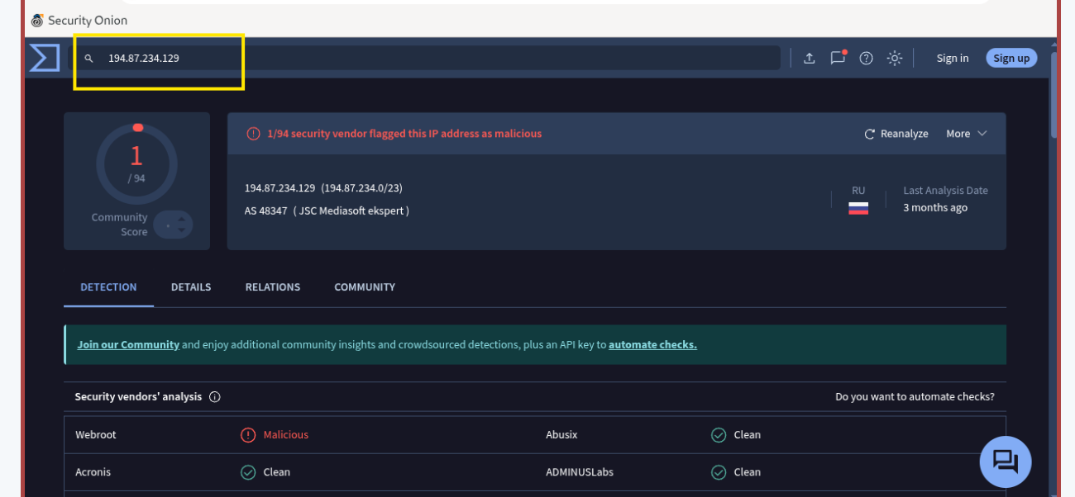

Slide 11
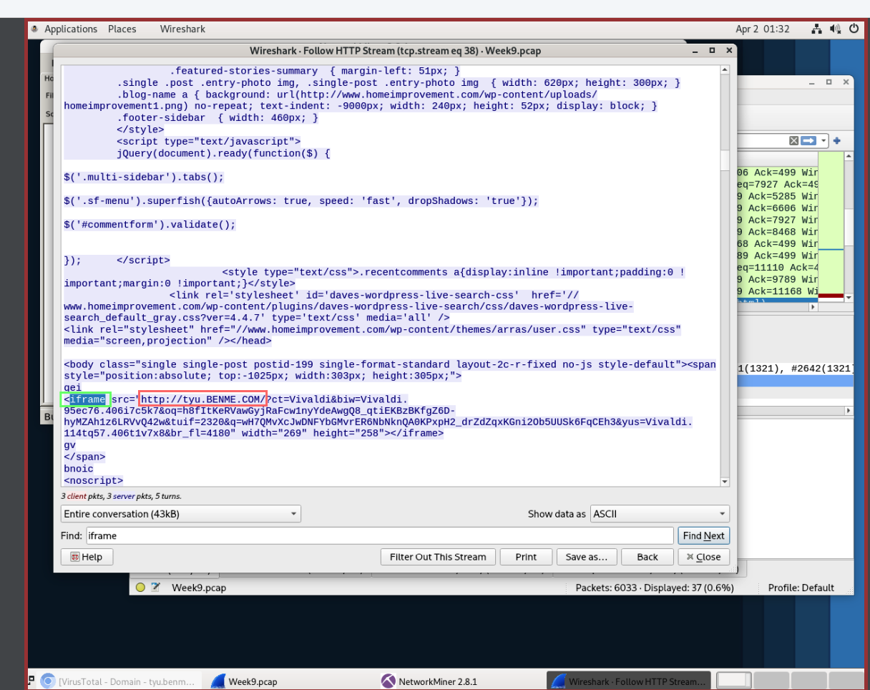
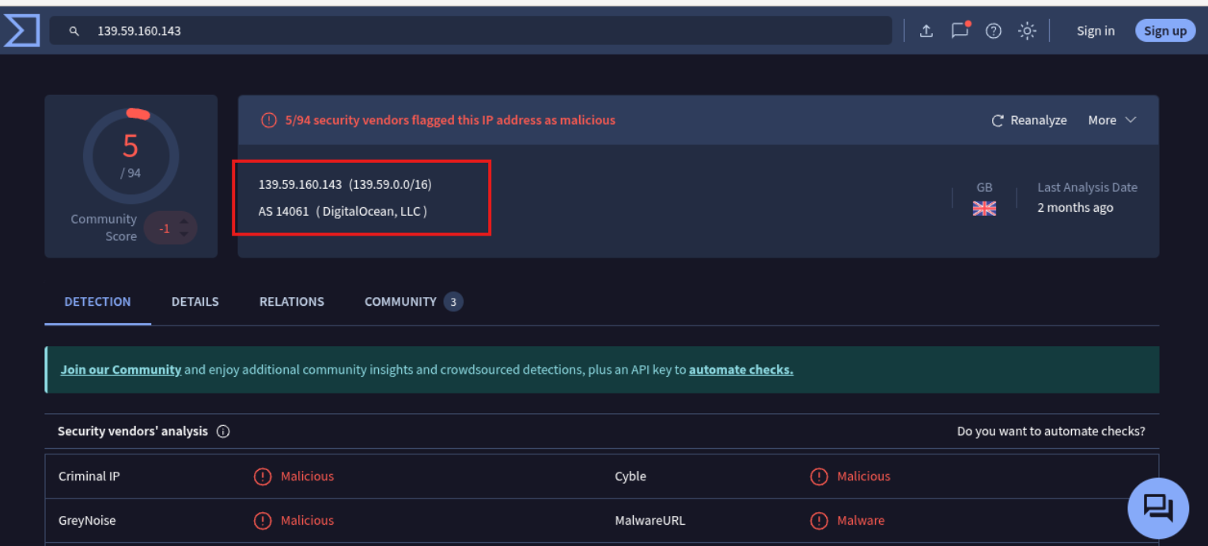
Evidence

Slide 12
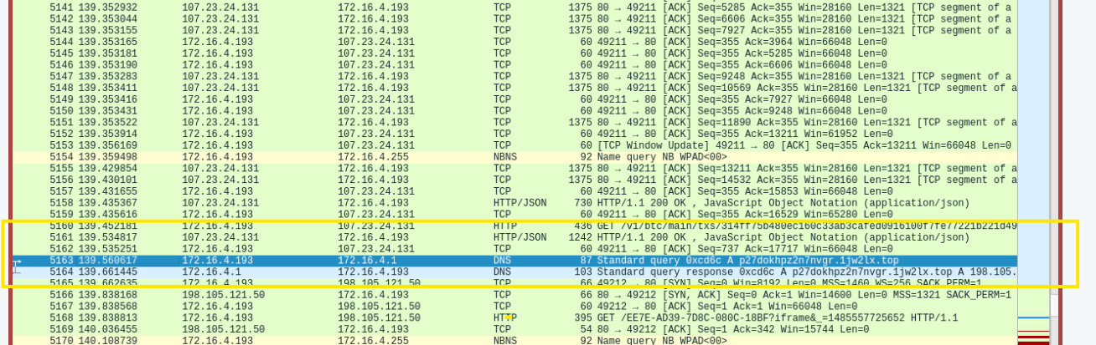

Slide 13
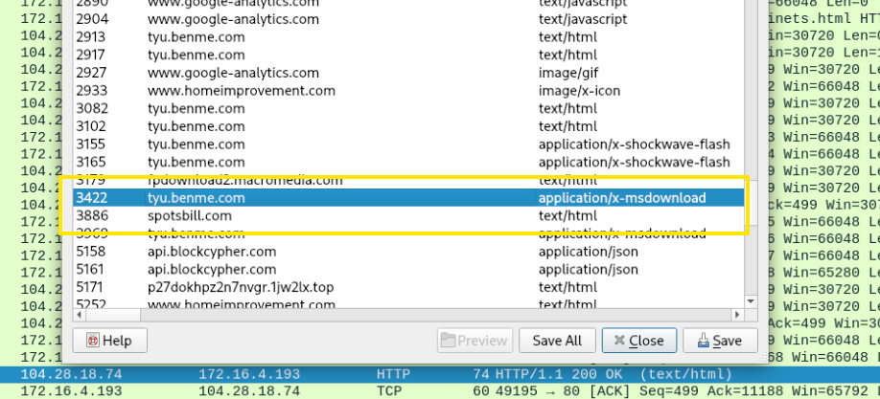
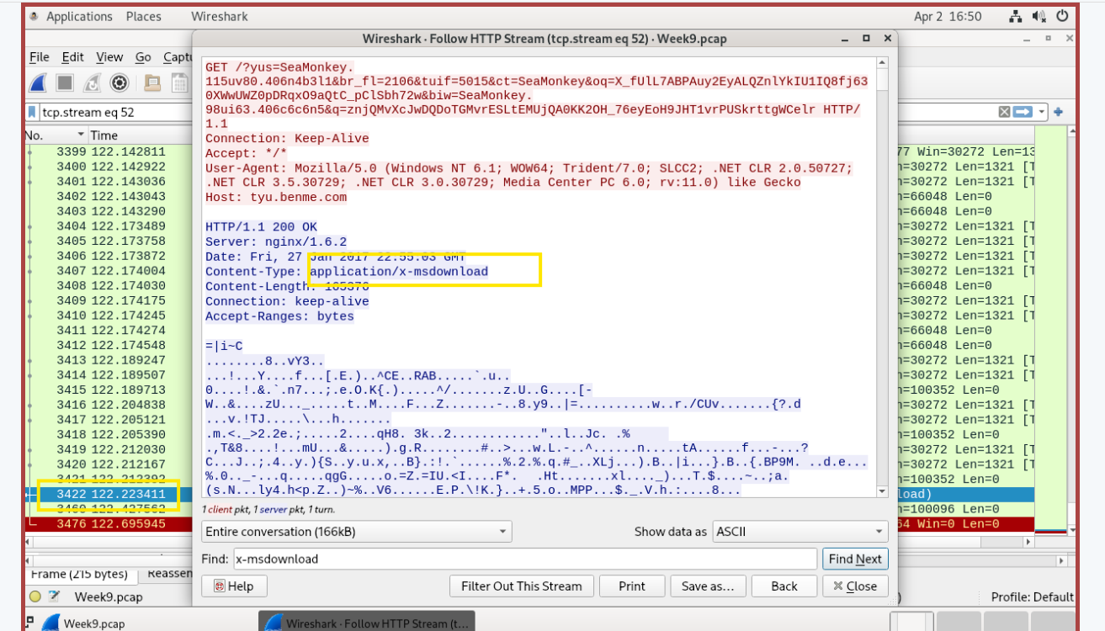

Slide 14
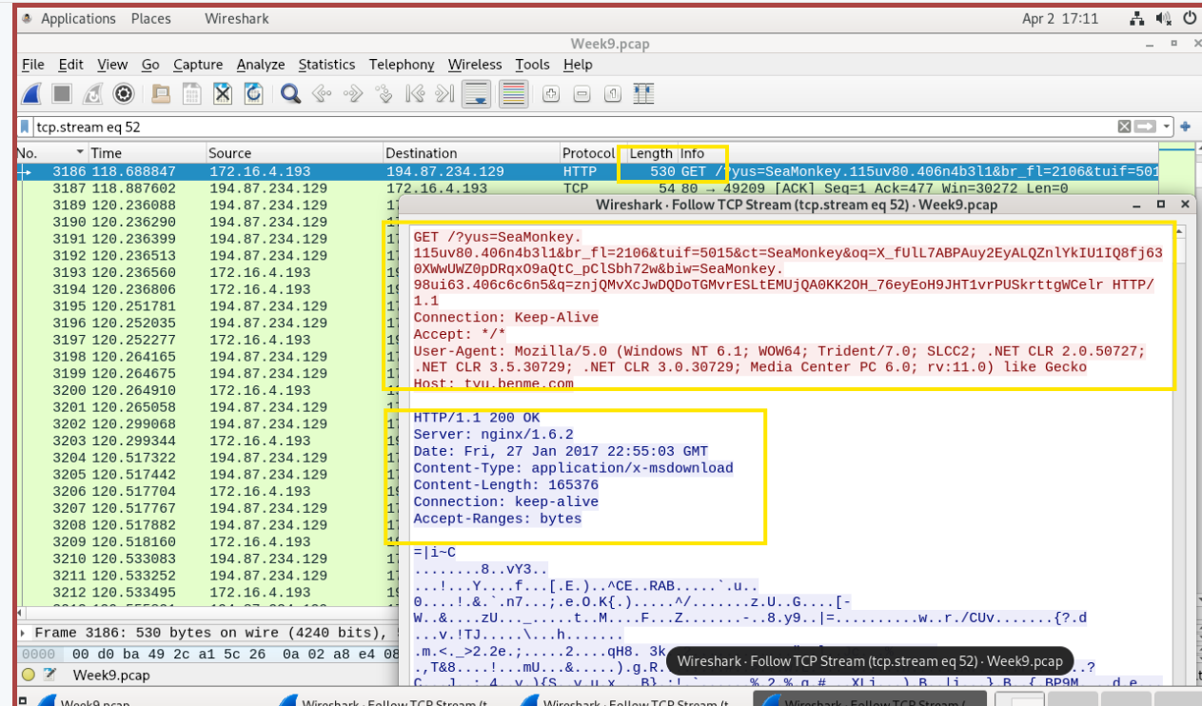
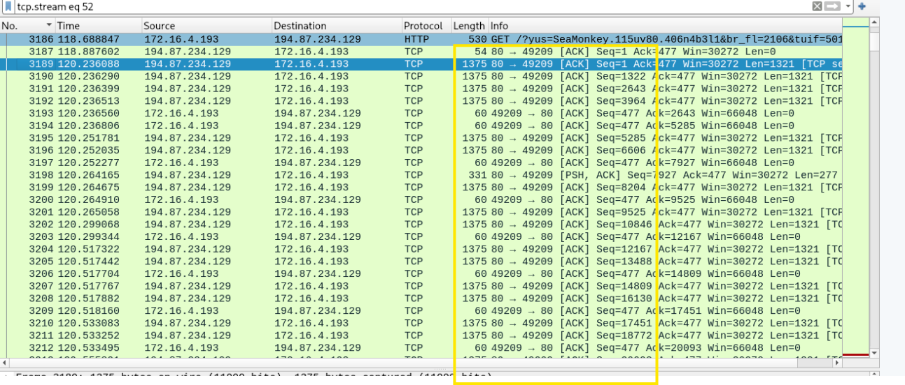

Slide 15
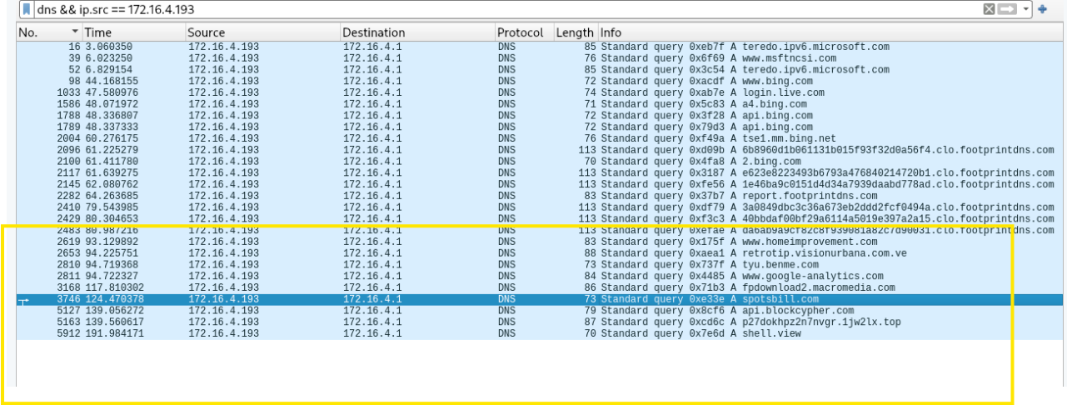

Slide 16
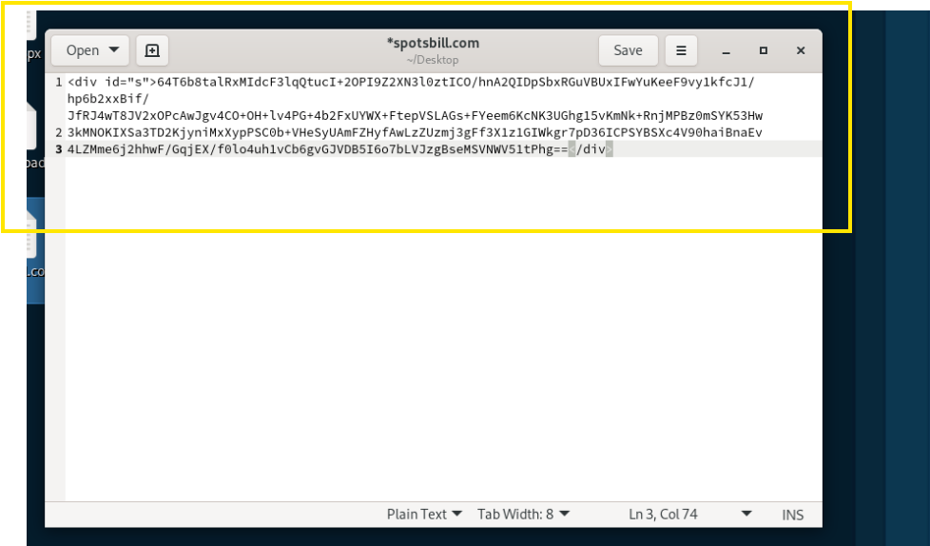
🧠 What This Actually Is
This is NOT normal website content.
🚨 Indicators:
Long encoded blob
No readable HTML structure
No images, scripts, or UI elements
Wrapped in a simple <div>
👉 This is machine-to-machine communication, not user content.
🔬 What Type of Data Is This?
This strongly resembles:
✅ Base64-encoded payload or data
Characteristics:
A–Z, a–z, 0–9, +, /
Long continuous string
No spacing or formatting
👉 Very typical of:
Malware staging
Encrypted/encoded C2 responses
Payload delivery
🎯 So What Is spotsbill.com in the Attack?
💥 Most Likely Role: Staging Server / Payload Host
Not primary C2.
Why:
It returns encoded data, not commands
Looks like:
Payload chunk
Configuration data
Secondary stage
👉 This suggests:
Malware is retrieving additional data after execution

Slide 17
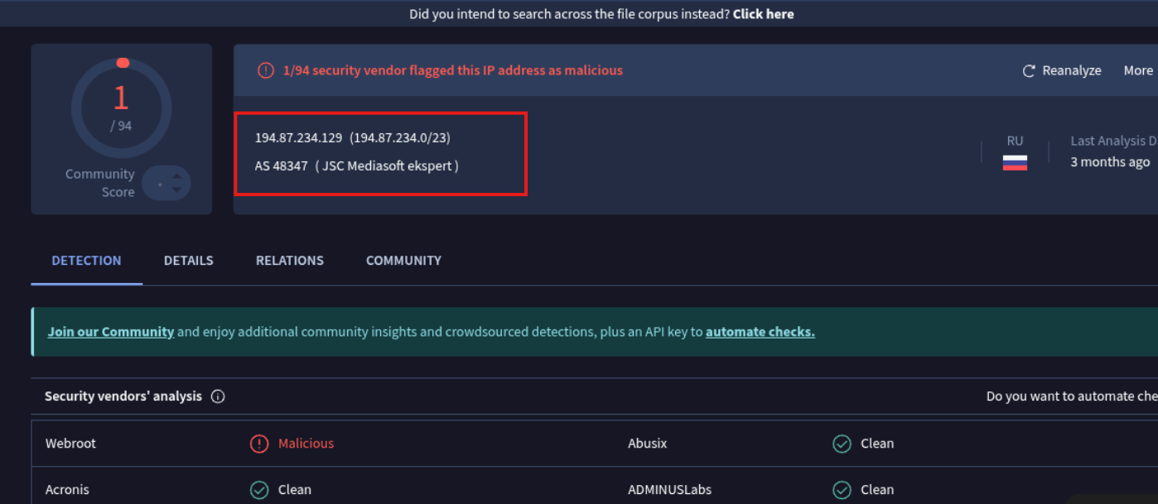
Evidence

Slide 18
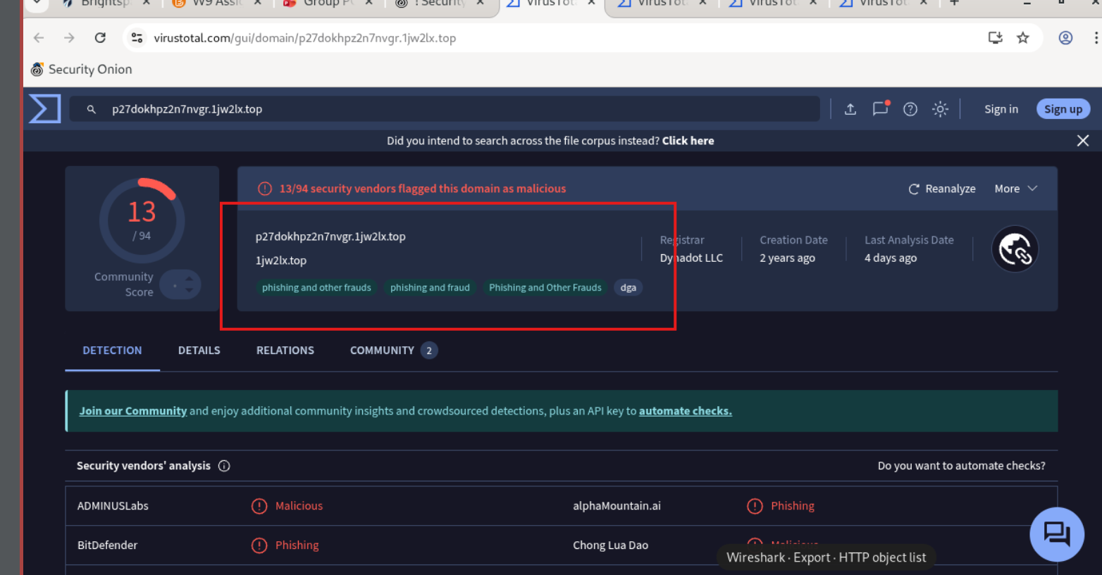

Slide 19
