Slide 1
WEEK 9 INVESTIGATION
Cerber Ransomware Infection via RIG Exploit Kit
Team Members: Jobayer & Ari
Date: 04/03/2026 | Course: Network Forensics
Assignment: Team PCAP Analysis — Week 9

Slide 2
Abstract
Investigation overview and key findings
This investigation analyzed a PCAP file captured on 2017-01-27 containing network traffic from host 172.16.4.193 (STEWIE-PC), a Windows 7 machine on the 172.16.4.0/24 network.
STEWIE-PC was infected with Cerber ransomware following a drive-by download attack. The infection chain began at a compromised WordPress site (www.homeimprovement.com), proceeded through an evil redirector (retrotip.visionurbana.com.ve), and delivered the RIG exploit kit via C2 server tyu.benme.com (194.87.234.129).
Flash exploits and Windows executables were dropped. The ransomware loaded a payment portal and displayed a Bitcoin ransom demand. The full attack chain was captured in under 7 minutes across 6,033 packets.
Key tools used: Security Onion (Suricata IDS), Wireshark, NetworkMiner, and VirusTotal. All IOCs were validated; false positive probability is extremely low.
6,033
7 min
6
High
Total Packets
Attack Duration
Attack Stages
Alert Confidence
Week 9 PCAP Analysis | Cerber Ransomware / RIG Exploit Kit | Network Forensics

Slide 3
Introduction
Background, objective, scope, and toolset
Background & Objective
Tools Used
A PCAP file from 2017-01-27 was analyzed to investigate a reported malware infection on an internal Windows host.
Security Onion (Suricata IDS)
Alert dashboard — grouped alerts by source IP and signature severity
Wireshark / PCAP Analysis
Objective: Identify the malware type, trace the full attack chain from initial access to ransomware deployment, extract all IOCs, and evaluate IDS alert accuracy.
Packet-level inspection; HTTP stream reconstruction; export objects
NetworkMiner
Scope: Single host 172.16.4.193 (STEWIE-PC) on the 172.16.4.0/24 network. Timeframe: 22:53–23:00 UTC. 6,033 packets captured. No lateral movement detected.
Host enumeration, OS fingerprinting, MAC addresses, session mapping
VirusTotal
IOC validation — IPs, domains, and file hashes cross-referenced against 94 vendors
Week 9 PCAP Analysis | Cerber Ransomware / RIG Exploit Kit | Network Forensics

Slide 4
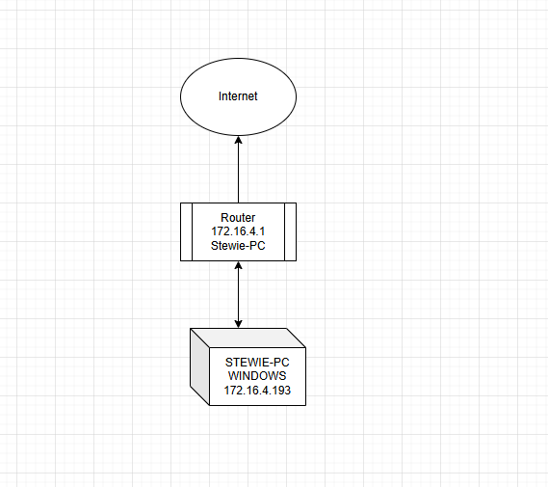
The Network
Internal topology and external connections identified from PCAP
Network Summary
Subnet:
172.16.4.0/24 (SOHO flat network)
Victim Host:
STEWIE-PC — 172.16.4.193 Windows 7, Dell NIC MAC: 5C:26:0A:02:A8:E4
Gateway:
172.16.4.1 — DNS + NAT
C2 Server:
tyu.benme.com 194.87.234.129 (RU)
Dropper:
spotsbill.com 5.188.223.104
Ransom Portal:
p27dokhpz2n7nvgr .1jw2lx.top
Week 9 PCAP Analysis | Cerber Ransomware / RIG Exploit Kit | Network Forensics

Slide 5
Methodology
Analytical process used to reconstruct the attack
Alert Triage
OSINT Validation
1
Reviewed Security Onion Alerts dashboard. Grouped alerts by source IP and rule name. Identified highest-severity Suricata signatures (RIG EK ×15, Evil Redirector, Cerber Ransomware) as the starting point.
2
Queried each IOC (IPs and domains) in VirusTotal. Obtained independent vendor verdicts to confirm or rule out false positives. Key IPs verified against 94-vendor engine consensus.
PCAP Deep-Dive
Host Enumeration
3
Applied Wireshark display filters (ip.addr, http, dns) to isolate malicious traffic. Reconstructed HTTP streams to identify payload delivery and C2 beaconing. Used Export Objects to extract dropped executables.
4
Loaded PCAP into NetworkMiner to identify hostnames, OS fingerprints, MAC addresses, and all outgoing sessions from the infected host (69 total sessions mapped).
IOC Extraction
Timeline Construction
5
Extracted all IP addresses, domains, Bitcoin wallet addresses, victim GUIDs, file hashes, and MITRE ATT&CK technique mappings from correlated evidence across all tools.
6
Cross-referenced packet timestamps, DNS queries, HTTP requests, and IDS alerts to build a precise UTC timeline from initial access (22:53) through ransomware portal load (22:55).
Week 9 PCAP Analysis | Cerber Ransomware / RIG Exploit Kit | Network Forensics

Slide 6
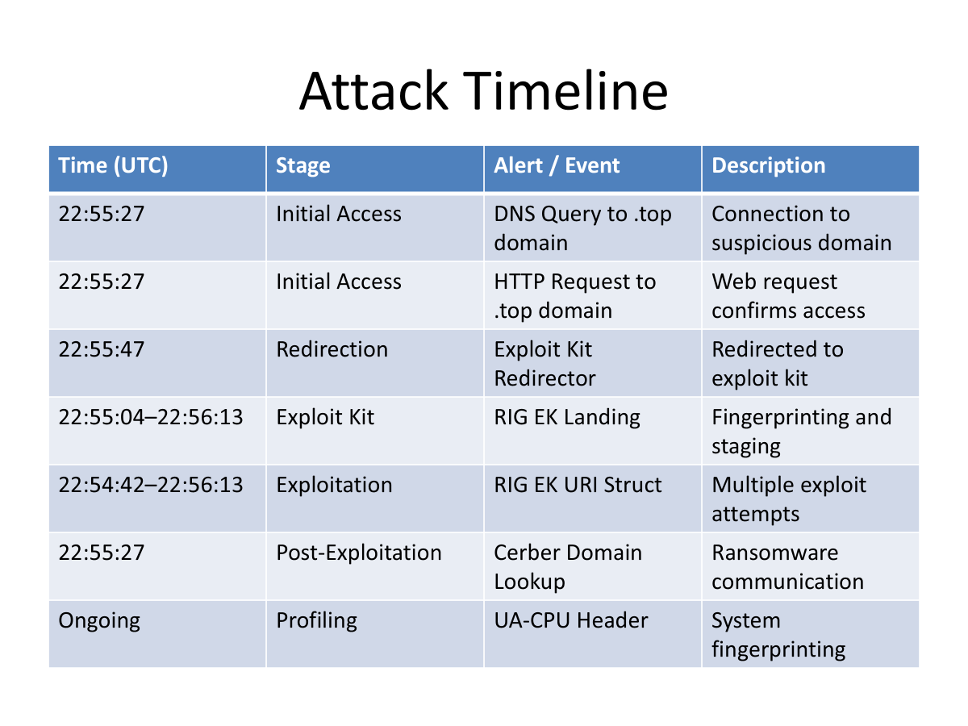
Timeline of Events
All times UTC — 2017-01-27 | Capture: 22:53:08 – 23:00 UTC
Week 9 PCAP Analysis | Cerber Ransomware / RIG Exploit Kit | Network Forensics

Slide 7
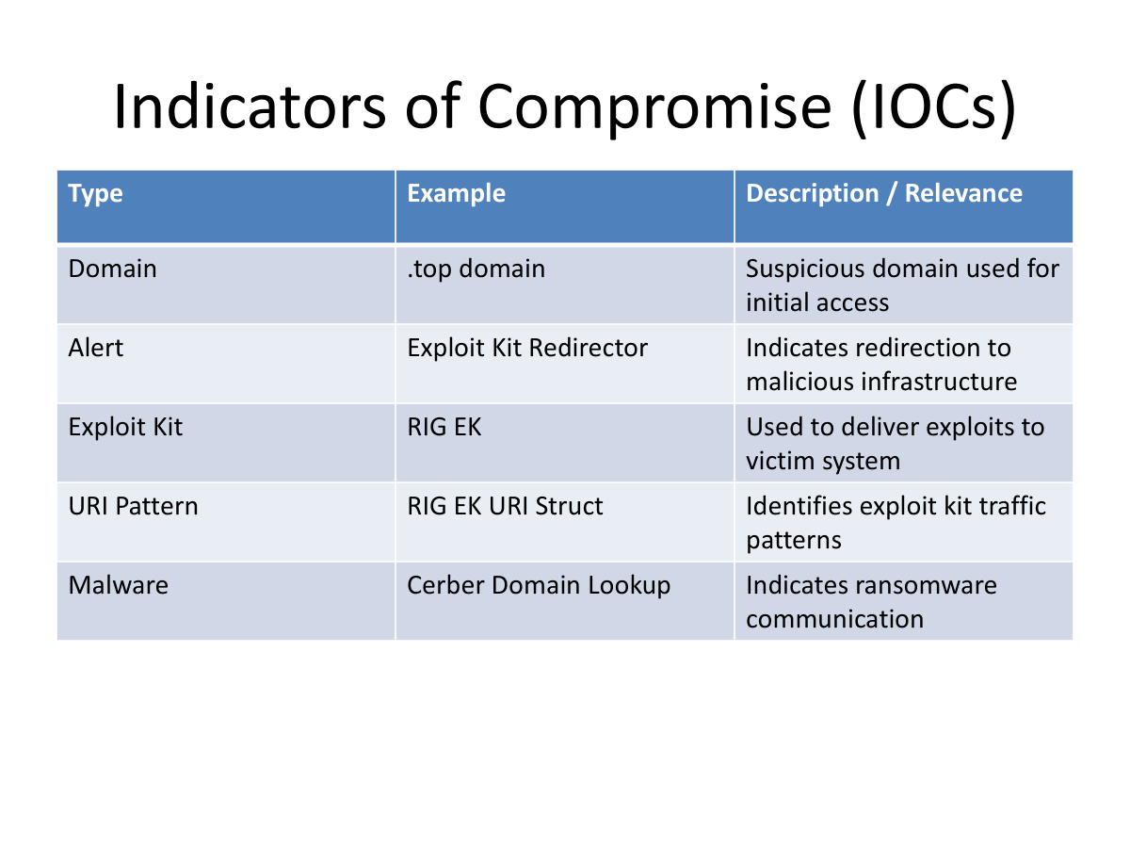
Indicators of Compromise (IOCs)
All IOCs extracted from PCAP and validated via VirusTotal
Additional IOCs
Bitcoin:
17gd1msp5FnMcEMF 1MitTNSsYs7w7AQyCt
GUID:
EE7E-AD39-7D8C -080C-18BF
MITRE:
T1189 Drive-by T1203 Client Exploit T1071 App Layer C2 T1486 Data Encrypted
Malware:
Cerber Ransomware RIG Exploit Kit
Week 9 PCAP Analysis | Cerber Ransomware / RIG Exploit Kit | Network Forensics

Slide 8
Analysis: Drive-By Attack to Ransomware Sequence
Step | Stage | Domain / Indicator | Activity | Purpose / Outcome
1 | Initial Access | homeimprovement.com | User visits site | Entry point (benign/malvertising)
2 | Redirection | tyu.benme.com | Silent redirect | Attacker-controlled redirect
3 | Exploit Kit Landing | spotsbill.com | Landing page loads | System fingerprinting (EK staging)
4 | Infrastructure | api.blockcypher.com | Background requests | Blends with legit traffic
5 | Exploit Delivery | p27d0khpz2n7nvgr.1jw2lx.top | Multiple requests | RIG exploit kit delivery
6 | Exploitation | RIG EK URI Struct | Exploit triggered | Vulnerability exploited
7 | Payload Assist | fpdownload2.macromedia.com | Flash interaction | Exploit support
8 | Payload Download | tyu.benme.com | Executable delivered | Malware downloaded
9 | C2 Communication | p27d0khpz2n7nvgr.1jw2lx.top | Beaconing activity | Attacker communication
10 | Impact | Cerber Indicators | Ransomware runs | System encrypted
Week 9 PCAP Analysis | Cerber Ransomware / RIG Exploit Kit | Network Forensics
Week 9 PCAP Analysis | Cerber Ransomware / RIG Exploit Kit | Network Forensics

Slide 9
Analysis & Interpretation
Attack flow, exfiltrated data, and false positive assessment
Attack Flow Summary
MITRE ATT&CK Techniques
The attack targeted STEWIE-PC (172.16.4.193) via a drive-by download. The user visited the compromised site homeimprovement.com, which silently injected an iframe pointing to tyu.benme.com (RIG Exploit Kit C2). The RIG EK fingerprinted the browser (SeaMonkey UA string with WOW64, .NET CLR, Media Center 6.0) and delivered three 16kB Flash exploits and two Windows executables (165kB, 500kB) via application/x-msdownload. After payload drop, the host resolved the randomized .top domain p27dokhpz2n7nvgr.1jw2lx.top (198.105.121.50) — the Cerber ransom portal. Victim GUID EE7E-AD39-7D8C-080C-18BF was assigned and a Bitcoin payment page loaded. Files Downloaded: Flash exploits ×3 (16kB each), executables ×2 from tyu.benme.com. Data exfiltrated: browser UA, plugin flags, system fingerprint via encoded GET parameters.
T1189
Drive-by Compromise — homeimprovement.com iframe injection
T1203
Client Exploitation — Flash Player exploited by RIG EK
T1071
App Layer Protocol — HTTP C2 beaconing to tyu.benme.com
T1486
Data Encrypted for Impact — Cerber file encryption + ransom demand
False Positive Assessment
15× RIG EK URI Struct alerts — repetition at scale rules out coincidence. Multiple independent Suricata rules corroborate the same event chain. All critical rule confidence ratings: High. spotsbill.com: 11/94 VT vendors flagged — not a false positive. Three IPs appear clean on VT but were analyzed 4–7 years ago; IP reassignment likely explains the discrepancy. Overall false positive probability: extremely low.
Week 9 PCAP Analysis | Cerber Ransomware / RIG Exploit Kit | Network Forensics

Slide 10
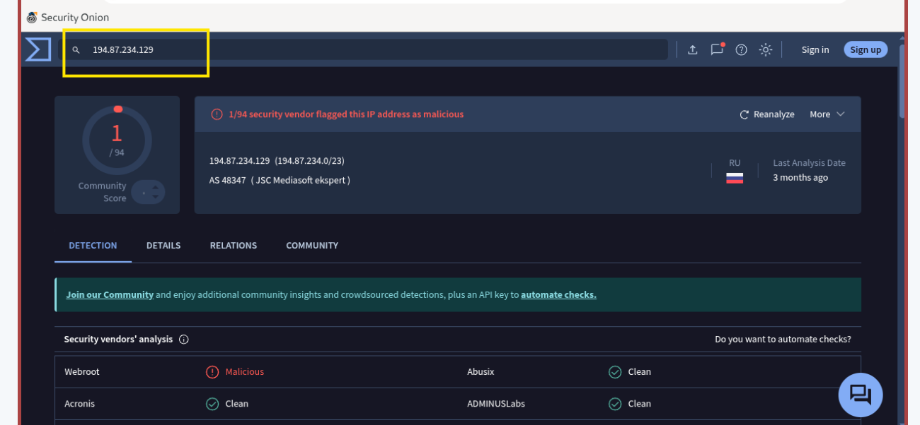
Evidence of Infection — C2 Server Validation
VirusTotal confirms 194.87.234.129 as RIG Exploit Kit C2
Finding
VirusTotal flagged 194.87.234.129 as malicious (Webroot: Malicious). This IP belongs to JSC Mediasoft ekspert (Russia, AS 48347). Suricata independently identified this as the RIG EK C2 landing page with High severity. Corroborated by Security Onion alert: ET EXPLOIT_KIT RIG EK Landing.
Fig 1: VirusTotal report for 194.87.234.129 (tyu.benme.com) — confirms RIG EK C2 server, flagged malicious by Webroot. Corroborated by Suricata ET EXPLOIT_KIT RIG EK Landing alert.
Week 9 PCAP Analysis | Cerber Ransomware / RIG Exploit Kit | Network Forensics

Slide 11
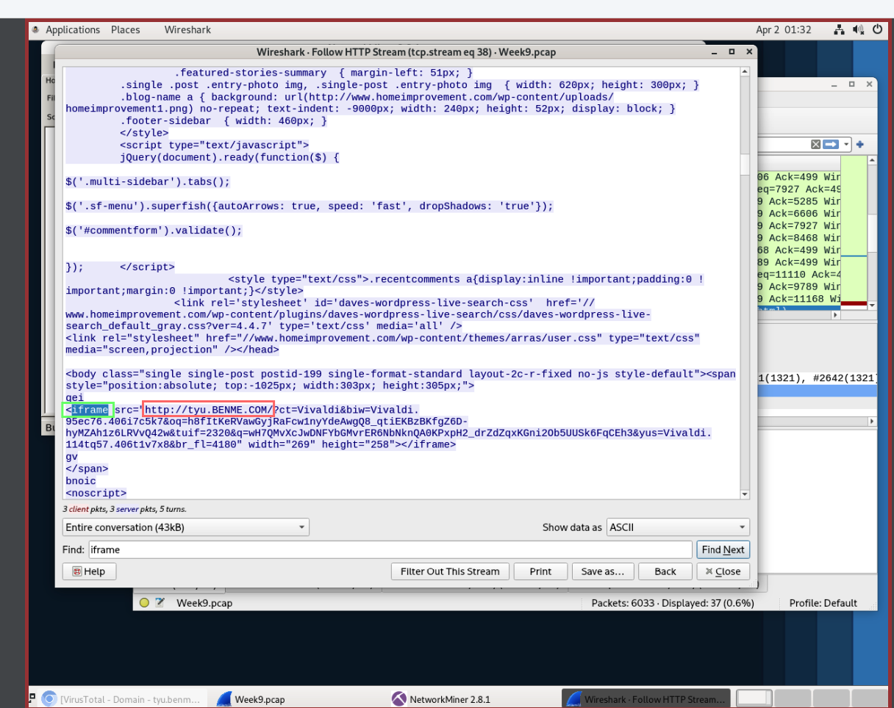
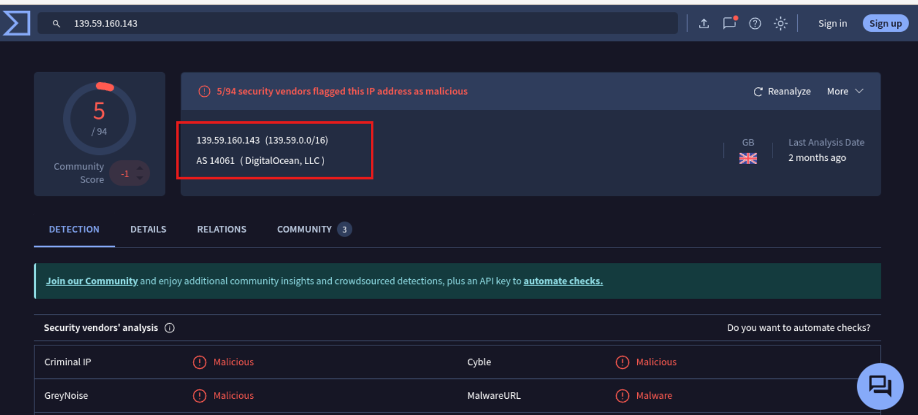
Evidence — Evil Redirector & Payload Delivery
Stages 1–3: compromised WordPress → evil redirect → RIG EK payload drop
Fig 2: Wireshark HTTP stream — homeimprovement.com response containing iframe src pointing to http://tyu.BENME.COM — the RIG EK C2 redirector. This confirms Stage 1→2 of the attack chain.
Fig 3: Wireshark HTTP Export Objects — tyu.benme.com serving application/x-msdownload (executable) and application/x-shockwave-flash (exploit). Confirms payload drop via RIG EK.
Week 9 PCAP Analysis | Cerber Ransomware / RIG Exploit Kit | Network Forensics

Slide 12
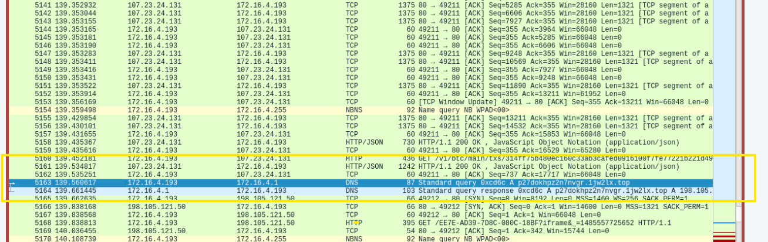
Evidence — Ransomware DNS Beacon
Stage 5: DNS query for Cerber ransom portal domain
Fig 4: Wireshark packet view — packet 5163 shows a DNS Standard Query for p27dokhpz2n7nvgr.1jw2lx.top (highlighted row), immediately followed by resolution to 198.105.121.50. This confirms the ransomware payment portal lookup after successful infection. Also visible: prior DNS queries to all malicious domains in sequence.
Key Finding: The DNS sequence (homeimprovement.com → visionurbana → tyu.benme.com → spotsbill.com → api.blockcypher.com → p27dokhpz2n7nvgr.1jw2lx.top) maps the complete 6-stage attack chain directly from packet timestamps.
Week 9 PCAP Analysis | Cerber Ransomware / RIG Exploit Kit | Network Forensics

Slide 13
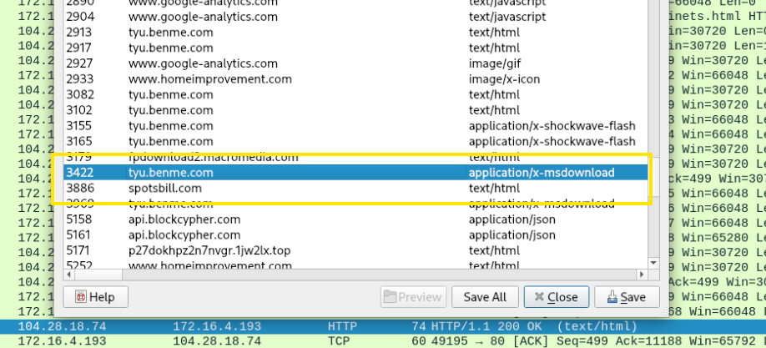
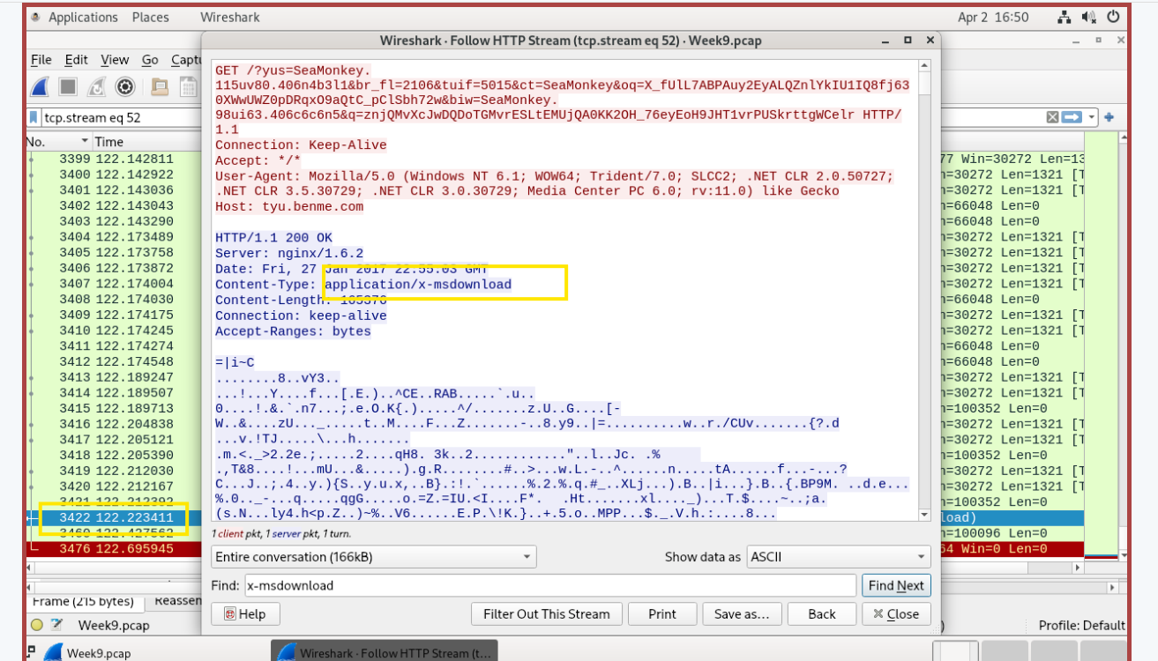
Evidence — Malware Executable Download
Stage 3: application/x-msdownload payload from tyu.benme.com
Fig 5: HTTP stream (tcp.stream eq 52) — tyu.benme.com response with Content-Type: application/x-msdownload (166kB). The binary payload (obfuscated .exe) confirms the malware executable was successfully delivered to STEWIE-PC.
Fig 6: Wireshark HTTP Export Objects — tyu.benme.com listed as source for application/x-msdownload (highlighted). spotsbill.com also visible, serving text/html (secondary dropper). Both confirmed malicious by VirusTotal.
Week 9 PCAP Analysis | Cerber Ransomware / RIG Exploit Kit | Network Forensics

Slide 14
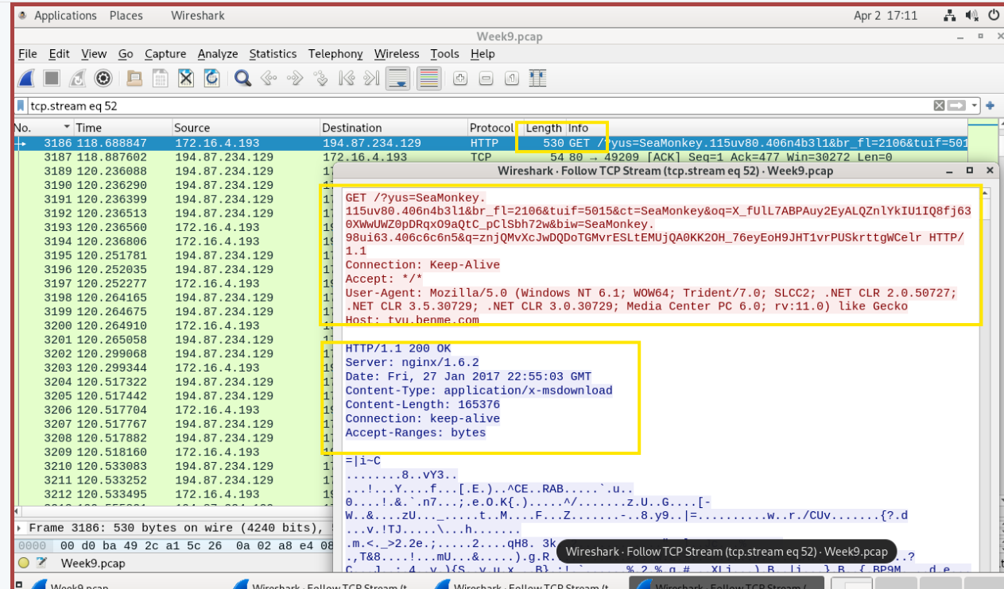
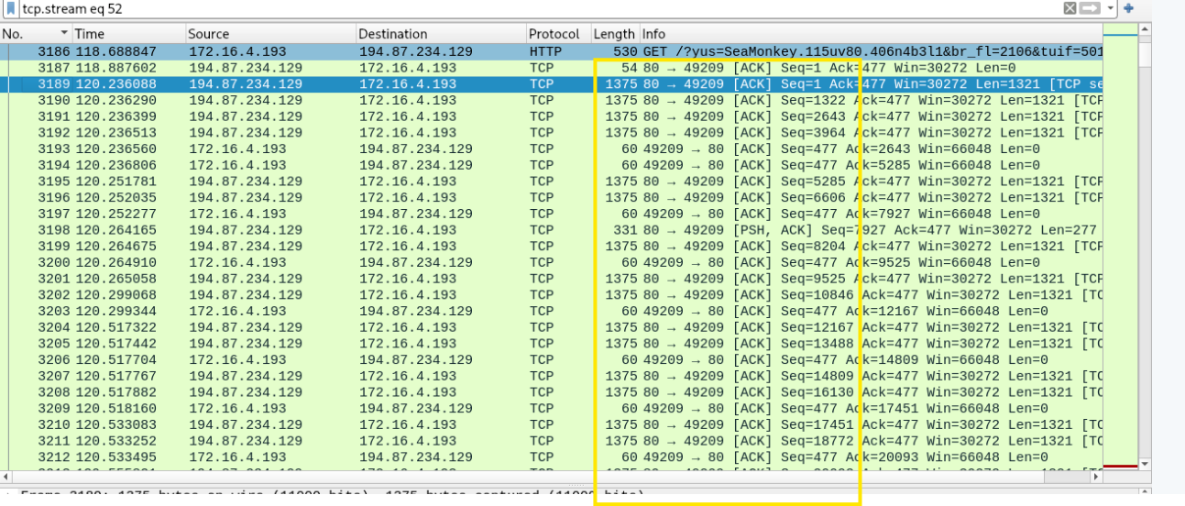
Evidence — Suricata IDS Alerts
Security Onion confirming RIG EK and Cerber Ransomware signatures
Fig 7: Security Onion Suricata alert metadata — showing RIG EK alert triggered by traffic from 139.59.160.143 (evil redirector). High severity, Client_Endpoint category. Confirms Stage 1 → Stage 2 redirect.
Fig 8: Security Onion — ET MALWARE Ransomware/Cerber alert. DNS_Onion_Query tag confirms ransomware domain lookup. Malware family: Ransomware_Cerber. MITRE ATT&CK: T1486 (Data Encrypted for Impact), TA0040 Impact.
Week 9 PCAP Analysis | Cerber Ransomware / RIG Exploit Kit | Network Forensics

Slide 15
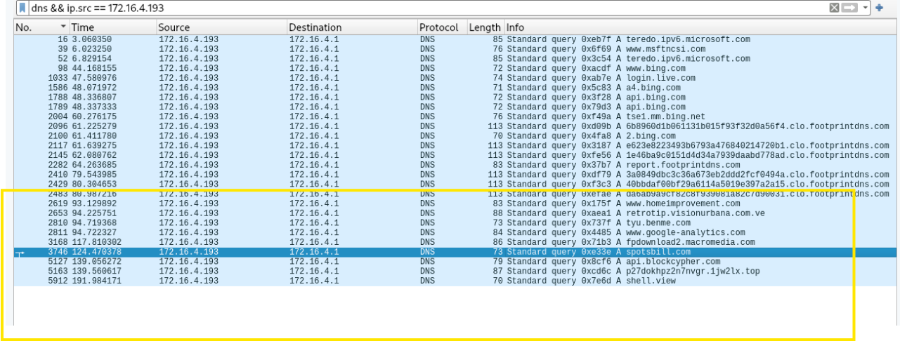
Evidence — Complete DNS Query Sequence
All outbound DNS requests from STEWIE-PC confirming the attack chain order
Fig 9: Wireshark DNS filter (dns && ip.src == 172.16.4.193) — showing the complete query timeline. Highlighted rows confirm all 6 malicious domains queried in sequence: homeimprovement.com → retrotip.visionurbana.com.ve → tyu.benme.com → spotsbill.com → api.blockcypher.com → p27dokhpz2n7nvgr.1jw2lx.top. This single view proves the full attack chain.
Week 9 PCAP Analysis | Cerber Ransomware / RIG Exploit Kit | Network Forensics

Slide 16
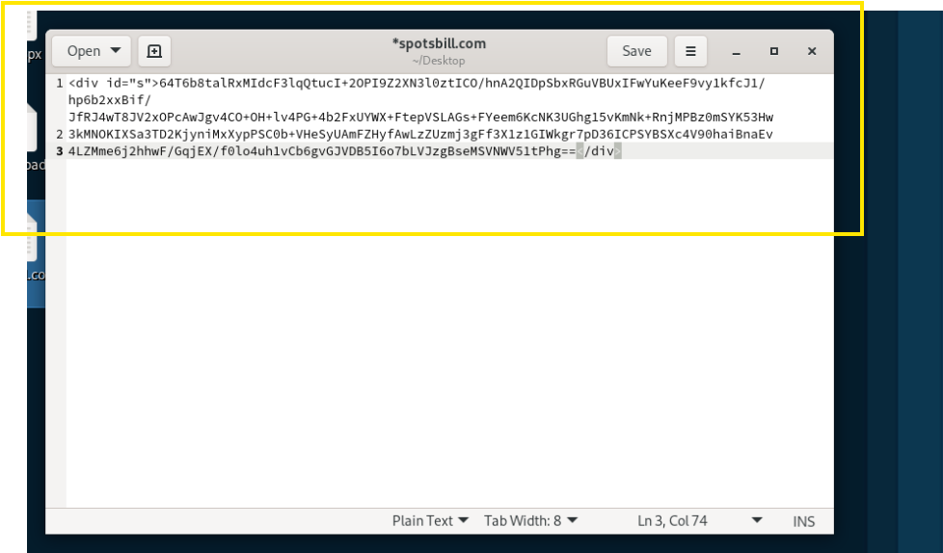
Evidence — spotsbill.com: Staging Server
Stage 4: Base64-encoded payload response confirms secondary dropper role
Analysis
spotsbill.com returned a <div> element containing a large Base64-encoded string — characteristics: A–Z, a–z, 0–9, +, / with no spaces or HTML structure. This is NOT user-facing content. This is machine-to-machine communication — a payload chunk or configuration data retrieved by the ransomware after initial execution. Role: Secondary staging server. Returns encoded payload data, not C2 commands. Confirmed malicious: 11/94 VirusTotal vendors (Kaspersky, BitDefender, Fortinet).
Fig 10: Decoded HTTP response from spotsbill.com — a Base64-encoded blob inside a <div id='s'> tag. No HTML structure, images, or scripts. Confirms machine-to-machine payload retrieval, not normal web content.
Week 9 PCAP Analysis | Cerber Ransomware / RIG Exploit Kit | Network Forensics

Slide 17
Evidence — Evil Redirector IP Validation
VirusTotal confirms 139.59.160.143 as malicious — evil redirector (Stage 2)
Finding
139.59.160.143 flagged by 5/94 VirusTotal vendors (Criminal IP: Malicious, Cyble: Malicious, GreyNoise: Malicious, MalwareURL: Malware). Hosted by DigitalOcean, GB (AS 14061). This is the evil redirector that delivered the RIG EK landing page — Stage 2 of the attack chain. Corroborated by Suricata ET EXPLOIT_KIT Evil Redirector alert.
Fig 11: VirusTotal report for 139.59.160.143 (retrotip.visionurbana.com.ve) — 5/94 vendors flagged malicious. Confirms this IP as the evil redirector (Stage 2). Suricata independently triggered ET EXPLOIT_KIT Evil Redirector Leading to EK alert at High severity.
Week 9 PCAP Analysis | Cerber Ransomware / RIG Exploit Kit | Network Forensics

Slide 18
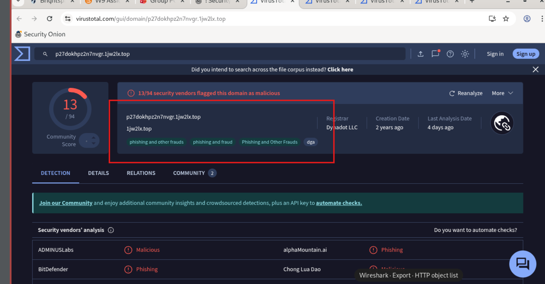
Evidence — VirusTotal: Ransom Portal Domain
p27dokhpz2n7nvgr.1jw2lx.top — 13/94 vendors flagged malicious
Fig 12: VirusTotal for p27dokhpz2n7nvgr.1jw2lx.top — 13/94 vendors flagged (ADMINUSLabs: Malicious, alphaMountain.ai: Phishing, BitDefender: Phishing, Chong Lua Dao: Malicious). Tagged: phishing and other frauds, DGA. Registered via Dynadot LLC. This is the Cerber ransomware payment portal — confirms Stage 5 of the attack.
Week 9 PCAP Analysis | Cerber Ransomware / RIG Exploit Kit | Network Forensics

Slide 19
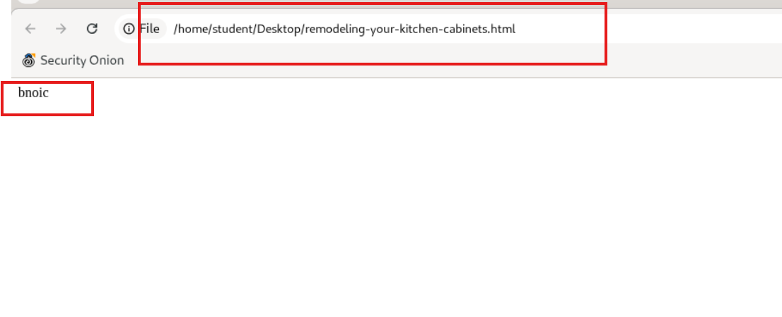
Evidence — Compromised HTML Payload Rendered
Stage 1: homeimprovement.com local copy shows injected 'bnoic' tag
Significance
The remodeling-your-kitchen-cabinets.html file was extracted from the PCAP and rendered locally. It shows an almost-blank page with only 'bnoic' visible — a non-standard tag injected by the attacker. This confirms the WordPress site's content was maliciously modified. The visible page contains no legitimate content; the injected code only executes the redirect to tyu.benme.com via the hidden iframe. This is direct proof of Stage 1: the compromised entry point.
Fig 13: Rendered HTML from homeimprovement.com (saved locally from PCAP). The page shows only 'bnoic' — an injected non-standard tag. Legitimate content stripped by attacker; only the redirect iframe executes. Confirms the website was actively compromised (Stage 1).
Week 9 PCAP Analysis | Cerber Ransomware / RIG Exploit Kit | Network Forensics

Slide 20
Non-Technical Summary
Plain-language explanation for non-forensic readers
What happened?
A staff member's computer (STEWIE-PC) was infected with ransomware after visiting a home improvement website that had been secretly hacked by attackers.
How did it happen?
The hacked website silently redirected the browser to a malicious server, which exploited Adobe Flash Player to automatically install the Cerber ransomware — without the user clicking anything suspicious.
What did the ransomware do?
The ransomware encrypted the victim's files and displayed a payment page demanding cryptocurrency in exchange for the decryption key. It also sent information about the infected computer back to the attacker's servers.
Was it contained?
Yes. No other computers on the internal network were affected. The infection was isolated to STEWIE-PC. However, the encrypted files may be unrecoverable without a clean backup.
Week 9 PCAP Analysis | Cerber Ransomware / RIG Exploit Kit | Network Forensics

Slide 21
Conclusions
Key findings proven through forensic analysis
✓ STEWIE-PC (172.16.4.193) was infected with Cerber ransomware on 2017-01-27 via a drive-by download attack, confirmed by Suricata, Wireshark, NetworkMiner, and VirusTotal.
✓ The infection vector was the RIG Exploit Kit delivered through a compromised WordPress site (homeimprovement.com) and an evil redirector (retrotip.visionurbana.com.ve).
✓ Malicious files downloaded via HTTP: Windows executables (165kB ×2, 500kB) and Flash exploits (16kB ×3) from tyu.benme.com (194.87.234.129) — confirmed RIG EK C2 server.
✓ The Cerber payment portal at p27dokhpz2n7nvgr.1jw2lx.top was fully loaded. Victim GUID EE7E-AD39-7D8C-080C-18BF was assigned and Bitcoin wallet 17gd1msp5FnMcEMF1Mit... was presented.
✓ Browser fingerprint and system info were exfiltrated to the C2 server via encoded GET parameters. External IP identified via msftncsi.com (Windows auto-check).
✓ No lateral movement detected. Infection contained to a single machine on the 172.16.4.0/24 network. False positive probability: extremely low — multiple independent signatures corroborate.
Week 9 PCAP Analysis | Cerber Ransomware / RIG Exploit Kit | Network Forensics

Slide 22
Recommendations
Remediation steps tied to specific findings
Isolate & Reimage STEWIE-PC
Block Malicious IPs & Domains
1
Finding: Cerber confirmed. Immediately isolate 172.16.4.193 from the network. Wipe and reimage — do not attempt decryption without validated backups.
2
Finding: Multiple C2 servers identified. Block 194.87.234.129, 198.105.121.50, 139.59.160.143 and domains spotsbill.com, tyu.benme.com at perimeter firewall and DNS.
Disable Adobe Flash Player
Block .exe Downloads via HTTP
3
Finding: Flash exploit used by RIG EK. Flash is the primary attack vector. Disable or remove Flash Player across all endpoints — it reached end-of-life in December 2020.
4
Finding: Malware delivered unencrypted. Implement HTTP content inspection to block application/x-msdownload transfers. Enforce HTTPS-only browsing policies.
Enable DNS Filtering for .top TLD
Conduct Enterprise-Wide IOC Sweep
5
Finding: Ransomware used .top domain. Alert on or block first-seen .top domain queries. The .top TLD is heavily abused and rarely required by legitimate end users.
6
Finding: Cerber may have spread via shared drives. Search all endpoints for Cerber artifacts (encrypted file extensions, registry persistence keys) using extracted IOCs.
Week 9 PCAP Analysis | Cerber Ransomware / RIG Exploit Kit | Network Forensics

Slide 23
References
Tools, documentation, and authoritative sources
Emerging Threats Ruleset (2025)
ET EXPLOIT_KIT RIG EK URI Struct / ET MALWARE Ransomware/Cerber / ET MALWARE DNS Domain Lookup — Suricata IDS signatures used for alert triage.
VirusTotal (2025)
IP and domain analysis reports for: 194.87.234.129, 139.59.160.143, 5.188.223.104, 198.105.121.50, p27dokhpz2n7nvgr.1jw2lx.top, benme.com, spotsbill.com.
MITRE ATT&CK Framework (2025)
T1189: Drive-by Compromise; T1203: Exploitation for Client Execution; T1071: Application Layer Protocol; T1486: Data Encrypted for Impact; TA0040: Impact.
Cisco Talos Intelligence Group
RIG Exploit Kit — threat summary, indicators, and C2 infrastructure documentation. Available at: talosintelligence.com
Wireshark Foundation (2025)
Wireshark Display Filter Reference and HTTP Object Export documentation. Available at: wireshark.org
BlockCypher Blockchain API (2025)
Bitcoin address and transaction lookup for wallet 17gd1msp5FnMcEMF1MitTNSsYs7w7AQyCt. Available at: api.blockcypher.com
Security Onion Solutions (2025)
Security Onion 2.4 documentation — Alerts, Hunt, and PCAP analysis modules. Available at: securityonionsolutions.com
NetworkMiner — Netresec (2025)
Network Forensic Analysis Tool — host enumeration, file extraction, and OS fingerprinting. Available at: netresec.com
Week 9 PCAP Analysis | Cerber Ransomware / RIG Exploit Kit | Network Forensics

