Slide 1




Salford & Co.
PITCH DECK

Slide 2

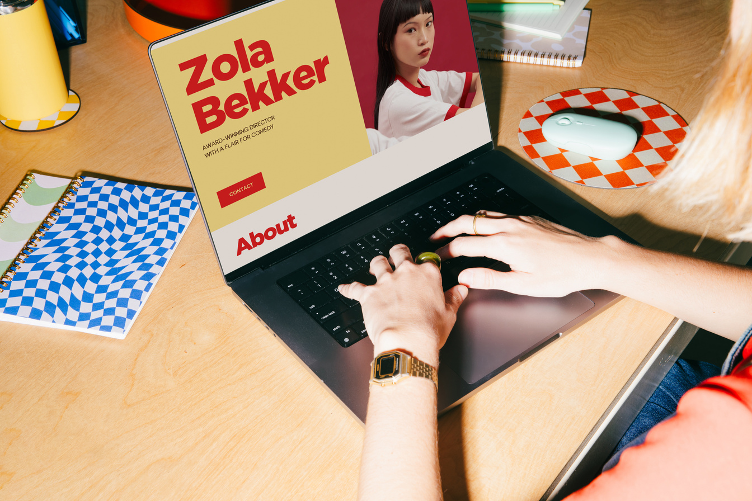


Salford & Co.
BORROW
BUDDY
a peer-to-peer platform for borrowing and lending everyday school items on campus.

Slide 3
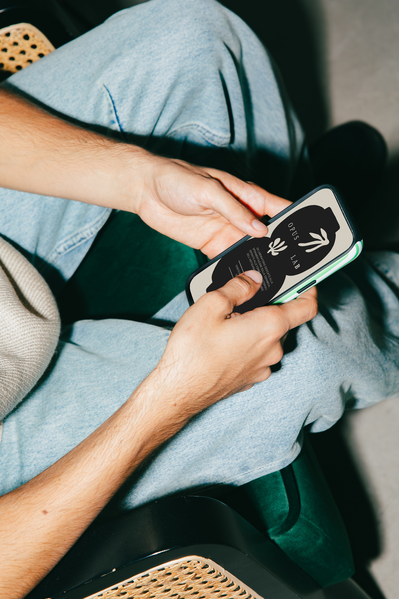
Salford & Co.
THE
PROBLEM
  Students often need items they'll rarely use again (calculator, charger, textbook, art supplies)
  No organized way to borrow from classmates who already own them
  Requests get lost in group chats; items go untracked

Slide 4

Salford & Co.
TARGET USERS
Borrowers
Lenders
Students who occasionally need an item
Students willing to share what they own

Slide 5

Salford & Co.
PROPOSED SOLUTION
An app where students can list an item they're willing to lend, and other students can browse what's available and request to borrow it.

Slide 6

Salford & Co.
HOW IT HELPS
  Core flow: A student posts an item as available; when someone borrows it, the owner marks it unavailable so no one else requests it while it's out.
  Directly fixes the problem: Replaces scattered, easy-to-miss chat requests with one visible, always-up-to-date list of what's borrowable and from whom.
  Basic concept: A simple web or mobile listing app — no payments, messaging systems, or delivery logistics needed for the MVP.

Slide 7

Salford & Co.
PROJECT
RATIONALE
It targets a real, everyday inefficiency with a narrow, well-defined entity (items) at its core. The scope stays realistic for SD1: track item status (available/unavailable), tie it to an owner, and let students browse. No complex systems required, but a clear, tangible win for anyone who's ever needed to borrow something on short notice.

Slide 8


Salford & Co.
December - 29 - 2026
THANK YOU
SO MUCH!
Presented By :
Anna Katrina Marchesi
Presented To :
Timmerman Industries
Email Address :
hello@reallygreatsite.com
Social Media :
@reallygreatsite
Phone Number :
+123-456-7890
Website :
www.reallygreatsite.com

