Slide 1
Joins and Set Operations

Slide 2
Joins
Equi joins
It is a simple sql join condition which uses the equal sign as the comparison operator. Two types of equi joins are SQL Outer join and SQL Inner join.
Inner Join (a.k.a. ‘natural’ join)
All the rows returned by the sql query satisfy the sql join condition specified.
Outer Join
This sql join returns all rows from both tables which satisfy the join condition along with rows which do not satisfy the join condition from one of the tables.
Full, Left and Right joins are all considered types of outer joins
Non equi joins (a.k.a. theta joins)
It is a sql join condition which makes use of some comparison operator other than the equal sign like >, <, >=, <=

Slide 3
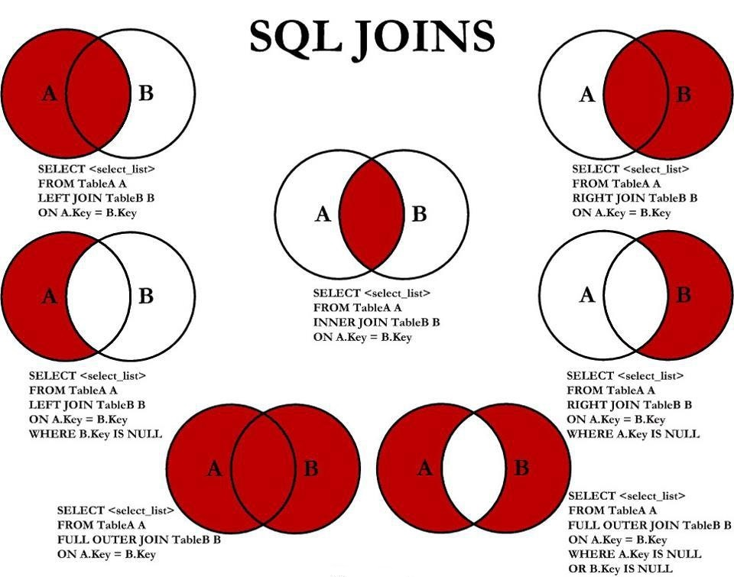
Joins

Slide 4
Set Operations and Unions
Set operations are used to manipulate two result sets, or the results of two select statements.
Postgresql supports the UNION, INTERSECT and EXCEPT operations.
We can optionally use the ALL keyword with a set operation to select all duplicate values.
query1 UNION [optional ALL] query2
query1 INTERSECT [optional ALL] query2
query1 EXCEPT [optional ALL] query2

Slide 5
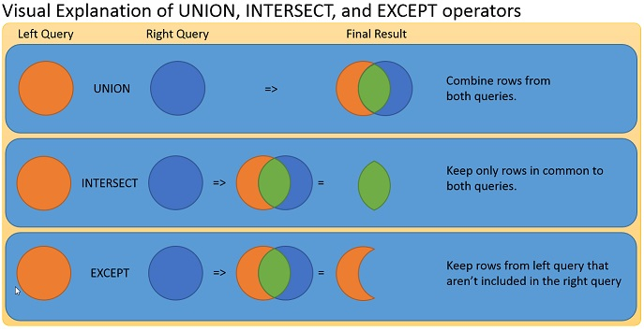
Unions

Slide 6
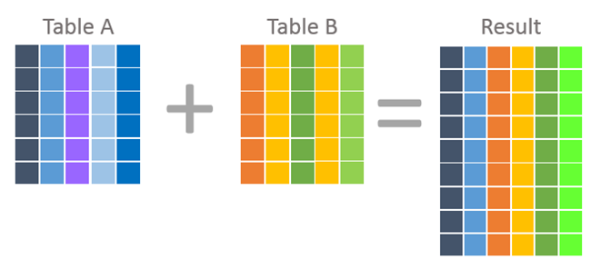
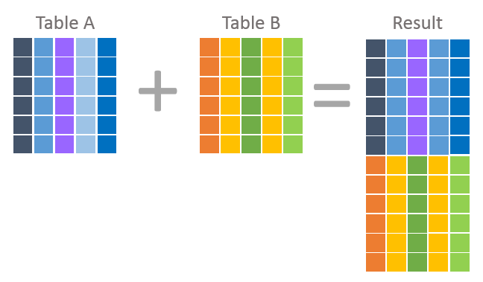
Joins vs Unions
Join statements will return a result which combines columns from each table
Unions will return a result which combines rows from each table

Slide 7
Sub Queries
As its name implies, a subquery is a query that is nested inside of a SELECT, INSERT, UPDATE or DELETE stataement, or inside of another subquery. EX:
SELECT
column_name
FROM
table_name
WHERE
column > (SELECT
avg(column_name)
FROM
table_name
);

Slide 8
VIEWS
A view is a named, virtual table based on the result-set of an SQL Query. They provide an interface through which to access your underlying tables.
The Syntax to create a view is:
CREATE [ OR REPLACE ] VIEW view_name AS
SELECT col_1, col_2, etc…
FROM table_name
WHERE condition;
After creation, you can query from the view, as you would another table:
SELECT * FROM view_name;
View are useful when you want to access some filtered data frequently these frequently.
You can DROP and modify (using CREATE OR REPLACE) existing views as needed.

Slide 9
VIEWS (example)
CREATE OR REPLACE VIEW high_salaries AS
SELECT emp_name, emp_salary FROM examples.employees
WHERE emp_salary > (SELECT avg(emp_salary) FROM examples.employees);
SELECT * FROM high_salaries;

