Slide 1
Design Patterns & Intro to Algorithms

Slide 2
Design Patterns - Singleton
The Singleton design pattern is used to ensure that only a single instance of a particular class is created throughout the lifetime of our application.
This is achieved by creating a static method that will return the singleton instance (or create a new one if one does not already exist)
Creation of a singleton object can occur either:
Lazily – only when it is first needed
Eagerly – available when the class is loaded into memory.
To create an effective singleton, you should do the following:
Create a static method to create or return a reference to the singleton object.
Create a single, private constructor in the class.
Override the clone() method (inherited from the Object class).

Slide 3
Lazy Singleton
public class LazySingleton {
private String data;
private static LazySingleton mySingleton;
private LazySingleton() { }
public static LazySingleton getSingleton() {
if (mySingleton == null) mySingleton = new LazySingleton();
return mySingleton;
}
public String getData() {
return this.data;
}
public void setValue(String value) {
this.value = value;
}
@Override
public Object clone() throws CloneNotSupportedException {
throw new CloneNotSupportedException();
}
}

Slide 4
Eager Singleton
public class EagerSingleton {
private String data;
private static EagerSingleton mySingleton = new EagerSingleton();
private EagerSingleton() { }
public static EagerSingleton getSingleton() {
return mySingleton;
}
public String getData() {
return this.data;
}
public void setValue(String value) {
this.value = value;
}
@Override
public Object clone() throws CloneNotSupportedException {
throw new CloneNotSupportedException();
}
}

Slide 5
Design Patterns - Factory
A Factory design pattern refers to the use of an interface to provide control over the creation of objects in a superclass but allows subclasses to implement the specific type of objects that will be created.
The Factory pattern allows for the creation of objects without exposing the actual creation logic to the client/users and allows for the created objects to be referenced using a common interface.

Slide 6
Design Patterns – Factory (cont…)
public interface SomeInterface {
// code...
}
public class ChildOne implements SomeInterface {
// code...
}
public class ChildTwo implements SomeInterface {
// code...
}
public class ChildThree implements SomeInterface {
// code...
}

Slide 7
Design Patterns – Factory (cont…)
public class SomeFactory {
public static SomeInterface createObject(String choice) {
switch (choice.toLowerCase().intern()) {
case "one":
return new ChildOne();
case "two":
return new ChildTwo();
case "three":
return new ChildThree();
default:
return new ChildOne();
}
}
}

Slide 8
What are Algorithms?
Any series of steps taken to solve a problem is an algorithm.
Some problems occur a lot in programming: sorting sets of data, searching data for particular values, finding relationships between data, etc.
Solving a problem requires balancing resources available
Memory space
Execution time
Algorithms are typically generic steps independent of the data provided. Sort(x), it doesn’t matter if x is numbers or people.

Slide 9
Creating Algorithm
‘Algorithm’ is often a buzzword, but its just a step-by-step approach to solving a problem.
Following directions to bake a cake
Giving directions to get to your house
If you have an array of numbers, and you want to sort them from lowest to highest. How do you do it?
There is no programming tricks here:
Break the problem down
Talk it out, like you're explaining it to a child.
Use Psuedocode
Practice!

Slide 10
Pseudocode
Planning and organization are key to creating efficient algorithms. To plan the logic for an algorithm, pseudocode is often used.
Pseudocode is an informal, artificial, text-based, and self-descriptive language that is used to describe the steps of an algorithm prior to the actual implementation.
In other words, pseudocode is used to explain the steps of an algorithm without worrying about the specific programmatic syntax/grammar (pseudocode cannot be compiled or executed).

Slide 11
Pseudocode – How to…
Limit one statement per line
All statements showing “dependencies”/”hierarchies” are indented (i.e. flow control statements and their associated blocks of code).
Statements are language agnostic (refrain from using keywords specific to a particular programming language)
Describe with words rather than programmatic symbols
Keep it simple, concise and readable.

Slide 12
Pseudocode - Examples
Not Bad:
(could be better)
Better:
(even now could still be improved)
if arrayNotNull = true
for y = 0 to arrayLength-1
if (array[index] = odd)
print
array[index]
if array is not null
for each element of array
if array index value is odd
print
value of array index
input double[] scores
output double average
int total = 0
int count = 0
if scores.length > 1
while count < scores.length-1
total += scores[index]
count++;
return total/count;
input: array of scores as doubles
output: average as double
initialize total to zero
initialize count to zero
if array length greater than 1
while count is less than array length
add array index to total
increment count
return total divided by count

Slide 13
Psuedo Code – Palindrome Algorithm
algorithm palindrome is input: string phrase output: true/false result
initialize length to length of phrase initialize c to zero
while c LEqual to length/2 if phrase[c] Nequal phrase[length - 1 – c] return false increment c
return true

Slide 14
Measuring Algorithms
Algorithms are designed to be independent of the number/type of inputs they are given.
i.e. An algorithm isn’t designed differently if it only sorts 5 objects instead of 500.
…but we must respect resources used. The same algorithm will likely take longer to sort 500 elements than it would to sort 5.
Algorithms are measured by the rate of growth of operations and memory as inputs increase. We refer to this as the efficiency or complexity of an algorithm.

Slide 15
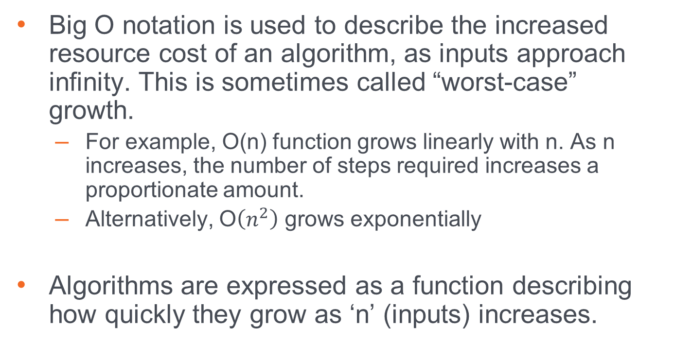
Big-O Notation
Big O notation is used to describe the increased resource cost of an algorithm, as inputs approach infinity. This is sometimes called “worst-case” growth.
For example, O(n) function grows linearly with n. As n increases, the number of steps required increases a proportionate amount.
Alternatively, O$\left(n^{2}\right)$ grows exponentially
Algorithms are expressed as a function describing how quickly they grow as ‘n’ (inputs) increases.

Slide 16
Big-O and Math
Big-O can involve a bit of limit calculus and algebra. This is one the science aspects of computer science.
In most circumstances, you can avoid the crunchy mathematical details if you understand the rules involved.
Deducing the complexity of an algorithm can be done through pattern recognition most of the time.

Slide 17
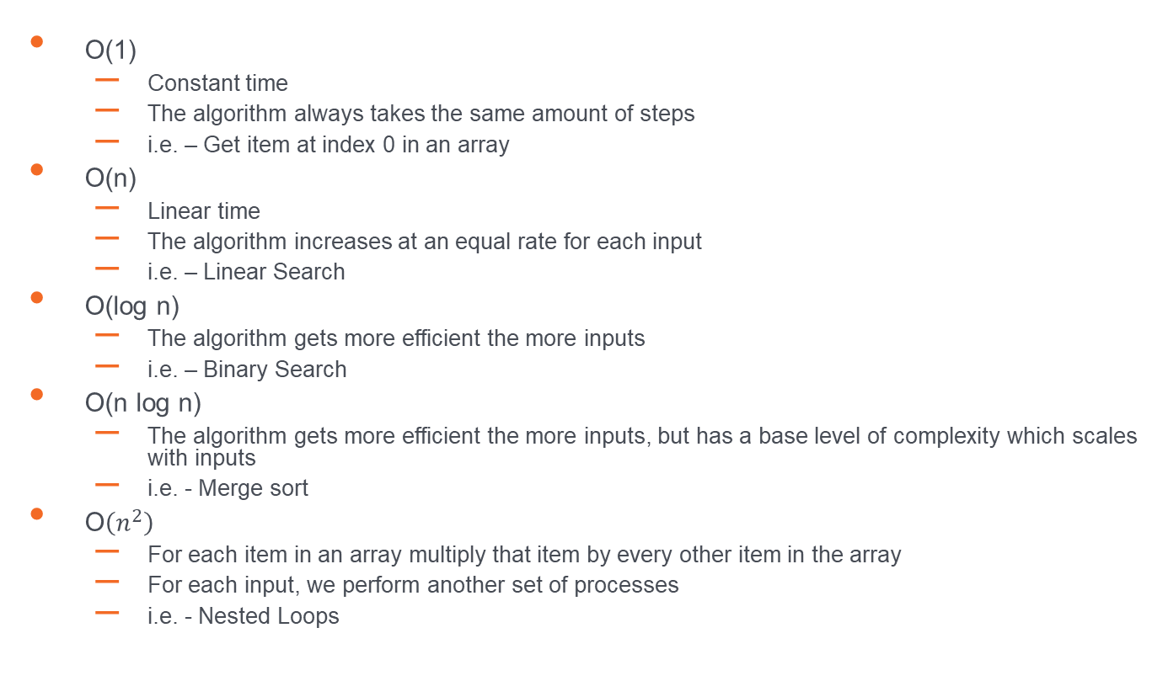
Big-O
O(1)
Constant time
The algorithm always takes the same amount of steps
i.e. – Get item at index 0 in an array
O(n)
Linear time
The algorithm increases at an equal rate for each input
i.e. – Linear Search
O(log n)
The algorithm gets more efficient the more inputs
i.e. – Binary Search
O(n log n)
The algorithm gets more efficient the more inputs, but has a base level of complexity which scales with inputs
i.e. - Merge sort
O$\left(n^{2}\right)$
For each item in an array multiply that item by every other item in the array
For each input, we perform another set of processes
i.e. - Nested Loops

Slide 18
Practice Makes Perfect
The only real way to get more proficient creating algorithms is to practice and work through different problems.
The links below are some popular resources that provide algorithm practice problems.
https://www.hackerrank.com/
https://www.codingame.com/
https://leetcode.com/
https://codesignal.com/

