Slide 1
Data Structures Java Collection API Generics

Slide 2
Array Based Structures
We are familiar with arrays- array-based structures simply use an array in the background.
Saving data in particular positions that each have corresponding indices. Then we can modify how these values are accessed if we wrap the array in another class.
Info
Index: 0
Info
Index: 1
Info
Index: 2
Info
Index: 3
Info
Index: 4
Info
Index: 5

Slide 3
Node Based Structures
Stores information in Nodes which may have one or more references to other Nodes.
Remember that any non primitive variable holds a reference, so if you have a variable Node next;
next really holds a reference to a Node object in memory.
Ex:
Info
Info

Slide 4
Simple Node Class
public class Node {
// Data
private Integer data = 0;
// Reference to next node
private Node next = null;
// Constructors
public Node(Integer data) {
this.data = data;
}
public Integer getData() { return data; }
public void setData(Integer data) { this.data = data; }
public Node getNext() { return next; }
public void setNext(Node next) { this.next = next; }
@Override
public String toString() {
return "Node: data ="+this.data;
}
}
We could structure this Node differently if we wanted to support a different data structure.

Slide 5
Stack
Many data structures can be supported differently with either nodes or arrays behind the scenes – for example:
public class ArrayStack {
int[] stack = new int[5];
int lastElementIndex = 0;
public void push(int element) {
if(lastElementIndex >= stack.length) {
int[] newStack = new int[stack.length*2];
for(int j = 0; j<stack.length; j++) {
newStack[j] = stack[j];
}
stack = newStack;
}
stack[lastElementIndex] = element;
lastElementIndex++;
}
public Integer pop() {
if (lastElementIndex> 0)
return stack[--lastElementIndex];
else
return null;
}
public int peek() {
return stack[lastElementIndex-1];
}
}
public class NodeStack {
Node top;
public void push(int element) {
Node node = new Node(element);
push(node);
}
public void push(Node node) {
node.setNext(top);
top = node;
}
public Node pop() {
Node poppedNode = top;
top = top.getNext();
poppedNode.setNext(null);
return poppedNode;
}
public Node peek() {
return top;
}
}

Slide 6
LinkedList (Single)
public class SingleNodeLinkedList {
Node head;
public boolean add(Node node) {
if(head == null) {
head = node;
}else {
Node runner = head;
while(runner.getNext() != null) {
runner = runner.getNext();
}
runner.setNext(node);
}
return true;
}
public boolean add(int value) {
Node newNode = new Node(value);
return add(newNode);
}
//Continued …
//Continued …
public Integer remove() {
if(head == null) {
System.out.println("Empty List");
return -1;
}else {
Node temp = head;
head = head.getNext();
temp.setNext(null);
return temp.getData();
}
}
public String toString() {
String s = "";
Node runner = head;
while (runner != null) {
s += runner + "-->";
runner = runner.getNext();
}
return s;
}
}

Slide 7
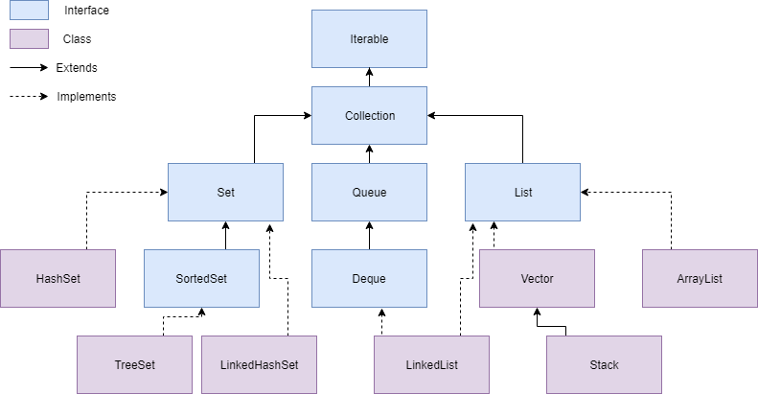
Collection Hierarchy

Slide 8
Collection Interface
Iterable – Everything can be “iterated through”. i.e. you can look at data within these items, one by one.
Collection – An Interface in Java that provides an architecture to store and manipulate objects
Set – A collection which cannot contain duplicate elements.
HashSet, LinkedHashSet, SortedSet
Queue – A collection which orders objects using a First-in-first-out principle or other strategy. Note, removal of elements may cause element re-ordering.
Priority Queue, Deque
List – An ordered collection of objects which utilizes indexes to maintain the order.
ArrayList, Vector, LinkedList

Slide 9
Lists
*ArrayList
Implementation of List interface that uses a dynamic array to store elements.
Not synchronized.
Vector
Similar to ArrayList; however, it is synchronized (thread-safe).
*Stack
Implementation of a Vector that processes data in a last-in, first-out order, like a stack of dinner plates.
*LinkedList
Implementation of the List interface that uses a doubly linked list to store the elements.
Lists use the add() method to add new information to the list, and the remove() method to remove information.

Slide 10
Sets
*HashSet
Algorithmically* hashes** data to store information. Uses a HashTable as it’s underlying data storage
LinkedHashSet
Similar to HashSet, however is stores data using a HashTable and a doubly linked list to maintain insertion order of elements.
SortedSet
Stores elements and sorts them based on natural ordering or the implementation of the Comparable interface of the elements in the collection.
Sets also use the add() method to add new information to the set, and the remove() method to remove information.
*An algorithm is simply a fancy way of saying “A step-by-step approach to solve a problem”.
**Hashing is the process of converting any information into numerical representation.

Slide 11
Queue
Dequeue
A collection where both the “front” and “back” support insertion and removal. Allowing it to be used as a list and stack simultaneously.
Priority Queue
A collection that removes elements based on sorted priority that is based on natural ordering or the implementation of the Comparator interface for the elements in the collection.
Queues can use the add(e), remove() and element() methods to add, remove and inspect information respectively. Alternatively a queue can use the offer(e), poll() or peek() method to do the same actions. The difference is that add(e), remove() and element() can result in an exception, whereas offer(e), poll() or peek() will return some other value, such as null.

Slide 12
Data Structures
List
Ordered
Allows Duplicates
Indexed***
Set
Non-ordered
No Duplicates
Queue
FIFO***
Ordered*
Allows Duplicates

Slide 13
Generics
All Java Collections use “Generics”: <Type>
Generics act as a specifier (and limiter) for a type of data to be used within a class or interface.
Generics can be used when writing classes, interfaces and methods*.
*To use generics in a method, the containing class or interface must use generics
Generic types must be an object, primitives are not allowed. ‘Generic primitives’ are achieved using wrapper classes.
Generics are a way of saying, “I don’t know what type this will be right now, but when this class is instantiated into an object, a type will be provided”
ArrayList<String> strList = new ArrayList<String>();

