Slide 1
Spring Boot

Slide 2
Spring Boot
Spring Boot is built on top of the Spring Framework
Simplifies project structure, setup & configuration
Manages dependencies and configurations internally through starts & Auto configuration.
Spring Boot is more user-friendly due to use of auto-configuration through conventions
Reduces Setup time significantly and minimizes boilerplate code
Configurations are centralized within an application.properties | application.yaml file.
You can use the Spring initializer web app (https://start.spring.io/) to create a Spring project without requiring special IDE tools / extensions

Slide 3
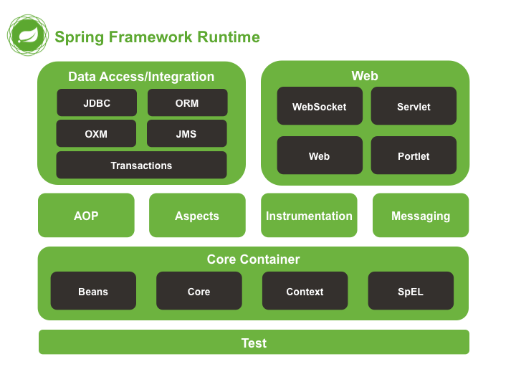
Spring Boot

Slide 4
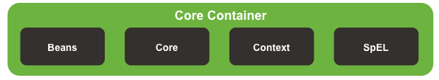
Spring Boot Modules - Core
*Beans : Provides support for configuring and managing beans in the IoC Container.
*Core : Core Module providing fundamental parts of the framework, including IoC Container and Dependency Injection features
*Context : Acts as the “glue” for the Spring application (application context). Provides access to application objects
Spring Expression Language (SpEL) : Powerful expression language for querying and manipulating objects at runtime.

Slide 5
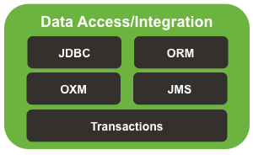
Spring Boot Modules - Data
*JDBC : Offers JDBC-Abstraction layer for Spring App
*Object Relational Mapping (ORM) : Provides integration with popular ORM frameworks such as Hibernate, JPA and JDO.
Object XML Mappers (OXM) : provides abstraction layer to support Object / XML mapping tools
Java Messaging Service (JMS) : Helps in producing and consuming messages using Springs JMS Support tools.
Transactions : Provides declarative transaction management capabilities.

Slide 6
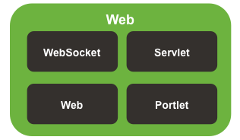
Spring Boot Modules - Web
WebSocket : Offers support for WebSocket-based communication between client and servers
*Servlet : Provides Model-view-controller architecture and components to develop web applications
*Web : Contains features for developing web apps including RESTful applications
Portlet : Offers support for developing portlet-based applications

Slide 7
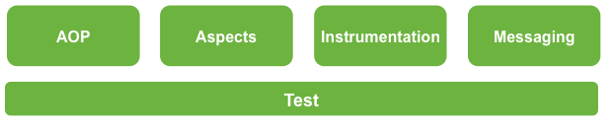
Spring Boot Modules - Other
Aspect-Oriented Programming (AOP) : provides support for aspect-oriented programming
Aspects : Provides integration with AspectJ, which is a richer and more powerful AOP library.
Instrumentation : Provides support for class instrumentation and classloader implementations for use in certain application servers.
Messaging : Provides support for messaging between different parts of a program or between programs (uses the observer design pattern).
*Test : Supports testing of Spring components with JUnit or TestNG.

Slide 8
Spring Boot DevTools
The Spring Boot DevTools (developer tools) module provides convenient features that aim to simplify the development and testing process.
Key Features:
*Automatic Restart : Reloading Java classes and configuring them on the server-side. This leads to dynamic server restarts upon modification of code.
*Live Reload : Spring Boot DevTools includes an embedded server called ‘LiveReload’ which allows the application to automatically trigger a browser refresh when changes are made to resources.
Global Configurations : Allows for global settings for all Spring Boot applications on a machine, allowing for re-use of common configurations, such as logger settings.
Remote Debugging : Supports remote debugging of an application to help with troubleshooting in different environments.

Slide 9
Consuming APIs - RestTemplate
RestTemplate is a class within the Spring framework which provides a convenient way to consume web services.
Included in the spring-web module.
Supports all HTTP Methods (GET, POST, PUT, DELETE, etc…)
Reponses can be mapped directly to model classes
Provides clean client and server error handling
Supports dynamic URI construction with URI templates.
Deprecated as of Spring v2.1

Slide 10
RestTemplate Example
import org.springframework.http.ResponseEntity;
import org.springframework.web.client.RestTemplate;
public class MyService {
public ResponseEntity<MyModel> getModel(String id) {
RestTemplate restTemplate = new RestTemplate();
String url = “http://website.com/uri/{id}”;
return restTemplate.getForEntity(url, MyModel.class, “1”);
}
}

Slide 11
Consuming APIs - WebClient
WebClient is a non-blocking (asynchronous), reactive web client introduced to replace ‘RestTemplate’.
Included in the spring-webflux module.
Used to consume RESTful services
Asychronous consumption by default
The method ‘block()’ can be used to transform requests into synchronous ones.
‘Mono’ and ‘Flux’ objects
Mono : Represents 0 or 1 item from the response
Flux : Represents 0 or more items from the response
Supports multiple Data formats, including JSON and XML
Useful for microservice applications, consuming REST APIs or interacting with HTTP-based services.

Slide 12
WebClient Example
import org.springframework.web.reactive.function.client.WebClient;
public class MyService {
public MyModel getModel(String id) {
WebClient webClient = WebClient.create(“http://website.com”);
String id = “1”;
MyModel myModel = webClient.get()
.uri(uriBuilder ->
uriBuilder.path( “/uri/{id}”)
.build(id))
.retrieve()
.bodyToMono(MyModel.class)
.block();
return myModel;
}
}

