Slide 1
Algorithms

Slide 2
Key Topics
Common Algorithms
Searching
Iterative Sorting
Recursive Sorting
Other

Slide 3
Searching

Slide 4
Common Algorithms – Linear Search
Searching algorithms are methods used to find an element within some collection or list.
Linear search is the most basic searching algorithm, which functions by checking each element of a collection in sequence until a match is found or until the whole list has been searched.

Slide 5
Linear Search
public int linearSearch(Integer target, Integer[] collection) {
int index = -1;
for (int i = 0; i < collection.length; i++) {
if (collection[i] == target) {
index = i;
}
}
return index;
}

Slide 6
Linear Search (visualization)
Target
35
10
15
19
23
28
35
41
49
62

Slide 7
Common Algorithms – Binary Search
A Binary Search (a.k.a. half-interval search) is another common algorithm used to find elements within a sorted collection.
Binary search finds the position of an element by looking at the element halfway between the recognized minimum and maximum value and eliminating half of the remaining elements if the target value is less than or greater than this halfway point.
The algorithm ends after finding the target value is found or all elements have been eliminated.

Slide 8
Binary Search
public int binarySearch(Integer target, Integer[] collection) {
int left = 0;
int right = collection.length-1;
while (left <= right) {
int mid = (right+left)/2
if (target < collection[mid]) {
right = mid - 1;
} else if (target > collection[mid]) {
left = mid + 1;
} else {
return mid;
}
}
return -1; // target number doesn’t exist
}

Slide 9
Binary Search (visualization)
Target
35
10
15
19
23
28
35
41
49
62

Slide 10
Iterative Sort

Slide 11
Common Algorithms – Swapping Elements
When sorting data in any programming language, a ‘swap’ is a typical algorithm to perform and is often performed multiple times as elements are moved into order.
/* Swap position of two indexes of an array */
void swap (Object[] arr, int l_index, int r_index) {
Object temp = arr[l_index];
arr[l_index] = arr[r_index];
arr[r_index] = temp;
}

Slide 12
Swap (visualization)
void swap (Object[] arr, int l_index, int r_index) {
Object temp = arr[l_index];
arr[l_index] = arr[r_index];
arr[r_index] = temp;
}
Temp
A
A
arr[l_index]
arr[r_index]
B
A
A
B
B
A

Slide 13
Common Algorithms – Bubble Sort
Bubble Sort is one of the simplest sorting algorithms, used to organize elements of a collection into a particular order.
Bubble Sort organizes elements by repeatedly comparing and swapping adjacent elements if they are in the wrong order.

Slide 14
Bubble Sort
public void bubbleSort(Integer[] arr) {
int n = arr.length;
for (int i = 0; i < n – 1; i++) {
for (int j = 0; j < n - 1; j++) {
if (arr[j] > arr[j+1]) {
int temp = arr[j];
arr[j] = arr[j+1];
arr[j+1] = temp;
}
}
}
}

Slide 15
Bubble Sort (visualization)
compare
compare
compare
compare
10
62
19
15
28
35
23
49
41

Slide 16
Common Algorithms – Selection Sort
Selection Sort is another common sorting algorithm that organizes elements within a collection.
The Selection Sort works by repeatedly finding the smallest element of a collection and moving the found element forward by swapping the position of the left-most element, with the smaller.

Slide 17
Selection Sort
public void selectionSort(Integer[] arr) {
int n = arr.length;
for (int i = 0; i < n – 1; i++) {
int minIndex = i;
for (int j = minIndex+1; j < arr.length - 1; j++) {
if (arr[minIndex] > arr[j]) {
minIndex = j;
}
}
int temp = arr[i];
arr[i] = arr[minIndex];
arr[minIndex] = temp;
}
}

Slide 18
Selection Sort (visualization)
Target
Current
Current
Current
Current
Current
Current
Current
Current
81
52
22
18
31
48
25
67
4
Low
Low
Low
Low
Low
Low
Low
Low

Slide 19
Recursive Sort

Slide 20
What is Recursion?
A recursive function is another method to repeat functionality by creating a function which calls itself, and returns the output
Successive executions are added to the execution stack
There must exist a base case at which the recursion stops, otherwise you will get a stack overflow
When the base case is found, values are returned down the execution stack, potentially being transformed along the way.
int recursion(int n ) {
if (n <= 0)
return 0; else
return recursion(--n);
}

Slide 21
Common Algorithms – Merge Sort
The Merge Sort is a more complex sorting algorithm that organizes elements of a collection by dividing continually dividing a collection into two halves, and then merging the split collections back together in sorted order.
The Merge sort relies on using recursion to repeatedly partition data into auxiliary collections before combining the values back together into a single collection.

Slide 22
Merge Sort
void merge(Integer arr[], int l, int m, int r) {
/* Find Sizes of two sub-arrays to be merged */
int n1 = m - l + 1;
int n2 = r - m;
/* Create temp arrays */
int[] L = new int[n1];
int[] R = new int[n2];
/* Copy data to temp arrays */
for (int i = 0; i < n1; ++i) L[i] = arr[l + i];
for (int j = 0; j < n2; ++j) R[j] = arr[m + 1 + j];
/* Merge the temp arrays */
int i = 0, j = 0; // Initial indexes of first and second subarrays
int k = l; // Initial index of merged subarry array
while (i < n1 && j < n2) {
if (L[i] <= R[j]) {
arr[k] = L[i];
i++;
} else {
arr[k] = R[j];
j++;
}
k++;
}
/* Copy remaining elements of L[] if any */
while (i < n1) {
arr[k] = L[i];
i++;
k++;
}
/* Copy remaining elements of R[] if any */
while (j < n2) {
arr[k] = R[j];
j++;
k++;
}
}
void sort(Integer arr[], int l, int r) {
if (l < r) {
// Find the middle point
int m = l + (r - l) / 2;
// Sort first and second halves
sort(arr, l, m);
sort(arr, m + 1, r);
// Merge the sorted halves
merge(arr, l, m, r);
}
}

Slide 23
Merge Sort (visualization)
51
17
22
45
37
91
5
72

Slide 24
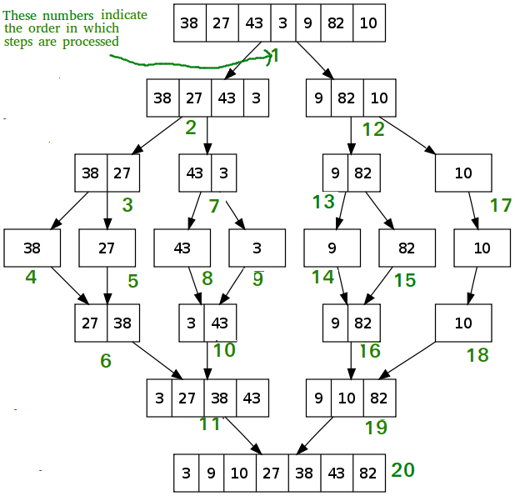
Merge Sort (visualization)

Slide 25
More Algorithms…
Quick Sort – Recursive Algorithm which swaps elements based on a ‘partition’.
Insertion Sort – Iterative Algorithm which moves lower elements toward the front by swapping their position with higher elements and continuing until the lower element is in the correct position.
Counting Sort – Iterative Algorithm that sorts elements of an array by counting the number of occurrences of each unique element and storing values an auxiliary Array. Then we use the index of the auxiliary array to map the sorted output.
Tim Sort – Recursive Algorithm which combines both Insertion sort and Merge sort to organize elements in blocks, known as ‘Runs’, and merging sorted blocks together.
And more…
Practice, Study and Experience

Slide 26
Algorithm Big-O
Linear Search
Time Complexity : O(n) – linear
Space Complexity : O(1) – Constant
Binary Search
Time Complexity : O(log n) – Logarithmic
Space Complexity : O(1) – Constant
Swap Elements
Time Complexity : O(1) – Constant
Space Complexity : O(1) – Constant
Bubble Sort
Time Complexity : O(n^2) – Exponential
Space Complexity : O(1) – Constant
Selection Sort
Time Complexity : O(n^2) – Exponential
Space Complexity : O(1) – Constant

Slide 27
Algorithm Big-O
Merge Sort
Time Complexity : O(n log(n)) – N times logarithm of N
Space Complexity : O(n) – Linear
Quick Sort
Time Complexity : O(n^2) – Exponential
Space Complexity : O(n) – Linear
Insertion Sort
Time Complexity : O(n^2) – Exponential
Space Complexity : O(1) – Constant
Counting Sort
Time Complexity : O(N+K) – Complexity is dependent on the size of the collection and the range of the values within the collection.
Space Complexity : O(k) – Complexity can vary depending on the range different of values. N = number of element. K = range for elements.
N = number of elements
K = Range of elements (largest – smallest)
Tim Sort
Time Complexity : O(n log(n)) – N times logarithm of N
Space Complexity : O(1) – Constant

