Slide 1
Software Development LifeCycle & Team Dynamics

Slide 2
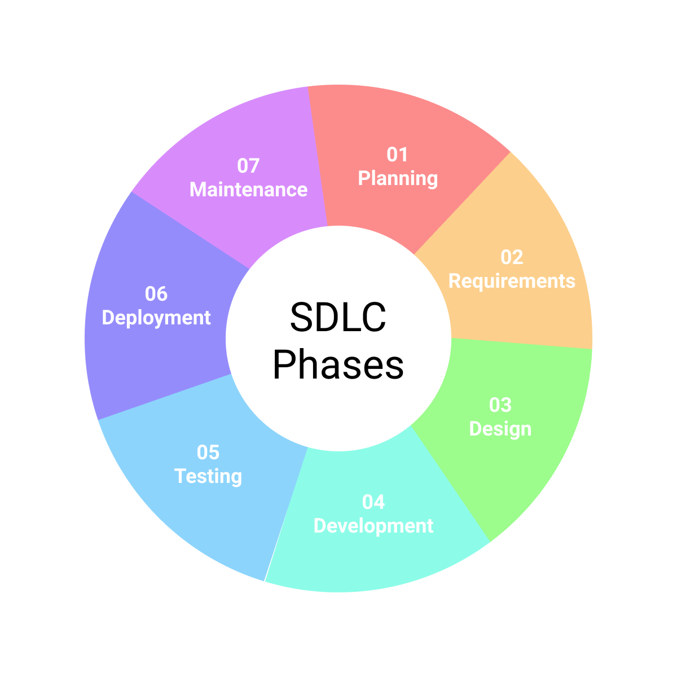
Software Development Lifecycle
Planning
Requirements Gathering/Analysis
System Design
Implementation/Development
Testing
Deployment
Maintenance & Operations

Slide 3
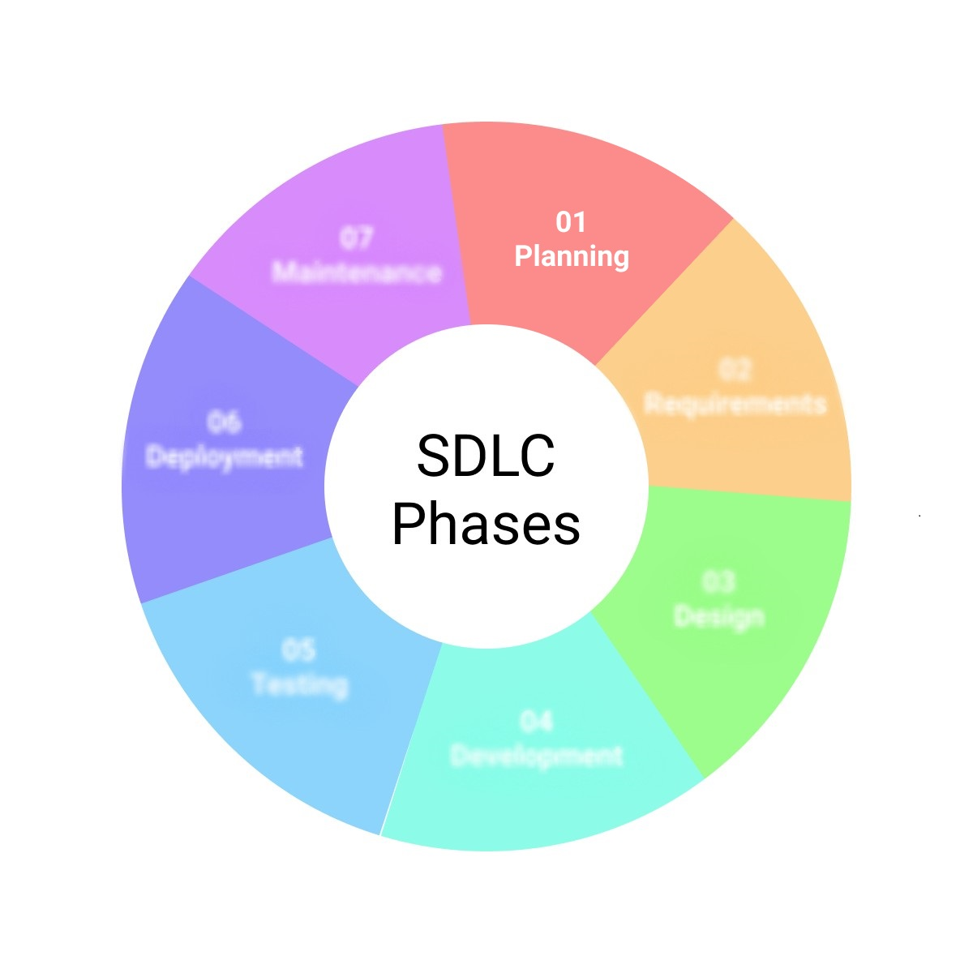
SDLC - Planning
During the Planning Phase…
Resources are calculated and allocated
Project Scheduling is done
Cost Estimates are calculated
Who is involved?
Project Managers
Product Managers
Business Analysts
Clients/Stakeholders

Slide 4
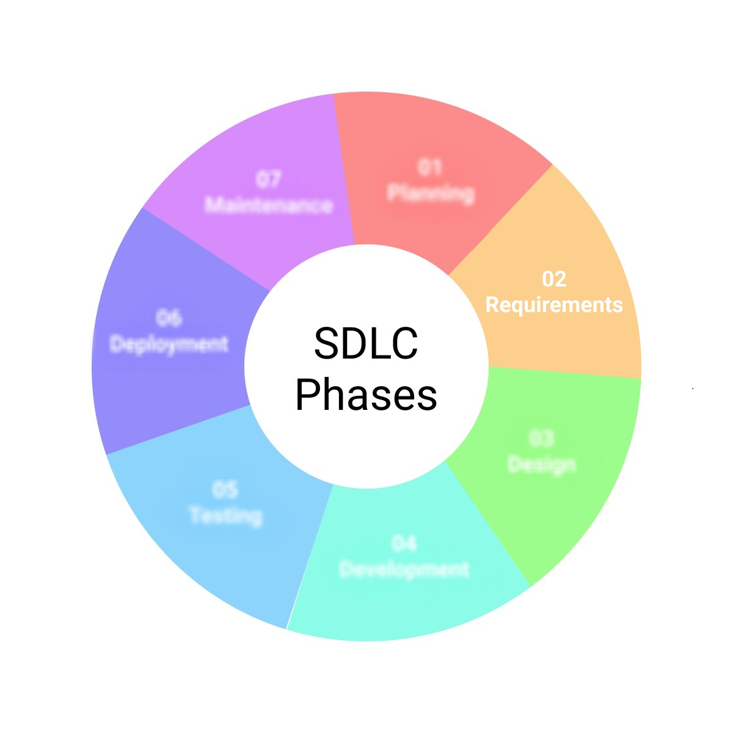
SDLC – Requirements Gathering/Analysis
During the Requirements Gathering/Analysis Phase…
Software requirements are detailed
Documentation is created
Project scope is defined
Who is involved?
Project Managers
Product Managers
Business Analysts
Lead Developers

Slide 5

SDLC – System Design
During the System Design Phase…
Software Specification Documentation* is created
*Defines the overall system architecture and design
Sprint Planning Meetings are scheduled
User stories are generated
Who is involved?
Lead Developers
System Architects
Designers

Slide 6

SDLC – Implementation/Development
During the Implementation Phase…
Design & System Spec documents are translates to actual code.
This is what is traditionally referred to as “software development”
System Tests are planned and work begins on creation of tests*
*Note: In Test Driven Development, the tests would be created first
Who is involved?
Developers
Testers

Slide 7

SDLC – Testing
During the Testing Phase…
Tests are created and conducted against code
Code logic is evaluated against original user stories.
Testing may involve:
Unit Testing
Integration Testing
User Acceptance Testing (UAT)
Etc…
Who is involved?
Quality Assurance (QA) Engineers
Testers
Developers

Slide 8

SDLC – Deployment
During the Deployment Phase…
Software is made available to end-users in production environment
System configurations for production environment is verified
Who is involved?
Operations Team
System Administrators/Engineers
Platform Administrators/Engineers

Slide 9

SDLC – Maintenance & Operations
During the Maintenance & Operations Phase…
System monitoring to ensure system continues to meet user needs.
Updates/patches are pushed as needed
System performance is monitored
Feedback is gathered and analyzed for possible improvements
Who is involved?
Operations Team
System Administrators/Engineers
Platform Administrators/Engineers
IT Operations
Developers (as needed)

Slide 10
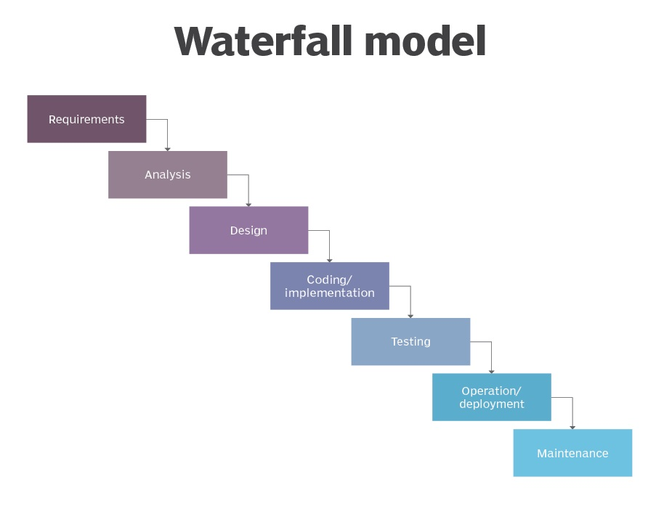
Waterfall Model
An implementation model for the SDLC in which each step is completed before moving to the next.
Pros:
Clearly defined goals and timeline
Less confusion regarding status of project completion
Easier to implement
Cons:
Not ideal for complex development projects
Consumes a lot of time because each phase must be planned carefully and completed fully
Since testing does not come until later, serious issues or complications may arise far into development.
Useful for:
Projects where human life may be at stake
Military programs
Projects that have a high degree of oversight/accountability

Slide 11
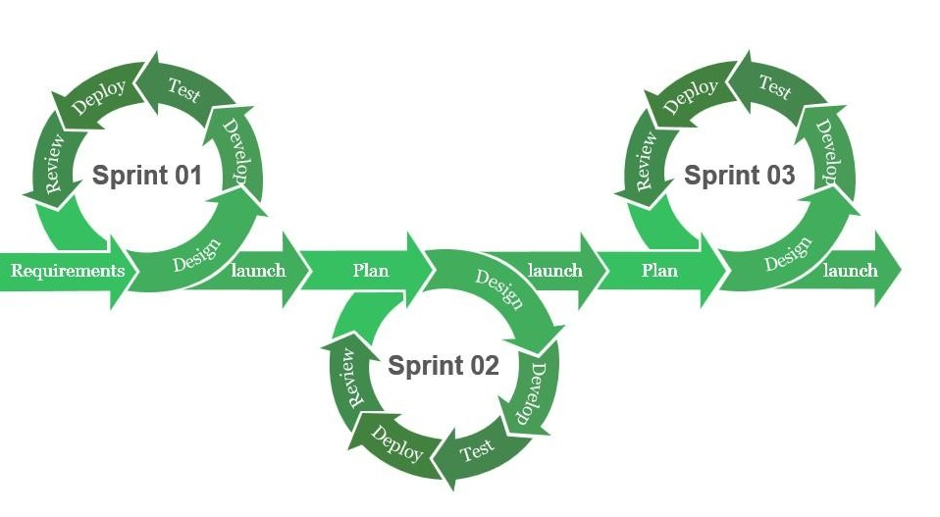
Agile Methodology
Methodology (work culture) which focuses on these core values:
Individuals & Interactions over Processes and Tools
Working software over comprehensive documentation
Customer Collaboration over contract negotiations
Responding to change over following a plan
Pros:
Responsive approach to issues that arise
Supports Cross-functional teamwork
(Typically) Reduced scope for faster implementation
Cons:
The final product depends on the customer, so it may shift. (moving target)
It can be harder to integrate new members into workflow due to shifting workflow needs.
May lead to inadequate documentation, which can cause confusion/misunderstanding
Useful for:
Most modern software development

Slide 12
Scrum
Scrum
A process framework used to manage the development of a product or software.
Scrums are well suited for cross-functional teams to coordinate efforts.
Work effort for a scrum are split into individual sprints where some amount of nontrivial work is completed
Sprint
An established timeframe (typically 1 month or less) during which a team produces a shippable* product.
A single sprints will not produce the entire project, but rather a useable piece of the project
https://www.agilealliance.org/agile101/agile-glossary/

Slide 13
Other Agile Terms
User Stories
Functional unit of work which can be expected to yield an expected result when implemented.
Typically, user stories are written from the perspective of the end user: “As a user, I can enter my login credentials and login to the platform”
Story Points
Relative Unit of measure used to estimate and/or plan work effort for user stories
Product Backlog
List of all new features, changes to existing features, bug fixes, etc… related to the product creation
Sprint Backlog
Subset of tasks from Product Backlog which establish work to be completed in current sprint
https://www.agilealliance.org/agile101/agile-glossary/

Slide 14
Scrum Ceremonies
Sprint Planning
Review backlog and determine work to be completed in next sprint
Daily Stand-up
Daily check-in meetings where the following is discussed:
Current Work Completed (what did I do yesterday?)
Current Tasks (what am I doing today?)
Any blockers or issues (what is stopping me from working?)
Sprint Review
Review all work accomplished in the sprint
Backlog is updated
Preparation for next Sprint planning meeting
Sprint Retrospective
Discuss opportunities for improvement in team workflow/processes to increase efficiency

Slide 15
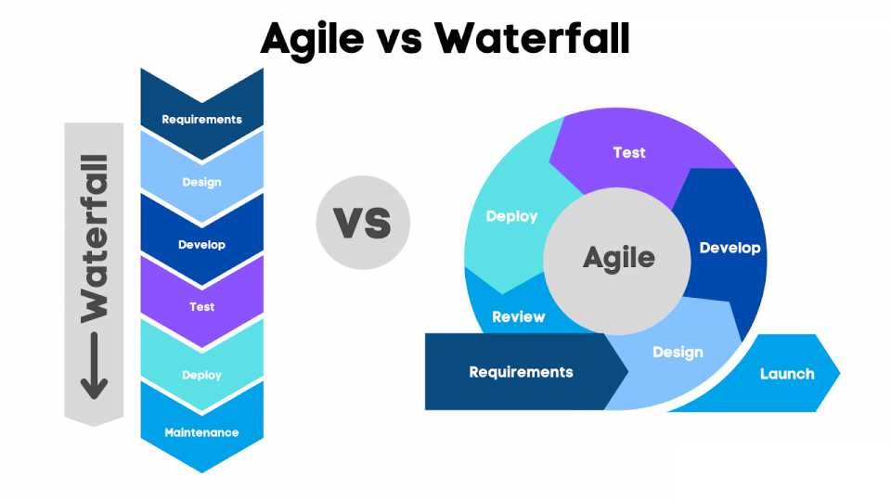
Agile vs Waterfall
Waterfall | Agile
Requires less coordination due to clearly defined phases | Faster Feedback cycles and Response to issues
The cost of the project can be determined early in development | Higher potential for customer satisfaction
Better focus on documentation and design requirements | Better visibility and accountability during product development
Design phase is more methodical and structured | Time to market is drastically reduced
Works better with projects with high degree of oversight and scrutiny | Flexible prioritization and teams typically lead to better productivity

